Slide 1
Myers-Briggs Test Online do on their own
http://www.humanmetrics.com/cgi-win/JTypes2.asp

Slide 2
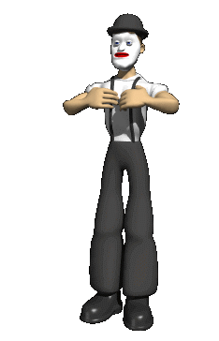
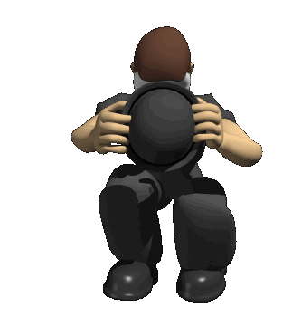
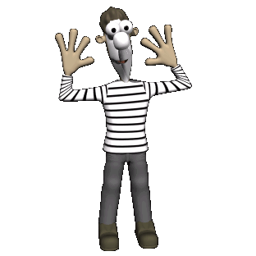
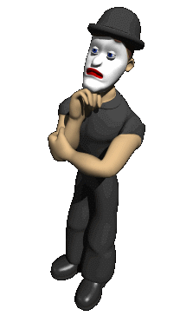
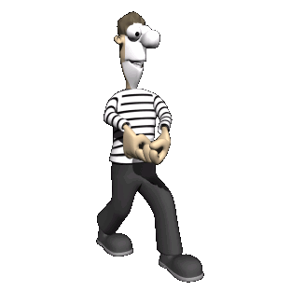
Personality
A person’s pattern of thinking, feeling and acting.
Let’s do a PERSONALITY TEST!
“You are what you eat.”
And one more to fill out / tabulate…

Slide 3
Personality
“Personality is far too complex a thing to be trussed up in a conceptual straightjacket.”
Four major perspectives on Personality
Psychoanalytic - unconscious motivations
Trait - specific dimensions of personality
Humanistic - inner capacity for growth
Social-Cognitive - influence of environment

Slide 4
Generally Agreed Upon
Layers of Personality
Mask – external layer, personas
Private Self / Ego – personal identity; switches in those with DID, dominates our conscious experience, tied to our memory for personal episodes in our lives
Unconscious – not normally accessible
  Freud’s version very different than modern; they spend most of their time here
  Gladwell’s book Blink

Slide 5
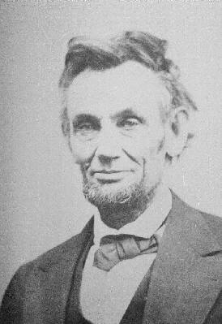
Trait / Type Perspective
No hidden personality dynamics…
just basic personality dimensions
Traits - people’s enduring characteristic behaviors
& conscious motives
(many believe these are bio rooted)
How do we describe & classify different personalities?
(Type A vs Type B or Depressed vs Cheerful?)
Myers-Briggs Type Indicator - classify people
based upon responses to 126 questions

Slide 6
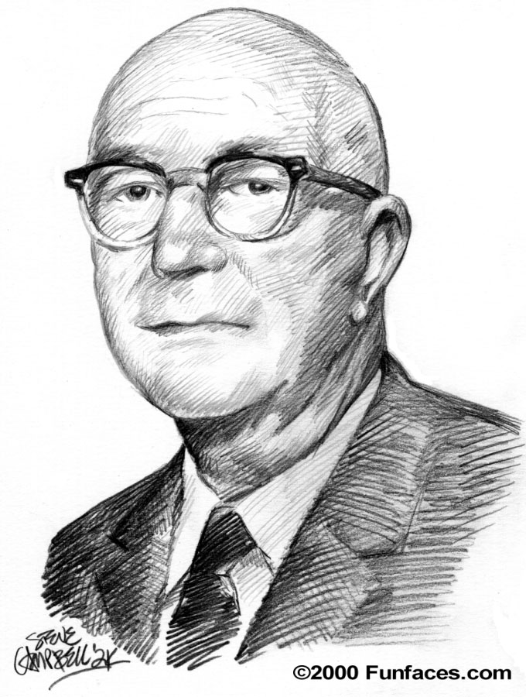
Gordon Allport
(1897-1967)
Found 50 different definitions in magazines, newspapers, and books
Omnibus = all-purpose definition is useless
Trait = profiling on dimensions
  Learned, not inherited: “Any theory that regard personality as stable, fixed, or invariable is wrong” (1961)
“Personality is everything that makes you an individual. It is the integration and interaction of your genetic inheritance, your experience, and your ways of relating the two.”

Slide 7
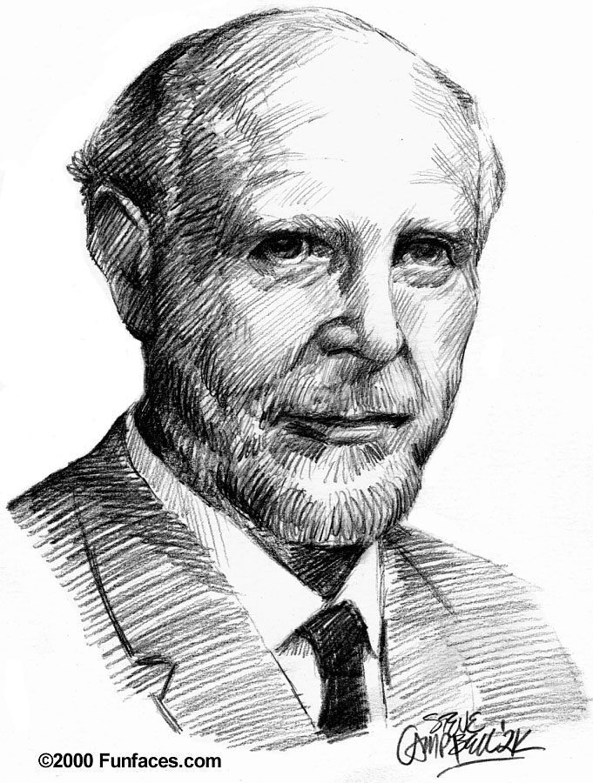
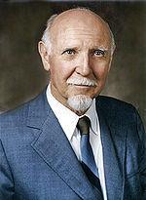
Raymond Cattell
(1905-1998)
16-Personality Factor (16-PF) TEST and the 16
Yes, occasionally, or no to 185 multiple choice questions
  “I like to go to parties.”
  When I find myself in a boring situation, I usually "tune out" and daydream about other things. True/False.
  When a bit of tact and convincing is needed to get people moving, I'm usually the one who does it. True/False.
Exs = Social boldness, sensitivity, abstractedness, etc.
Notes:
http://en.wikipedia.org/wiki/16_Personality_Factors

Slide 8
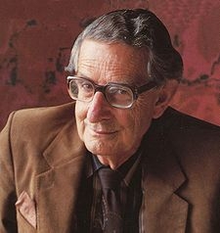
Hans Eysenck
(1916-1997)
2 dimensions of personality
Introversion vs. Extroversion: introverts avoid social stimulation, extroverts seek it
Neuroticism vs. Stability: Neurotics get emotionally upset and thus are moody, anxious, impatient, etc.
The Model
A 3rd was later added: Psychoticism vs. Nonpsychotism: psychotics are aggressive and lack concern for others

Slide 9
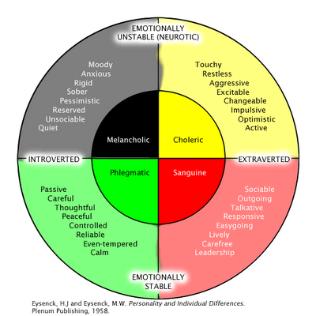
Hans Eysenck 2 Dimensions of Personality

Slide 10
The Big Five – 15-13 (19)
Openness
Imaginative/Practical
Independent/Conforming
Conscientiousness
(vs. undirectedness)
Organized/Disorganized
Careful/Careless
Sociable/Retiring
Fun Loving/Sober
Extraversion
Agreeableness
(vs. antagonism)
Soft-Hearted/Ruthless
Trusting/Suspicious
Calm/Anxious
Secure/Insecure
Neuroticism

Slide 11
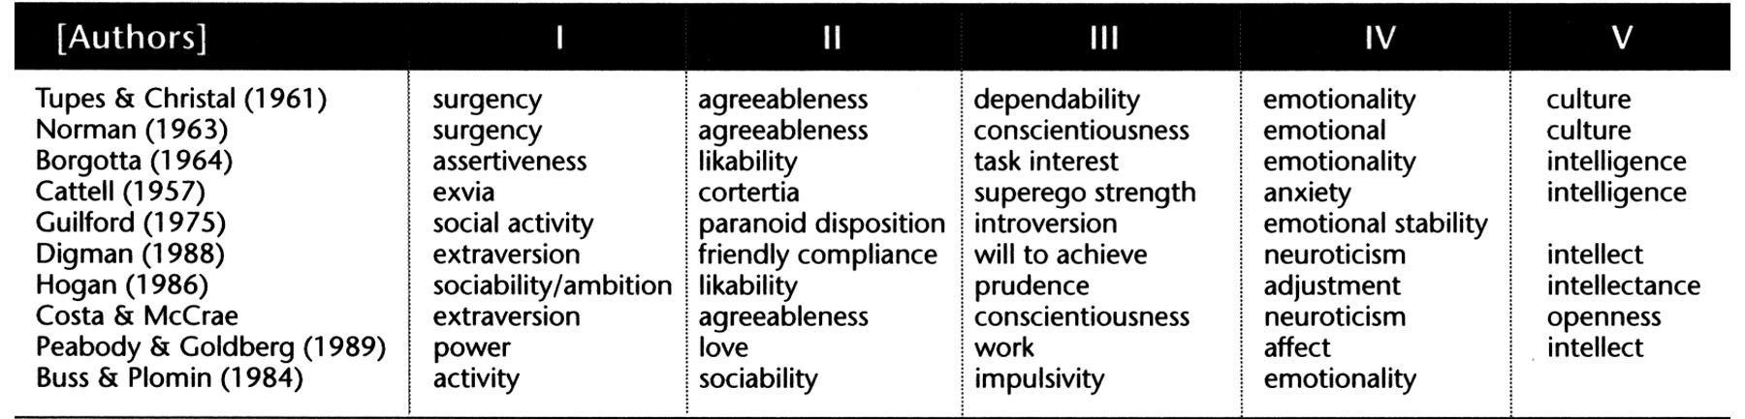
Convergence on The Big 5
(Goldberg, 1993)
Very stable after age 30
  Though, with age we get less neurotic, less extroverted, less open to experience, more conscientious, and more agreeable
Reliable—.5 to .7 on different admins years apart
Extroverts – less disturbed by intense stimuli, more likely to live/work with many ppl, more adventurous sexually, more likely to look in the eye when talking, more likely to talk a lot at group meetings

Slide 12
Assessing Traits
How can we assess traits?
(aim to simplify a person’s behavior patterns)
Personality Inventories
MMPI
most widely used personality inventory (not in the pop culture sense, but by professionals)
assess psychological disorders (not normal traits)
considered objective (no interpretation needed)
Based in TYPES

Slide 13
Nature v Nurture
Big 5, heritability = .40-.50
Dogs are selectively bred…
Why isn’t there a “perfect personality?”
Gender Differences

Slide 14
Bouchard’s Twin Research
Bouchard, U of Minn
Identical twins separated at birth
  Adoption Agencies no longer like to do this
  James Lewis and James Springer separated weeks after birth
  Oskar and Jack

Slide 15
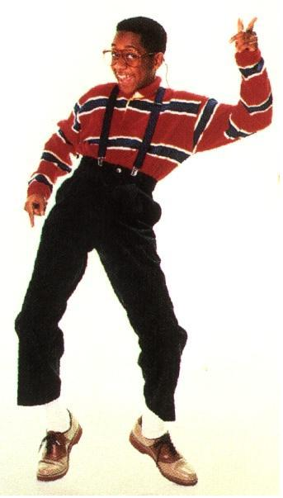
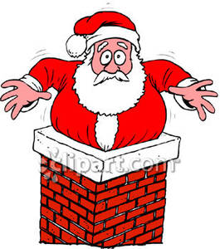
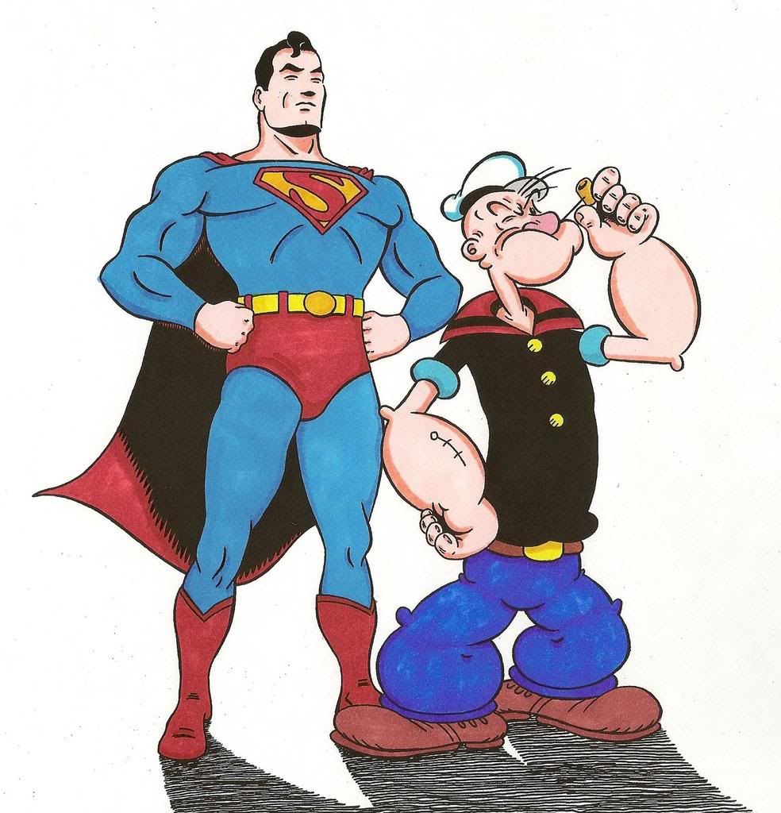
William Sheldon’s
Somatotypes
ENDOMORPHS (Santa Claus)
  ROUND, SOFT BODES WITH LARGE ABDOMENS (Jolly Personalities)
MESOMORPHS (Superman)
  STURDY, UPRIGHT BODES WITH STRONG BONES AND MUSCLES (Extrovert Personality)
ECTOMORPHS (Steve Urkel)
  THIN, SMALL-BONES FRAGILE BODIES (INTROVERT PERSONALITY)

Slide 16
Barnum Effect
Moving Images 19

Slide 17
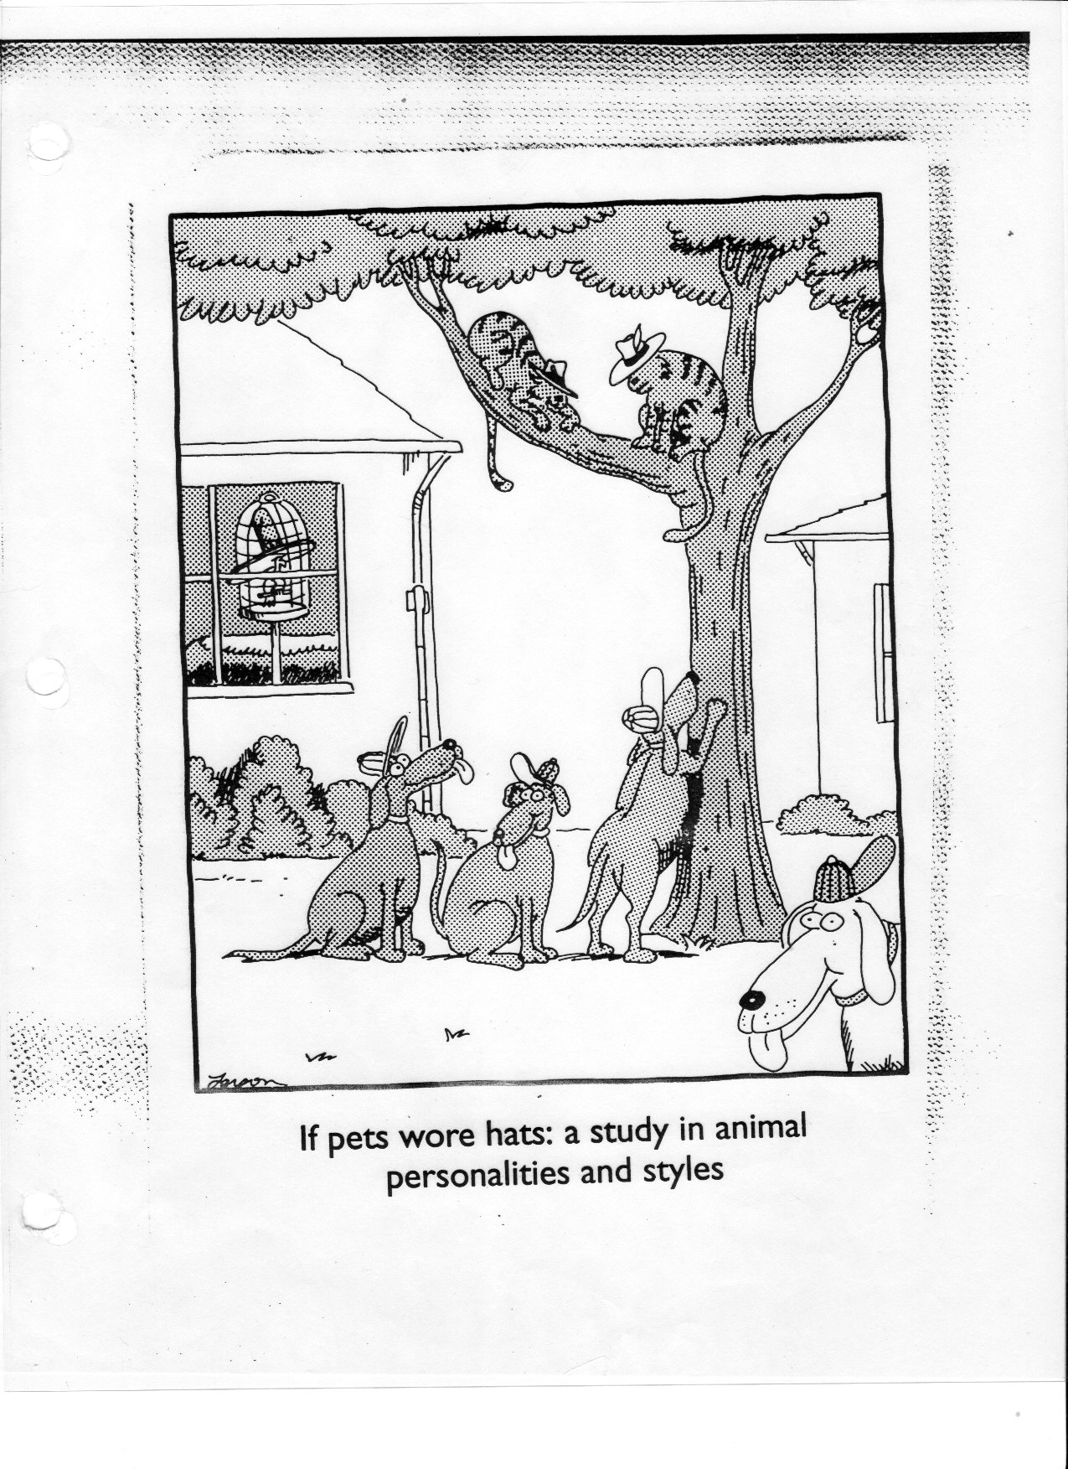
Insert Cartoon:
Pets, Hats, and Personalities

Slide 18
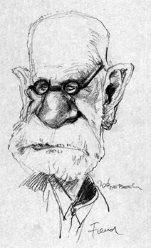
Psychoanalytic Perspective
Of Personality

Slide 19
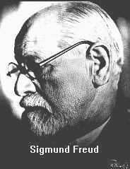
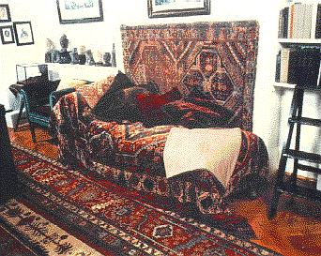
Psychoanalytic Perspective
“first comprehensive theory of personality”
University of Vienna 1873
Voracious Reader
Medical School Graduate
(1856-1939)
Specialized in Nervous
Disorders
Some patients’ disorders
had no physical cause!

Slide 20
The Unconscious
“the mind is like an iceburg - mostly hidden”
Conscious Awareness
small part above surface
Unconscious
below the surface
(thoughts, feelings,
wishes, memories)
Repression
banishing unacceptable
thoughts & passions to
unconscious
Libido

Slide 21
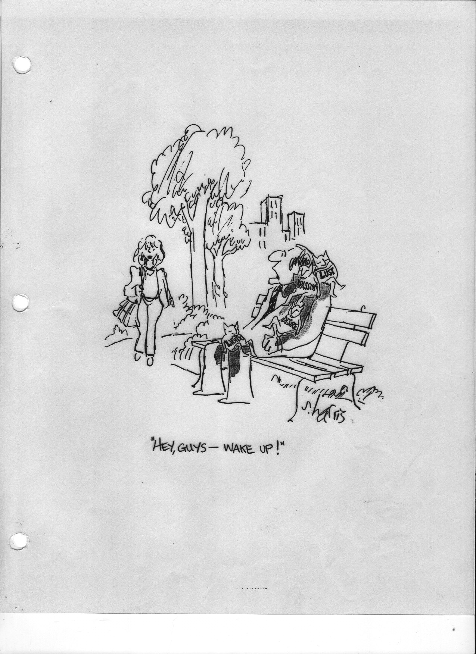
Libido

Slide 22
Freud & Personality Structure (1890s)
“Personality arises from conflict btwn aggressive,
pleasure-seeking impulses and social restraints”
Id - energy constantly striving to satisfy basic drives
Pleasure Principle
Ego - seeks to gratify the Id in realistic ways
Reality Principle
Super
Ego
Ego
Super Ego
- voice of conscience
that focuses on how
we ought to behave
Id

Slide 23
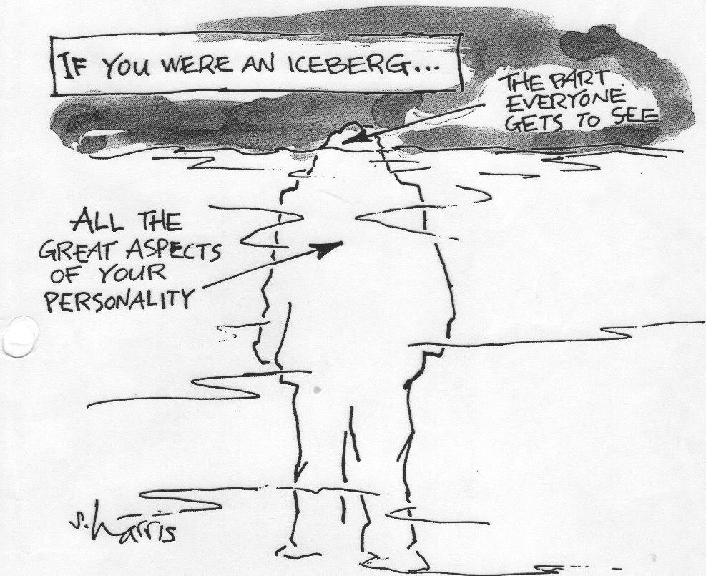
Iceberg

Slide 24
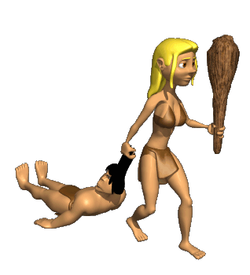
Id
Freud used “es”, meaning it…someone else translated it to id
Drives us toward eros (sex) and thanatos (death/aggression)
Unconscious energy that drives us to satisfy basic sexual and aggressive drives.
Id operates on the pleasure principle, demanding immediate gratification.

Slide 25
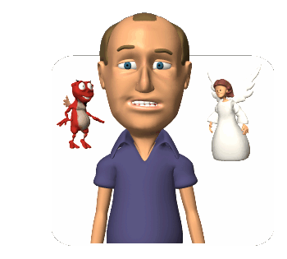
Ego
German for “I”
The boss “executive” of the conscious.
Its job is to mediate the desires of the Id and Superego.
Works by the “reality principle”.

Slide 26
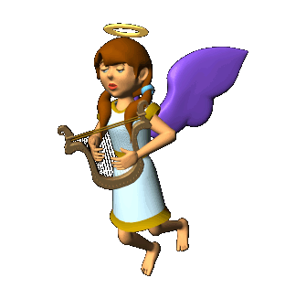
Superego
Part of personality that represents our internalized ideals.
Standards of judgment or our morals.

Slide 27
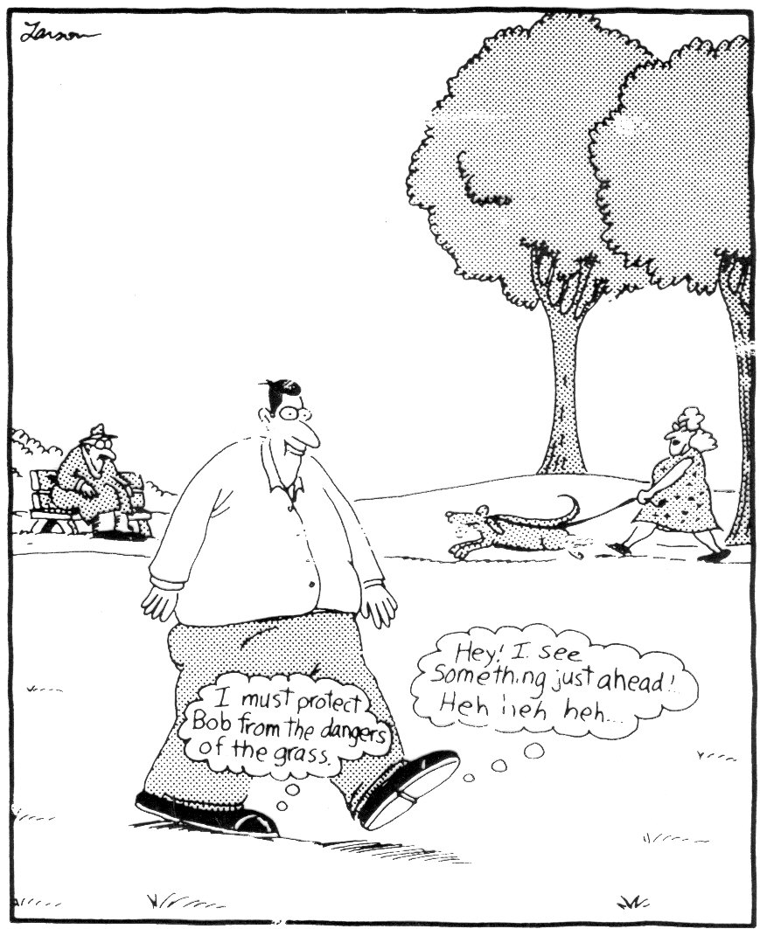
Good vs. Evil

Slide 28
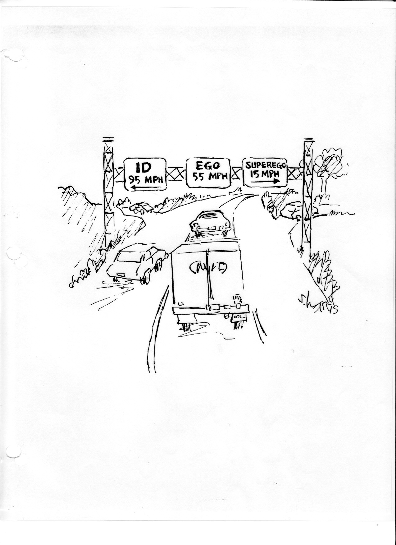
Id, Ego, Superego

Slide 29
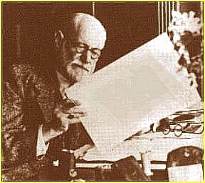
Psychoanalytic Perspective
“first comprehensive theory of personality”
Q: What caused neurological
symptoms in patients with no
neurological problems?
Hypnosis
Unconscious
Free
Association
“Psychoanalysis”

Slide 30
Freudian Slips
George W Bush
George W Bush
Nipple
W Again!
Bill Clinton
Compilation...Top 10
Sheppard Smith
A Man who Climbs Mount Everest

Slide 31
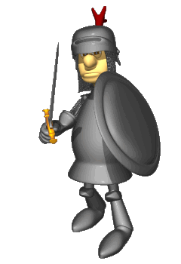
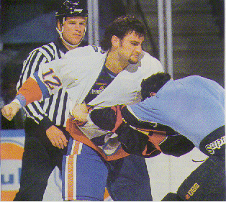
Defense Mechanisms
Ego
Id
When the inner war
gets out of hand, the
result is Anxiety
Ego protects itself via
Defense Mechanisms
Super
Ego
Defense Mechanisms reduce/redirect
anxiety by distorting reality

Slide 32
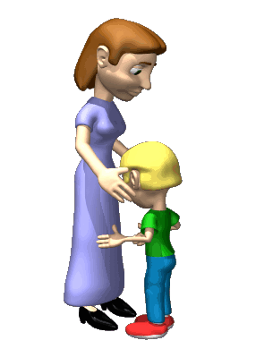
Repression
The Mac Daddy of them all!
Push or banish anxiety driven thought deep into unconscious.
Why we do not remember lusting after our parents.
If we do become aware that we are blocking off certain thoughts, its called suppression.

Slide 33
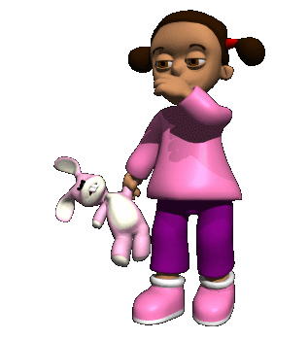
Regression
When faced with anxiety the person retreats to a more infantile stage.
Thumb sucking on the first day of school.

Slide 34
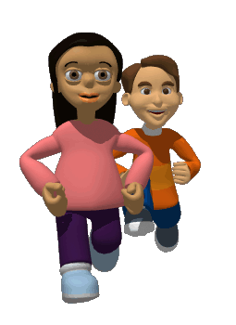
Reaction Formation
Ego switches unacceptable impulses into their opposites.
Being mean to someone you have a crush on.
Homophobia

Slide 35
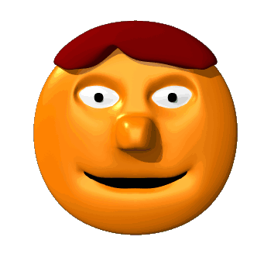
Projection
Disguise your own threatening impulses by attributing them to others.
Thinking that your spouse wants to cheat on you when it is you that really want to cheat.
Robert Sears

Slide 36
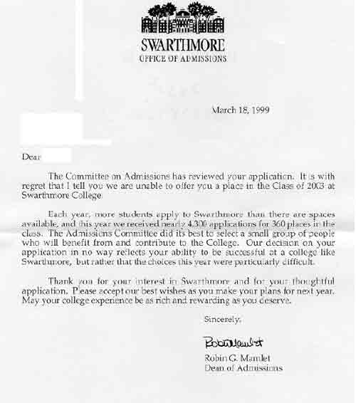
Rationalization
Offers self-adjusting explanations in place of real, more threatening reasons for your actions.
You don’t get into a college and say, “I really did not want to go there it was too far away!!”

Slide 37
Displacement
Shifts the unacceptable impulses towards a safer outlet.
Instead of yelling at a teacher, you will take anger out on a friend by smashing his window.
Boys can’t kill dad, so they box, play football, or rugby

Slide 38
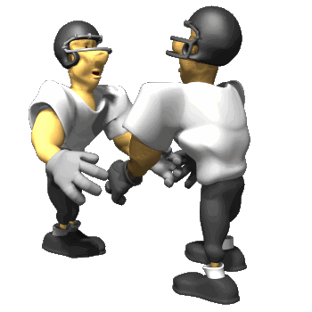
Sublimation
Special case of displacement
Re-channel their unacceptable impulses towards more acceptable or socially approved activities.
Channel feeling of homosexuality into aggressive sports play.
Serial killers who like to cut up bodies might instead become surgeons.

Slide 39
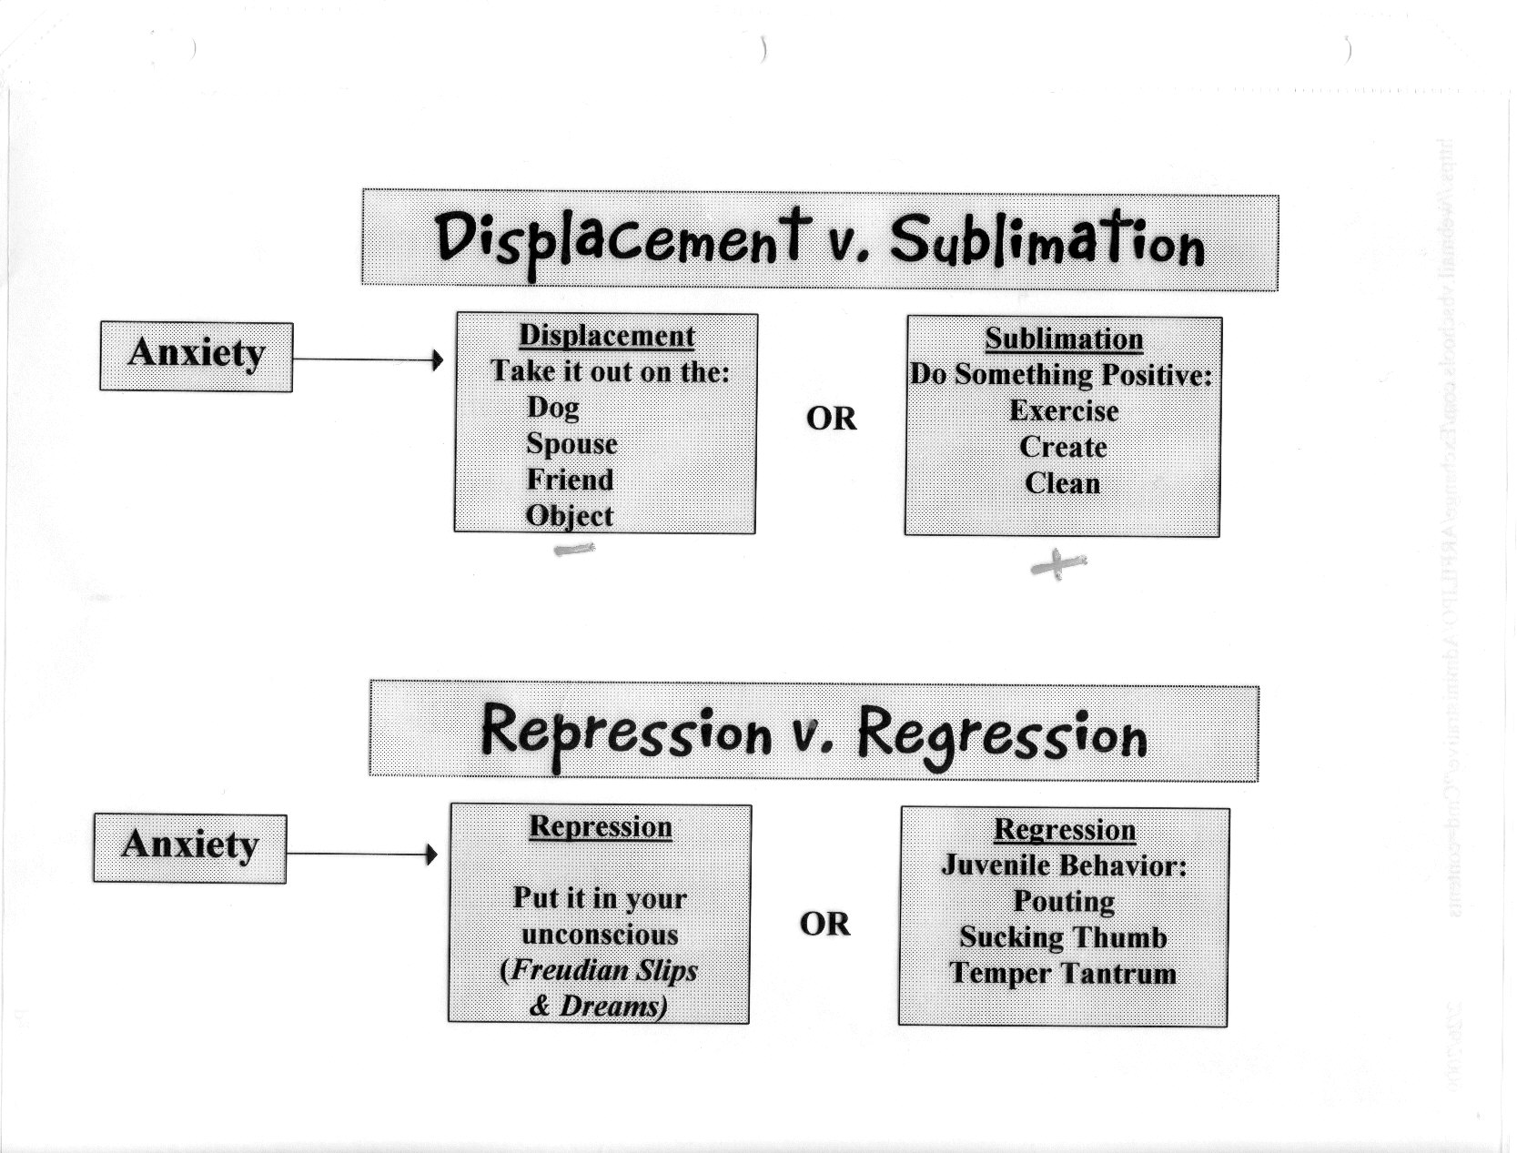
Insert Slide: Displacement vs. Sublimation, Repression vs. Regression

Slide 40
Defense Mechanisms – Overview
Repression - banishes certain thoughts/feelings from consciousness (underlies all other defense
mechanisms)
Regression - retreating to earlier stage of fixated
development
Reaction Formation - ego makes unacceptable impulses appear as their opposites
Projection - attributes threatening impulses to others
Rationalization - generate self-justifying explanations to hide the real reasons for our actions
Displacement - divert impulses toward a more
acceptable object
Sublimation - transform unacceptable impulse into
something socially valued

Slide 41
Defense Mechanisms CW / HW (Handout 15-4)
There are others btw
Intellectualization
Undoing
Isolation
Conversion Reaction
Identification

Slide 42
Freud & Personality Development
“personality forms during the first few years of life,
rooted in unresolved conflicts of early childhood”
Psychosexual Stages – Graphic Orgo
Oral (0-18 mos) - centered on the mouth
Anal (18-36 mos) - focus on bowel/bladder elim.
Phallic (3-6 yrs) - focus on genitals/“Oedipus Complex”
(Identification & Gender Identity)
Latency (6-puberty) - sexuality is dormant
Genital (puberty on) - sexual feelings toward others
Strong conflict can fixate an individual at Stages 1,2 or 3

Slide 43
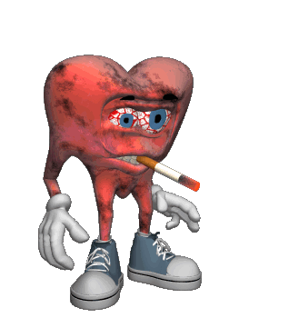
Fixation
A lingering focus of pleasure-seeking energies at an earlier psychosexual stage.
Where conflicts were unresolved.
Orally fixated people may need to chain smoke or chew gum.
Or denying the dependence by acting tough or being very sarcastic.
Anally fixated people can either be anal expulsive or anal retentive.

Slide 44
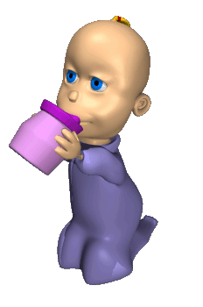
Oral Stage
0-18 months
Pleasure center is on the mouth.
Sucking, biting and chewing.
Adult: dependent, pleasure-oriented, gullible, child-like, easily led astray
Obese, smoke, chew gum
All this is the “oral personality”
Trying to recapture lost oral paradise
Reaction Formation to this = sarcasm, overly independent, tough, cynical…known as “oral aggressive type”

Slide 45
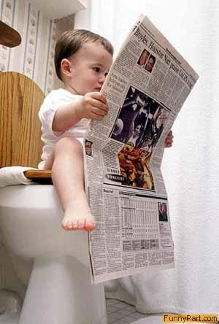
Anal Stage
18-36 months
Pleasure focuses on bladder and bowel control.
  Fascinated by one’s own waste products
Forcing toilet training, child may hold back in rebellion = Anal retentive
  Fastidious, neat, orderly
Or child may go when he/she feels like it to maintain control = Anal expulsive
  Messy
No evidence supporting this

Slide 46
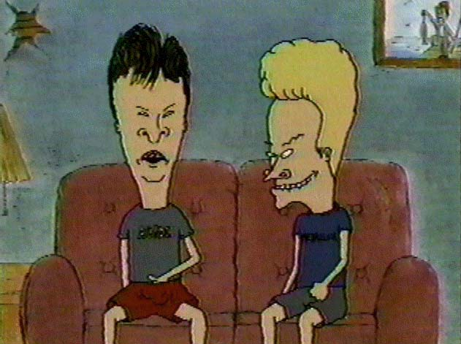
Phallic Stage
3-6 years
Pleasure zone is the genitals.
Coping with incestuous feelings.
The Family Drama: Oedipus & Electra complexes.

Slide 47
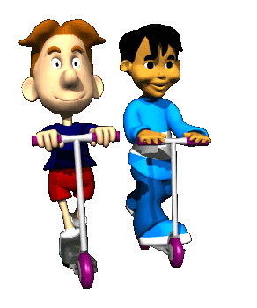
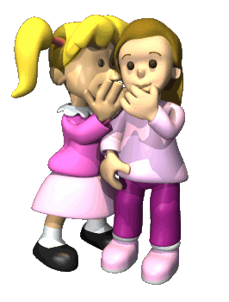
Latency Stage
6- puberty
Dormant sexual feeling.
Cooties stage.

Slide 48
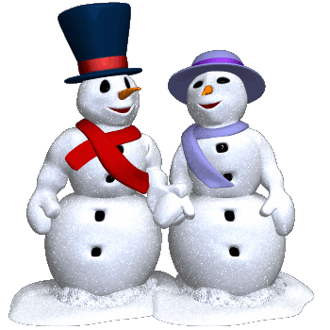
Genital Stage
Adolescence (12?) to death.
Maturation of sexual interests.
  Meaning not self-centered about sex
  Concerned about erotic satisfaction of the partner

Slide 49
Evaluating the Psychoanalytic Perspective
Were Freud’s theories
the “best of his time”
or were they simply
incorrect?
Current research
contradicts
many of Freud’s
specific ideas
Development does not
stop in childhood
Slips of the tongue are
likely competing
“nodes” in memory network
Dreams may not be
unconscious
drives and wishes

Slide 50
Development does not
stop in childhood
Development is life-long (Erikson) and not fixed in childhood
Gender identity occurs without presence of same sex parent
Superiority of the
Male Sex
Thoroughly discounted
Yeah, right! Ha!

Slide 51
Defense Mechanisms
No proof they actually exist
Ex: Repression
  Why don’t Holocaust survivors block out their memories of this obviously horrific and anxiety filled time of their lives?
Sexual Repression =
Psycho Disorders
Sex repression may diminish, but psych problems remain

Slide 52
Freud’s Ideas as Scientific Theory
Theories must explain observations
and offer testable hypotheses
Few Objective Observations
Few Hypotheses
(Freud’s theories based on his recollections &
interpretations of patients’ free associations,
dreams & slips o’ the tongue)
HE NEVER claimed psych = predictable science!
Does Not PREDICT Behavior or Traits

Slide 53
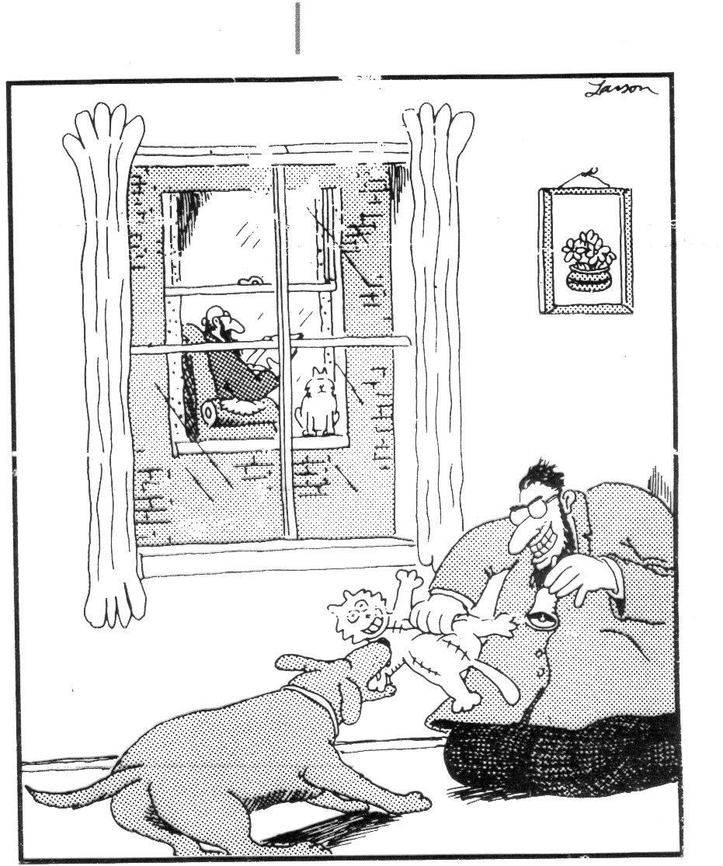
Insert cartoon: freud’s cat and pavlov’s dog
Unbeknownst to most students of psychology, Pavlov’s first experiment was to ring a bell and cause his dog to attack Freud’s cat.

Slide 54
The Unconscious & Assessment
How can we assess personality?
(i.e., the unconscious)
Objective Tests?
No - tap the conscious
Projective Tests?
Yes - tap the unconscious
Thematic Apperceptions Test (TAT)
Rorschach Inkblot Test

Slide 55
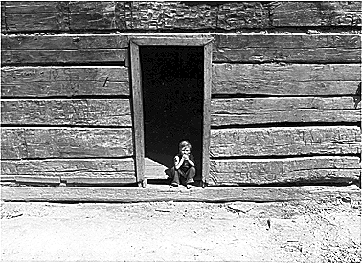
Thematic Apperception Test
A projective test which people express their inner feelings through stories they make about ambiguous scenes

Slide 56
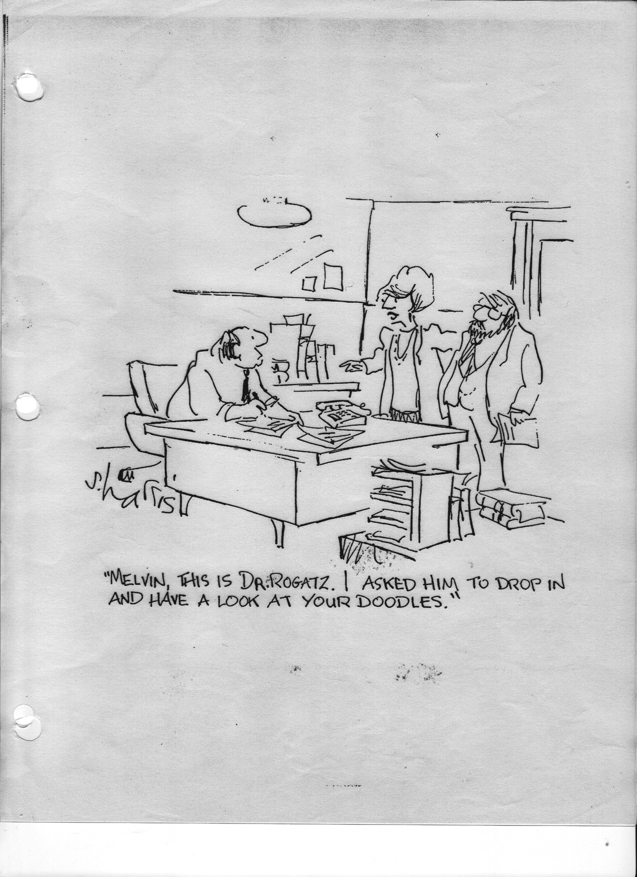
The Doodle Personality Test

Slide 57
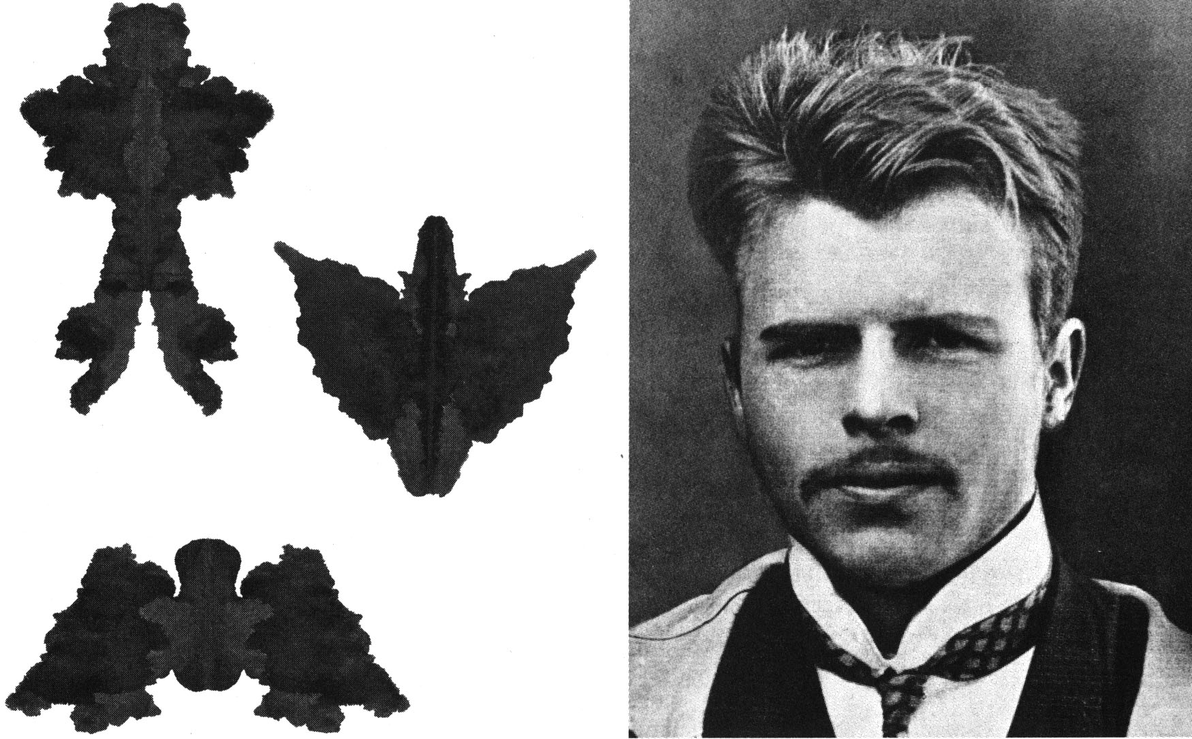
Hermann
Rorschach Inkblot Test
The most widely used projective test
A set of ten inkblots designed to identify people’s feelings when they are asked to interpret what they see in the inkblots.
See website from quia

Slide 58
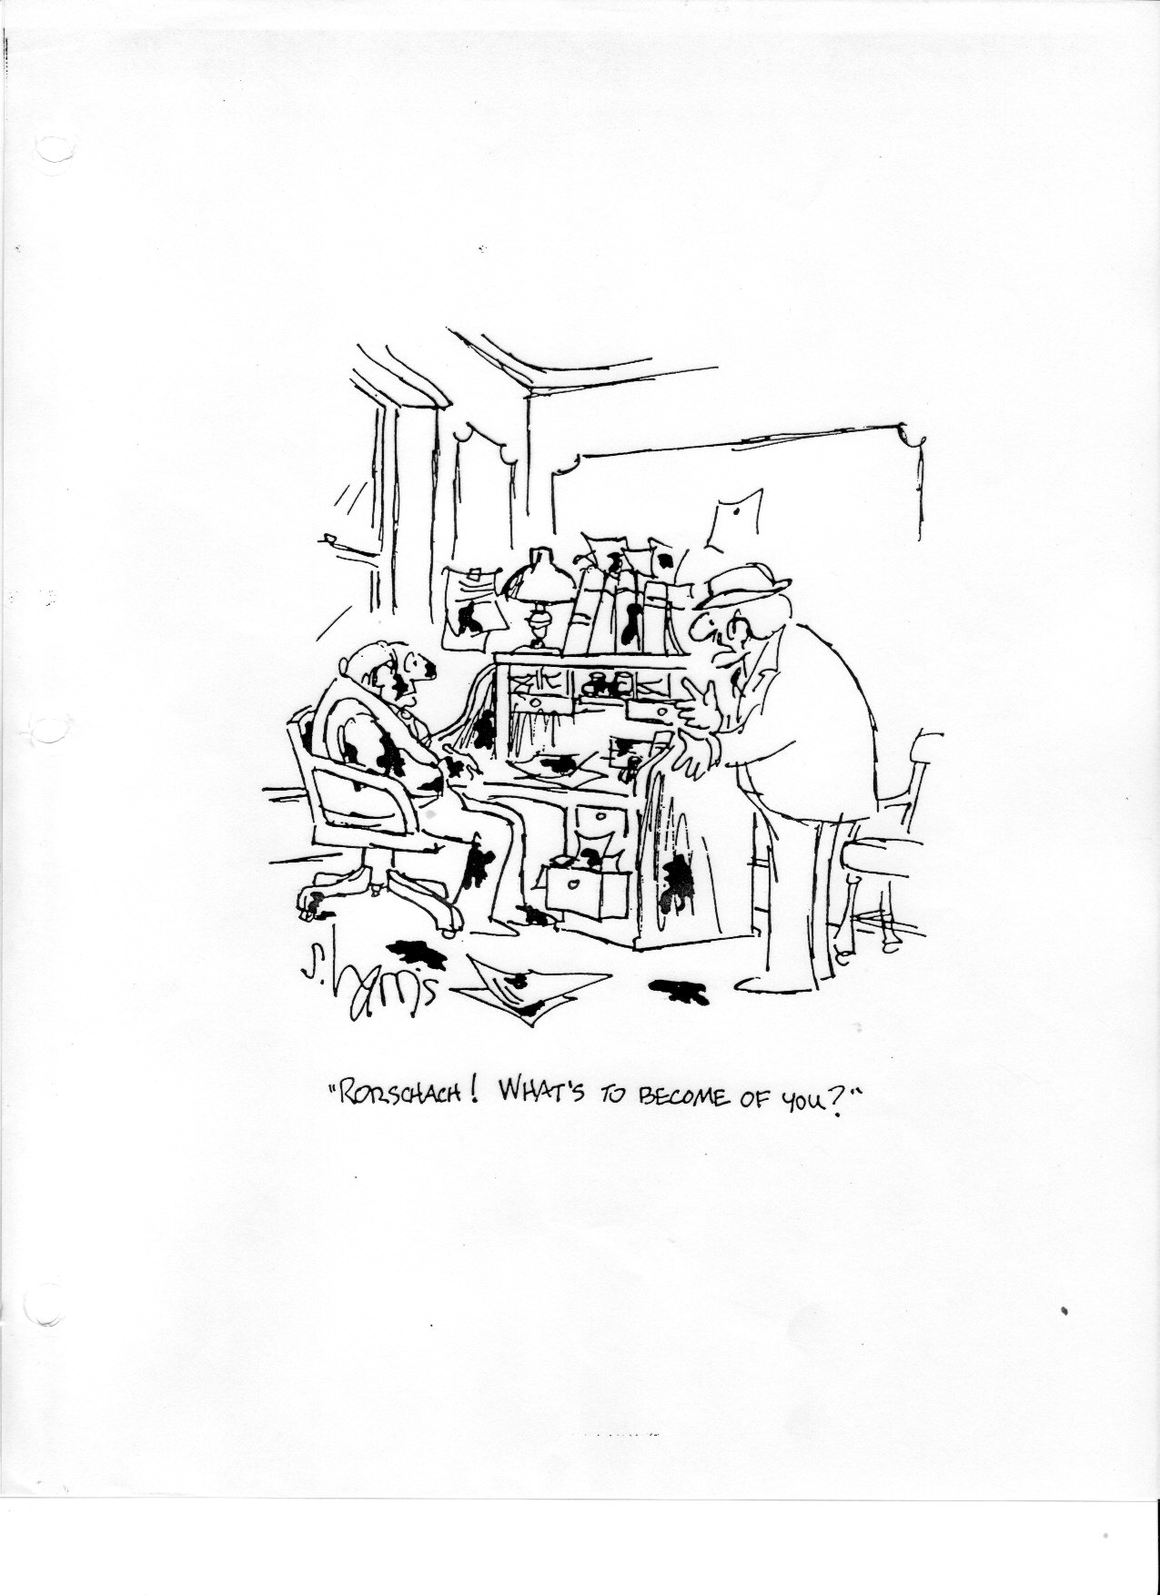
Rorschach Inkblot Cartoon

Slide 59
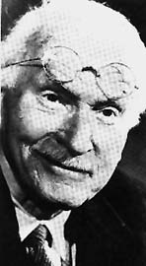
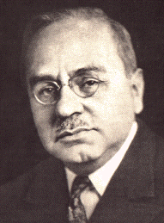

Neo-Freudians
Psychologists that took some premises from Freud and built upon them.
Carl Jung
Alfred Adler
Karen Horney

Slide 60


Carl Jung
(1875-1961)
Less emphasis on social factors; way less on sex
Focused on the unconscious.
Personal unconscious
We all have a collective unconscious: a shared/inherited well of memory traces from our species history.

Slide 61


Alfred Adler
(1870-1937)
Childhood is important to personality.
But focus should be on social factors- not sexual ones.
Our behavior is driven by our efforts to conquer inferiority and feel superior.
Inferiority Complex

Slide 62


Karen Horney (HORN-eye)
(1885-1952)
Childhood anxiety is caused by a dependent child’s feelings of helplessness.
This triggers our desire for love and security.
Fought against Freud’s “penis envy” concept.

Slide 63
The Humanistic Perspective
Maslow’s
Self-Actualizing
Person
Roger’s
Person-Centered
Perspective
“Healthy” rather than “Sick”
Individual as greater than the sum of test scores

Slide 64

Humanistic Psychology
In the 1960’s people became sick of Freud’s negativity and trait psychology’s objectivity.
Along came psychologists wanted to focus on “healthy” people and how to help them strive to “be all that they can be”.

Slide 65
Maslow & Self-Actualization
Self-Actualization
the process of fulfilling our potential
Studied healthy, creative people
Abe Lincoln, Tom Jefferson &
Eleanor Roosevelt
Self-Aware & Self-Accepting
Open & Spontaneous
Loving & Caring
Problem-Centered not Self-Centered
Esteem
Love Needs
Safety
Physiological

Slide 66





Who did Maslow study?

Slide 67
Self-Actualized People
They share certain characteristics:
They are self aware and self accepting
Open and spontaneous
Loving and caring
Not paralyzed by others’ opinions.
They are secure in who they are.

Slide 68






Self-Actualized People
Problem centered rather than self-centered.
Focused their energies on a particular task.
A Few deep relationships, rather than many superficial ones.

Slide 69
Roger’s Person-Centered Perspective
People are basically good
with actualizing tendencies.
Given the right environmental
conditions, we will develop
to our full potentials
Genuineness, Acceptance, Empathy
Self Concept - central feature
of personality (+ or -)

Slide 70

Genuineness
Being open with your own feelings.
Dropping your facade.
Being transparent and self-disclosing.

Slide 71

Acceptance
Unconditional Positive Regard:
An attitude of acceptance regardless of circumstances.
Accepting yourself or others completely.

Slide 72

Empathy
Listening, sharing, understanding and mirroring feelings and reflecting their meanings.
Preschool study

Slide 73

Self-Concept
All of thoughts and feelings about ourselves trying to answer the question….
WHO AM I?

Slide 74
Self-Concept
Both Rogers and Maslow believed that your self-concept is at the center of your personality.
If our self concept is positive….
We tend to act and perceive the world positively.
If our self-concept is negative….
We fall short of our “ideal self” and feel dissatisfied and unhappy

Slide 75
How does a Humanistic psychologist test your personality?
How do psychoanalytic and trait assess?
Perceived Self vs. Ideal Self
  How do you think others see you?
  How do you want others to see you?
You would be asked to fill out a questionnaire asking to describe yourself both as you would ideally like to be and what you actually are.
When the ideal self and the way you currently see yourself are alike - you are generally happy.

Slide 76



Assessing your Self-Concept
→
My Perceived Self
My Ideal Self

Slide 77

Self-Esteem
One’s feelings of high or low self-worth.
Moving Images: 20: Hazards of Pride

Slide 78
Do minorities have lower self-esteem?
NOT REALLY
They value the things which they excel.
They attribute problems to prejudice.
They compare themselves to their own group.

Slide 79

Self-Serving Bias
A readiness to perceive oneself favorable.
People accept more responsibility for successes than failures.
Most people see themselves as better than average.
Seinfeld clip: soft walker
Handout 15-24 –
Self-Ratings

Slide 80
Bandura is Back
Social cognitive theory stems from social learning theory (under the umbrella of behaviorism).
Behaviorism (as introduced by Watson) supports a direct and unidirectional pathway between stimulus and response, representing human behavior as a simple reaction to external stimuli.

Slide 81
Social-Cognitive Perspective
Behavior learned through
conditioning & observation
What we think about our situation
affects our behavior
Interaction of
Environment & Intellect

Slide 82
Social Cognitive Theory
Focus on how we interact with our environment.
Reciprocal Determinism: the interacting influences between personality and environmental factors.

Slide 83
Reciprocal Determinism
the interacting influences between personality and environmental factors.
Personal/
Cognitive
Factors
Environment
Factors
Behavior
Internal World + External World = Us

Slide 84

Social Cognitive Perspective
Different People choose different environments.
The TV you watch, friends you hang with, music you listen to were all chosen by you (your disposition)
But after you choose the environment, it also shapes you.

Slide 85

Social Cognitive Perspective
Our personalities help create situations to which we react.
If I expect someone to be angry with me, I may give that person the cold shoulder, creating the very behavior I expect.

Slide 86
Personal Control – Julian Rotter
Internal Locus of Control
You pretty much control your own destiny
External Locus of Control
Luck, fate and/or powerful others control your destiny
Methods of Study
Correlate feelings of control with behavior
Experiment by raising/lowering people’s sense of
control and noting effects

Slide 87

Learned Helplessness
The hopelessness and passive resignation an animal or human learns when unable to avoid repeated aversive events.

Slide 88
Outcomes of Personal Control
Learned Helplessness
Uncontrollable
bad events
Perceived
lack of control
Generalized
helpless behavior
Important Issue
Nursing Homes
Prisons
Colleges

Slide 89
Self-Handicapping

Slide 90
The 4 Perspectives
Psychoanalytic
Trait
Draws attention to unconscious, irrational aspects of human existence
Freud, Jung, Adler, Horney
Projective Tests: TAT, Rorschach Inkblot
Durable characteristics of a person
Sheldon, Eysenck
The Big 5
MMPI-2, “The Big Five” personality chart

Slide 91
The 4 Perspectives
Humanistic
Social-Cognitive
Importance of self, self-actualization
Maslow, Rodgers
Self-esteem tests, negative self concept tests
Combines social/observational learning with premise that the situation’s context is very important in determining our individual behavior
Bandura, Albert, Ellis
No assessment

Slide 92
Day ___:
If you were an animal, disease, favorite childhood toy, poster (what would you say), psychologist, and a candy bar what u be & why?

Slide 93


Day ___:
Are people inherently/generally good or evil?

Slide 94

Day 57:
How do you think other people perceive you? Describe what they might say about you if they were asked to describe your personality.
Then, ideally how would you like others to perceive you? Describe how you would want other people to describe your personality.

