Slide 1
Social Psychology –
the scientific study of how we think about, influence, and relate to one another
Andy Filipowicz
Ocean Lakes High School

Slide 2
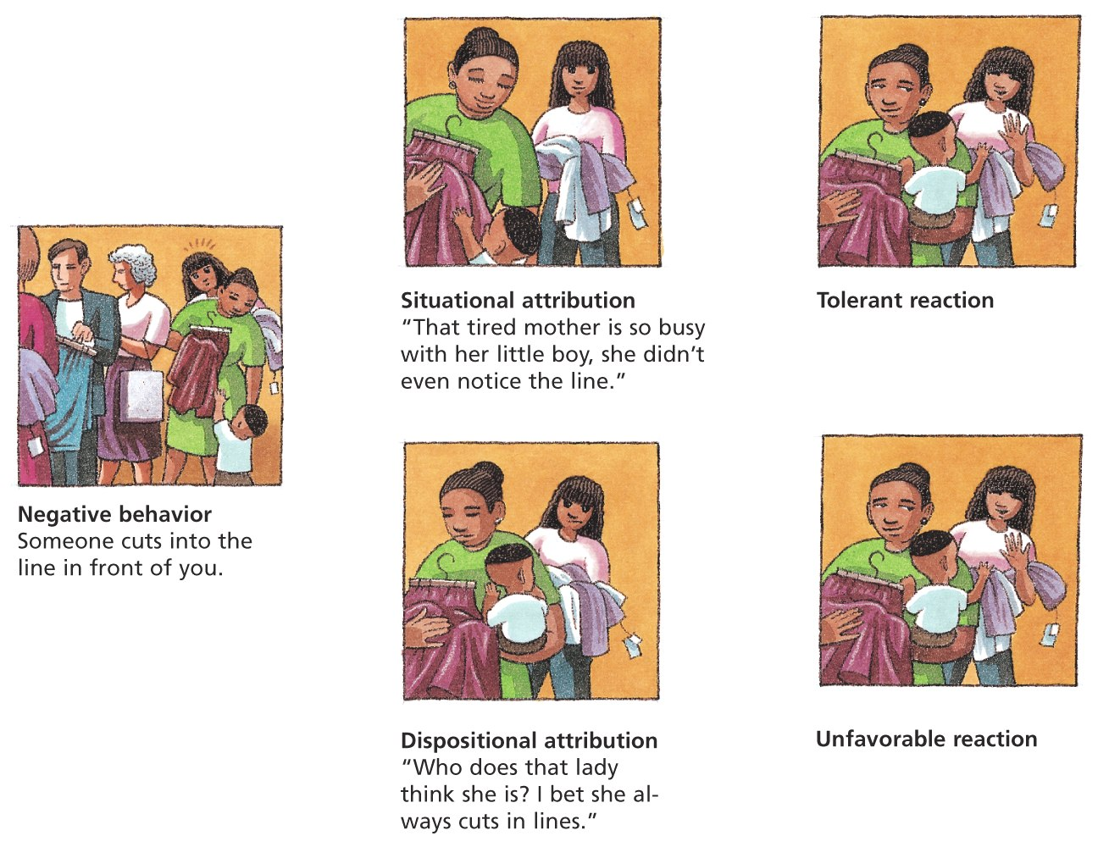
Social Thinking – Attributing Behavior
Attribution Theory
We explain others’ behavior in 1 of 2 ways:
Internal disposition (inner trait)
Situational factors

Slide 3
Social Thinking – Attributing Behavior
Kelley’s Covariation Model
Consensus
Distinctiveness
Consistency
If L, L, H = Personal Attribution
If H, H, H = Situational Attribution
Standard Attribution Biases Stable vs. Unstable
Person-stable attribution
Person-unstable attribution
Situation-stable attribution
Situation-unstable attribution

Slide 4
Social Thinking – Attribution Biases
Stable vs. Unstable
Person-stable attribution
Person-unstable attribution
Situation-stable attribution
Situation-unstable attribution

Slide 5
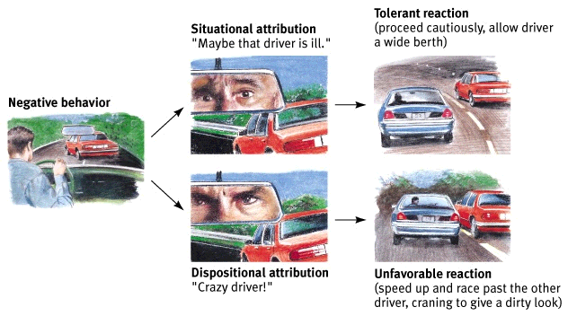
Social Thinking – Attribution Biases
Fundamental Attribution Error
When observing others’ behavior =
OVER estimate PERSONAL attributes
Ex: Lauren S fails the AP test, therefore Lauren S is stupid
UNDER estimate SITUATIONAL factors
Seems to be a western phenomenon
Asked to describe the causes of negative actions they have observed
With increased age, Indians make more situational attributions, while Americans make more personal attributions
What about our explanation of 9/11
Tolerant reaction
(proceed cautiously, allow
driver a wide berth)
Situational attribution
“Maybe that driver is ill.”
Negative behavior
Dispositional attribution
“Crazy driver!”
Unfavorable reaction
(speed up and race past the
other driver, give a dirty look)

Slide 6
Actor-Observer Discrepancy
Attribute personality causes of behavior when evaluating someone else’s behavior
Attribute situational when evaluating our own behavior
Why?
hypothesis 1:
we know our behavior changes from situation to situation, but we don’t know this about others
hypothesis 2:
when we see others perform an action, we concentrate on actor, not situation -- when we perform an action, we see environment, not person
Notes:
Instructors may wish to discuss the research that shows that we tend to explain ingroup/our successes and others' failures as personality-driven, while we tend to explain ingroup/our failures and others' successes as situational when discussing the actor-observer discrepancy

Slide 7
Social Thinking – Attribution Biases
Self-fulfilling Prophecy: process by which one’s expectations about a person eventually lead that person to behave in ways that confirm those expectations
1) Perceiver’s expectations
2) Perceiver’s behavior toward the target
3) Target’s behavior toward the perceiver

Slide 8
Social Thinking – Attributing Behavior
Self-Serving Bias: tendency to overstate one’s role in a positive venture and underestimate it in a failure…remember the Seinfeld skit with the silent walker?
Individualistic cultures do this.
Self-Effacing Bias (Modesty bias) - involves blaming failure on internal, personal factors, while attributing success to external, situational factors
Collectivist cultures do this.
Less likely to commit the fundamental attribution error
More likely to attribute the causes of another person’s behavior to external, situational factors rather than to internal, personal

Slide 9
Cross-Cultural Differences
Western culture
people are in charge of own destinies
more attributions to personality
Some Eastern cultures
fate in charge of destiny
more attributions to situation
0.70
0.60
0.50
0.40
0.30
0.20
0
United States
Attributions to internal
disposition
India
8 11 15 Adult
Age (years)
Notes:
Hockenbury slides (Shulman)

Slide 10
Social Thinking – Attribution Biases
False-consensus Effect – tendency to overestimate the extent to which others share their opinions, attributes, and behaviors
Ex: Personality Questionnaire
Actually, this is a form of the availability heuristic (kind of like how base-rate fallacy is an availability heuristic = tendency to ignore the statistics)

Slide 11
Using Attitudes as Ways to “Justify” Injustice
Just-world belief bias
a tendency to believe that life is fair, people get what they deserve and deserve what they get
it would seem horrible to think that you can be a really good person and bad things could happen to you anyway
Just-world belief bias leads to “blaming the victim”
we explain others’ misfortunes as being their fault
e.g., she deserved to be raped, what was she doing in that neighborhood anyway?

Slide 12
Attitudes…

Slide 13
Social Thinking – Attitudes and Actions
What is an attitude?
predisposition to evaluate some people, groups, or issues in a particular way
can be - or +
Has three components
Cognitive—thoughts about given topic or situation
Affective—feelings or emotions about topic
Behavioral—your actions regarding the topic or situation

Slide 14
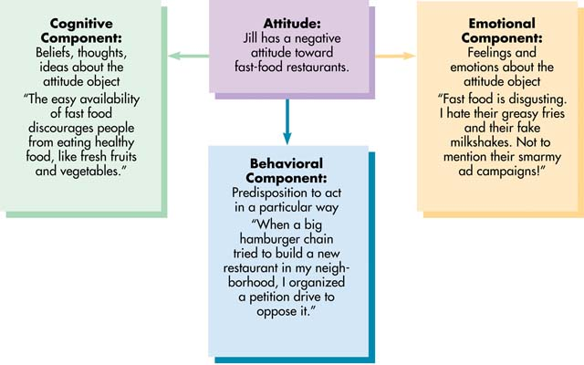
Components of Attitudes
An attitude is a positive or negative evaluation of an object, person, or idea

Slide 15
The Effect of Attitudes on Behavior
You’re most likely to behave in accordance with your attitudes when
Attitudes are extreme or are frequently expressed
Attitudes have been formed through direct experience.
You are very knowledgeable about the subject.
You have a vested interest in the subject.
You anticipate a favorable outcome or response from others for doing so.
Attitudes and Actions Line up, IF…
Outside influences on what we do are minimal
We are keenly aware of our attitudes

Slide 16
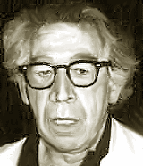

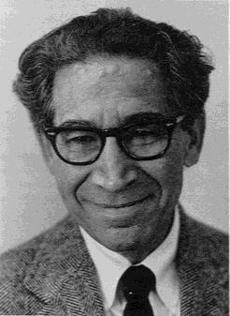
Social Thinking – Attitudes and Action
1919-1989
Cognitive Dissonance Theory
we act to reduce the discomfort (dissonance) we feel when two of our thoughts (cognitions) are inconsistent
Become aware that attitudes and actions DO NOT MIX? = reduce dissonance by changing attitudes

Slide 17
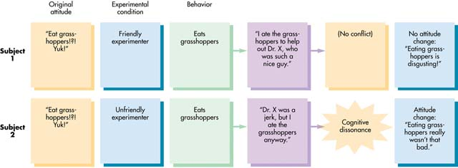
How Cognitive Dissonance Leads to Attitude Change
When your behavior conflicts with your attitudes, an uncomfortable state of tension is produced (dissonance). However, if you can rationalize or explain your behavior, the conflict (and the tension/dissonance) is eliminated or avoided.
If you can’t explain your behavior, you may change your attitude so that it is in harmony with your behavior.

Slide 18
Insufficient-justification effect
Festinger & Carlsmith (1959)
gave subjects a boring task, then asked subjects to lie to the next subject and say the experiment was exciting
paid ½ the subjects $1, other ½ $20
then asked subjects to rate boringness of task
$1 group rated the task as far more fun than the $20 group
each group needed a justification for lying
$20 group had an external justification of money
since $1 isn’t very much money, $1 group said task was fun

Slide 19
Cognitive Dissonance: A Review
If you have a good excuse for a behavior that does not go with your attitude then you avoid dissonance.
If you do not have a good excuse for a behavior that is against your attitude you must change your attitude to fit your behavior.

Slide 20
Compliance – Setting Traps: Sequential Request Strategies
Foot-in-the-Door Phenomenon
tendency for people who have first agreed to a small request to comply later with a larger request
Examples:
1) Time off from School
2) Housewife Inventory
Increases compliance on avg = 13%; only works if ppl are motivated to be consistent with their self-images

Slide 21
Compliance – Setting Traps: Sequential Request Strategies
Door-in-the-Face
tendency for people to agree to a smaller request after first rejecting a larger, more burdensome request
Examples:
1) Habitat for Humanity
2) Girl Scout Cookies
Explanations:
Perceptual Contrast
Reciprocal Concessions

Slide 22
Compliance – Setting Traps: Sequential Request Strategies
That’s Not All Folks!
Influencer begins with a somewhat reasonable request, then decreases the request’s size/demand by offering a discount or bonus
Example: Cup Cake Salesman

Slide 23
Compliance – Setting Traps: Sequential Request Strategies
Low-Balling
Influencer secures agreement with a request but then increases the size of that request by revealing hidden costs
Betting that you’ll go ahead with the purchase despite the added cost
Examples
1) Used Car Shop
2) 6am Wake-Up Call!
Explanations:
Commitment to a course of action
Commitment to the salesperson!

Slide 24
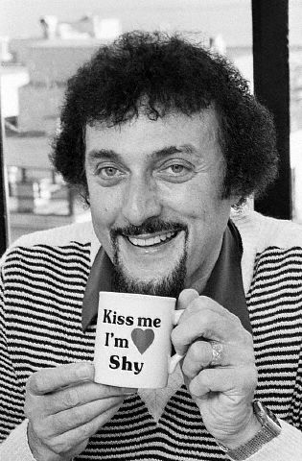
Compliance – Role Playing / Conformity
Role Playing
set of expectations about a social position
defines how those in the position ought to behave
Example:
Phillip Zimbardo’s Prison Study
WebSite
In Parts:
1 of 3
2 of 3
3 of 3

Slide 25
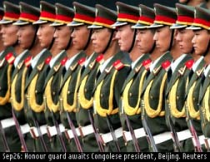
Social Influence – Conformity
Conformity
adjusting one’s behavior or thinking to coincide with a group standard
Examples:
1) Heaven's Gate
2) Elevator Pressure
3) Japanese Prank!
3) Chameleon Effect

Slide 26
Social Influence – Conformity
The chameleon effect
Number
of times
0.8
0.7
0.6
0.5
0.4
0.3
Participant Participant
rubs face shakes foot
Confederate rubs face
Confederate shakes foot

Slide 27
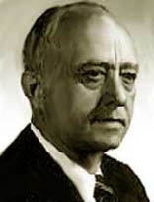
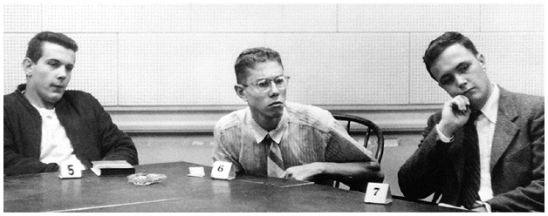
Social Influence – Conformity: The Classics
Examples
1) Sherif’s Light Study (pic →)
2) Asch’s Line Study

Slide 28
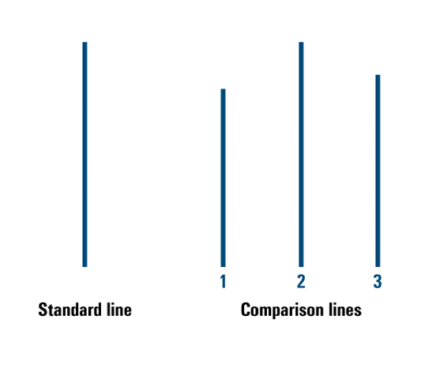
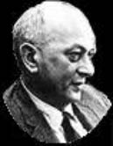
Social Influence – The Classics
RESULTS:
Asch found that 76% participants conformed to at least one wrong choice during multiple trials.
BUT when data from all the trials was combined, subjects gave wrong answer (conformed) on only 37% of the critical trials. Means that almost 2/3 of people said correct answer even when others said the wrong one (did not conform)
Control group that responded alone (no group present) chose correctly 99%.
Number of confederates…
1 confederate = no effect
2 confederates = little effect
3 / 4 confederates = maximum effect achieved
A single ally is enough to induce non-conformity

Slide 29
Social Influence – Why Do We Conform?
Informational Social Influence
Influence resulting from truly believing that others are correct in their judgments (Sherif’s study, b/c it was a hard, ambiguous task; 4 eyes = better than 2 eyes)
Private acceptance
Normative Social Influence
influence resulting from a person’s desire to avoid disapproval for appearing as a deviant (Asch’s line study)
Public conformity

Slide 30
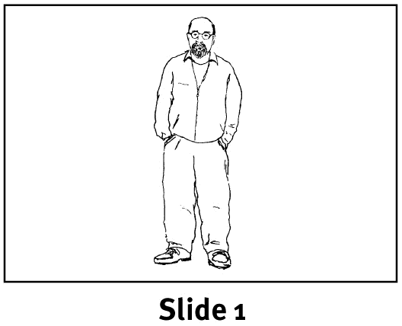
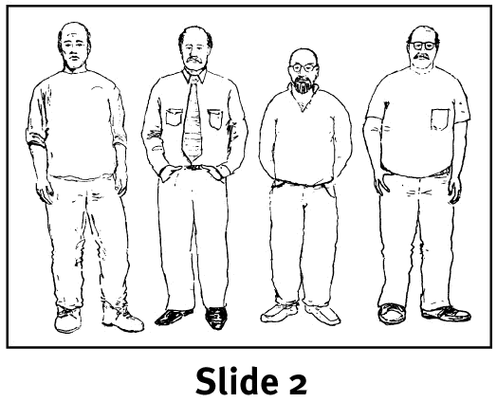
Social Influence – Easy vs. Hard Tasks
50%
40
30
20
10
0
Difficult judgments (Sherif-like)
Participants judged which person in Slide 2 was the same as the person in Slide 1
Conformity highest
on important
judgments
Percentage of
conformity to
confederates’
wrong answers
Easy judgments (Asch-like)
Low High
Importance

Slide 31
Social Influence – Optimal Conditions for Conformity
YOU ARE MOST LIKELY TO CONFORM WHEN YOU…
feel incompetent, insecure, or uninformed
are in a group of 3 or more (larger than this show no more conformity)
realize the rest of the group is unanimous
are impressed by the status of the group
have made no prior commitments to a response
(Your culture) encourages respect for social standards (east Asian cultures)
are younger (20s-30s) rather than older (retirement age)
are perceiving that you are being observed by researchers
In this case, women conform more and men conform less than if in a more private situation

Slide 32
Culture & Conformity
In general, levels of conformity have steadily declined since Asch’s original study of U.S. college students in the 1950s
Individualistic cultures tend to emphasize independence, self-expression, and standing out from the crowd; thus the whole notion of conformity tends to carry a negative connotation
Collectivistic cultures, however, publicly conforming while privately disagreeing is regarded as socially appropriate tact or sensitivity

Slide 33
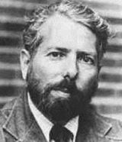
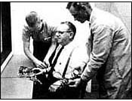
Social Influence – Obedience
Behavior change produced by the commands of perceived authority
Darren Brown's Recreation
Just cuz he’s awesome: PickPocket
Stanley Milgram Experiment - Will People Do Anything If Ordered?
The Pick It Up Experiment
Yale...some footage (look up experiment @last 30 sec of top 1)

Slide 34
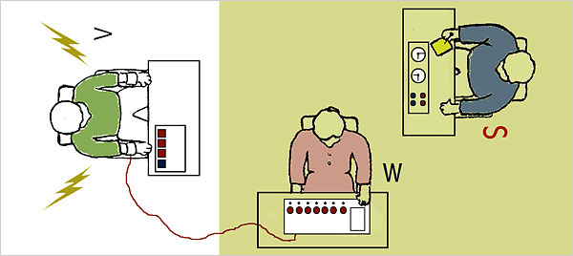

Slide 35
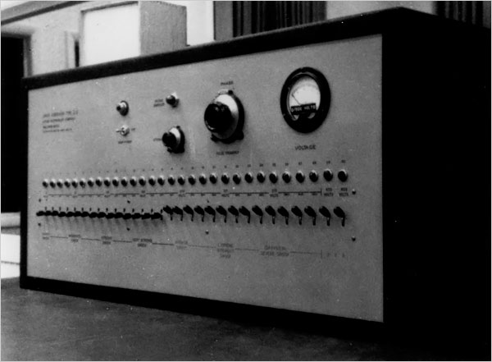

Slide 36
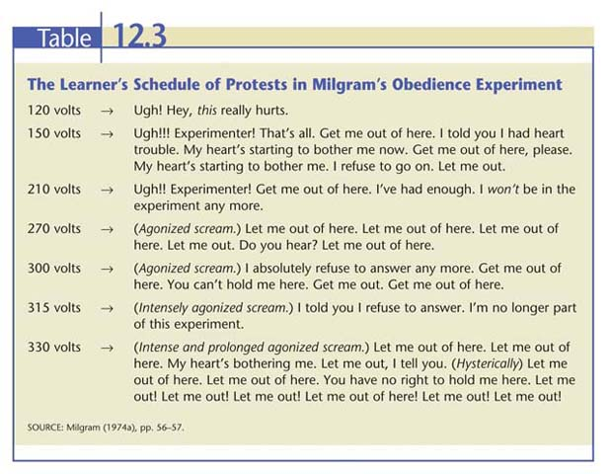

Slide 37
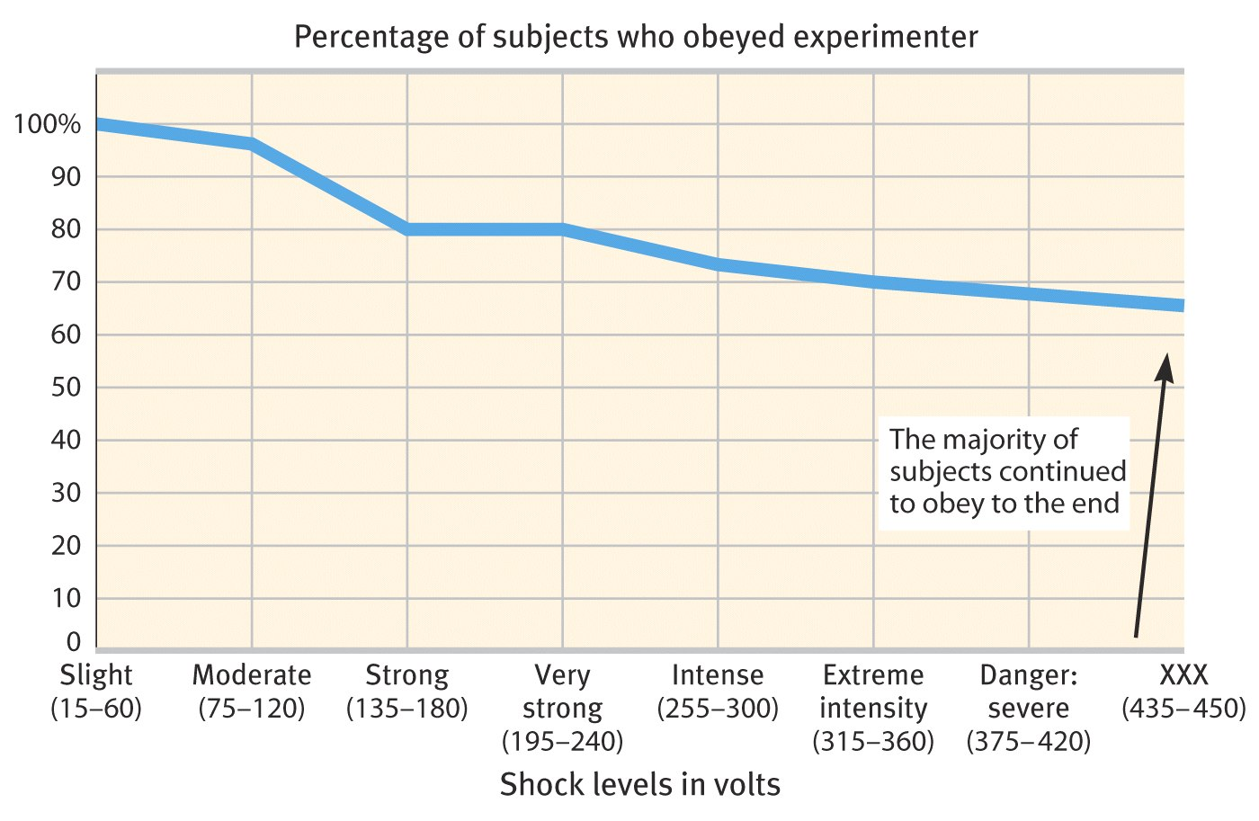
Social Influence – Obedience
Milgram’s CLASSIC obedience experiment

Slide 38
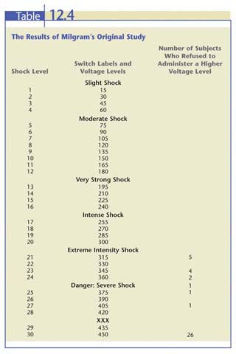

Slide 39
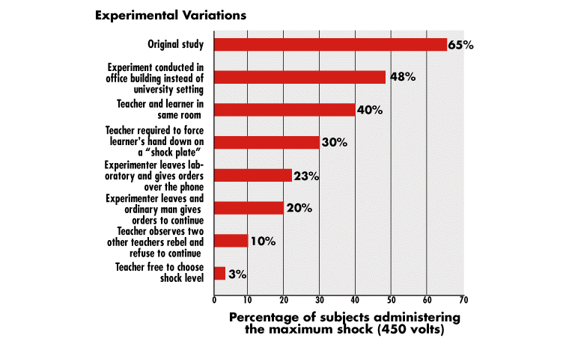

Slide 40
Social Influence – Obedience
Conditions (IVs) influencing obedience (DV):
Proximity
Closer to the “learner” = less obedience
Closer to the experimenter = more obedience
Contact
Visual contact (as opposed to auditory contact) with confederate = less
Physical contact (forcing participant’s hand onto the shock plate) = least
But still, 30% delivered the biggest shocks possible
Perceived authority = more at Yale than at TCC
Replace experimenter with assistant = less
When other confederates were present in the room = way less!
View slide: Factors that Influence Obedience (graph of all this)

Slide 41
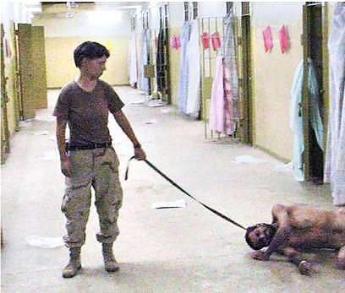
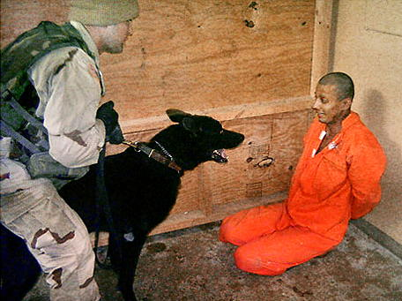
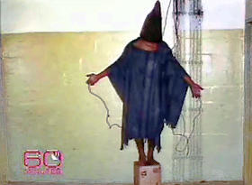
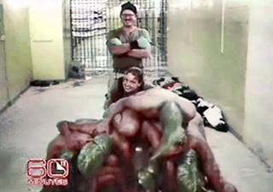
Abu Ghraib Prison: “I was just following orders.”

Slide 42
Social Influence – The Presence of Others
Social Facilitation
improved performance of tasks in the presence of others
When?
simple or well-learned tasks
NOT tasks that are difficult or not yet mastered
Examples:
1) Cockroaches
2) Home Team Advantage
WHY Social Facilitation occurs?
1) mere presence theory
2) evaluation apprehension theory
3) distraction-conflict theory

Slide 43
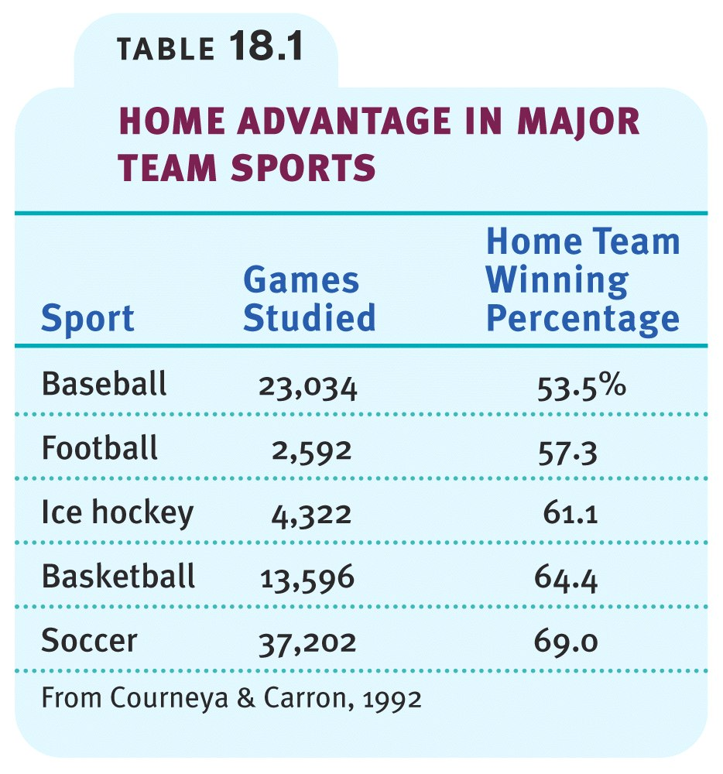
Social Facilitation – The Presence of Others

Slide 44
Social Influence – The Presence of Others
Social Loafing = slacking off in a group
tendency for people in a group to exert less effort when pooling their efforts toward attaining a common goal than when individually accountable
Less likely to occur when:
People believe their own performance can be identified and evaluated
Task is important and meaningful
Small group
Cohesive group
Its women
Person comes from Eastern, collectivist cultures (so, take advantage of Asians when you are in groups with them)

Slide 45
Social Influence – The Presence of Others
Deindividuation – loss of a person’s sense of individuality and the reduction of normal constraints against deviant behavior
read page 266 in my blue book
Example: Trick or Treat: Please Take Just 1

Slide 46
Social Influence – The Presence of Others
Group Polarization – the exaggeration, through group discussion, of initial tendencies in the thinking of group members
Example: Racists love Company (next slide)
Why?
1) Persuasive Arguments Theory
2) Double Theory
3) Social Categorization

Slide 47
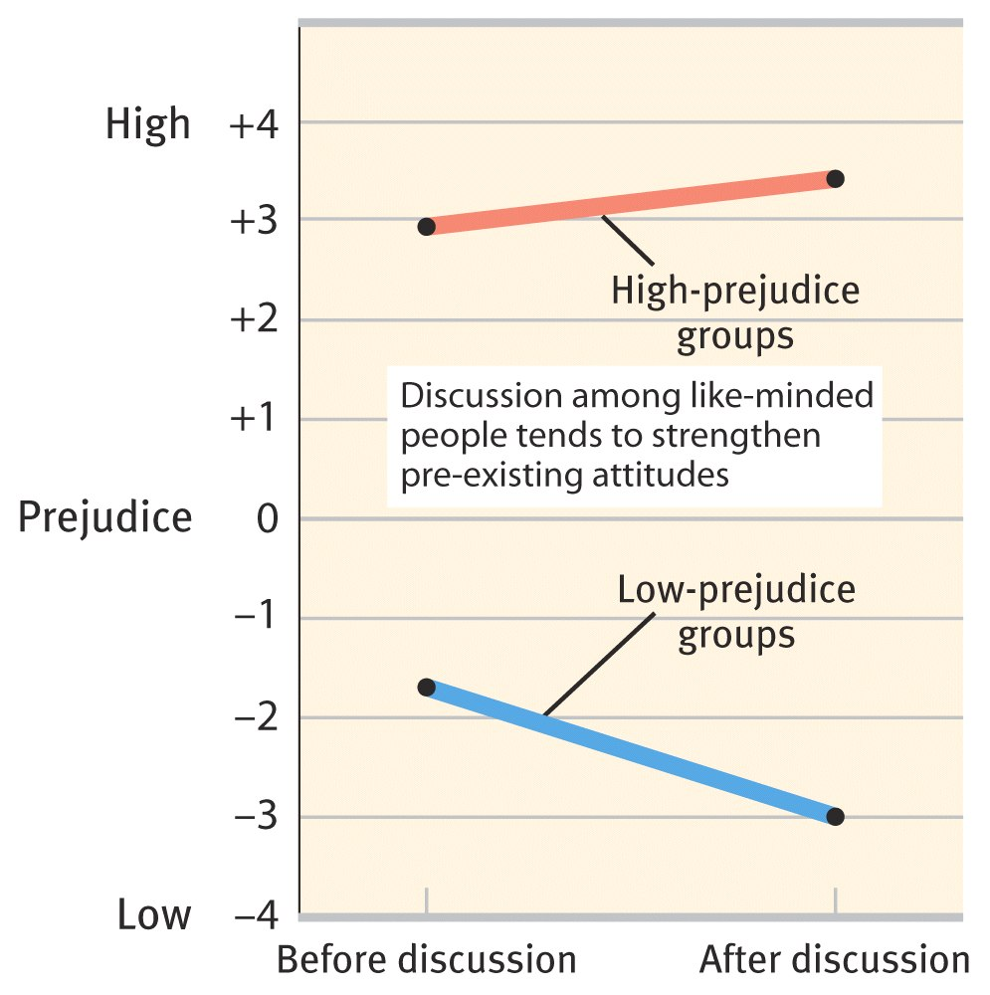
Social Influence – The Presence of Others
If a group is like-minded, discussion strengthens its prevailing opinions

Slide 48
Social Influence – The Presence of Others
Groupthink
mode of thinking that occurs when the desire for harmony in a decision-making group overrides realistic appraisal of alternatives
Alternate Def: group decision-making style that is characterized by an excessive tendency among group members to seek concurrence
Example: Bay of Pigs
How to Avoid?
1) avoid isolation; seek mediation
2) always use a devil’s advocate!
3) leaders should encourage critical discussion and not take a stand too early

Slide 49
SOCIAL RELATIONS

Slide 50
Social Relations
Prejudice – Undeserved, negative feelings toward persons based on their perceived membership in certain groups
Stereotyping can lead to prejudice (She’s from NY, therefore she is rude and pushy)
Prejudice can lead to discrimination (a behavior – I refuse to teach to people from NY)
Examples:
1) A Game of Shooting
2) Stereotype-Consistent Memories
According to scapegoat theory, it results from frustration
Stereotype – a generalized (sometimes accurate, but often over-generalized) belief about a group of people

Slide 51
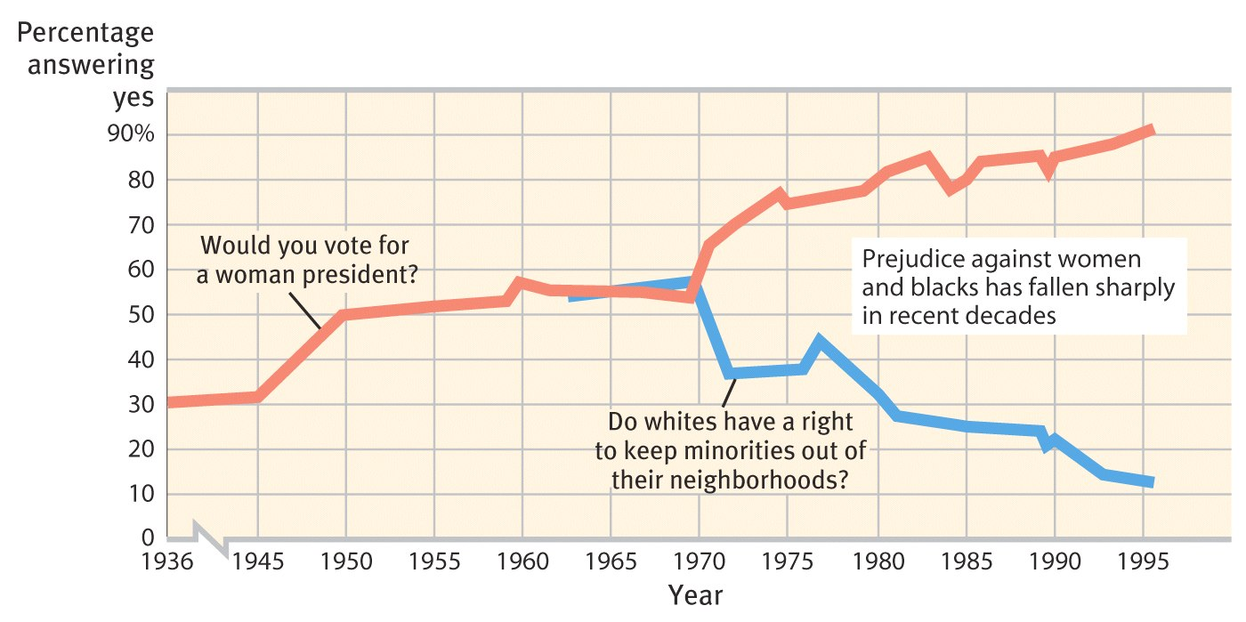
Social Relations
Americans today express much less racial and gender prejudice

Slide 52
Social Relations
Confirmation Bias – tendency to interpret, seek, and create information that seems to confirm original expectations
Example:
Basketball Players
Self-Fulfilling Prophecy –
Example:
Academic Performance

Slide 53
Combating Prejudice
Contact Theory – contact between hostile groups will reduce animosity, but only if the groups are made to work toward a superordinate goal
Examples:
1) Independence Day alien takeover
2) Sherif’s Robbers Cave study (1966)

Slide 54
Social Relations
Ingroup
“Us”- people with whom one shares a common identity
Outgroup
“Them”- those perceived as different or apart from one’s ingroup
Ingroup Bias
tendency to favor one’s own group

Slide 55
Social Relations
Aggression
any physical or verbal behavior intended to hurt or destroy
2 Types:
Instrumental: aggressive act intended to secure a particular end
Hostile: anger without a clear purpose
Frustration-Aggression Principle
principle that frustration – the blocking of an attempt to achieve some goal – creates anger, which can generate aggression
Other Explanations of Aggression:
Freud: Thanatos
Social Learning: Bandura’s Bobo Dolls
Environmental: hot temperature = more aggressive acts

Slide 56
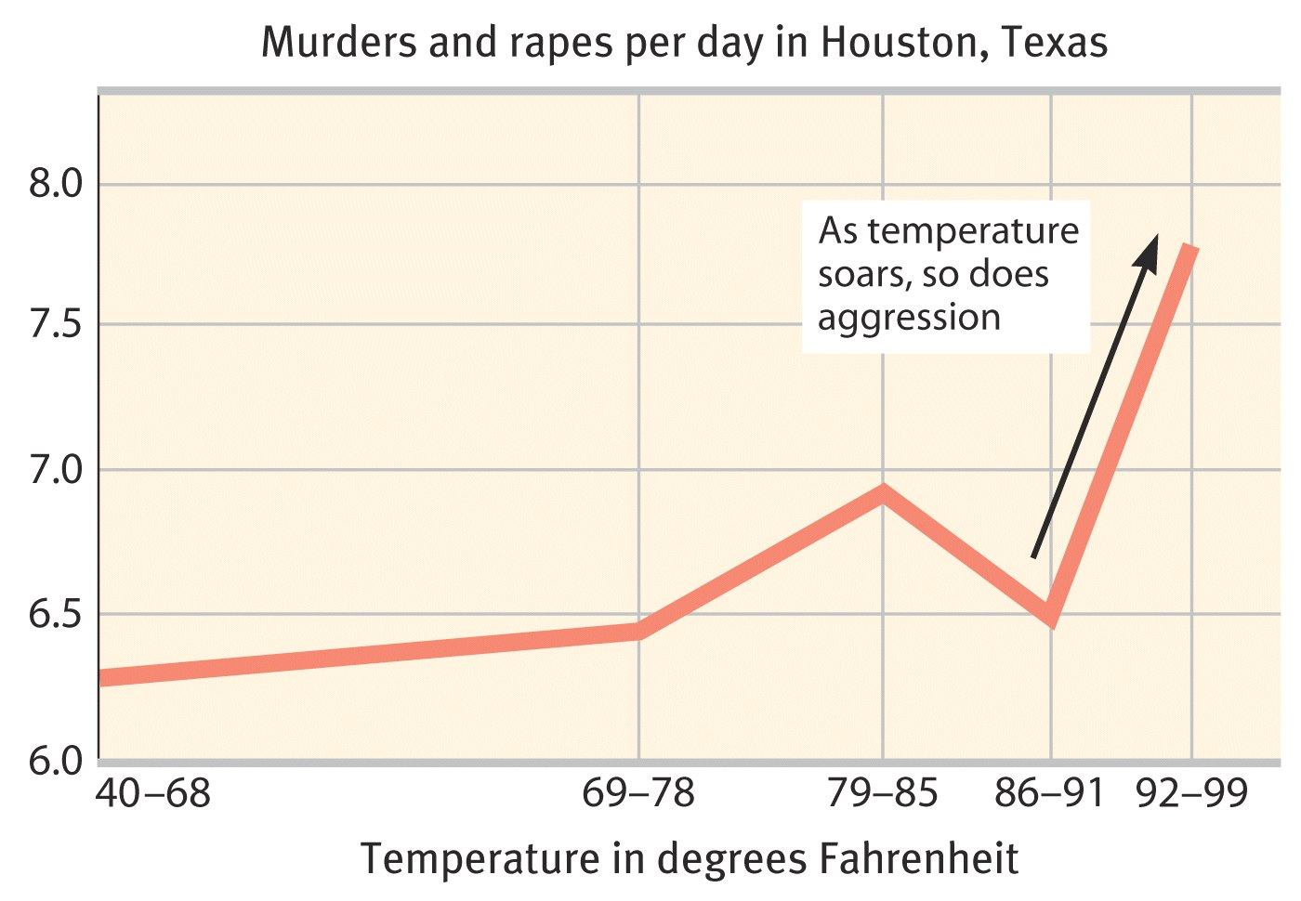
Social Relations

Slide 57
Social Relations
Social Trap
a situation in which the conflicting parties, by each rationally pursuing their self-interest, become caught in mutually destructive behavior
Examples: overfishing, destruction of the rain forest, global warming?

Slide 58
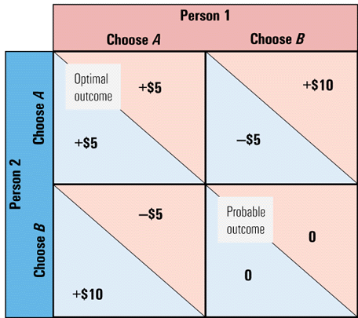
Social Relations
Person 1
Choose A Choose B
Social trap
by pursuing our self-interest and not trusting others, we can end up losers
Optimal
outcome
Person 2
Choose B Choose A
Probable
outcome

Slide 59
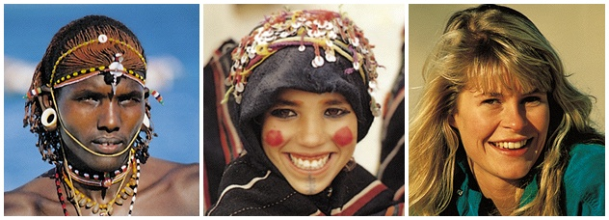
Social Relations- Attractiveness
Mere Exposure Effect
repeated exposure to novel stimuli increases liking of them
Conceptions of attractiveness vary by culture
Limitations of the MEE:
If you initially dislike someone / something, exposure will likely make you dislike them / that more
Overexposure is possible, esp. if ppl become bored, so don’t smother your crushes!

Slide 60
Social Relations- Attractiveness
Being “Hot” is Rewarding
Examples:
1) 5th grade teachers
2) petitions
3) Texas judges
4) Salaries
5) Cinderella – Hot ppl are rated as kind as well
The Problem of Being Beautiful
Essay writing and grades on papers

Slide 61
Social Relations – First Encounters
Matching Hypothesis – people are attractive to others who are similar in physical attractiveness
In terms of age, education, race, religion, height, level of intelligence, socioeconomic status, all of these have greater correlation in a couple than in 2 random people
Complementary Hypothesis – NO SUPPORT
Here’s something Crazy: Changing Opinions!
Example: Personal Meetings and Interpretations

Slide 62
Social Relations – Mate Selection
Evolutionary Perspective
Women: limited biologically to a finite number of babies; must be highly selective = older, financially secure or ambitious men
Men: unlimited number of babies = young (fertile), and physically attractive (smooth skin, full lips, lustrous hair, good muscle tone, other youthful features)
Examples:
1) World Survey on What Makes a Good Mate
2) Age Tendencies
3) What Makes You Madder?

Slide 63
Social Relations – Mate Selection
Sexuality: men are pigs. (men view the world in more sexualized terms)
Examples:
1) Casual Conversations
2) Reading Stories
So, What is “Beautiful?”
Cross-culturally, we pretty much agree on scales of 1-10.
Men like women who have the hour glass figure.
Women like men who have resources
Composite images – we like the prototypical human face
Infants know who’s hot – spend more time staring
Some cross cultural and time differences – skinny/fat?

Slide 64
Violent Porn Watching – Does It Contribute to Violent Behaviors?
YES
associated with a marked increase in males’ acceptance of male dominance in intimate relationships
increases men’s self-reported likelihood of committing rape
Leads to a desensitization, which results in increased violence and sexual exploitation of women
NO
No clear direct connection
Violence, sex crimes are present in countries where there is no porn available (Saudi Arabia, China, Iran)
Sex offenders had less exposure to sexually explicit materials than most men, first saw the materials at a later age than most men, and often find sexual images more distressing than arousing.

Slide 65
Social Relations – Close Relationships
Passionate Love
an aroused state of intense positive absorption in another
usually present at the beginning of a love relationship
Companionate Love
deep affectionate attachment we feel for those with whom our lives are intertwined
Sternberg’s Triangular Theory of Love
Intimacy (emotional), Passion (motivational), Commitment (cognitive)

Slide 66
Social Relations – Close Relationships
Equity Theory
Benefits vs. Contributions
When C > B, we feel angry and resentful
When B > C, we feel guilty
Social Exchange Theory
the theory that our social behavior is an exchange process, the aim of which is to maximize benefits and minimize costs
Self-Disclosure
revealing intimate aspects of oneself to others
Why?
We disclose to ppl we like
We like people who disclose to us
We like people to whom we have disclosed

Slide 67
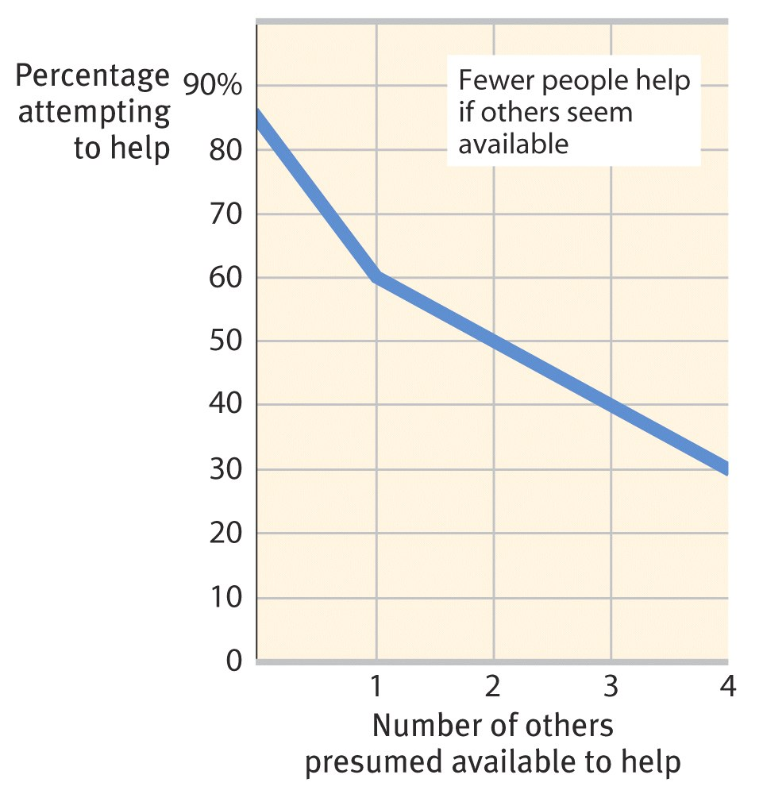
Social Relations
Altruism
unselfish regard for the welfare of others
Bystander Effect
tendency for any given bystander to be less likely to give aid if other bystanders are present
Kitty Genovese

Slide 68
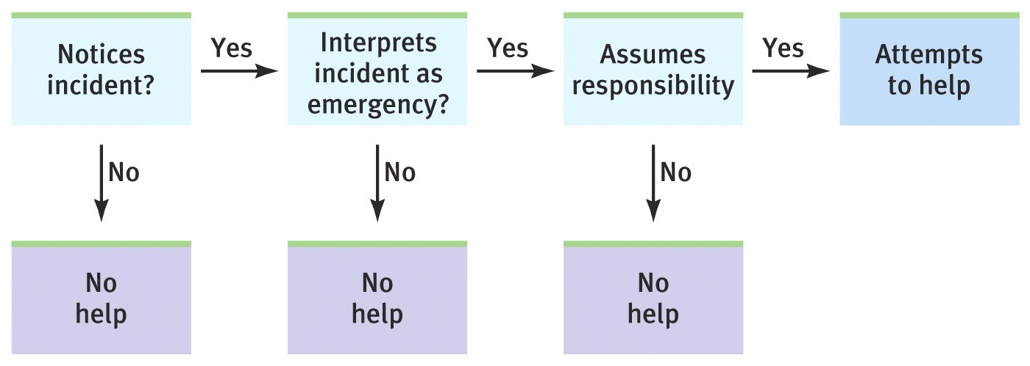
Social Relations
The decision-making process for bystander intervention

Slide 69
Social Relations – Altruism
Pluralistic Ignorance – the state in which ppl mistakenly believe that their own thoughts and feelings are different from those of others, even though everyone’s behavior is the same
In other words, no one acts because each person thinks the other ones must know there really isn’t an emergency, else they would act
Diffusion of Responsibility – the belief that others will or should take the responsibility for providing assistance to a person in need
Group leaders are more likely to act (politicians, SCA presidents, etc.)
Some people who have certain jobs (nurses, ambulance drivers, etc.) are more likely to act
Audience Inhibition – reluctance to help for fear of making a bad impression on the neutral observers

Slide 70
Social Relations – Altruism
Other Predictors: PPL are LESS likely TO HELP if…
They live in urban vs. rural areas
They have a higher cost of living
They are in a hurry
They are not in a good mood
Example: Smelling and Helping
They do not feel guilty
Example: You Broke My Camera
They perceive the victim as unattractive
Example: Grad School Application

Slide 71
Social Relations
Graduated and Reciprocated Initiatives in Tension-reduction (GRIT)
a strategy designed to decrease international tensions
one side announces recognition of mutual interests and initiates a small conciliatory act
opens door for reciprocation by other party

Slide 72
Day 66:
What is the single most… (do as many of these as possible…they take some thought):
Nicest thing you’ve ever seen/heard someone do?
Meanest thing you’ve ever seen/heard someone do?
Strangest thing you’ve ever seen/heard someone do?

Slide 73
Journal: Day 68
During times of war, soldiers are sometimes ordered by their superiors to do some pretty horrible acts (i.e., Nazi soldiers in Holocaust).
Who should be held responsible for unethical acts when there is a superior/subordinate relationship (think about other types of relationships → boss/employee, coach/athlete, teacher/student, etc.)
The superior? The subordinate? Both? WHY?
HAVE OUT YOUR ESSAYS…

