Slide 1
Journal
You read a little bit about different neurotransmitters.
Please draw cartoon figures of each of the following neurotransmitters where the function(s) of each NT is apparent in the appearance of or the behavior of your NT cartoon figures.
Serotonin
Dopamine
Acetylcholine
Endorphins
GABA

Slide 2
Journal:
Think of an experience in your life where your sympathetic nervous system was in full throttle. What was the event? Describe your body’s physiological reactions during that experience.

Slide 3
Journal Day 17:
Think of at least 5 different brain parts / lobes and describe 5 specific example / behavior where you used each of those brain parts over the past few days.

Slide 4
Day 18: Practice questions
Stimulation of portions of the left temporal lobe of the brain during surgery will cause the patient to
a) see lights.
b) lose the sense of smell.
c) jerk the left arm.
d) extend the tongue.
e) hear sounds.
Which of the following neurotransmitters is most associated with Alzheimer’s Disease? Deficiency or excess?
a) Acetylcholine
b) Dopamine
c) Serotonin
d) Epinephrine
e) GABA
Which of the following is the most abundant inhibitory neurotransmitter in humans, in that the majority of synapses respond to it?
a) dopamine
b) G.A.B.A
c) Epinephrine
d) Glutamate
e) Substance P
The driver of a car that has pulled up next to you at a red light turns up the volume on her radio. The increase in perceived sound that you experience is primarily due to:
neurons firing more intensely
increased secretions by the pituitary gland.
c) changing oscillations of the sound wavelengths.
d) more neurons firing more frequently.
e) increased speed of inter-neural communication

Slide 5
Journal:
Do this: Handedness Questionnaire (in journal) & Wagner Preference (on paper)
Describe your findings to both. Does anything surprise you?

Slide 6
Results
2007-2008
1A
Right Dom: 8
Left Dom: 2
No Dom: 9
2A
Right Dom: 12
Left Dom: 3
No Dom: 9
4A
Right Dom: 5
Left Dom: 3
No Dom: 2
25
8
20
2008-2009
1B
Right = 14
Left = 1
No Dom = 4
2B
Right = 13
Left = 1
No Dom = 6
48
7
20
3A:
Right = 10
Left = 4
No Dom = 7
4A
Right Dom: 11
Left Dom: 1
No Dom: 3

Slide 7
2009-2010: Left / Right Brain Dominance
 | L | R | Split
2A | 4 | 5 | 3
3A | 3 | 13 | 9
1B
2B | 6 | 11 | 7
4B | 0 | 6 | 4

Slide 8
Movie Questions: Please Copy!
How does Jody demonstrate the “plasticity” of the brain?
How does the phrase “use it or lose it” apply to Liz’s case?
In what areas of the brain was Michael advanced for his age? Deficiencies?

Slide 9
Biological Basis of Behavior
Chapter 2 of Myers 9th edition
Andy Filipowicz
Ocean Lakes High School
Virginia Beach, VA
AWESOME WEBSITE FOR BRAIN STUFF!!!!
And
Another One

Slide 10
WebQuest
http://outreach.mcb.harvard.edu/teachers/Summer05/RoseMaryMcClain/TeenBrain.pdf

Slide 11
WOW!
Vilayanur Ramachandran
http://www.psychclips.co.uk/clip82.html

Slide 12
Neurological possibilities
100 billion neurons Milky Way Galaxy
1 trillion supportive cells glia
10¹⁴ synapses 1 quadrillion
but, synapses always changing dynamic
conclude: infinite possibilities
"nothing is more constant about the nervous system than its ability to change”¹
Called: hope
Called: neural plasticity
“If you don’t use it you lose it”
¹p 1475, Barinaga. Science 1994 266:1475-1476

Slide 13

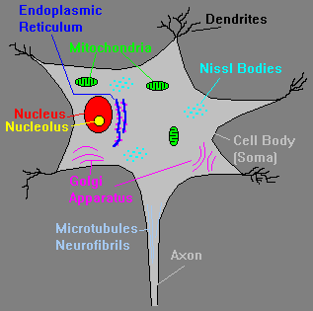
Neural Communication
Endoplasmic reticulum (ER) - system of tubes for transport of materials within cytoplasm. Can have ribosomes (rough ER) or no ribosomes (smooth ER). With ribosomes, the ER is important for protein synthesis.
Golgi Apparatus - membrane-bound structure important in packaging peptides and proteins (including neurotransmitters) into vesicles.

Slide 14
Anatomy of a Neuron Cell (stand up!)
Receptor Sites
Dendrites
Synapse & Synaptic Cleft
MS = MS!
Myelin Sheath
Soma
Terminal Buttons
= flow of neural impulse
Axon
N.T.’s (inside)
Notes:
MS = MS: Multiple Sclerosis means multiple hardening of lesions that develop around the myelin sheaths of axon bundles in the brain, spinal cord, and optic nerves

Slide 15
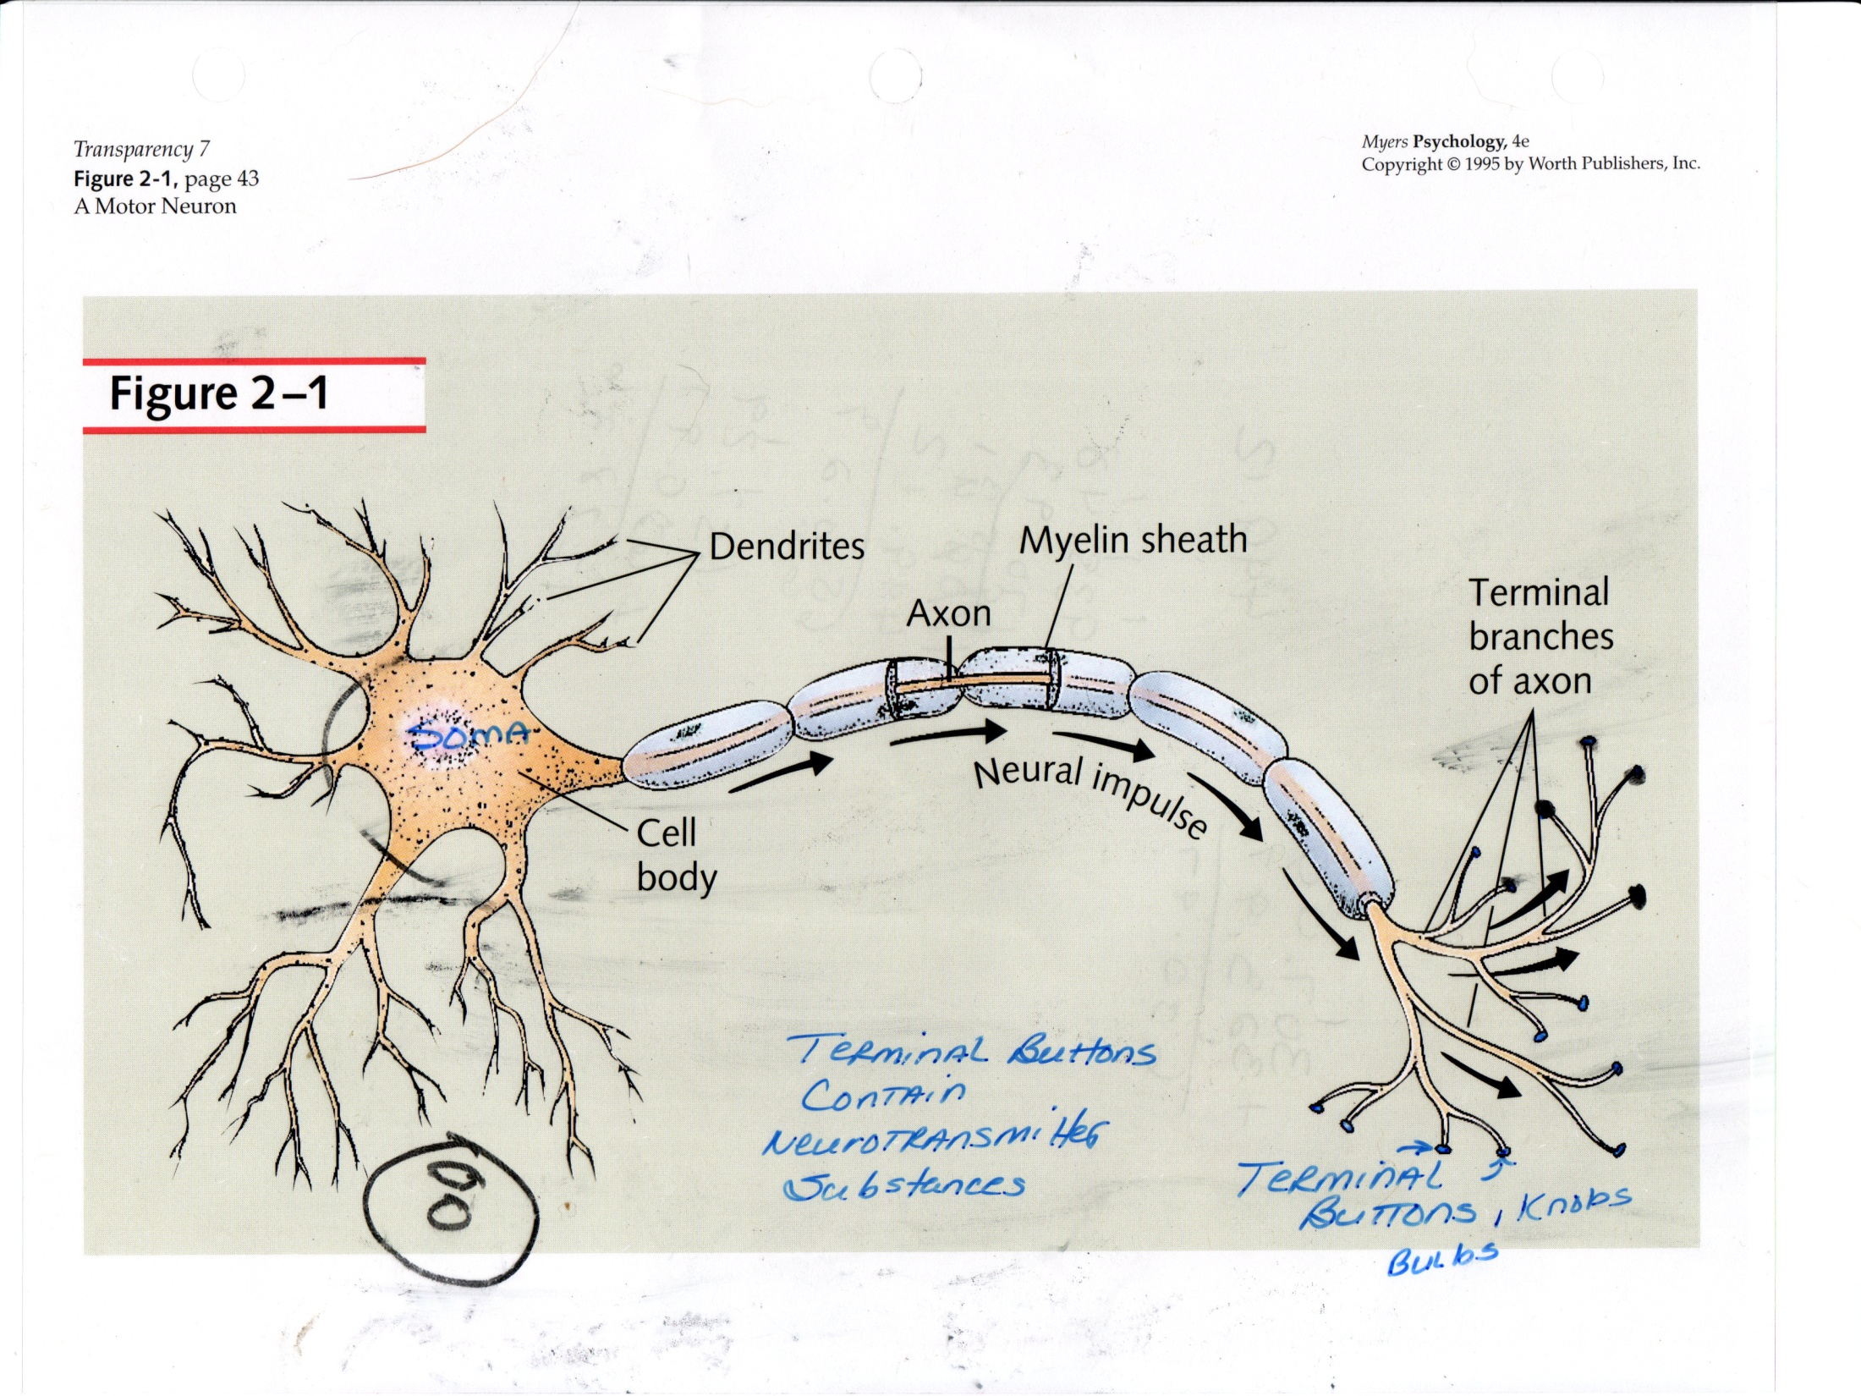
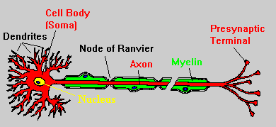

Slide 16
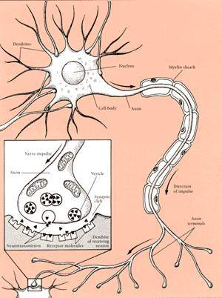

Slide 17
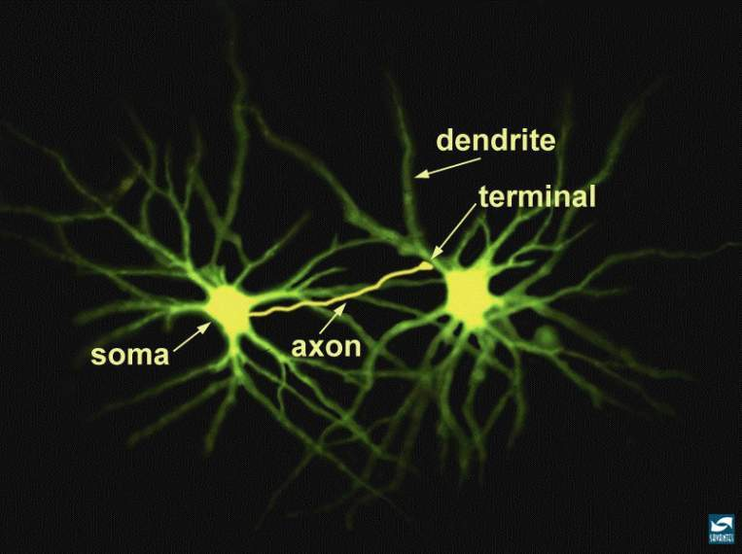
Stars of this universe: neuron
http://www.nida.nih.gov/Teaching2/largegifs/slide5.gif
Sends an electrical signal that travels a couple hundred miles/hr

Slide 18
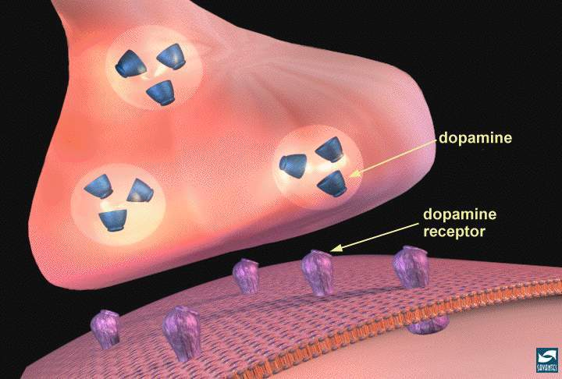
Neurotransmission: focus of medications (e.g., dopamine)
axon terminal
2. Dopamine released from storage vesicles
http://www.nida.nih.gov/Teaching2/largegifs/slide7.gif
3. Dopamine binds receptor
1. Calcium influx
synapse
postsynaptic receptors

Slide 19
The Synapse -- Lock and Key Principle
Axon (a.k.a. Pre-synaptic Neuron)
= flow of neural impulse
= Vesicles
N.T.’s = &
Axonic Terminal Knob
Synaptic Cleft
Re-uptake
Receptor Sites
Post-Synaptic Dendrite of new neuron
Continuation of neural impulse

Slide 20
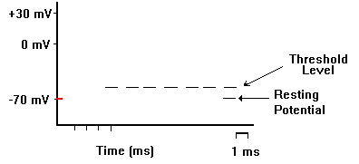
The Neural Impulse – A Demonstration with Hershey’s
Volunteers…
Definition:
the electro-chemical discharge or “firing” of a neuron (a.k.a. action potential).
electrical WITHIN neuron (at axon).
chemical OUTSIDE neuron (at synaptic cleft via N.T.’s & at dendritic &/or axonic cellular membrane via ions)
Components of the “action potential”:
Polarization / depolarization.

Slide 21
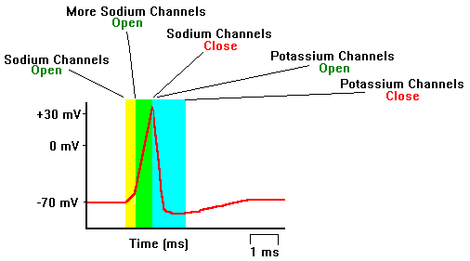
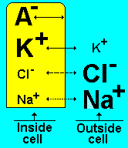
Ions – potassium (K+), sodium (Na+), chloride (Cl-).
Sodium-Potassium Pump

Slide 22
Research Methods

Slide 23
Research Methods for the Brain
Electrical Stimulation Of The Brain:
literally, “touching” the brain w/ an electrical probe.
Brain Damage & Lesions -- Neuropsych.
EEG -- measures electrical (neural) activity only; used for sleep studies

Slide 24
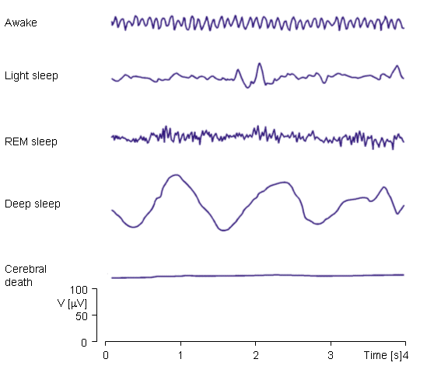

Slide 25
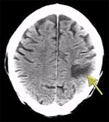
CAT (or CT) Scan -- 3 dimensional image made with X-Rays.
Only 1 perspective
Axial →

Slide 26
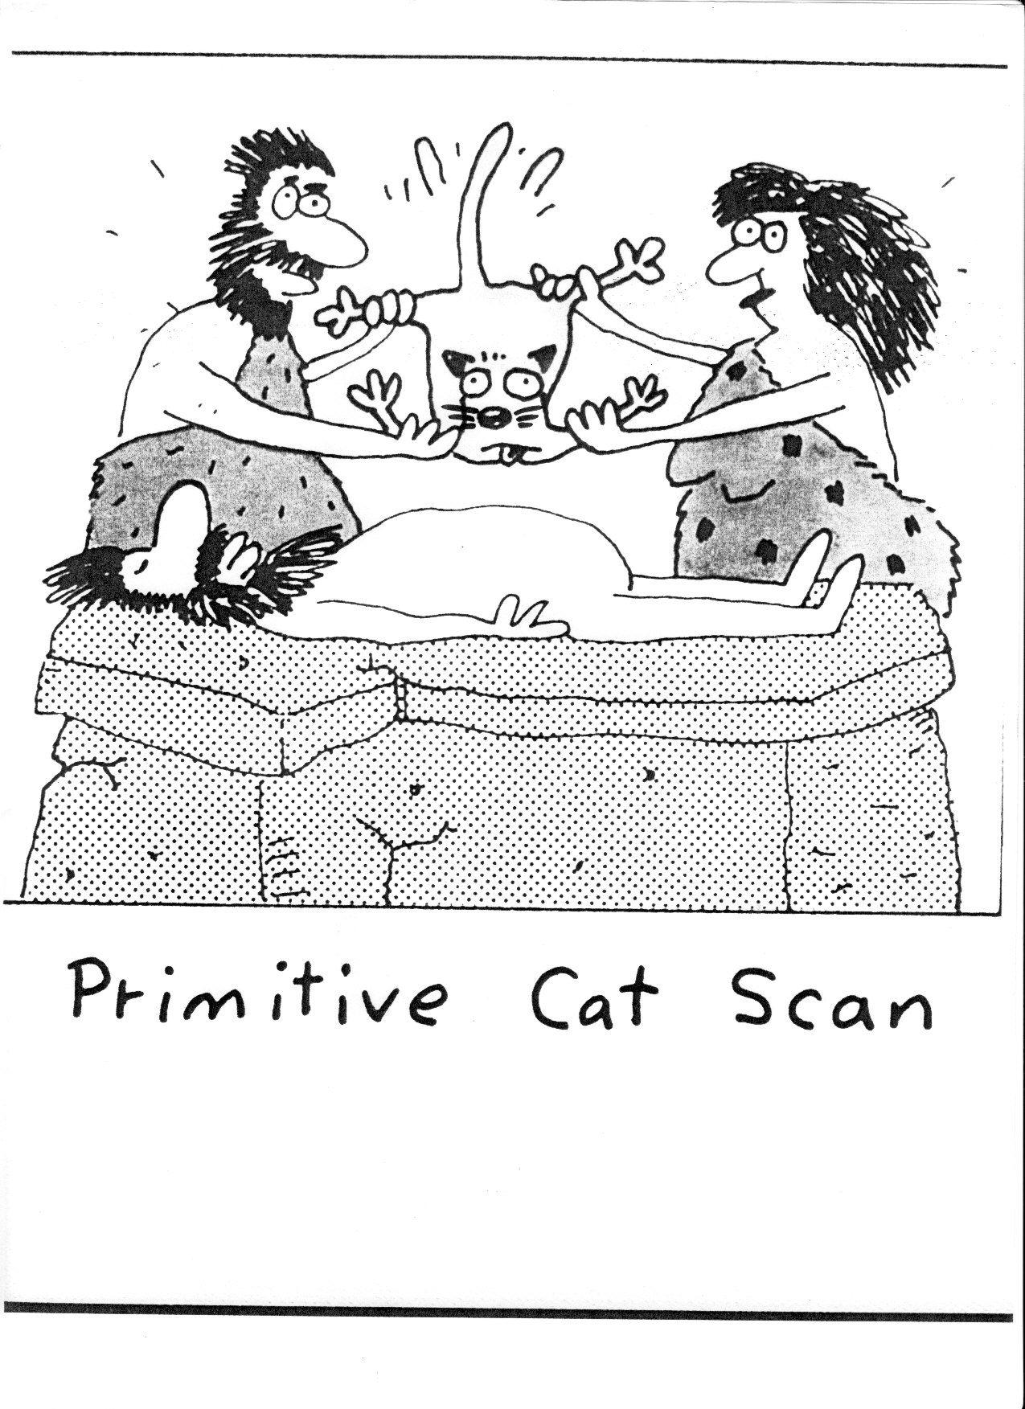

Slide 27
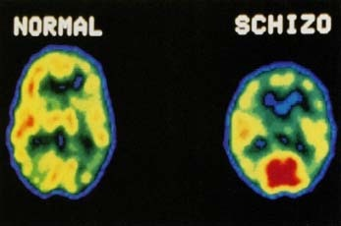
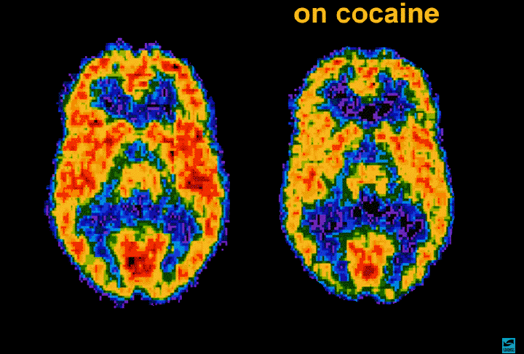
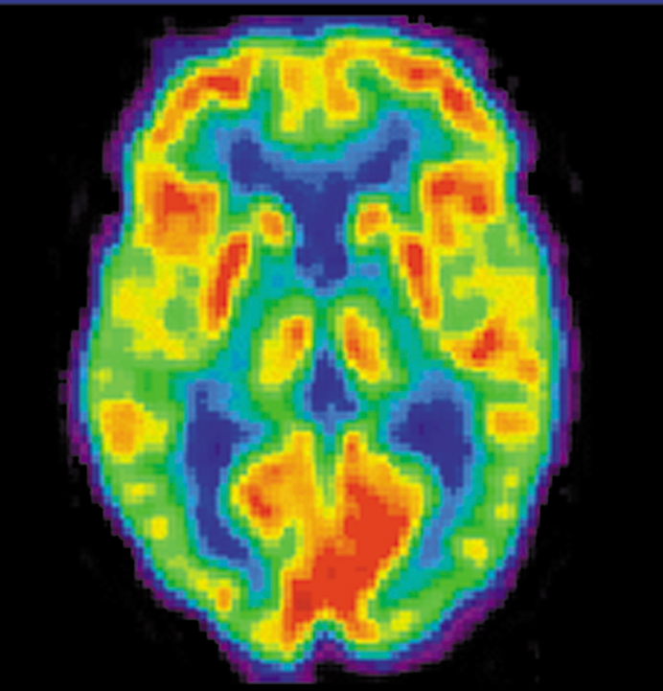
PET Scan -- “colored” metabolic activity.
Inject a low does of radioactive sugar molecules into the blood, and then X-ray it…these will “light” up

Slide 28
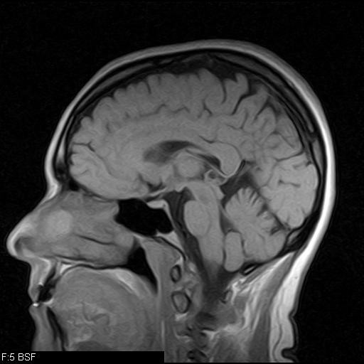
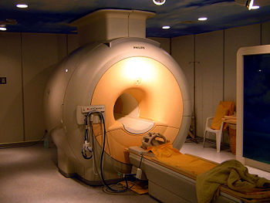
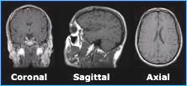
Magnetic Resonance Imaging
MRI -- hydrogen atoms for metab. activity.
Measures tissue density & fluid
Makes use of up/down spin of H atoms which produce a magnetic field capable of absorbing energy & detectable by radio frequencies
Functional MRI (3 dimensional image).
Multiple perspectives
Notes:
How does MRI work? During the exam, a radio signal is turned on in bursts, and the energy is absorbed differently by the different atoms in the body. This energy is reflected out of the body and detected by the MRI scanner. A digital computer constructs these reflections into a picture of the brain. The switching on and off of the device that measures the reflected MR signals (called the gradient coils) produces the knocking sound heard during the exam.

Slide 29
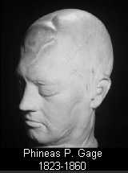
ACCIDENTS!
PHINEAS GAGE
DVD 2-25: Frontal Lobes & Behavior: The Story of Phineas Gage
Follow up: How Phineas Gage Lost It
Some interesting stories…

Slide 30
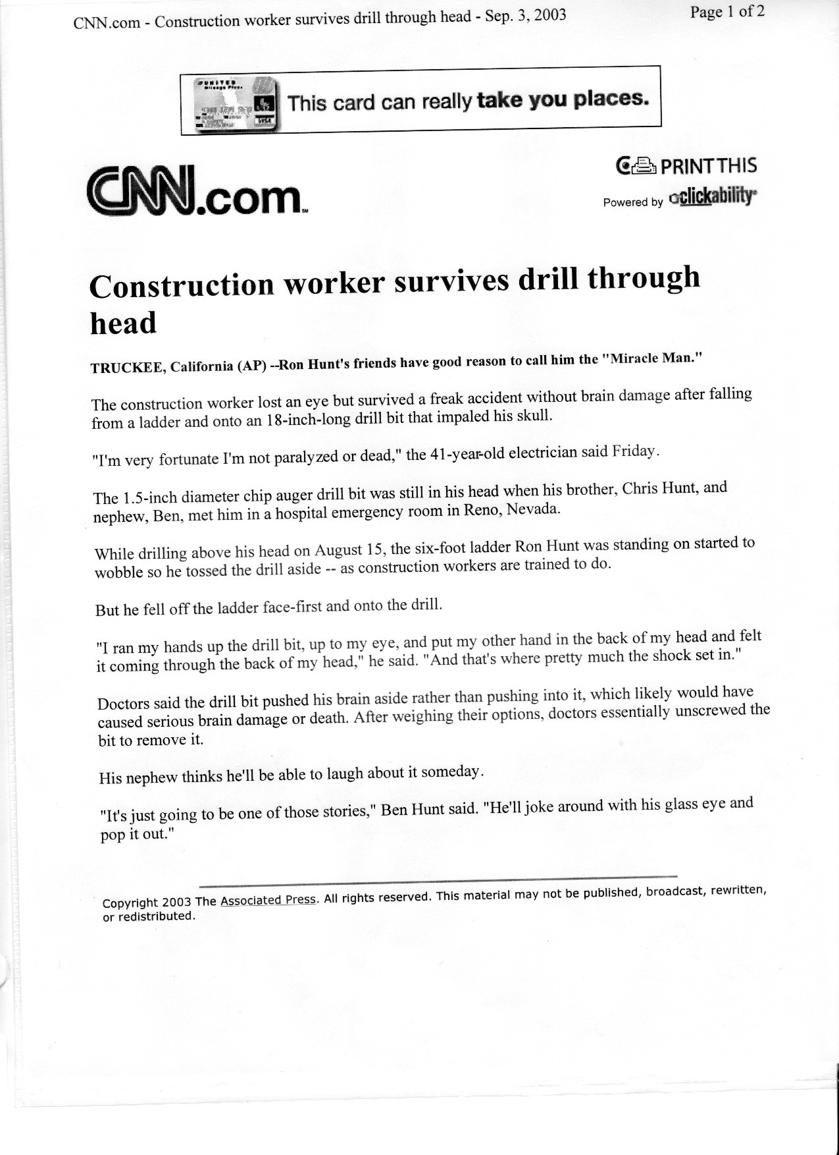

Slide 31
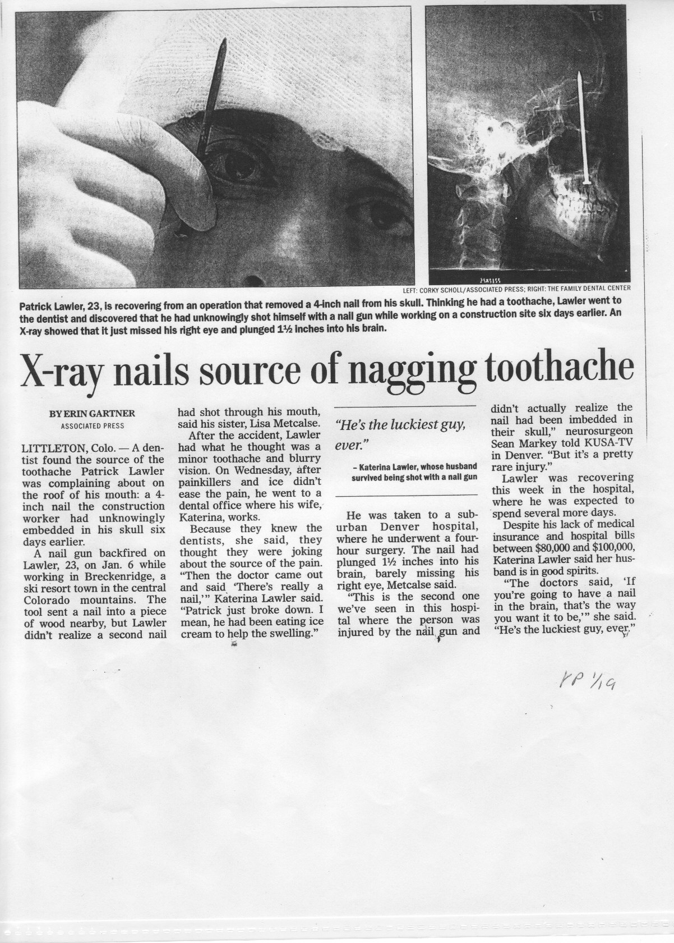

Slide 32
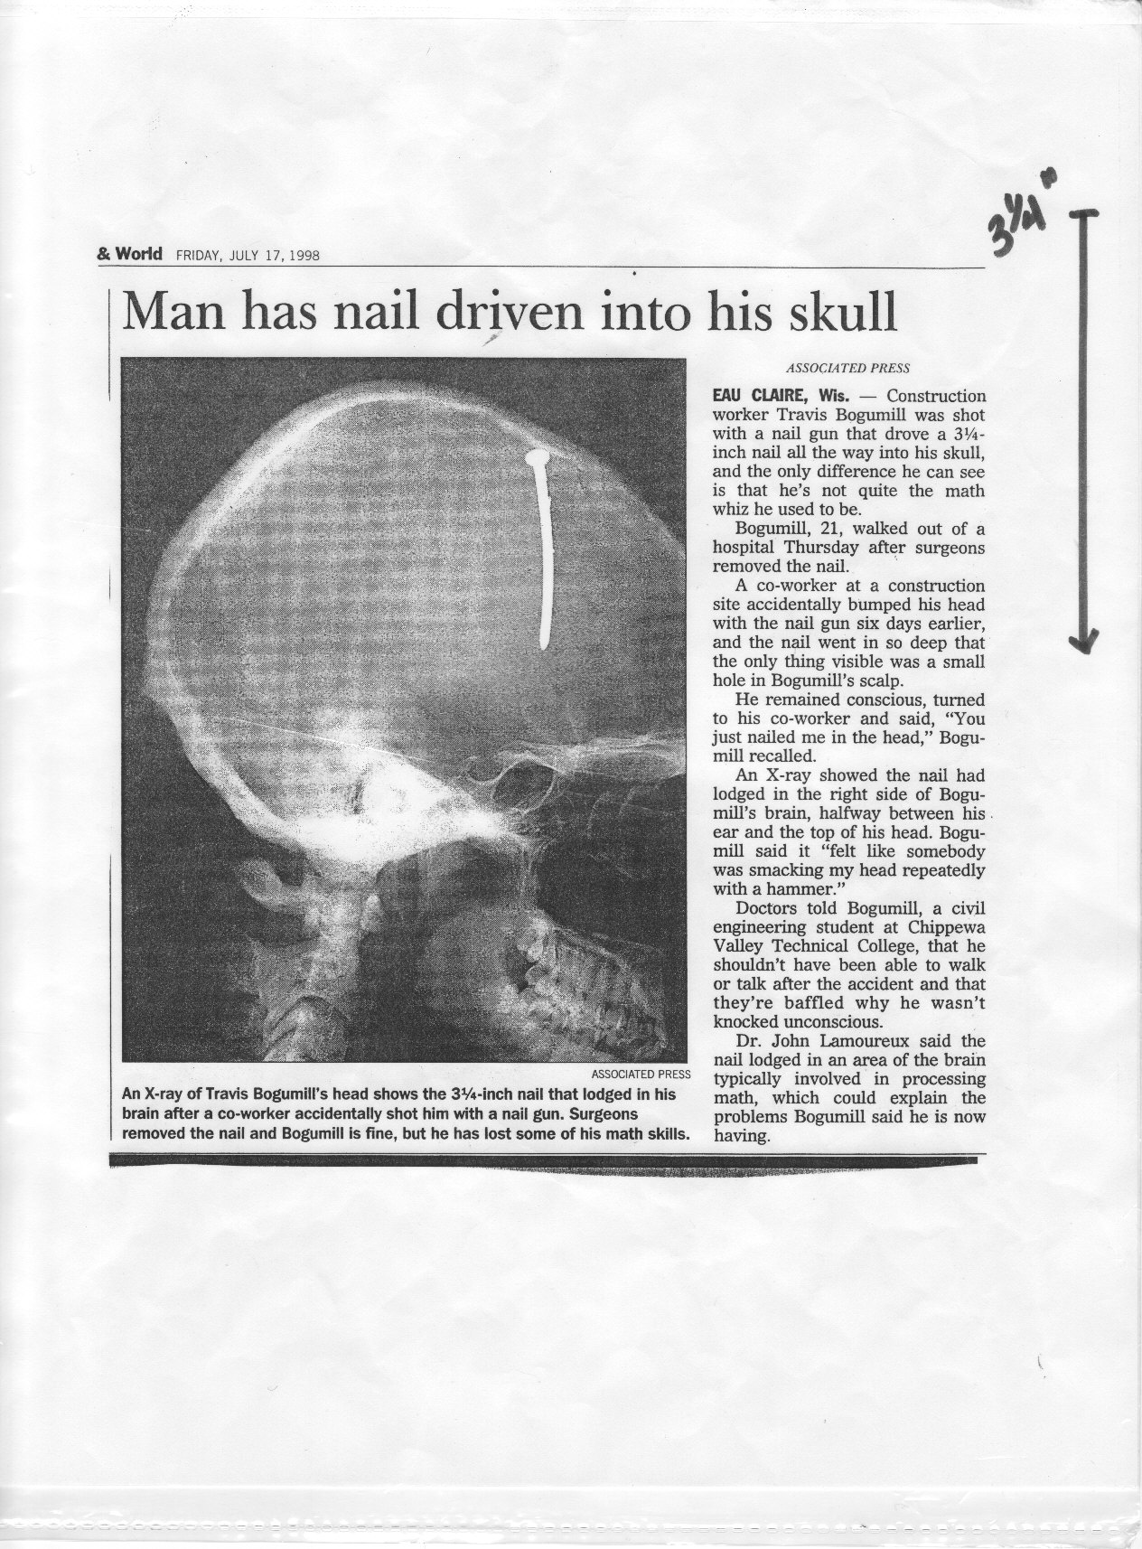

Slide 33
Neurotransmitters
Mouse Party

Slide 34
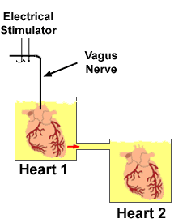
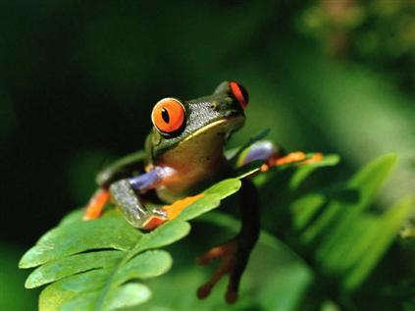

Discovery of NT’s
1921, Austrian Otto Loewi had a dream…
About a frog heart…

Slide 35
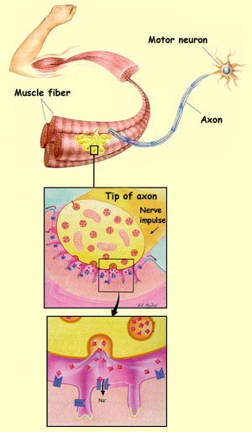
Types of Neurotransmitters & Their Effects on the N.S. (handout)
Acetylcholine (Ach) (excitatory):
the brain’s “memory” & “muscle” chemical.
deficiencies: Alzheimer’s disease.
excesses: muscle spasms.
Various Agonists and Antagonists

Slide 36
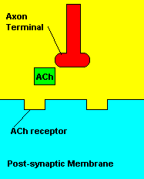
Chemical Weapons: Nerve Agents
Blocks action of AChE
Can’t stop ACh
ACh builds up at synapse
Ach continues to act!
Neuromuscular Effects | Autonomic Nervous System Effects | Central Nervous System Effects
Twitching Weakness Paralysis Respiratory failure | Reduced Vision Small pupil size Drooling Sweating Diarrhea Nausea Abdominal pain Vomiting | Headache Convulsions Coma Respiratory arrest Confusion Slurred speech Depression Respiratory depression

Slide 37
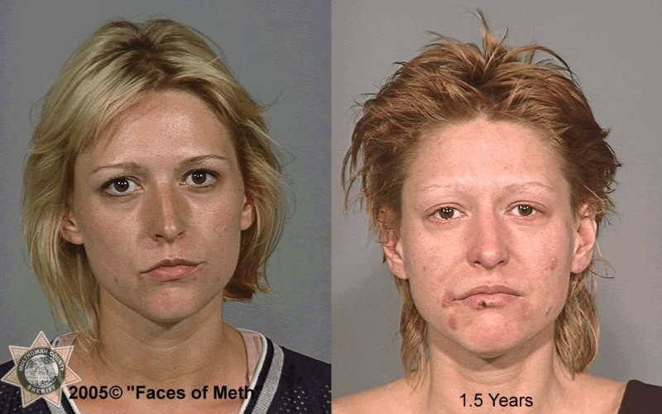
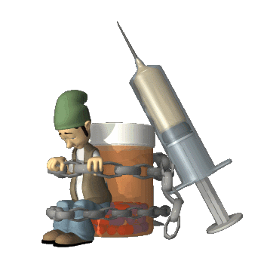
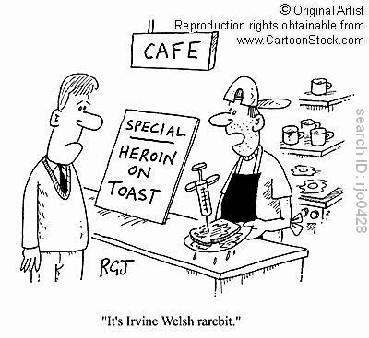
Dopamine! (Excitatory)
Fine movement , emotion, motivation, and feelings of pleasure / euphoria
the brain’s “drug addiction” chemical.
Brain gets used to increased DA levels, if drug is not taken, opposite effects are likely (depression)
Deficiencies: Parkinson’s disease
Cannot execute smooth, controlled movements
Treatment = L-Dopa, synthetic precursor to DA
Excesses: schizophrenia, delusions, hallucinations, addictions.
Interestingly, released when a pleasurable activity is expected to happen
Perhaps it’s more involved with “desire” than pure “pleasure”

Slide 38
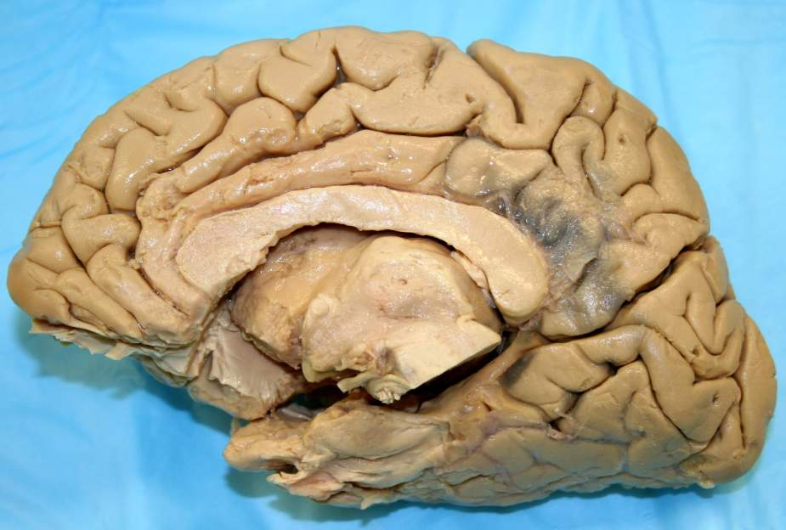
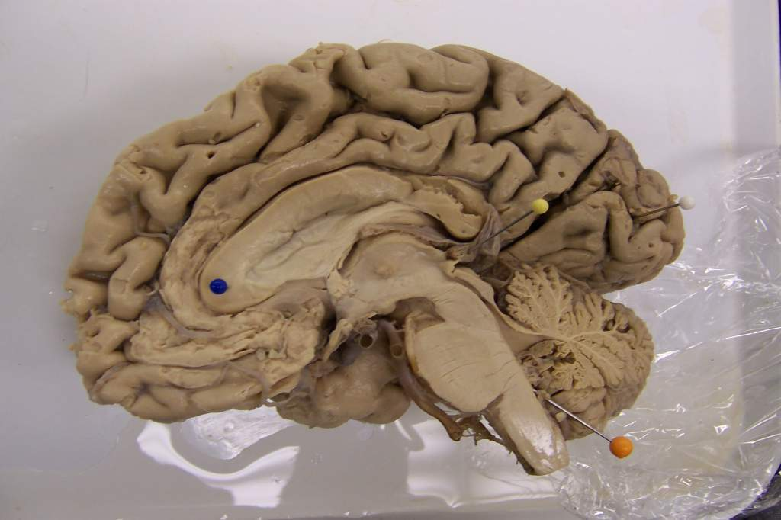
Chemical dependency: injures reward circuitry
Photo by Paul Aravich EVMS
thalamus
Orbital frontal cortex
nucleus accumbens
Ventral tegmental area dopamine

Slide 39

Parkinson’s
Named after James Parkinson, a London physician
He described it as “involuntary tremulous motion” in 1817
For 100 years, though to be an illness of the spinal cord, muscles, and motor regions of the cerebral cortex
1960s – realized it was caused by the death of cells that produce Dopamine
The 1st illness attributed to NT deficiency
DA doesn’t cross the BBB
L-dopa does and it does cross it
Harsh side effects, though: nausea, anxiety, irritability, hyperactivity, dangerous clumsiness, uncontrollable movement, frightening hallucinations
Awakenings (1973) Oliver Sachs

Slide 40
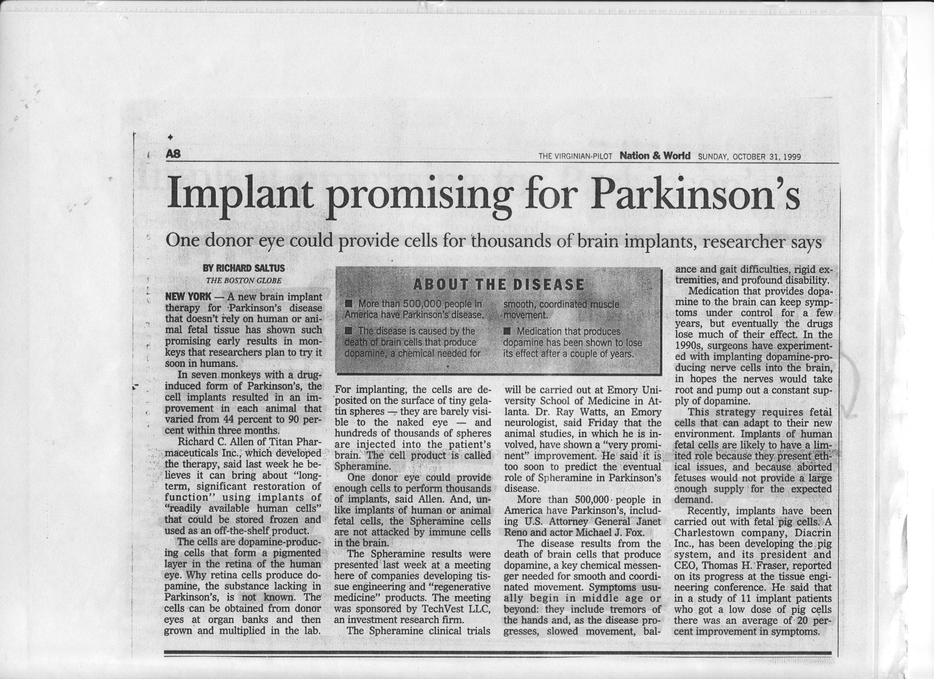

Slide 41

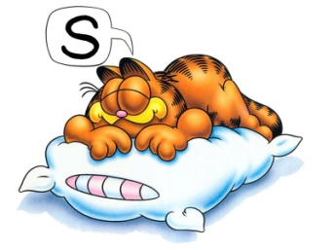
Types of Neurotransmitters & Their Effects on the N.S. (cont’d.)
Norepinephrine (excitatory):
the brain’s “attention/focus” & “mood” chemical.
deficiencies: depression, anorexia, ADHD
Adderall / Strattera (SNERI) increases NE and Dopamine levels
excesses: mania, bulimia, insomnia, ADHD, anxiety, phobias / fears, panic.
It’s like the brain’s own caffeine
NE / E can also be hormones (released directly into the blood)
Serotonin (inhibitory):
the brain’s “sleep” & “mood” & “memory” & “cognition” chemical.
deficiencies: insomnia, depression, bulimia, ↓ pain tolerance, PMS, OCD, anxiety, panic attacks, ADHD.
excesses: hyper-somnia, ↑ pain tolerance, anorexia.

Slide 42
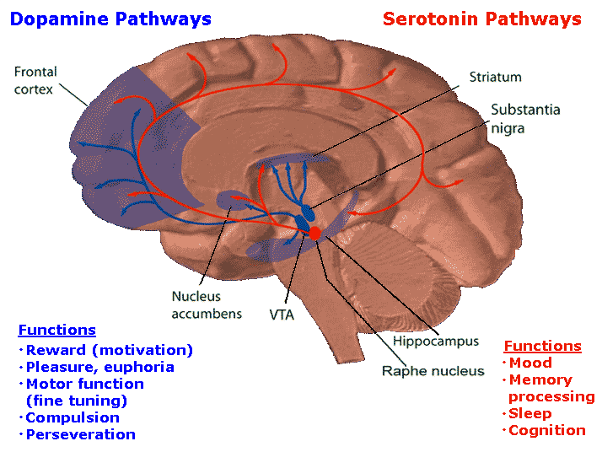

Slide 43
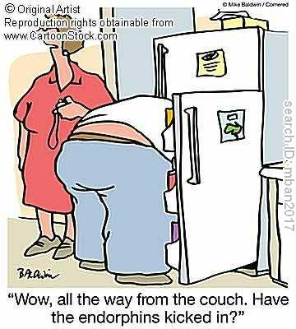
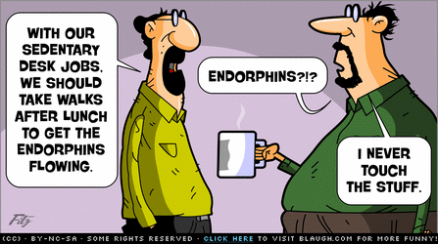
Types of Neurotransmitters & Their Effects on the N.S. (cont’d.)
Endorphins (inhibitory):
the brain’s “heroin” & “pain-killer” chemical.
100 times MORE addictive than heroin (disinhibit dopamine path)
deficiencies: insomnia, depression, ↓ pain tolerance, PMS, anxiety.
excesses: hyper-somnia, ↑ pain tolerance, mood elevator, “muscle buzz”, “runner’s high”.
Literally = “endogenous morphine” (1975)
The Mind 1:5: Endorphins: The Brain’s Natural Morphine

Slide 44
GABA (inhibitory) -- Gamma Amino Butryic Acid:
the brain’s “anti-anxiety”, “muscle tone” chemical.
deficiencies: anxiety dis-orders, depression, phobias, nervousness, panic attacks.
excesses: listlessness, serenity, drunkenness.
THE MAIN INHIBITORY NT OF THE BRAIN
Produce more flow of Cl- into cell or K+ out…causes hyperpolarization, meaning less likely to fire
HOWEVER, latest research shows it has some excitatory effects in certain areas (hippocampus) in early developmental times.

Slide 45
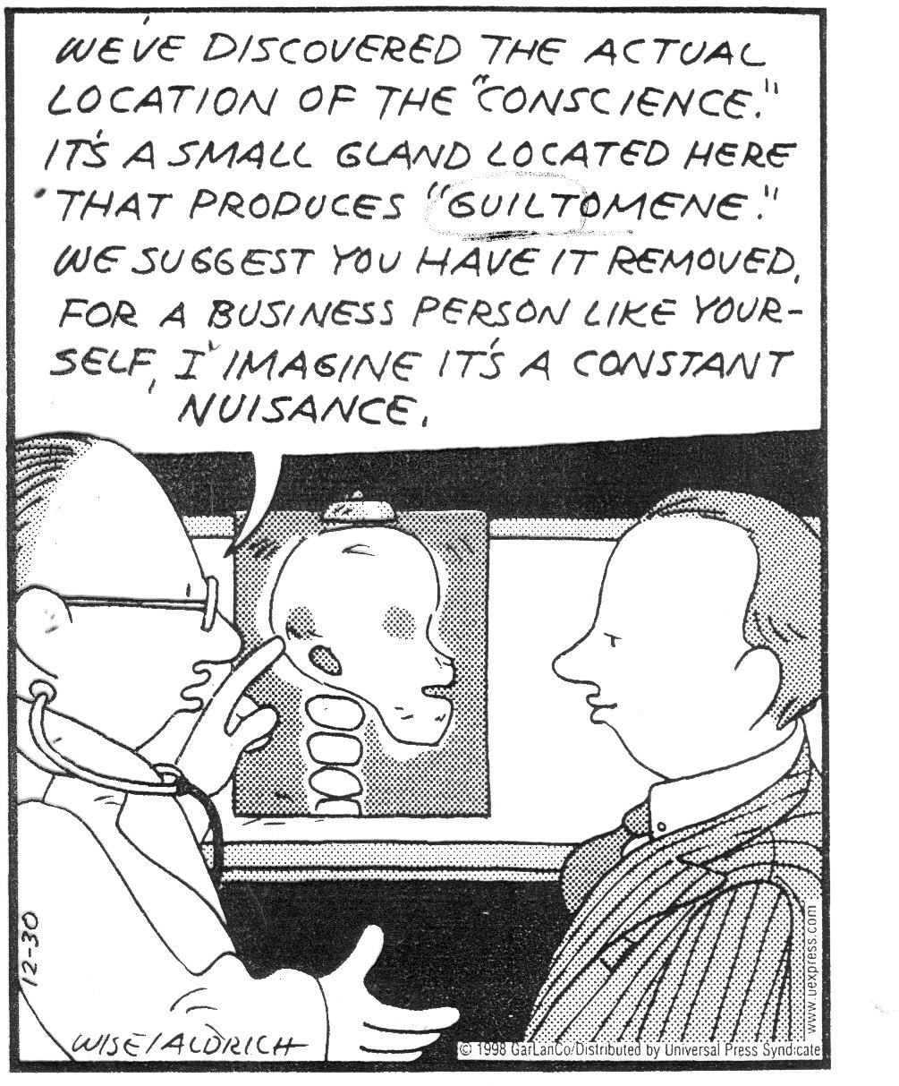
DOCTOR
LAWYER

Slide 46
Acetylcholine - appears to play an important roll in cognitive function, especially memory.
Dopamine - is the brains natural energizer and used for mental focus.
Norepinephrine - is also a stimulating neurotransmitter providing mental and physical energy and can also create anxiety.
Epinephrine - is a excitatory neurotransmitter involved with allertness and mental focus.
Serotonin - relaxes the mind and instills a sense of emotional well being, it is our natural mood stabilizer and sleep promoter, our natural Prozac. It also helps with anxiety migraines and insomnia.
Gamma amino butyric acid (GABA) - is our major inhibitory neurotransmitter. Deficiencies can cause anxiety and tremours to name a few.
Endorphins - are the bodies natural pain killers.
Glutamate - is the most abundant excitatory neurotransmitter in the brain. Glutamate malfunction is involved with parkinson's disease, alzheimer's disease, tourette's syndrome and vascular dementia.
Phenylethylamine (PEA) - is involved with energy and mood elevation. Low levels are involved with ADD and ADHD while elevated levels are associated with schizophrenia.
Notes:
http://www.custommedicine.com.au/brain-function/

Slide 47
Neuromodulators
Inc or dec the sensitivity of neurons to receive NTs
Schizophrenia and smoking tobacco are highly correlated
We think it’s self-medication, b/c
Nicotine is a negative neuromodulator for DA in schizophrenics

Slide 48
The Nervous System

Slide 49
The Human Nervous System:
Human Nervous System
Central Nervous System
Peripheral Nervous System
Brain
Spinal Cord
Autonomic N.S.
Somatic N.S.
Sympathetic N.S. (mobilizer)
Parasympathetic N.S. (replenisher)
Common goal = homeostasis

Slide 50
Afferent vs. Efferent Neurons
Sensory or Afferent Neurons
Collect signals from sense organs/body & transmit impulses to the CNS
Motor or Efferent Neurons
Transmit impulses away from the CNS and toward glands/muscles (E for EXITS the brain)
Interneurons
Transfer messages from one neuron to another (Sensory to Motor) within the CNS
Reflexes make use of these

Slide 51
Human Nervous System
Central Nervous System
Peripheral Nervous System
Autonomic N.S.
Somatic N.S.
Peripheral = messages to and from CNS
Somatic = Skeletal = voluntary movement of skeletal muscles

Slide 52
Autonomic N.S.
Sympathetic N.S. (mobilizer)
Parasympathetic N.S. (replenisher)
Autonomic = Automatic stuff
Heartbeat
Digestion
Glandular activity
Sympathetic = arousal = “fight or flight”
Parasympathetic = back to normal

Slide 53
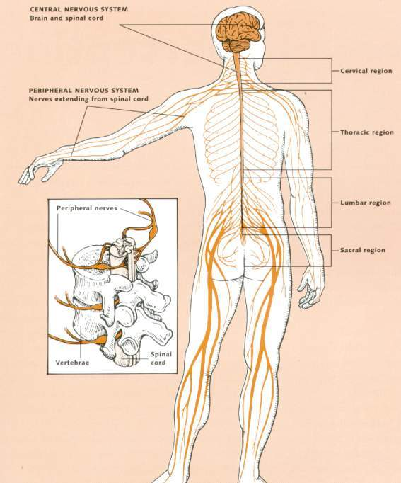
Cranial & Spinal nerves
12 pairs of Cranial nn
31 pairs of Spinal nn
What’s up with the arm pit?
Brain Facts. Society for Neuroscience, 1997, p. 11

Slide 54
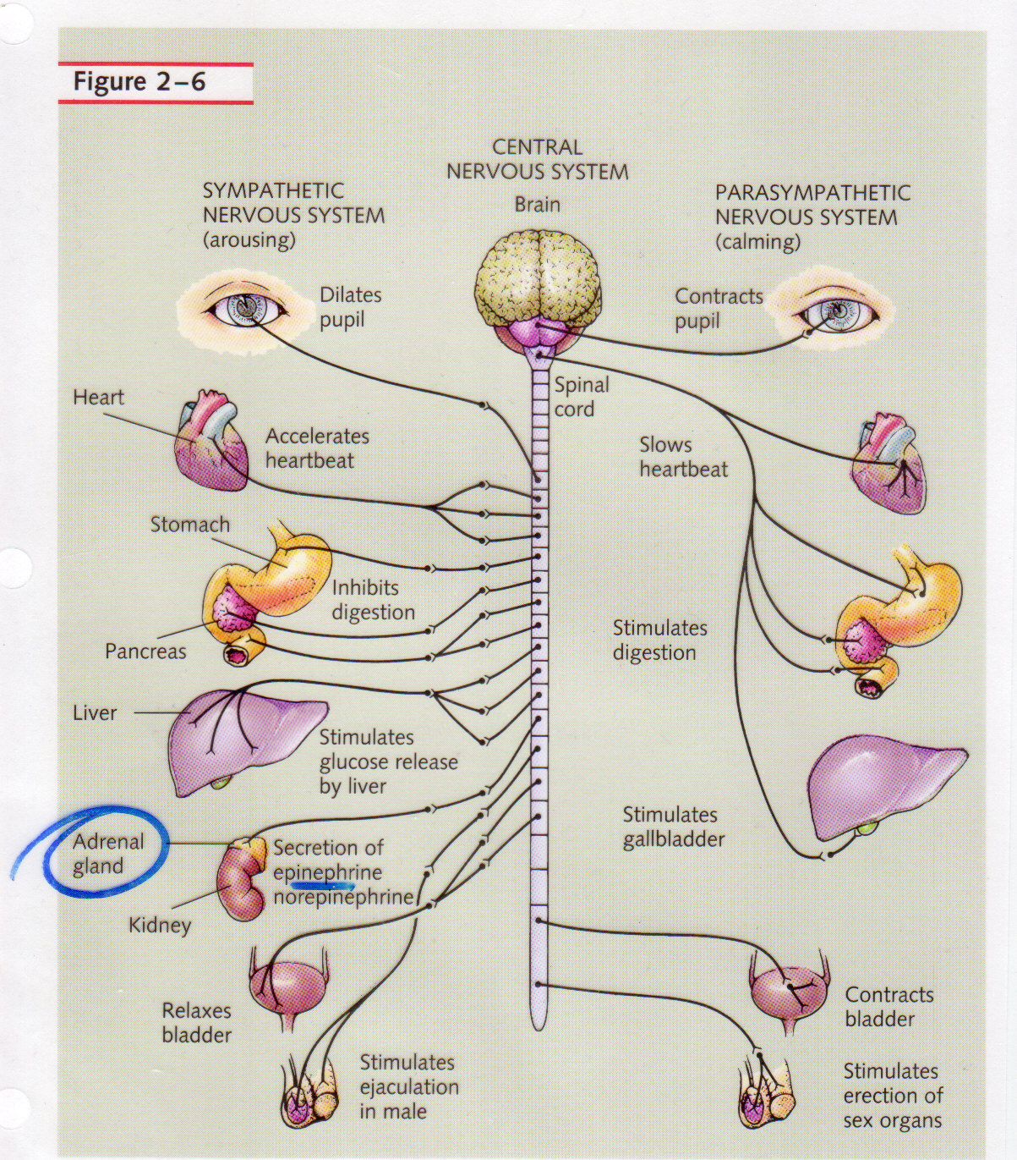
That’s why when you’re really scared, you have an “accident” ☹

Slide 55
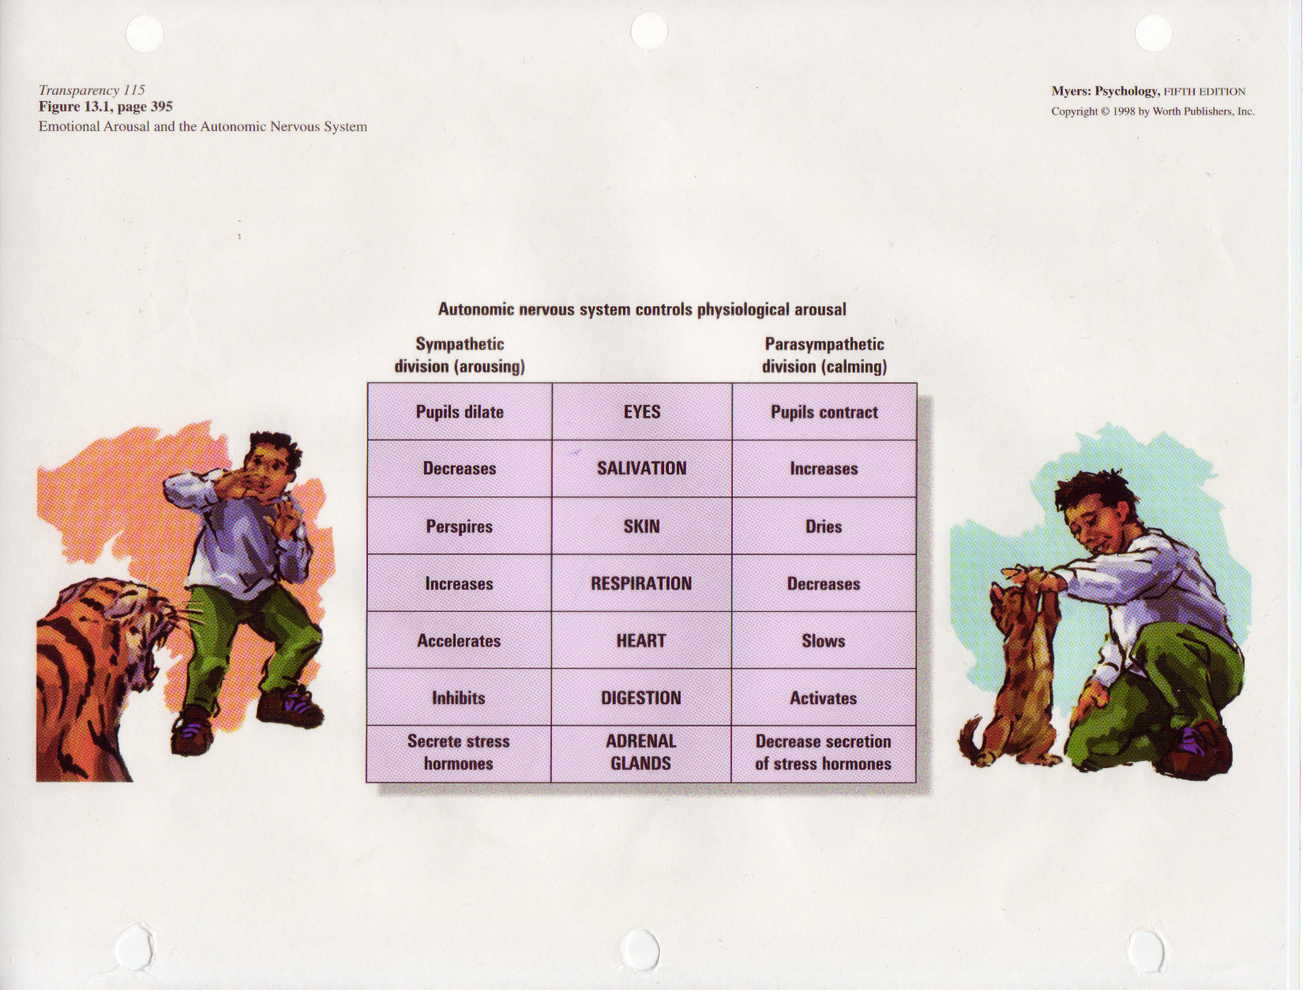

Slide 56
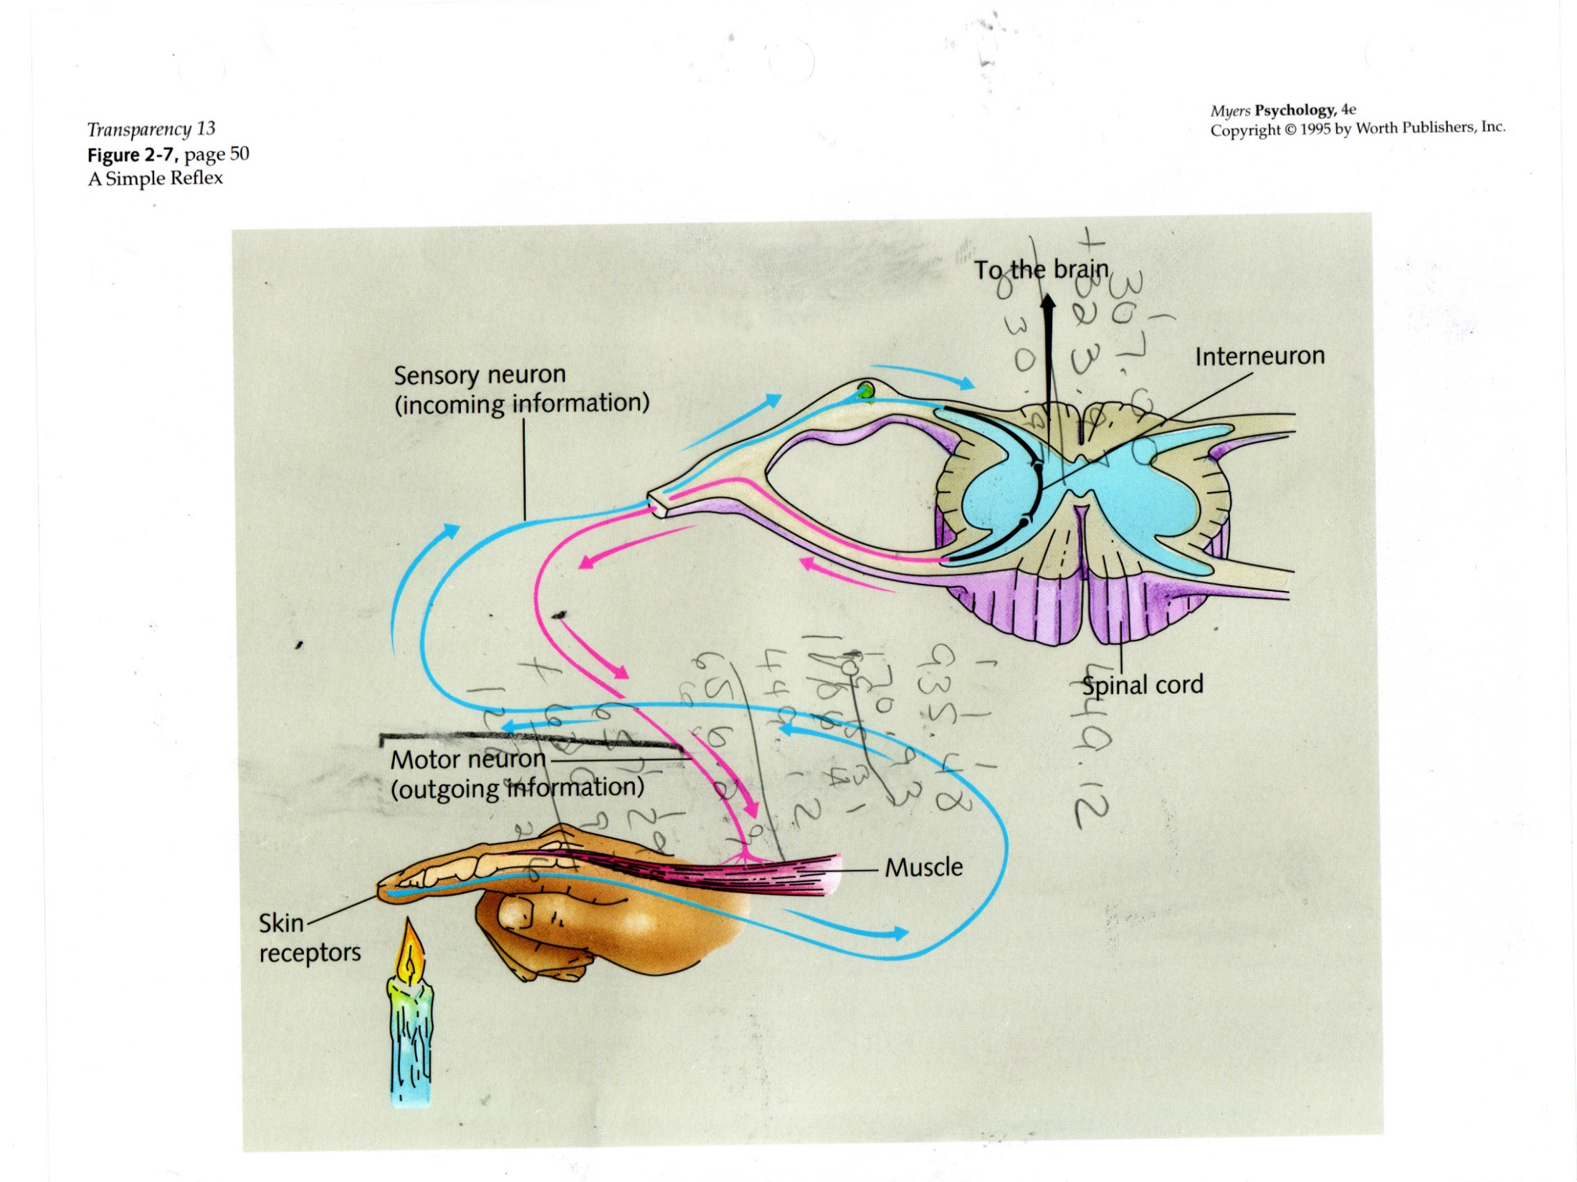

Slide 57
The Brain

Slide 58
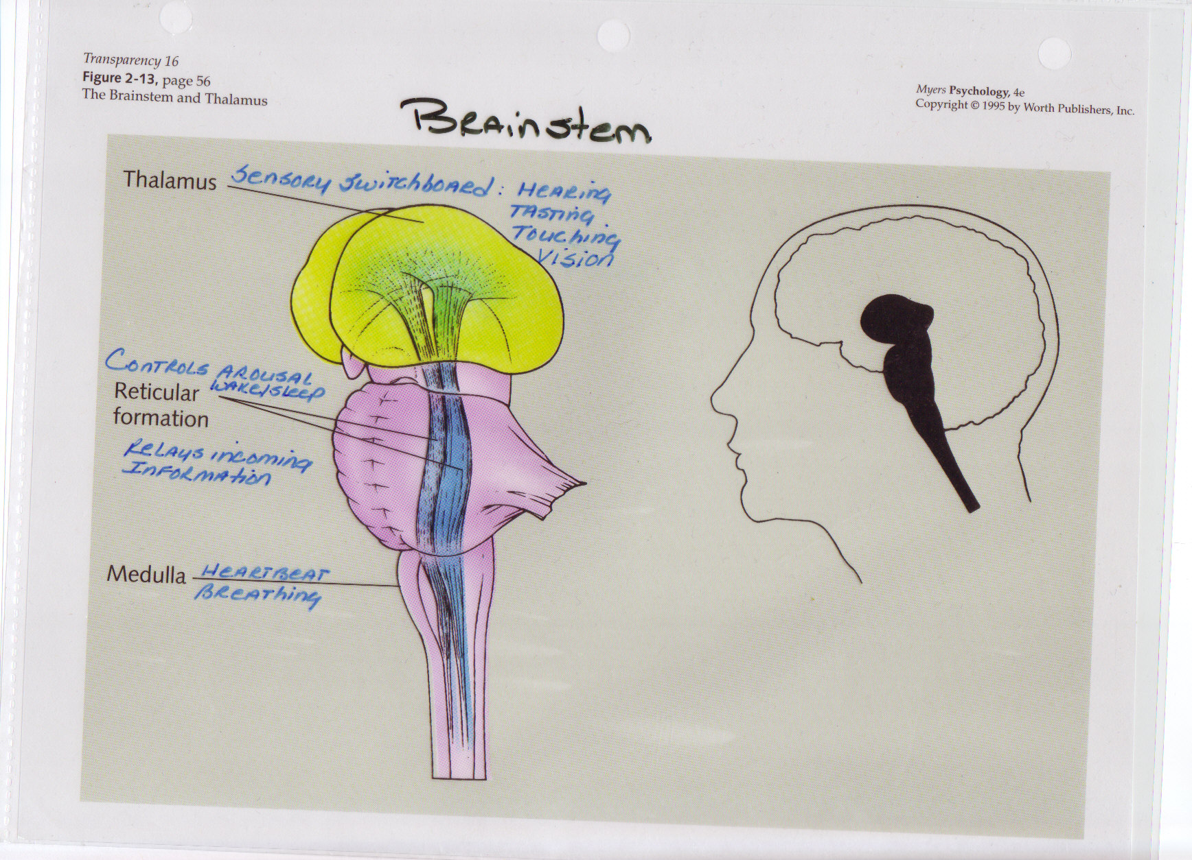
Brainstem – Biologically Old
Reticular Formation Controls Sensory Processes
Especially movement of the eyes
Coordinates reflex reactions to visual and auditory stimuli

Slide 59
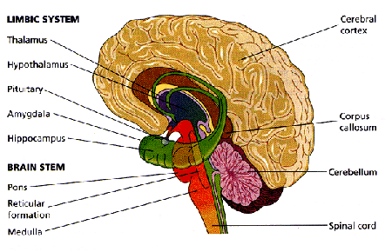
Pons
relay of info from cerebrum (cerebral hemispheres) (motor) and spinal cord (sensory)
Respiration, taste, sleep

Slide 60

Pinky & THE BRAIN!!!

Slide 61
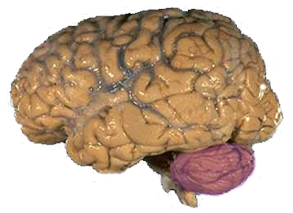
Cerebellum
Cerebellum = “little brain”
Coordination of motor activity, posture
Why can’t we tickle ourselves…article

Slide 62

Parts of the Brain
Medulla Oblongata – The Waterboy
Notes:
http://www.youtube.com/watch?v=RPDbDys7akQ (start at 3:30)

Slide 63
Limbic System
Amygdala
Hippocampus
Hypothalamus

Slide 64
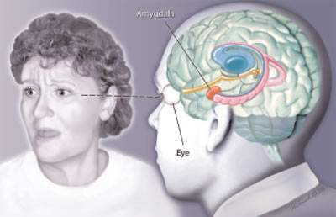
Amygdala: attaches emotional significance to events: PTSD
Hippocampus proper
Projects directly & indirectly to hippocampus to enhance memory for emotional stimuli
Reading Faces, Brain Briefings. Society for Neuroscience http://web.sfn.org/content/Publications/BrainBriefings/reading.html#fullsize

Slide 65
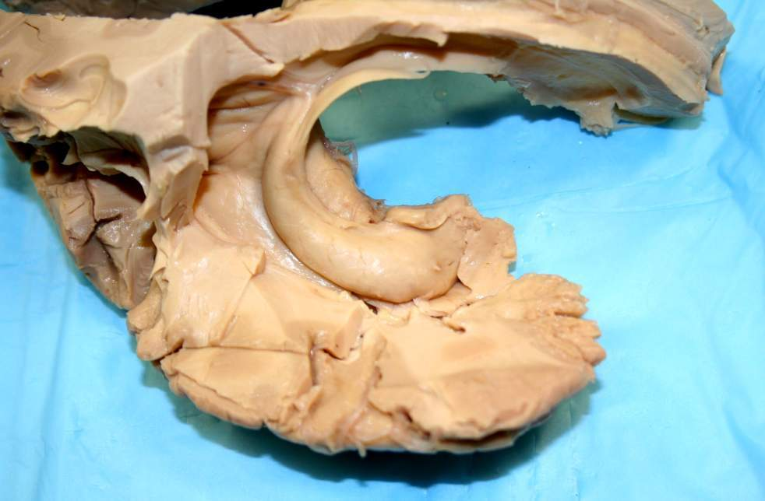
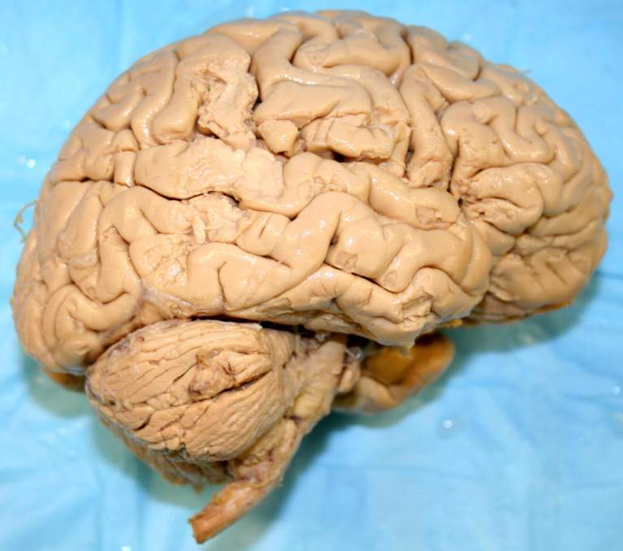
+
Amygdala
Posterior
Anterior
Photo by Paul Aravich EVMS
Right amygdala
Right hippocampus proper

Slide 66
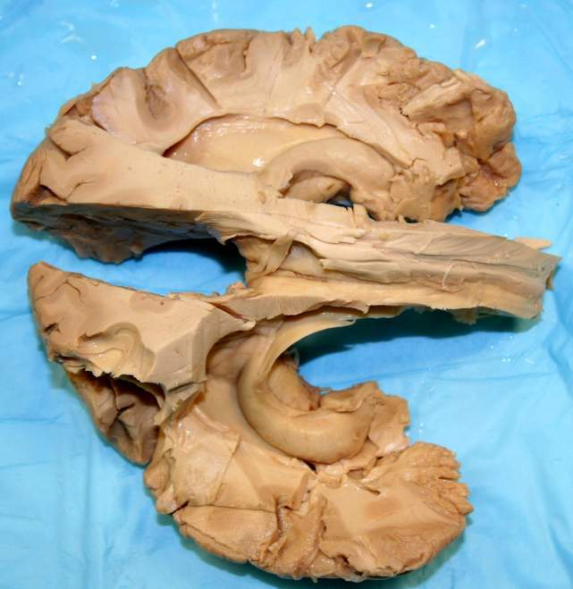
Amygdala
Left hippocampus proper
Left amygdala
Posterior
Anterior
Superior view w/ most of brain removed
Right amygdala
Right hippocampus proper
Photo by Paul Aravich

Slide 67
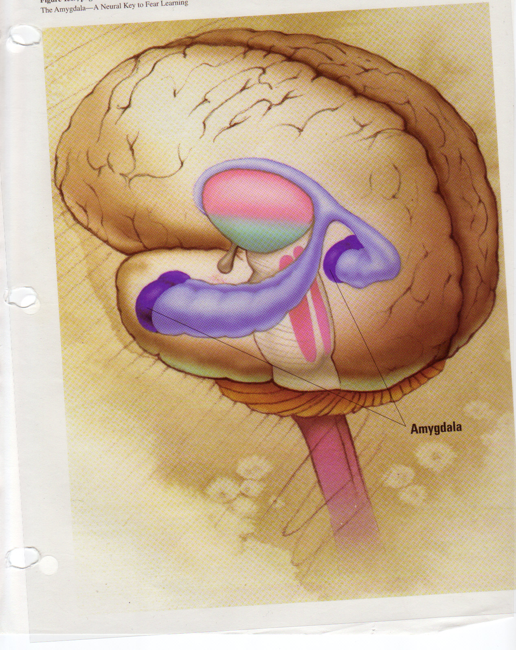

Slide 68
Learning/memory problems: Hippocampal formation
Posterior
Anterior
hippocampus
Photo by Paul Aravich EVMS
Temporal lobe: “The thumb of the cortical boxing glove”

Slide 69
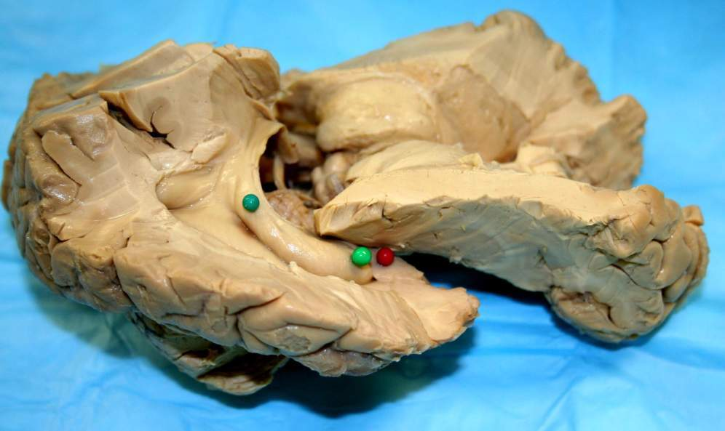
Hippocampus most of brain removed
Photo by Paul Aravich EVMS
Posterior
Anterior
Right amygdala
Right Hippocampus proper
Lateral view

Slide 70
+
Posterior
Anterior
Photo by Paul Aravich EVMS
Right hippocampus proper
Lateral view

Slide 71
Hippocampus
Left hippocampus proper
Posterior
Anterior
Superior view w/ most of brain removed
Right hippocampus proper
Photo by Paul Aravich

Slide 72

The case of “Clive Wearing” – video (you tube or Mind 10,11) or HM

Slide 73

The Lobes of the Brain

Slide 74


Slide 75

Sensory ←Cortex

Slide 76
FRONTAL = higher order thinking
Includes motor cortex
PARIETAL = includes sensory cortex
TEMPORAL = auditory (from opposite ear)
OCCIPITAL = visual (from opposite visual field)

Slide 77


Slide 78

Challenging behaviors: damage to Prefrontal cortex separates us from the animals
Beardsley Scientific American 1997 August, p. 80
Executive functions
Impulse control
Social withdrawal

Slide 79


Slide 80

http://www.woodrow.org/teachers/bi/1991/homunculus.html
If you want: Experiment: http://www.woodrow.org/teachers/bi/1991/homunculus.html

Slide 81

Motor Cortex
Probe the Motor Cortex

Slide 82


Slide 83
Forgotten cells: glial cells = GLUE
Many more glia than neurons
Myelinating cells (make white matter)
CNS: Oligodendroglia cells
Peripheral nervous system: Schwann cells
Microglia
technically not glia; more similar to macrophages, developmentally
respond to injury; can make original insult worse
Astrocytes: protoplasmic in gray matter; fibrous in white matter
also respond to injury; can make original insult worse
Various other functions
Ependymal cells (help make CSF): adult stem cells?
Radial glia developmental guidance factors

Slide 84
Brain cancer: Gliomas
Account for about
40% of all brain tumors and
77% of all malignant brain tumors
Types, e.g.
Astrocytoma 35% of brain tumors
-most common glioma
-high grade astrocytoma: Glioblastoma multiforme
-Glioblastoma: most common adult malignant brain tumor
Oligodendroglioma 4% of all brain tumors
Ependymoma 2% of all brain tumors
http://www.cancer.org Am Cancer Soc. What are brain and spinal cord tumors

Slide 85
Language in the Brain

Slide 86

Language – Broca’s & Wernicke’s Areas
AWESOME website explaining language in the brain
Pronounced after Hearing it
Auditory cortex
Wernicke’s
Recognized as a word associated with its corresponding auditory form
Broca’s
Syntatic structure / articulation plan
Motor Cortex
Makes muscles of mouth / larynx produce spoken word
Pronounced after Reading it
Primary Visual Cortex
Angular Gyrus
Categorize, conceptualize, draw connections among various characteristics of object
It names an object / reads it name / retrieves meaning of word
Wernicke’s
Broca’s
Motor Cortex

Slide 87


Broca’s Aphasia
Biggest thing: Trouble producing language, both reading / pronouncing, but can understand it.
Trouble distinguishing object from the subject
The student is congratulated by the teacher.
Nonetheless, understanding of language is generally good.
Wernicke’s Aphasia
Biggest thing: Reduces understanding of language, both written and spoken
Can read smoothly “Place object A on top of object B” just fine, but don’t understand what is being asked of them.
Broca's Aphasia
Wernicke‘s
Gray's Anatomy -- Broca's
CBS Story -- Broca's

Slide 88

Classic cortical language areas: aphasias
Arcuate fasciculus: connects Broca’s & Wernicke’s
Wernicke’s area: left planum temporale on the posterior superior temporal gyrus. Some authors include supramarginal gyrus as shown here
Broca's area: left inferior frontal lobe
Burt. Textbook of Neuroanatomy. Saunders, 1993, p. 469

Slide 89

Language: regardless of handedness on Left side
Anterior
`
Posterior
Photo by Paul Aravich EVMS
Injure: cannot speak but understand (Broca or expressive aphasia)
Injure: cannot understand but can “speak” (Wernicke/ receptive aphasia)
Note Right side: puts emotional tone in language
Note Right side: perceives emotional tone in language

Slide 90

More Videos
Brain Rap (mute on reticular formation)

Slide 91
By Function
Survival
Medulla, reticular formation, pons
Emotions
Limbic system including amygdala, hypothalamus
Sensation
Thalamus, occipital lobe, temporal lobe, parietal lobe, sensory cortex, motor cortex, cerebellum
Cognition
Front lobe, association areas, hippocampus
Language
Broca’s Area, Wernicke’s area, angular gyrus

Slide 92

The Cerebral Hemisphere (Left)
Skull cap
Cerebral Cortex (1-3 mm. thick)
Events of outside world interpreted here.
Occipital lobe (vision)
Frontal lobe (thought)
Temporallobe (audition)
Parietal lobe (tactility)
Behavioral and stress responses begin at cortex.
Motor and Sensory cortices

Slide 93





Left and Right Cerebral Hemispheres
Left hemisphere appears to regulate:
verbal skills, including:
language, reading, writing, speech, mathematical ability, logic (↑ in women).
Right hemisphere appears to regulate:
non-verbal skills, including:
visual-spatial (3-dimensional) abilities, musical and artistic abilities, & visual recognition tasks (↑ in men).
Notes:
The Brain – DVD 1-5: The Divided Brain (6:45)

Slide 94
Left / Right Functioning
Partners!
Whomever is more outgoing, choose A
A = singer!
B = observer & timer!
Directions for A…
Write the Pledge of Allegiance while singing “Row, row”
Directions for B…
Write out your B day schedule while singing “Old MacDonald”

Slide 95


Separated by the corpus callosum
You Tube
Split Brain!
Early Split Brain Research Gazzaniga
Split brain behavioral experiments (this one is the best)
Eyes → LGN (Lateral Geniculate Nucleus) → Primary Visual Cortex in the Occipital Lobe
From LGN to Primary is called Optic Radiation…damage at any point along this = blindness, so we believe this is where conscious visual perception must take place

Slide 96
A Demonstration of Split Brain
2 Volunteers
Left Brain / Right Brain
Criss-Cross inside arms
Which should be allowed to talk?
Goal: Tie Shoes
Let’s sever the connection a bit...
Blindfold!
Now, let’s sever it entirely…
Now, no talking

Slide 97
Some Facts & Theories about Handedness...
10% of pop is left-handed (slightly more among males)
9 of 10 fetuses (ultrasound) suck their right hand thumb
2/3 babies lie to with their heads turned to the right
Of these head right babies, after 5 months, almost all will reach for things with their right hand

Slide 98

The Most Current Findings:
Parents’ handedness
Right handed parents = 92-96% of their children are right-handed
Left handed parents = 45-50% of their children are left-handed
1 left, 1 right = 80% of children right handed
What about our class…
How many lefties?
How many of your parents were lefties?
Parents DO NOT = genes, though! Observational learning could cause these figures

Slide 99

Summarizing the Article’s Findings
BUT, adopted children are more similar to biological parents
ID TWINS vs. Fraternal TWINS…uh-oh, no differences…20-30% of twins have 1 left, 1 right…
What do you think????
Perhaps twinning itself then contributes to handedness?!!!

Slide 100
More Left Handednes
95% of right-handers process speech on the left side of brain
50% of left-handers process speech on left side
25% of left-handers process speech on the right
25% of left-handers process speech equally
Deaf People and Aphasia

Slide 101
Stuttering
Stuttering -- Purdue University
The Stuttering Foundation
fMRI reveal extra gyri in Temporal Lobe
Part of Wernicke’s area larger (left planum temporale)
Normall, we have asymmetry between lobes
Actually, it’s the MOST asymmetrical feature of brain (starts at 31 weeks after gestation).
Function → “location of sounds in space”
So, Stuterrers have more symmetry
2 Explanations:
1) Right side making up for deficiency in left side
2) Right side is competing with left side, causing there to be confusion
But, is this just the right side compensating?
Chimps also have leftward asymmetry, but other primates do not…so, maybe they’ve got language?
Dyslexia
Rightward asymmetry (right side bigger) correlated with dyslexia
Notes:
http://health.howstuffworks.com/alien-hand.htm/printable

Slide 102
Phantom Limb Syndrome
Moving Images #4
Thalamus has a body map, each part is represented. Conserves a memory of missing body part. These cells that used to direct responses to the part become “unemployed” and start to fire abnormally, which is interpreted as pain.
Alien Hand Syndrome
Dr. Strangelove
Tourette’s Syndrome
California Department of Education
Notes:
http://health.howstuffworks.com/alien-hand.htm/printable

Slide 103
The Endocrine System
http://biology.clc.uc.edu/courses/bio105/endocrin.htm

Slide 104
The Parts…
Hypothalamus
Pituitary Gland
Thyroid & Parathyroid Glands
Adrenal Glands
Pancreas
Gonads: Ovary, Testes

Slide 105
Hypothalamus
The GOVERNOR of the endocrine sys
Directs activities
Hunger, thirst
Body temp.
Aggression
Sexual behavior

Slide 106
Pituitary Gland
Produces the largest # of hormones
AKA Master gland
Found under the brain, connected to the hypothalamus

Slide 107

Thyroid / Parathyroid Glands
Thyroid
Produces thyroxin, which regulates metabolism
http://www.thyroid.org.au/Information/disorders.html
Parathyroid
Controls calcium in the blood & tissue

Slide 108
Adrenal Glands
Fight or Flight gland
Produces epinephrine and norepinephrine
Hormone if directly into the blood stream!

Slide 109

Pancreas – Diabetes
Insulin and glucagon have the opposite effect
Insulin stimulates the storage of the energy you just ate, so your blood sugar doesn’t get too high
Glucagon stimulates the breakdown of the energy you have stored, so your blood sugar doesn’t get too low (during the times when you are not eating)

Slide 110
Gonads
Masculine hormones:
Testosterone
Feminine Hormones:
Estrogen
BOTH males and females produce BOTH hormones!!!
Tesosterone
Males: 6-8 mg/day
Females: 0.5 mg/day
Brain differences??? NO!
Mating Behaviors in Rats

Slide 111
Pineal Gland
Pea-sized!, near the limbic system
Regulates melatonin in the blood
In darkness, pineal gland releases melatonin (sedative properties)
SAD: too much melatonin in the blood

Slide 112


Slide 113
Can we grow more brain cells and become smarter?
http://www.pbs.org/saf/1302/video/watchonline.htm
Grow Your Own Brain

Slide 114
Key Point: Plasticity
7. BRAIN – Brain Anomaly and Plasticity: Hydrocephalus Hydrocephalus, a childhood disorder of excess fluid in the brain, illustrates brain plasticity — the brain’s amazing ability to rebound after injury. While patients with this disorder experience compression and destruction of brain tissue early in life, many are able to function normally later in life, after their brains have compensated for the loss.

Slide 115

Subdural bleed: most common intracranial bleed
Dura mater
Photo by Paul Aravich EVMS
Anterior
Posterior

Slide 116
Causes of TBI
Falls 28%¹ Major issue for people w/ disabilities
Vehicles 20%¹
Assaults 11%¹ including shaken baby syndrome
Firearms 10%²
#1 leading cause TBI death- 44% TBI deaths²
2/3 by suicide²
Each relates to children as well as to adults
1http://www.biausa.org/word.files.to.pdf/good.pdfs/generalbraininjuryfactsheet2005.pdf
²http://www.cdc.gov/Migrated_Content/Fact_Sheet/Freeform_Fact_Sheet_(General)/Traumatic_Brain_Injury_updated_May_2004.pdf

Slide 117
Review Activities
Poker & Brain Parts Handout
AP Brainiac Lab
Psych Sim: Hemispherization
Pattern Recognition L/R
SuperHero Assignment
Jeopardy!

