Slide 1
Journal Day
Imagine that you are outside on a clear night in which there are no clouds, and there is a bright FULL MOON. Pretend that on a table in front of you are objects that range in size from a BB to a beach ball as follows:
1. BB 2. Pea 3. Dime
4. Penny 5. Nickel 6. Quarter
7. Golf ball 8. Baseball 9. Softball
10. Small salad plate 11. Large dinner plate 12. Frisbee
13. Basketball 14. Beach ball
Please pretend that you are going to pick one of these things that WHEN HELD AT ARM’S LENGTH JUST COVERS UP THE MOON. Imagine that you are picking one that when you hold it in your hand will JUST BARELY COVER UP THE MOON so that you can no longer see it.
_____ Put the number of the object you chose here.

Slide 2
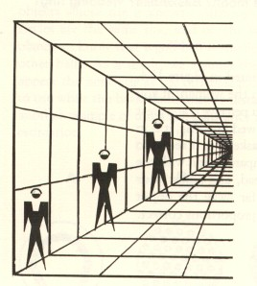
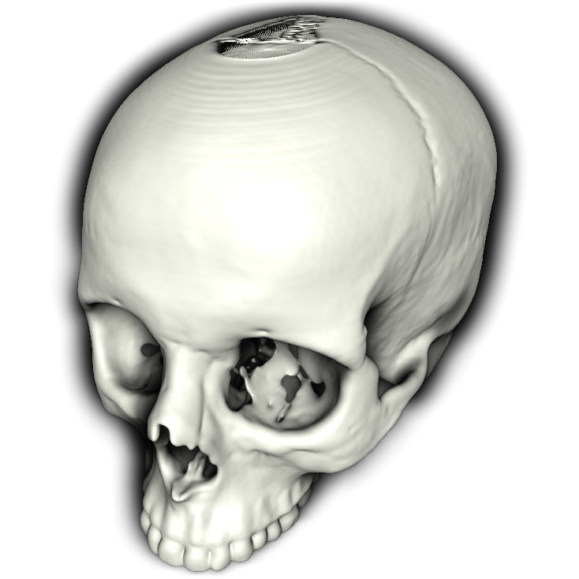
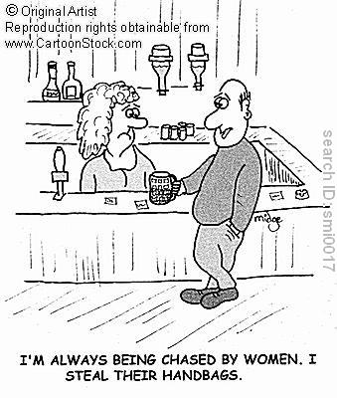

Slide 3
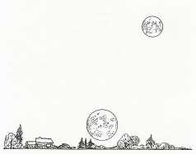
Moon Illusion…
The moon is often judged to be 50-75% larger when on the horizon compared to the high sky
There are no definite answers as to why…we only can say it isn’t the Ponzo illusion
Why not? Airplane pilots report similar effects with no horizontal cues

Slide 4
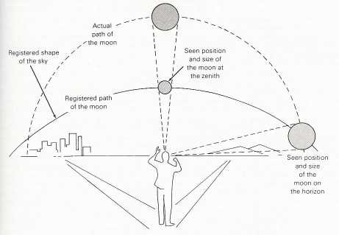
1 worthy hypothesis: The mental-sky dome model: The Moon Illusion
Moon Illusion
Notes:
Our expectation of the earth’s atmosphere is that of a dome (longer at the ends)…therefore when the same retinal image is cast upon our eyes (staright above and on the horizon), we perceive the horizon moon as larger than it actually is because we are adjusting for the perceived increased distance.

Slide 5
Day
Do you believe in any paranormal phenomena?
Ghosts
UFOs (aliens)
Reading people’s minds
Predicting the future
Telepathic communication
WHY?
OR…Have you ever had personal experiences or know of others who have claimed to have had personal experiences with one of these paranormal phenomena?

Slide 6

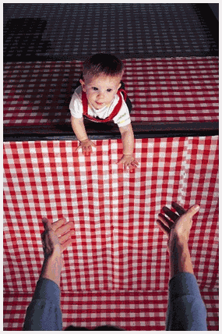
HW Quiz:
Is it a face or a vase? Which term best applies to this “dual” image?
What is this apparatus called? →

Slide 7
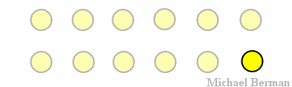
3) If you are in a car staring out the side window (hopefully not while actually driving), what depth perception cue tells allows you to interpret the difference in speed seen in your lower visual field vs. the higher visual field as a sign of depth?
4)

Slide 8

5) In this picture similar to a Necker Cube, what Gestalt principle explains your tendency to see a triangle within this picture?

Slide 9
Some Fun…
Changing Illusions...VOLUNTEERS!!!!
3 Spinning Colors...The Phi Phenomenon with links to all kinds of cool perceptual illusions!
Stepping Feet
Hidden Bird
Necker Cube Illusion; Necker 2
Why is this?
One last afterimage
After Image – Whom do you see?

Slide 10
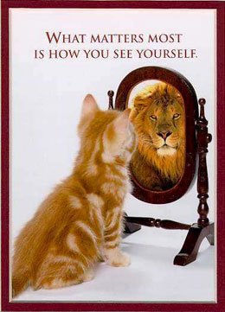
Perception & Interpretation

Slide 11
Selective Attention
We sense 11,000,000 bits of info / s
We are consciously aware of about 40/s
1 cool effect
Cocktail Party Effect – DEMONSTRATE (below)– we can selectively listen to only one voice among many; or we can listen in to 1 ear
3 chairs, 3 volunteers, 2 books
Earphones, selective attention!
Read some passages from the book
Pay attention to info coming into the right ear please.

Slide 12
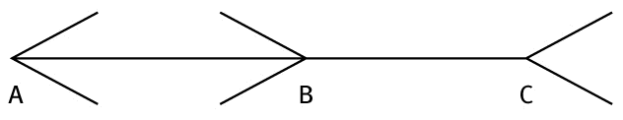
Perceptual Illusions
Café Wall Illusion
Muller-Lyer (below)

Slide 13
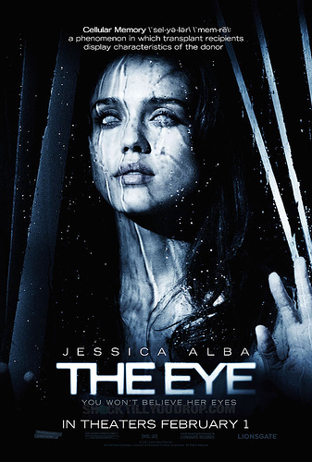
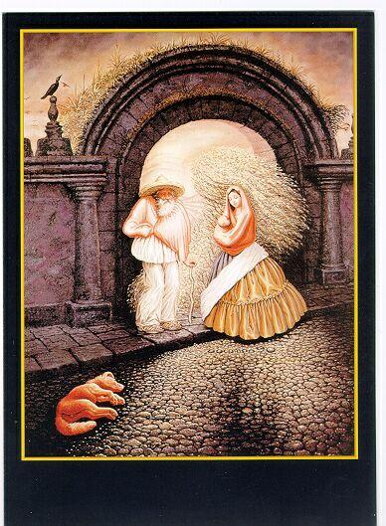
Perceptual Organization
Visual capture – the tendency for vision to dominate other senses
Can other senses “capture” our attention? YES!
Handout/Visual: Kinesthetic Capture
Visual agnosia – complete sensation of the visual field, but objects seen without meaning” – The Man Who Mistook his Wife for a Hat (Oliver Sacks) (pg. 10)

Slide 14
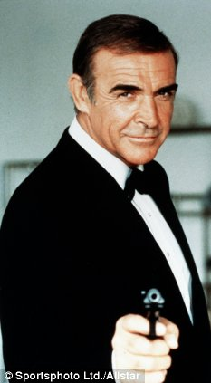
Phonagnosia
Sean Connery
Notes:
http://scienceblogs.com/neurophilosophy/2008/10/first_case_study_of_developmental_phonagnosia.php

Slide 15
Form Perception
Form Perception
Depth Perception
Motion Perception
Perceptual Constancies

Slide 16
Figure & Ground Relationships
Figure and Ground Relationship Illusion
Figure – any object
Ground – its surroundings
Illusion – it reverses back and forth (237)
Face or Vase?
Paper or Staircase?
Woman?

Slide 17
Gestalt – Grouping
Gestalt – German word for form or whole
The whole is > the sum of its parts
Rules for how we bring order to our vision are applied by even 6-month old infants
5th = Closure – we fill in gaps to create a complete, whole object
Closure Shapes
What is it?
CLASS ACTIVITY ! ☺

Slide 18
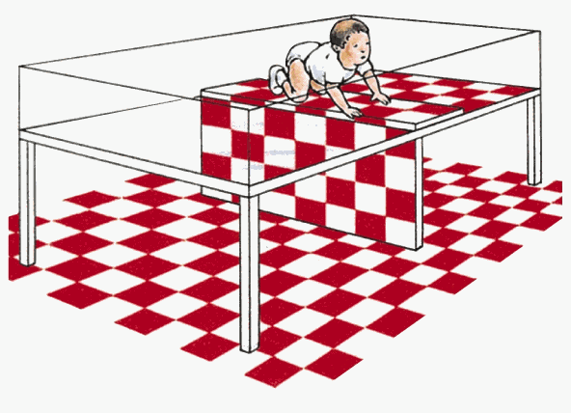
Depth Perception
Depth Perception – perceiving objects as 3-D when our eyes really only receive and send 2-D image
Visual cliff – had mothers coax infants onto the edge of a safe canyon…most refused to do so…probably instinctual b/c even very young animals (goats, chicks) do this too page 238

Slide 19
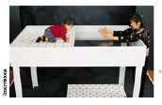

Slide 20
Depth Perception: Binocular cues – DEMONSTRATION
Hold two pencils with two hands out in front of you
Touch them together
Now, do it with one eye closed
WHY is it easier with 2 eyes??
1) Retinal disparity – the difference between the two images your eyes project to the brain (Another Demonstration: finger sausage)
2) Convergence – Kinesthetic cue;
muscles causing eyes to turn inward is interpreted as “closer”

Slide 21
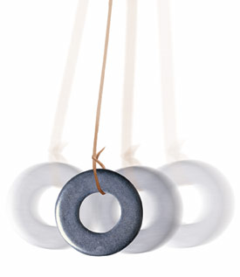
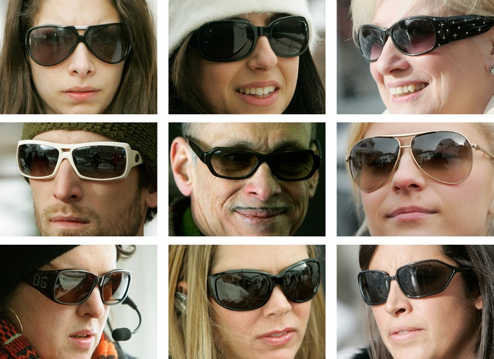
The Pulfrich Pendulum Effect (skip in 10-10)

Slide 22
Depth Perception
Biological Motion: Biological Motion?
Kinetic Depth: Globe or Circle?
Disappearing Act
1 More Motion After Effect: The Rising Waterfall

Slide 23
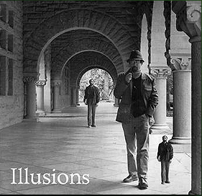
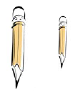
Monocular Cues

Slide 24


Slide 25
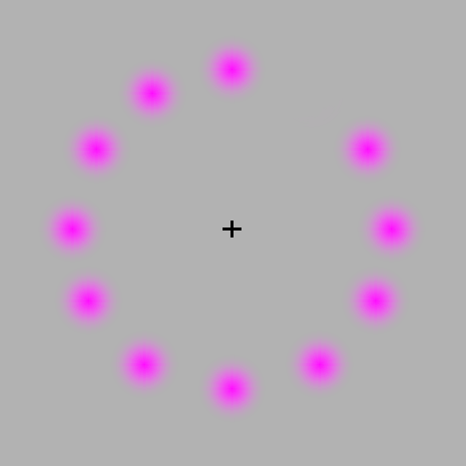
No One Gets Why on This…

Slide 26
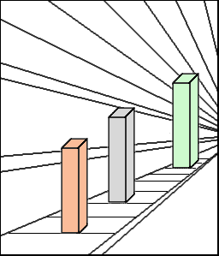
Monocular Cues
Linear perspective – parallel lines converge
Ponzo Illusion
Ponzo Illusion (playground)

Slide 27
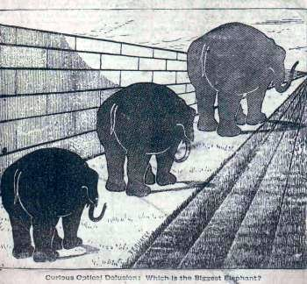
Light & Shadow
Nearby objects reflect more light to our eyes. Thus, two identical objects, if one appears dimmer, it seems farther away

Slide 28
Motion Perception
Phi Phenomenon – an illusion of movement when two or more adjacent lights blink on and off in succession
Over the Mountain
Stroboscopic movement – Movies, cartoons, etc. are just a fast succession of slides

Slide 29
Perceptual Constancy
Perceiving objects as unchanging even as illumination and retinal images change
Shape and Size Constancies
Size Constancy – we perceive objects as having a constant size, despite that our distance from them varies
Variation in Retinal Size – even though the retinal image/size changes, our perception of the size usually doesn’t…this is size constancy
Demonstrations:
1) Enlarging finger
2) The floating X (thanks to afterimages)

Slide 31
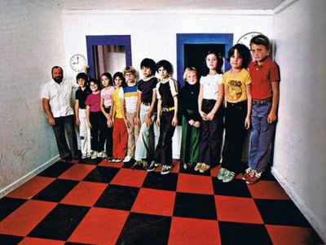

Slide 32
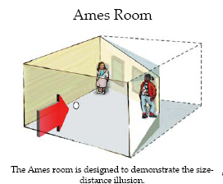
The Ames Room
http://www.youtube.com/watch?v=5ic7QGjGEX8 (2 dudes walking corner to corner)
http://www.youtube.com/watch?v=Ttd0YjXF0no (Ramachandran explains it)
How do these terms relate?
Relative size
Monocular cues
Retinal size
Size constancy
Notes:
Size Constancy – despite our distance varying from an object, we perceive it as unchanging in size
Relative Size – if we know that 2 objects are of the same size, we perceive the one that casts the smaller image as being further away…Ames Room tricks us and overrides this info by using our schema for rooms as 2 sets of parallel walls

Slide 33
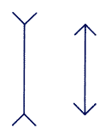
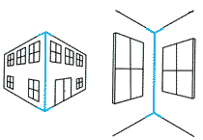
Muller-Lyer Explained
Relative Depth mistakes
City buildings vs. Inside corners…
Line running down the outside corner is the closest
Line running up the back corner is further away
Same image, brain adjusts
The brain realizes that this line is really shorter than it appears when compared to the rest of the building.
Muller-Lyer Illusion
The T Illusion or Horizontal - Vertical Lines Illusions
Notes:
http://www.questacon.edu.au/illusions/muller-lyer_explain.html

Slide 34
Unexplainable Illusion? Poggendorf
Distance? Shape? Constancies???
Poggendorf
Poggendorff Illusion
Poggendorf with Extravagant Explanationswith explanation

Slide 35
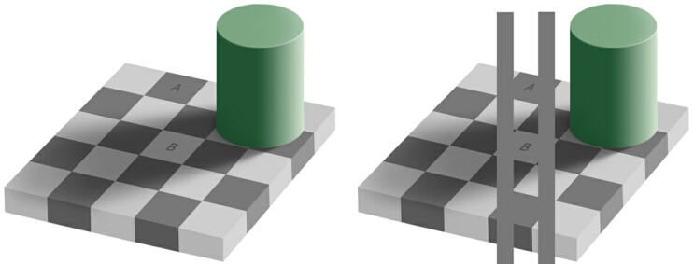
Perceptual Constancy – Light
Perceived lightness = relative luminance (the amount of light an object reflects relative to its surroundings) (similar to color constancy)
White paper reflects 90% of light
Black paper reflects 10% of light
In sunlight, black paper actually may reflect 100x more light than white paper indoors, but black is still black, and white is still white…
Simultaneous Contrast
Munker-White Illusion
Stepping Feet (kinesthetic color contrast)

Slide 36
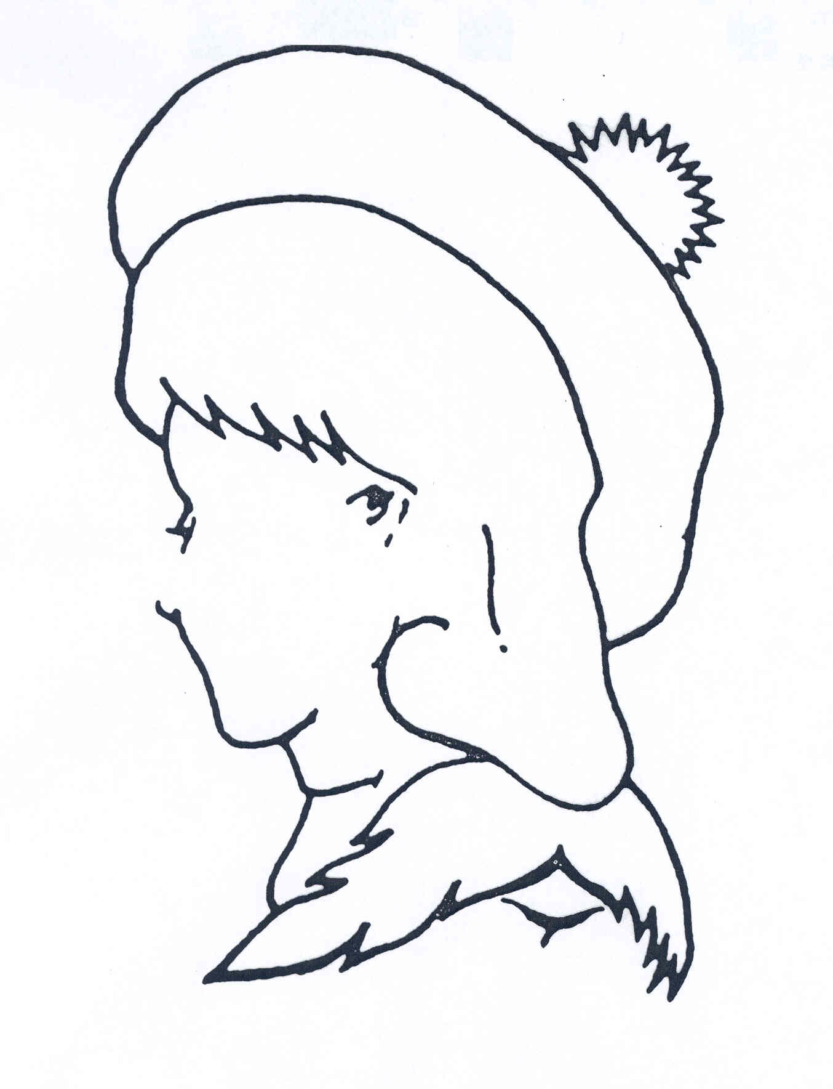
Perceptual Interpretation

Slide 37
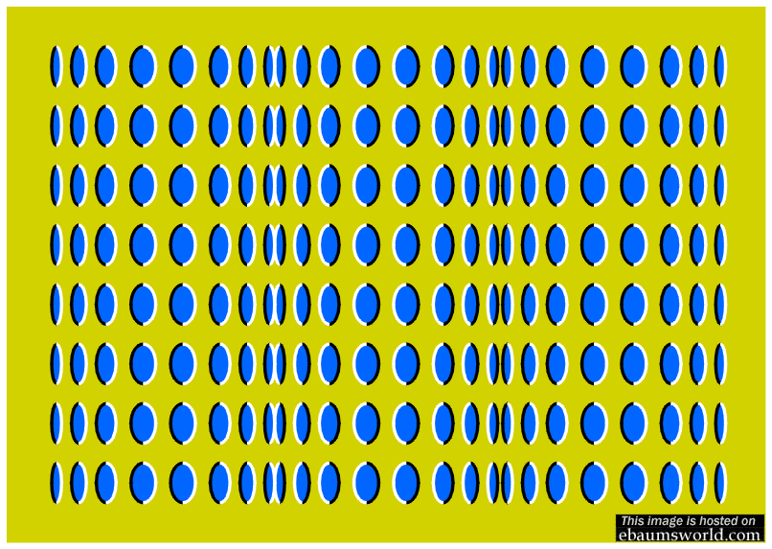

Slide 38
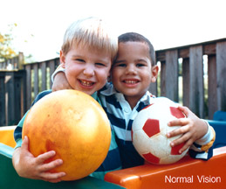
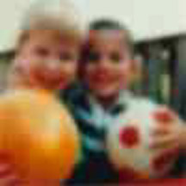
Sensory Deprivation
Ppl born with cataracts, then removed…could distinguish btwn figure and ground (innate) but could not recognize objects by sight that were familiar by touch

Slide 39
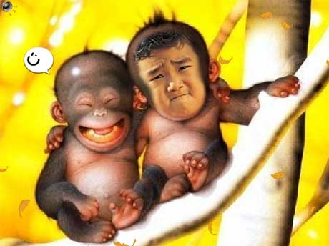
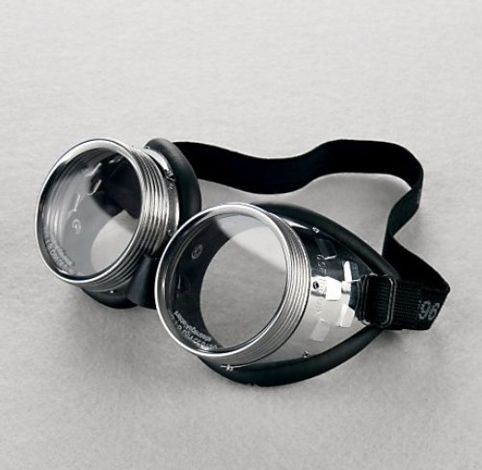

Monkeys born and outfitted with goggles that allowed only diffuse, unpatterned light…following infancy, remove goggles, could distinguish color and brightness, but not form of a circle or square (cortex lacked the normal connections to recognize these)
Feature Detection: Kitten born in darkness, except for 5 hours when placed in a horizontally or vertically striped environment (249)…later, the kittens had trouble recognizing the other shape
Would only play with a rod when held upright if raised in the vertical environment and vice versa
All this suggests a CRITICAL PERIOD for normal sensory and perceptual development…more on this in Developmental. Psych. Chapter

Slide 40
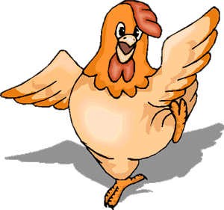
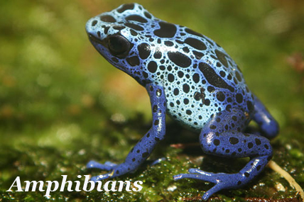
Perceptual Adaptation
Chicks fitted with lenses that changes the location of objects 40 degrees to the left do not adapt…they continually peck at where the feed seems to be
Upside down lenses (Mind vid?)
Humans, kittens, monkeys can adapt
We do not turn in back to right side up, we just learn to do it upside down (upside down just seems normal then)
Fish, frogs, salamanders cannot

Slide 41
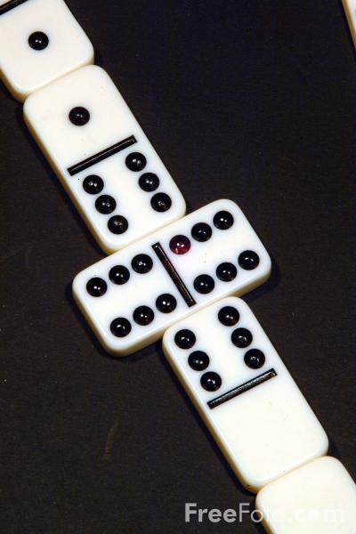
Perceptual Set!!
The true “Cognitive Expectations” part of perception
What number follows each of these (DON’T GO ON!! READ TO THEM!!)?
32
73
373
2624
4099
Why?

Slide 42
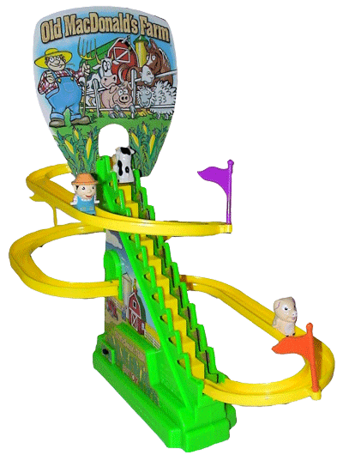

Perceptual Set!!
Pronounce these words aloud!
MAC DONALD
MAC HENRY
MAC MAHON
MAC HINERY
“TIME FLIES I CANT THEYRE TOO FAST.”
MAKE SOME MEANING OUT OF THIS.
CANT? TRY TIME AS THE VERB AND FLIES AS THE NOUN.
TIME THE FLIES! GET IT?
Notes:
Mac

Slide 43
Perceptual Set
CHO
PHO
USE

Slide 44

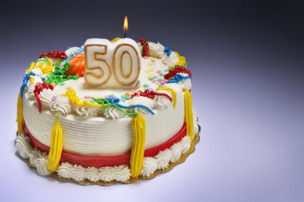
Perceptual Set
Sally announces to her kindergarten classmates that today is the birthday of both her father and her grandfather. Both are exactly 50. Her teacher says that’s impossible. Is Sally right?
My page 20

Slide 45


Perceptual Set
STORY TIME!!!
End of year teacher gifts (20)
Another STORY! 6 volunteers
Did the stories change? (21) – show page

Slide 46
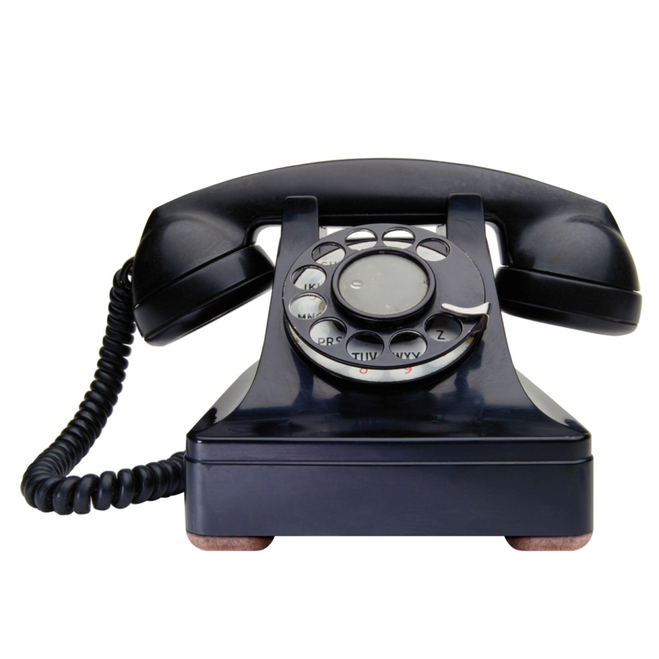
Perceptual Set
MORE STORY TIME!!!
TELEPHONE GAME AGAIN!!! How stories can be changed by our expectations!
(STORY ON NEXT PAGE 4 after the game)
1) Leveling – perceiver drops details that do not fit the assumptions
2) Sharpening – details consistent with values and interests of perceiver are emphasized
3) Assimilation – padding and organization are used to make the central theme fit the subject’s expectations

Slide 47
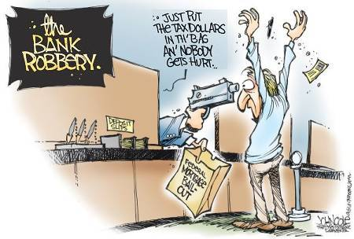
Three men, masked and armed with pistols, robbed the Glenwood State Bank yesterday morning at 9:30 AM.They escaped in a Ford two-door bearing a 1971 Connecticut license plate, taking $647 in coins and $2,190 in five-dollar bills. A lieutenant in the Marines claims he saw the car going north at noon yesterday.

Slide 48

Perceptual Set – Context Effects
Dead or Asleep
Transporting dead patients through the hospital…just uncover their faces!

Slide 49
Expectations
What do these letters spell?
FOLK
How about these?
CROAK
And what do these letters spell?
SOAK
What do we call the white of an egg?
YOLK!
NOPE!

Slide 50
Human Factors Psychology
A branch of psychology that explores how people and machines interact and how machines and physical environment can be adapted to human behaviors
Mapping of the stove controls (255)
Examples of Bad Human Designs (23)

Slide 51
Parapsychology

Slide 52
Extrasensory Perception -- Parapsychology
Parapsychology – the study of paranormal phenomena or ESP (Extra Sensory Perception) such as:
Telekinesis or psycho kinesis – mind over matter (levitating a table or influencing the roll of dice)
Clairvoyance – perceiving remote events (a friend’s house is on fire)
Precognition – perceiving future events
Telepathy – reading another person’s mind

Slide 53
Precognition
Me → 25 #1
Tom Cruise’s movie…?

Slide 54
Mr. Flip is Telepathic
Please write one thing about yourself on this slip of paper and seal in it the envelope I provided.
3 students leave the room
Class now select a card randomly here
Call back students
Students out of the room…one of you call my telepathic friend…number is on the podium…dial 9 first!

Slide 55
Premonitions or Pretensions?
National Enquirer made 486 predictions between 1978 and 1985…only 2 came true
The Farmers Almanac once predicted that it would snow 3 times in July in Florida…and it did…
Police dept. psychics make no more accurate guesses than average individuals…or vague explanations can be refitted in hindsight
Given enough time, improbable becomes inevitable
Goldman, Sachs, and Comp. (investing banking firm) now offers $1 million to anyone who can prove they have a genuine psychic power…no takers yet (roughly 30 years now…used to be $10,000)…many tested, none for real
MONTEL: SYLVIA!
Browne debunked

Slide 56
ESP Tested
“A reproducible ESP phenomenon has never been discovered, nor has anyone produced any individual who can convincingly demonstrate psychic ability” – (Myers, 2004, 2010)
Psychology is not closed minded about ESP
ESP should be testable and provable, so the fact that we haven’t found it out there means we cannot accept it as a truth…will this hold forever? Who knows?
Page 263…ESP-N
Let’s find out if anyone is capable of precognition, clairvoyance, or telepathy

