Slide 1
Chapter 8 – Learning
Andy Filipowicz

Slide 2
If you want:
Learning Style Quiz

Slide 3
Learning: Defined
Learning: Relatively permanent change in [observable] behavior due to experience
NOT temporary changes due to disease, injury, maturation, or drugs
As class moves on, determine what you are learning about the balloons…

Slide 4
Learning Processes
Behaviorism (today)
Classical conditioning (today)
Operant conditioning (next time)
Other forms of learning (time after)

Slide 5
Behaviorism
The view that psychology should restrict its efforts to studying observable behaviors, not mental processes.
Founded by John Watson
Thought that all human behavior is a result of conditioning or due to past experience and environmental influences.
Claimed he could take any child and train him to become any type of specialist.
?What famous study did Watson do?

Slide 6
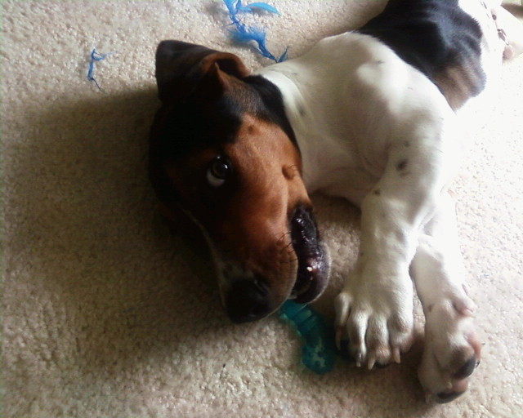
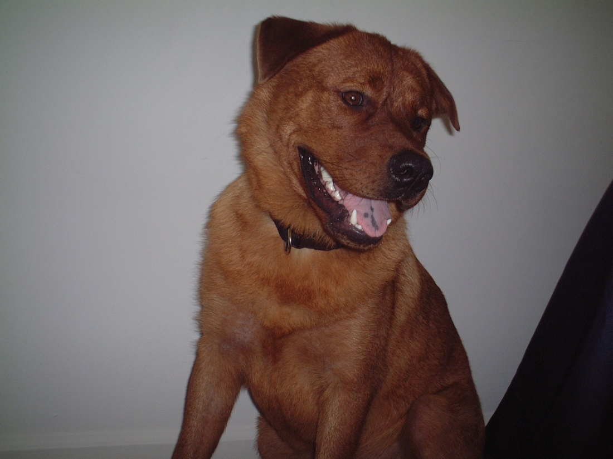
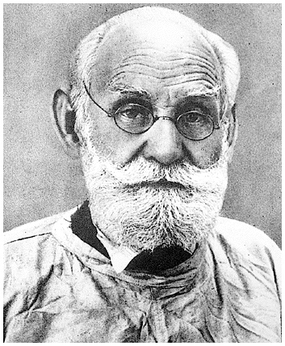
Classical Conditioning & Ivan Pavlov
Russian physiologist – digestion/saliva!
Conditioned dogs by mistake

Slide 7
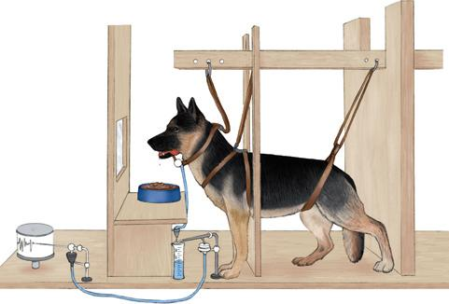
An apparatus for Pavlovian conditioning. A tube carries saliva from the dog’s mouth to a lever that activates a recording device (far left). During conditioning, various stimuli can be paired with a dish of food placed in front of the dog. The device pictured here is more elaborate than the one Pavlov used in his early experiments.

Slide 8
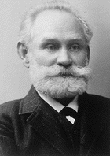



Classical Conditioning: Definitions
Unconditioned Stimulus (US): a stimulus that has the ability to produce a specified response before conditioning begins.
(FOOD)
Unconditioned Response (UR): the response produced by the US.
(SALIVATION PRODUCED BY FOOD)
Conditioned Stimulus (CS): an initially neutral stimulus that comes to produce a new response because it is associated with the US.
(BELL)
Conditioned Response (CR): the response produced by the CS.
(SALIVATION PRODUCED BY THE BELL)

Slide 9
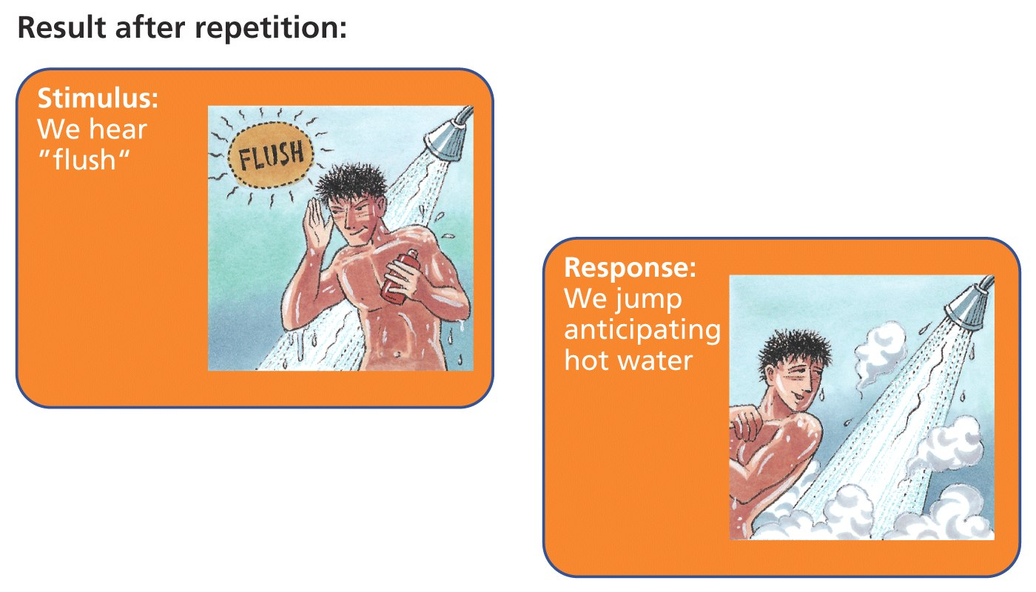
Stimulus-Response Relationship

Slide 10

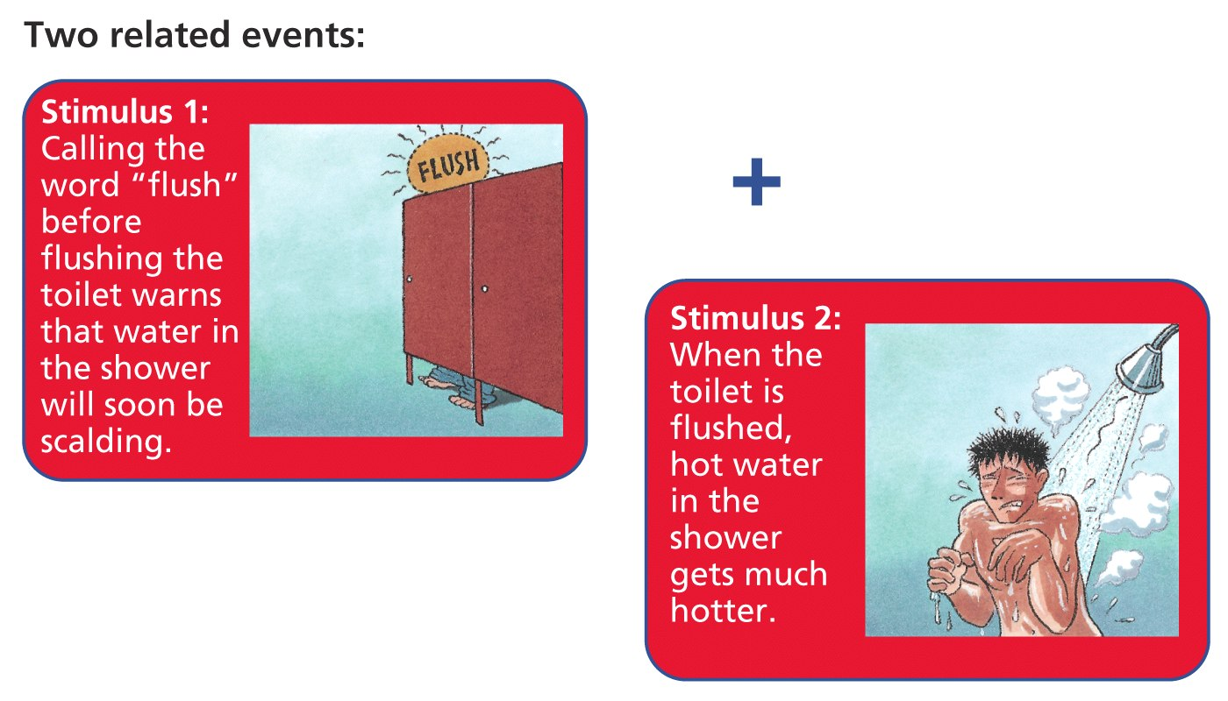
A Simple Example

Slide 11
What You Can Do In College...
What You Can Do In College, Part II

Slide 12
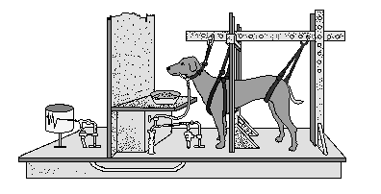

Classical Conditioning: The Elements of Associative Learning
Ivan Pavlov
Conditioning Trial:
Salivation
Test Trial:
Salivation

Slide 13
Classical Conditioning: Basic Principles
Acquisition
Repeatedly pairing a CS with a US will produce a CR.
1 pairing = presenting the CS and then quickly presenting the US:
Salivation
Extinction
After conditioning has taken place, repeatedly presenting the CS without the US will make the CR weaker and eventually make it disappear.
X

Slide 14
The Office
Better Sound Quality?

Slide 15
Classical Conditioning: Additional Principles
Spontaneous Recovery
Following extinction, the CR reappears at reduced strength if the CS is presented again after a rest period.
Stimulus Generalization
After a CR has been trained to a CS, that same CR will tend to occur to similar stimuli without further training;
The greater the similarity, the stronger the response will be.
Conditioning:
Test for Generalization:

Slide 16
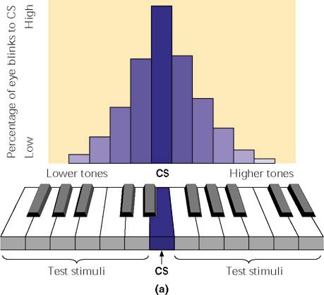
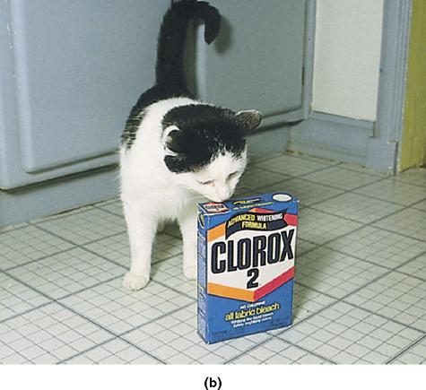
Fig. 8.6 (a) Stimulus generalization. Stimuli similar to the CS also elicit a response. (b) This cat has learned to salivate when it sees a cat food box. Because of stimulus generalization, it also salivates when shown a similar-looking detergent box.

Slide 17
Classical Conditioning
Stimulus Discrimination
A subject responds to the CS but not to a similar stimulus because the CS was paired with a US but the similar stimulus was presented without the US.
X

Slide 18
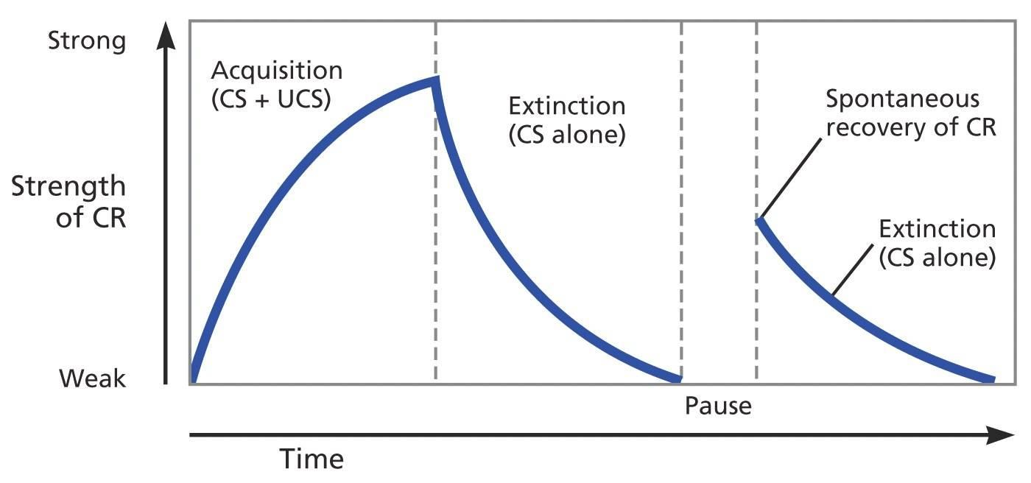
Extinction & Spontaneous Recovery

Slide 19
And now a demonstration
Need a volunteer who doesn’t mind being sprayed in the face with water
(personal notes pg. 5)
What is the US, UR, CS, CR?
US = water in face
UR = flinch or squint
CS = sound of word “can”
CR = flinch or squint
Extinction…
Spontaneous Recovery…
Reconditioning…

Slide 20
Another Demonstration?
If time, Eye Blink Conditioning?

Slide 21
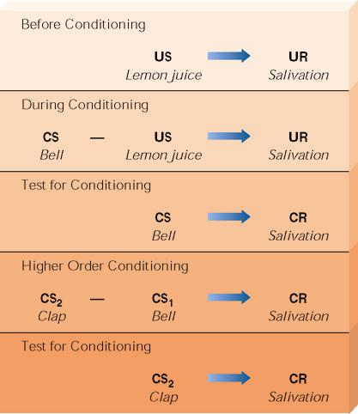
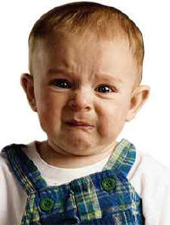
Fig. 8.5 Higher Order conditioning takes place when a well-learned conditioned stimulus is used as if it were an unconditioned stimulus. In this example, a child is first conditioned to salivate to the sound of a bell. In time, the bell will elicit salivation. At that point, you could clap your hands and then ring the bell. Soon, after repeating the procedure, the child would learn to salivate when you clapped your hands

Slide 22
Applying Classical Conditioning
Desensitization: Exposing phobic people gradually to feared stimuli while they stay calm and relaxed
Moving Images??: Systematic Desensitization (Elevator lady)
Vicarious Classical Conditioning: learning to respond emotionally to a stimulus by observing another’s emotional reactions

Slide 23
Taste Aversions
A single bad experience can stay with us…
Story time!!! “My frozen chicken dinner”
Imagine your favorite bowl of soup… (personal notes pg.6-7)

Slide 24
Temporal Arrangements of CS and US
Delay Conditioning:
The CS begins before the US and overlaps it.
CS
US
Rank: 1st: Works the best!
EX: bell rings, continues to ring as food is presented

Slide 25
Temporal Arrangements of CS and US
Trace Conditioning:
The CS begins and ends before the US begins.
CS
US
Rank: 2nd: Overall, not very good.
EX: bell rings and ends just before food is presented

Slide 26
Temporal Arrangements of CS and US
Key Variable: The CS-US Interval
This is the time between CS onset and US onset.
CS
US
Obviously, longer trace = less learning
For every situation, there is an optimal CS-US interval.
Intervals that are too short or too long give slower
conditioning.

Slide 27
Temporal Arrangements of CS and US
Backward Conditioning:
The CS begins after the US begins.
CS
US
Rank: 3rd: Not really effective either.
EX: food is presented, then the bell rings

Slide 28
Temporal Arrangements of CS and US
Simultaneous Conditioning:
The CS and US begin at the same time.
CS
US
Rank: 4th: Not very good at all…why?
EX: bell begins to ring at the same time the food is presented. Both begin, continue, and end at the same time.

Slide 29
Temporal Arrangements of CS and US
How these procedures rank in effectiveness:
Best
Delay Conditioning
Trace Conditioning
Backward Conditioning
Worst
Simultaneous Conditioning

