Slide 1
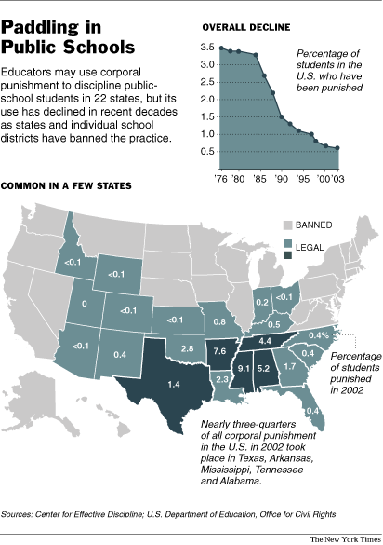
Thinking ?:
Is it okay for parents to spank (or use other corporal punishment on) their children?
What about schools? Should teachers be allowed to use corporal punishment on students in violation of school rules?
Even better: http://www.corpun.com/counuss.htm With videos!
http://abcnews.go.com/GMA/story?id=3924024

Slide 2
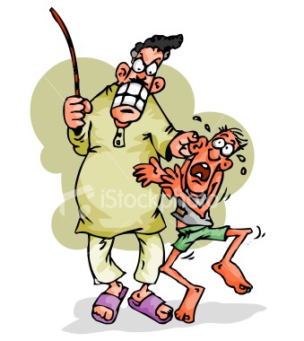
Thinking ?:
What rewards or punishments, if any, have you ever or do you currently receive for excellent or poor grades?

Slide 3
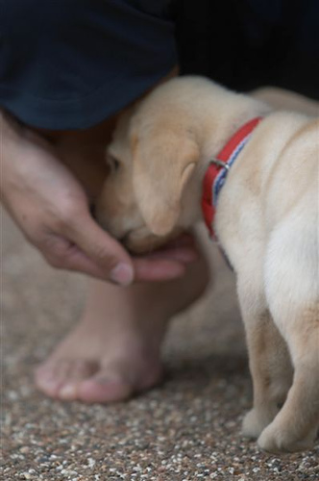
Operant Conditioning

Slide 4
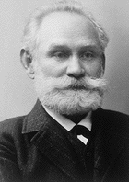
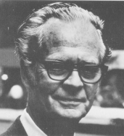


Operant Conditioning VS. Classical Conditioning
In Classical Conditioning, the subject’s response has no consequences; it produces no change in the environment.
REFLEXIVE!!
The dog gets the food as the bell is rung whether or not he salivates to the bell.
The dog’s behavior doesn’t matter.
In Operant Conditioning, the dog has to stand up to
get the food. His behavior DOES matter
OPERANT

Slide 5
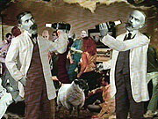
The Law of Effect
Edward Thorndike (1874-1949)
If Beh is rewarded, it is likely to recur
BRILLIANT!
He called this INSTRUMENTAL LEARNING b/c “C” was instrumental in shaping future behaviors
Puzzle boxes and cats (1898)
Notes:
In other words, in Pavlov’s experiment, the food is not a reward for responding to the bell because it is given no matter what the dog does.
In the Operant Conditioning example, the food is a reward because it depends on the dog’s behavior—he has to stand up.
Operant Conditioning works on the Law of Effect: behavior changes according to its consequences.
The Law of Effect does not apply to Classical Conditioning.
Reflexes are not sensitive to their consequences.

Slide 6
Early Operant Conditioning
NOT insightful…it’s trial and error at first
First Trial
in Box
Scratch at bars
After Many
Trials in Box
Scratch at bars
Push at ceiling
Push at ceiling
Situation:
stimuli
inside of
puzzle box
Situation:
stimuli
inside of
puzzle box
Dig at floor
Dig at floor
Howl
Howl
Etc.
Etc.
Etc.
Etc.
Press lever
Press lever
Notes:
Hockenbury slides (Schulman)
Thorndike put cats into puzzle boxes and made them find the solution to their quandary.
Thorndike did not elicit a response as Pavlov had, he had to wait for the animal to emit the proper response, learn from it and do it again.
The trial and error process through which the animals learned the way to trip the latch was what Thorndike called his law of effect. Responses that produce a satisfying effect in a particular situation become more likely to occur again in that situation, and responses that produce a discomforting effect become less likely to occur again in that situation.
Instrumental responses- actions which function as tools to work some change
in the environment; also called operant responses.
Ex: flipping a switch to light a room; rats pushing a lever to
receive food
Operant conditioning- learning process by which the consequence of an
operant response affects the likelihood that the response will
occur in the future.

Slide 7
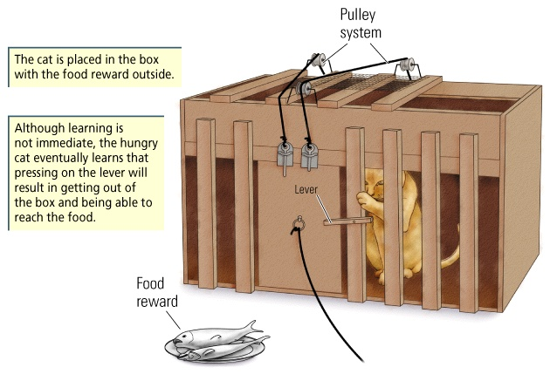
Thorndike’s Puzzle Box

Slide 8
“A person does not act upon the world, the world acts upon him.”
B. F. Skinner (1904–1990)
Notes:
DiscPsy Photo p179

Slide 9
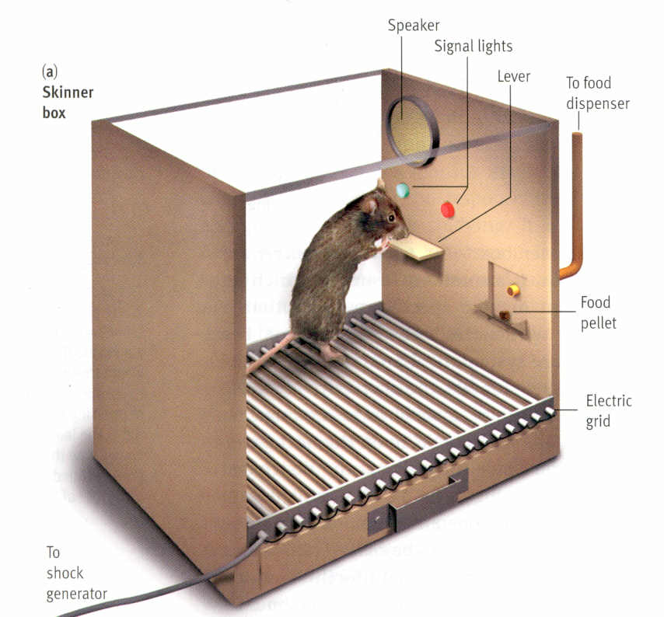
The Skinner Box

Slide 10
B.F. Skinner (1904-1990)
Skinner Box
Pressing Lever = Behavior or OPERANT
The behavior “operates” on the environment to produce a desirable outcome.
Food = Reinforcer
Process of Giving food = reinforcement
SKINNER (kinda boring, skip)

Slide 11
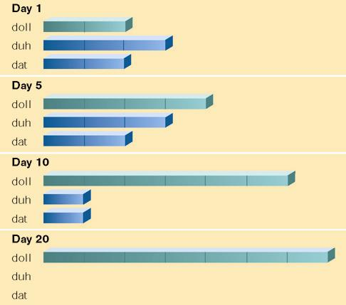
Day 1 = no reinforcement Day 2-5 = beginning of reinforcement → give doll only when she says “doll” “duh” or “dat” Day 10 = reinforce only when saying “doll”

Slide 12
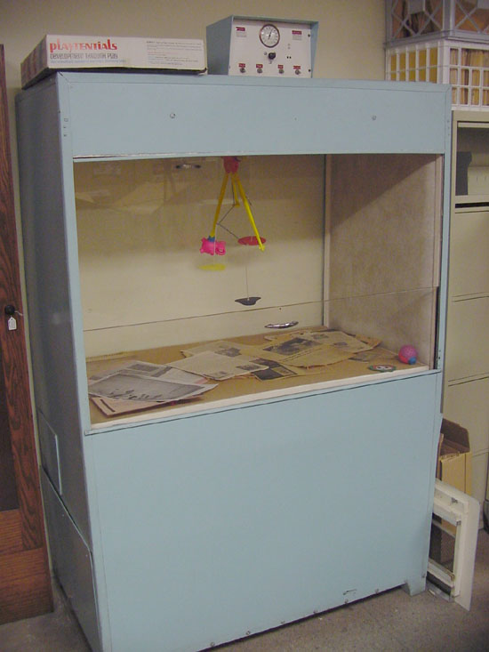
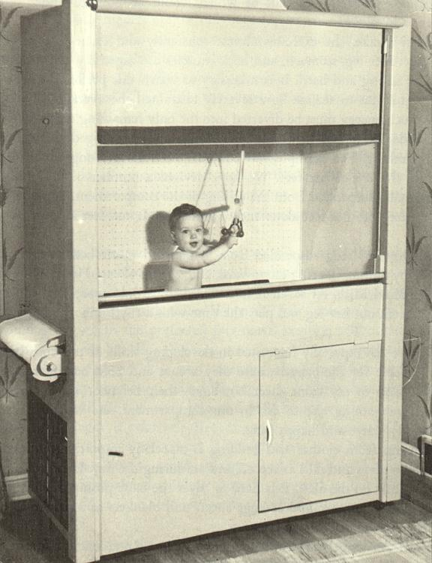
Skinner’s Air Crib: A room fit for a…Baby!
To read more on this invention: Click Here!

Slide 13


Reinforcement/Punishment
Reinforcement - Any consequence that increases the likelihood of the behavior it follows
Reinforcement is ALWAYS GOOD!!!
Reinforcement leads to this: Pigeons Turning
Punishment - Any consequence that decreases the likelihood of the behavior it follows
Who decides which is which?
Examples?

Slide 14
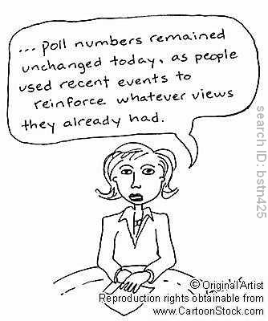
Types of Reinforcement

Slide 15
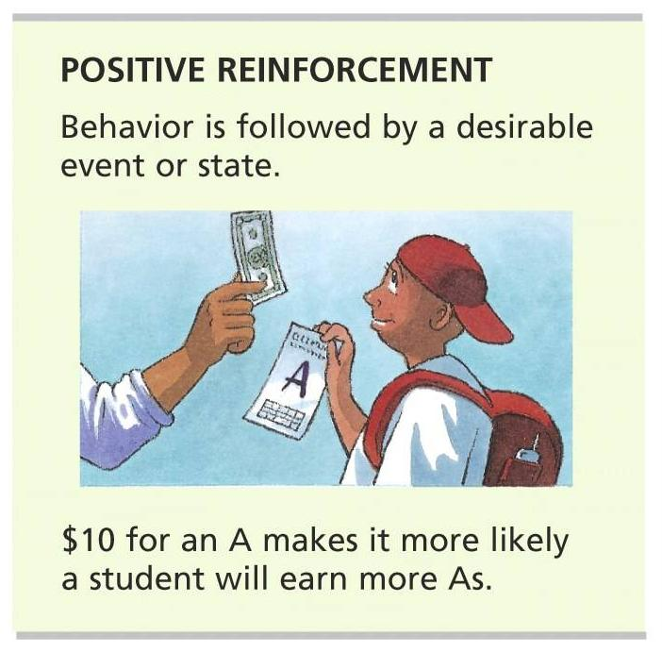
Positive (+) Reinforcement
Encourages & increases frequency of behavior
EFFECTS: ADDS SOMETHING PLEASANT
?What other examples can you develop?

Slide 16
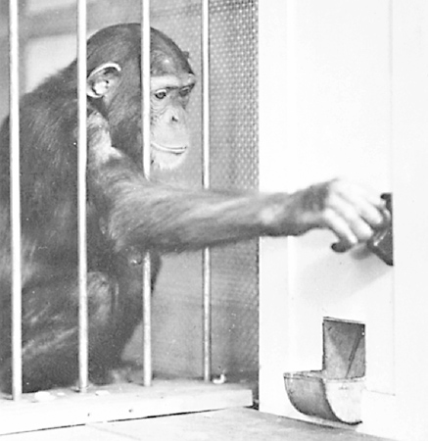
Token Economies
Poker chips normally have little or no value for chimpanzees, but this chimp will work hard to earn them once he learns that the “Chimp-O-Mat” will dispense food in exchange for them.

Slide 17
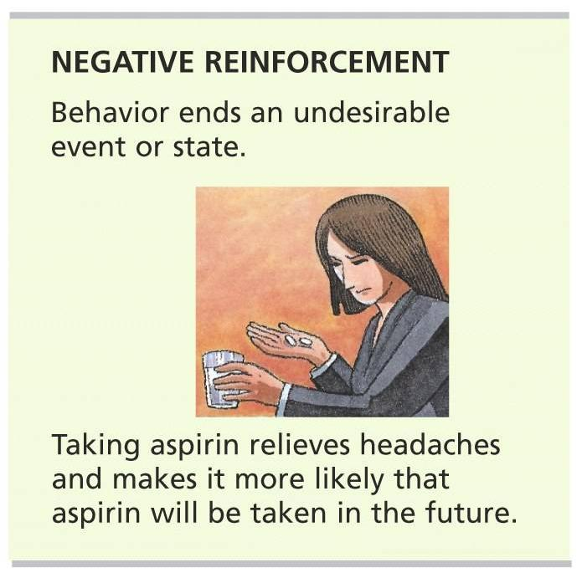
Negative (-) Reinforcement
ALSO Encourages & increases frequency of behavior
EFFECTS: REMOVAL of something unpleasant
?What other examples can you develop?
Personal notes pg.12 examples
(Handout 8-6, pg. 13)

Slide 18
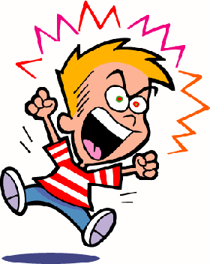
Billy Throws a Tantrum
Billy throws a tantrum and demands to eat the newly baked brownies instead of his dinner. His parents give in for the sake of peace and quiet.
How is this an example of positive reinforcement?
How is this an example of negative reinforcement?
Below are answers
+ Reinforcement = Child’s tantrum reinforced when parents give in
- Reinforcement = Parents’ behavior reinforced when Billy stops screaming
Notes:
The child’s tantrum is reinforced when the parents give in (pos. reinforcement)
The parents’ behavior will be reinforced when Billy stops screaming (neg. reinforcement).

Slide 19
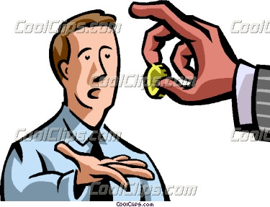
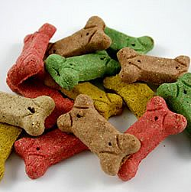
Primary VS Secondary Reinforcement
Something that is naturally reinforcing
Examples: food, warmth, water, etc.
The item is reinforcing in and of itself
Something that a person has learned to value or finds rewarding because it is paired or associated with a primary reinforcer
Money
Grade
Signs of respect & approval.

Slide 20
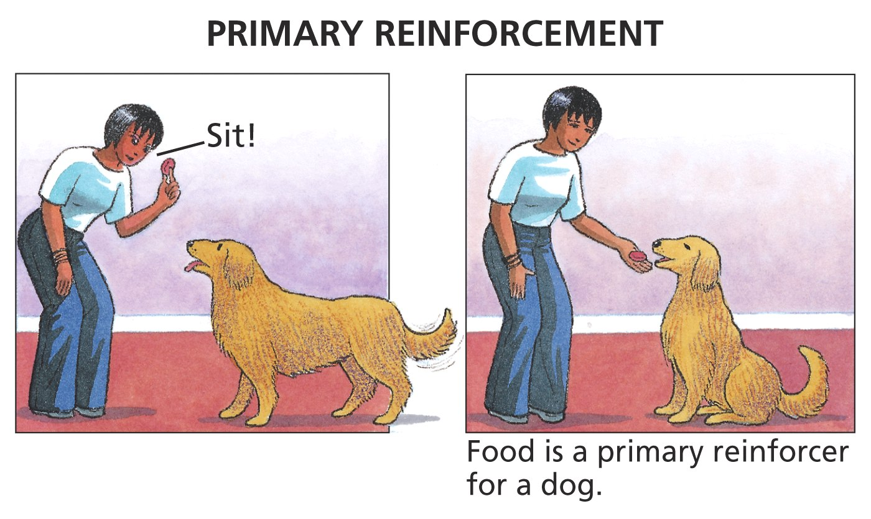
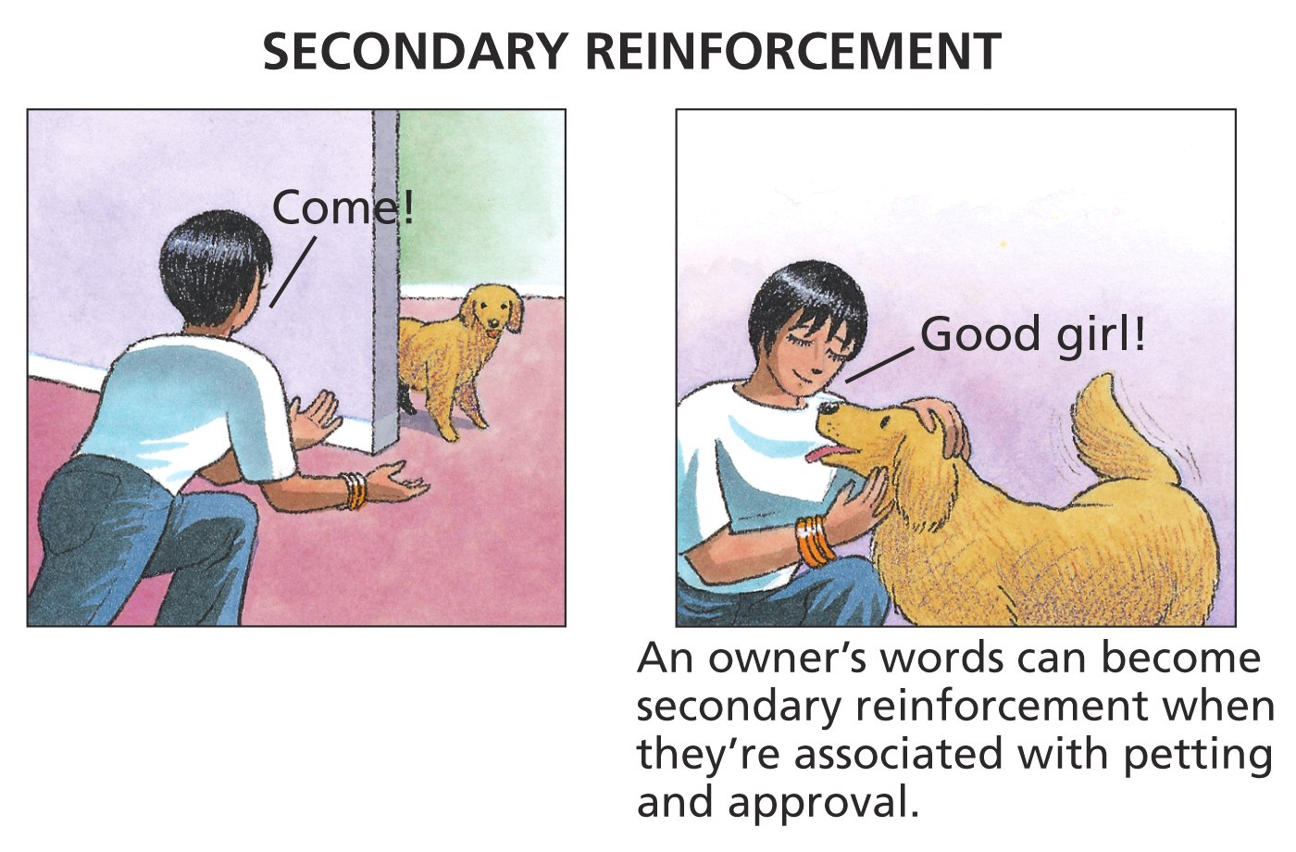

Slide 21
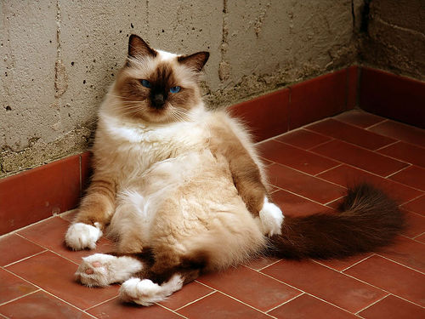

Immediate Versus Delayed Reinforcement

Slide 22
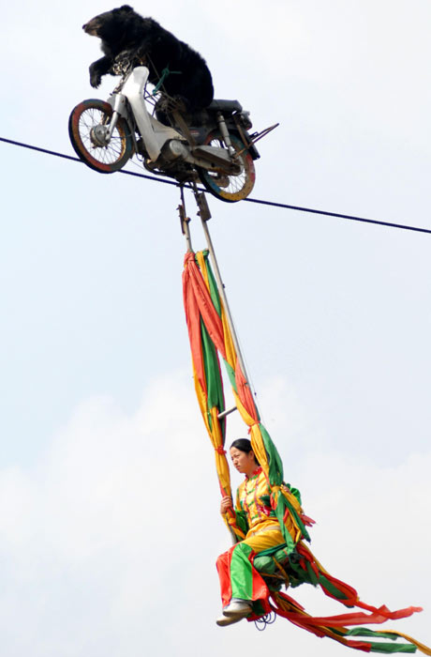
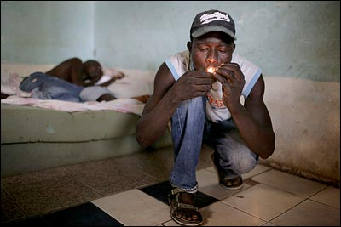
Immediate Reinforcers
Immediate reinforcers – behaviors that immediately precede the reinforcer become more likely to occur
Apply to training animals?
Undesirable human behaviors with imm. reinforcers?
Smoking, alcohol, other drugs = immediate rewards outweigh long term negatives

Slide 23
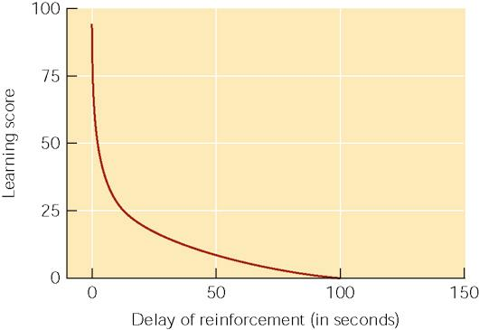
The effect of delay of reinforcement. Notice how rapidly the learning score drops when reward is delayed. Animals learning to press a bar in a Skinner box showed no signs of learning if food reward followed a bar press by more than 100 seconds (Perin, 1943).

Slide 24
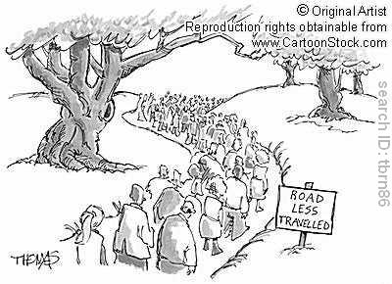

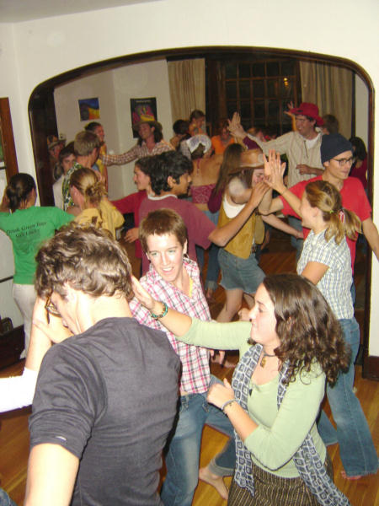
Delayed Reinforcers
AKA Delayed Gratification
Give up small reward now for
Big reward later
M Scott Peck’s The Road Less Traveled
"Delaying gratification is a process of scheduling the pain and pleasure of life in such a way as to enhance the pleasure by meeting and experiencing the pain first and getting it over with. It is the only decent way to live" (p. 19).
Premack Principle
AP Psych Notecards
Going out Friday night
Notes:
whichever of 2 activities is preferred can be used to reinforce the other
Don’t like making AP Psych notecards, but do like going out on Friday night? Do the undesirable one first and make going out a reinforcer

Slide 25
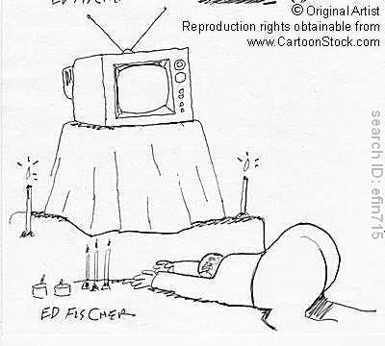

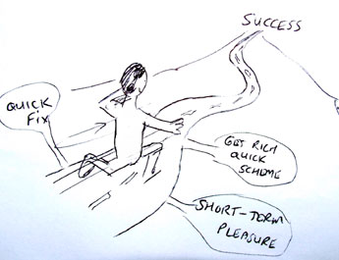
Delaying Gratification
Examples of doing / not doing?
Stay up late to watch TV when next day we’re tired
Smoke for satisfaction now when later it will kill us
Immediate reinforcement is more effective than delayed reinforcement
Ability to delay gratification predicts higher achievement / higher life satisfaction / higher intelligence ! ☺
Handout 8-4 (personal notes pg. 12)

Slide 26

Punishment: The Process of Punishment

Slide 27
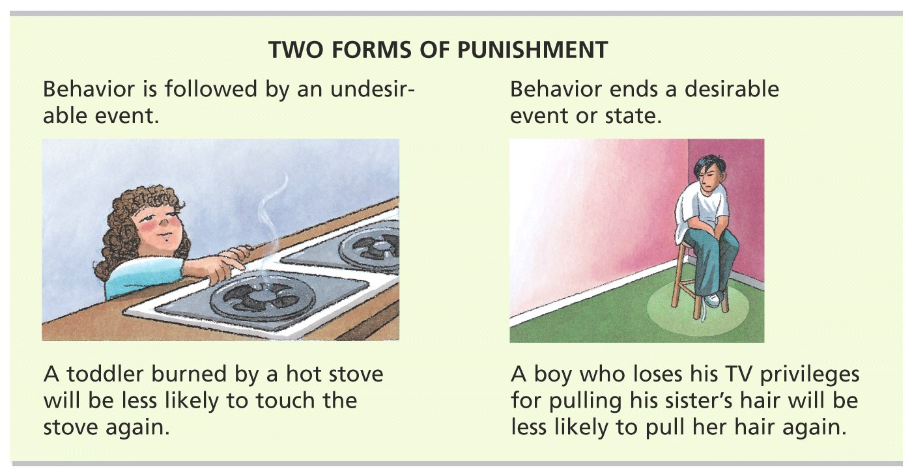
Punishment’s effect is opposite that of reinforcement – it decreases the frequency of behavior

Slide 28
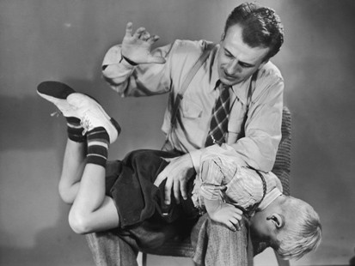
Positive vs. Negative Punishment
Punishment by Application
Something is added to the environment you do NOT like.
Spanking: http://www.corpun.com/counuss.htm With videos!
Something is taken away that you DO LIKE.
Lose a privilege.
No dessert after dinner
Study block example

Slide 29
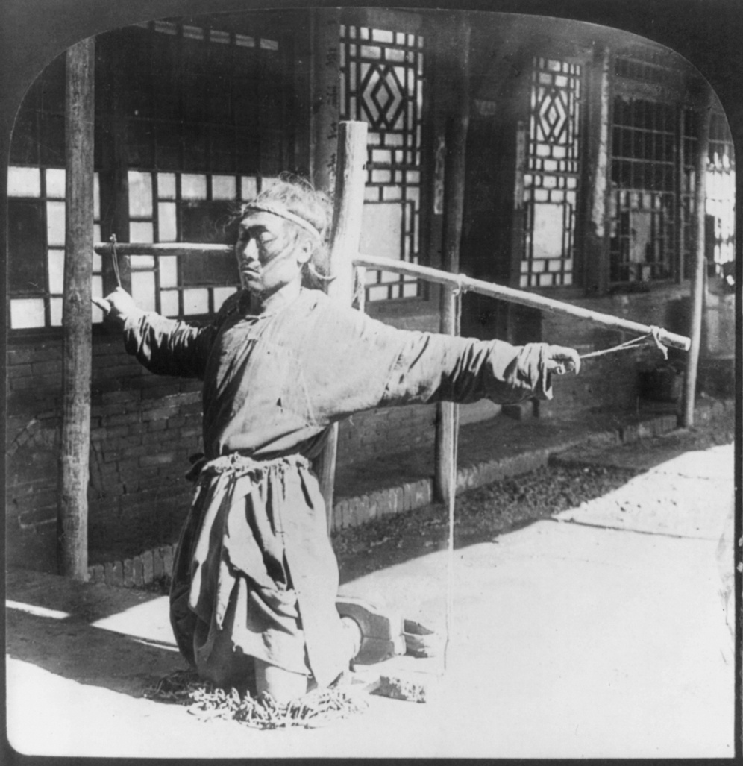
Desired Effects of Punishment
Punishment can effectively control certain behaviors if…
It comes immediately after the undesired behavior
It is consistent and not occasional
Especially useful if teaching a child not to do a dangerous behavior
Most still suggest reinforcing an incompatible behavior rather than using punishment

Slide 30

Undesirable Effects of Punishment
What is the alternative, acceptable behavior?
Tells what NOT to do
New settings, same bad behavior
Fear of the punisher, anxiety, & lower self-esteem
Learn to use aggression to solve problems.

Slide 31
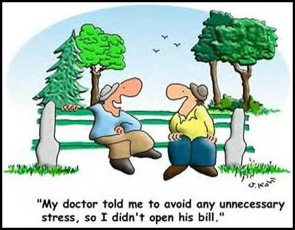

2 Forms of Learning from Punishment
Escape Learning
Avoidance learning
Situation: Katelyn creates a ruckus in English class she hates and is asked to leave the class. Maya is evidencing escape learning. If Katelyn skips English class altogether, that is avoidance learning.

Slide 32
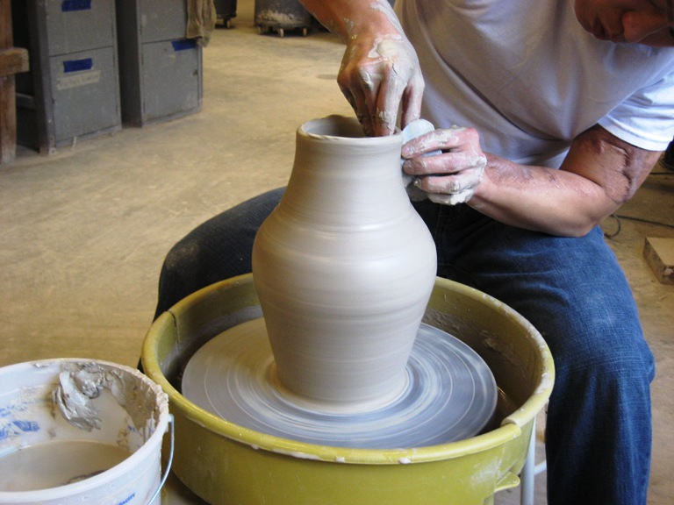
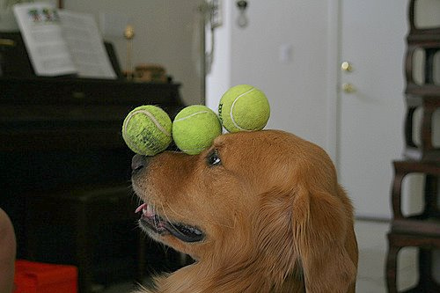
Some Reinforcement Procedures: Shaping

Slide 33
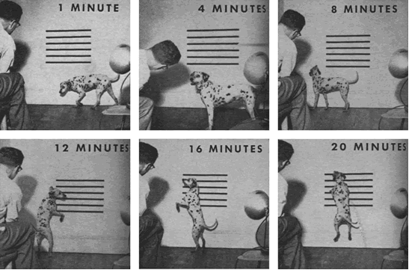
Skinner attached some horizontal stripes to the wall which he then used to gauge the dog's responses of lifting its head higher and higher. Then, he simply set about shaping a jumping response by flashing the strobe (and simultaneously taking a picture), followed by giving a meat treat, each time the dog satisfied the criterion for reinforcement. The result of this process is shown below, as it was in LOOK magazine, in terms of the pictures taken at different points in the shaping process. Within 20 minutes, Skinner had Agnes "running up the wall"
Pigeons

Slide 34
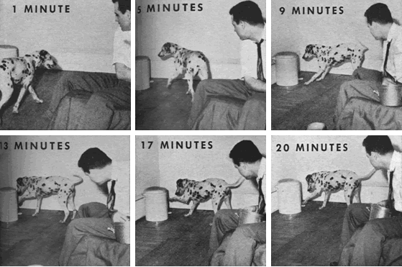
For the second shaping demonstration, Skinner trained Agnes to press the pedal and pop the top on the wastebasket. Again, the photographer's flash served as the conditioned reinforcer, and each step in the process was photographed. The results are shown below.

Slide 35
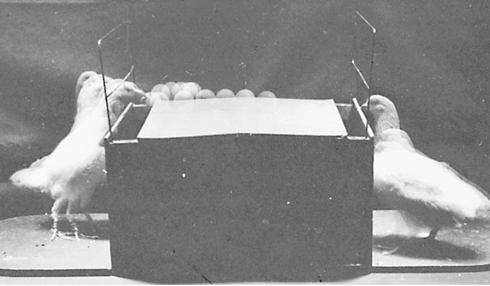
Operant conditioning principles were used to train these pigeons to play Ping-Pong. Shaping

Slide 36
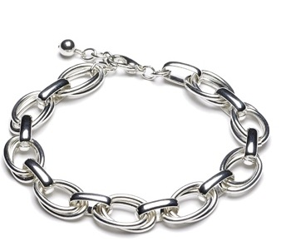
Chaining
A # of responses successively in order to get a reward

Slide 37

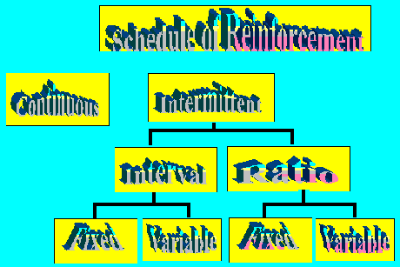
Schedules of Reinforcement

Slide 38
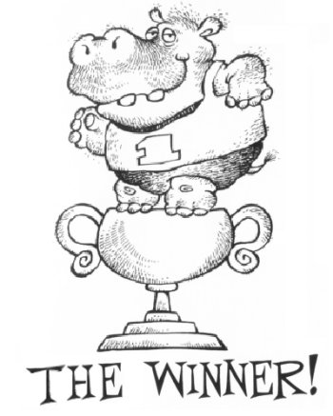
Continuous Reinforcement
Reward follows every correct response
Learning occurs rapidly
Behavior extinguishes quickly once reinforcement stops.
Once that reliable candy machine eats your money twice in a row, you stop putting money into it.

Slide 39
Partial Reinforcement
Reward follows only some correct responses
Learning takes longer
More resistant to extinction
Includes the following types:
Fixed-interval (FI) and variable interval (VI)
Fixed-ratio (FR) and variable-ratio (VR)

Slide 40

Fixed-Ratio Schedule (FR)
Reward after defined number of correct responses
Faster = More Rewards
i.e. piece work:
You get $5 for every 10 widgets you make.
Approach 8,9,10, even faster!

Slide 41
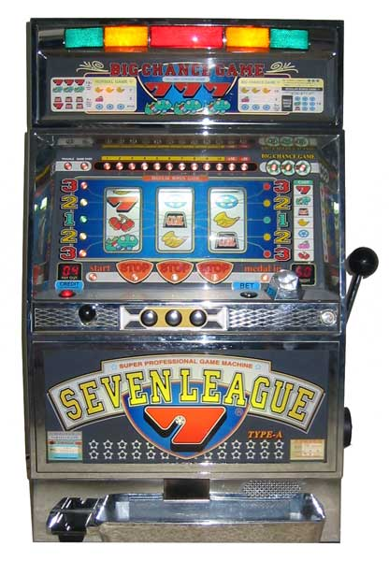
Variable-Ratio Schedule (VR)
Unpredictable number of correct responses
High rates of responding with little pause in order to increase chances of getting reinforcement
This schedule is very resistant to extinction.
Sometimes called the “gambler’s schedule”; similar to a slot machine or fishing

Slide 42
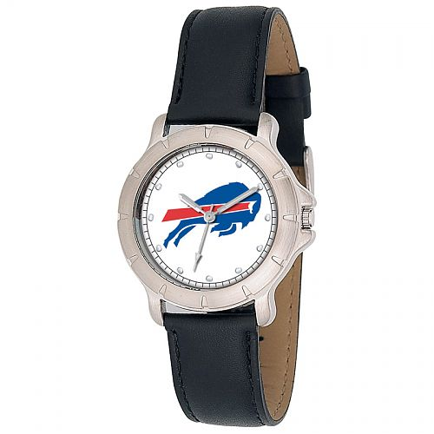
Fixed-Interval Schedule
defined period of time
Produces gradual responses at first and increases as you get closer to the time of reinforcement
Example: a known weekly quiz in a class, checking cookies after the 10 minute baking period.

Slide 43
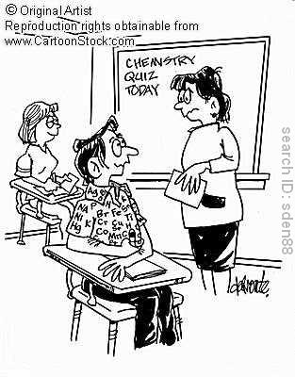
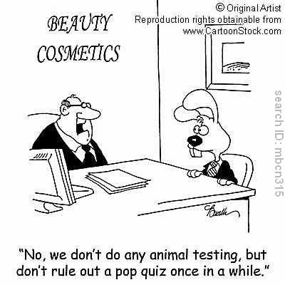
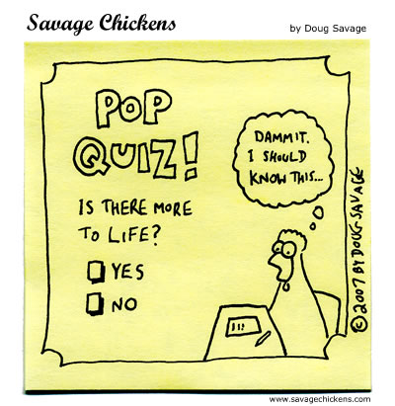
Variable-Interval Schedule
unpredictable amount of time
Produces slow and steady responses
Example: truly “pop” quiz in a class

Slide 44
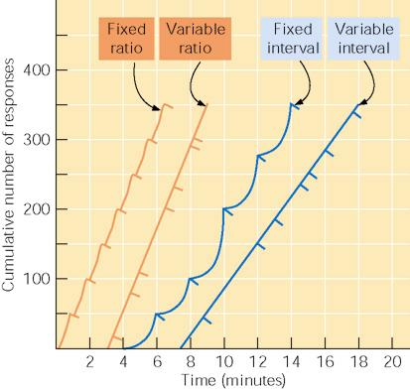

Slide 45
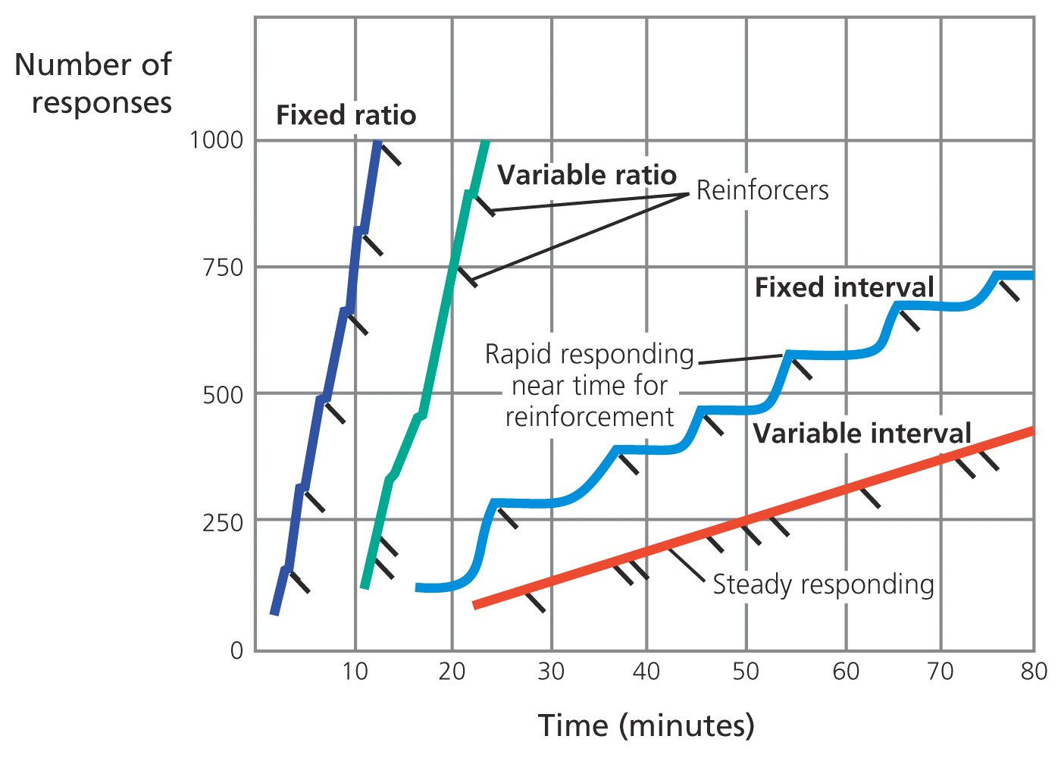
Schedules of Reinforcement

Slide 46
Lessons
Resistance to extinction
Variable > Fixed
Why?
Noticing a break in the pattern is harder

