Slide 1
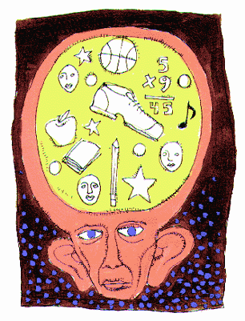
Memory
Chapter 9
☺

Slide 2
Journal: Day 6
If you could have your memory of any part, event, period, instance, etc. of your life erased what would you chose and/or would you do it?

Slide 3
Journal: Day 7
In your everyday life, what sorts of strategies do you use to help you remember things you don’t want to forget? (i.e. studying for a test, remembering all the things you must do in a day, attempting to remember the name of someone whom you have just met, etc.)
How, or why, do you think these strategies work or not work for you?

Slide 4
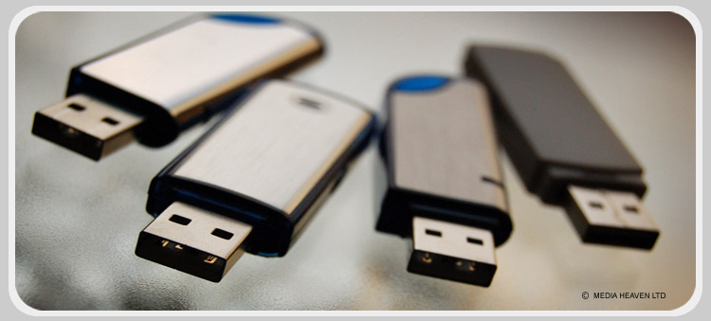
Introducing Memory

Slide 5
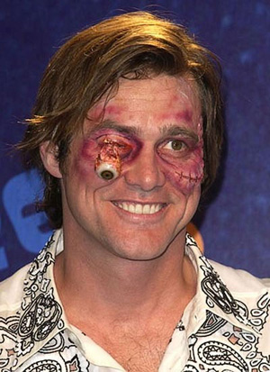
What is Memory?
If technological advances would allow it, would you ever want to intentionally get rid of memories of some specific events?
Eternal Sunshine of the Spotless Mind (Chapter 7: Empty Your Life; 7 min.)
  Clementine is Joel’s girlfriend
  Clementine has their troubled relationship erased from her memory
  Joel finds out and seeks similar treatment
  But, as the memory fades, Joel changes his mind and seeks to reverse the process
If you were a Holocaust survivor, would you want that memory erased?

Slide 6
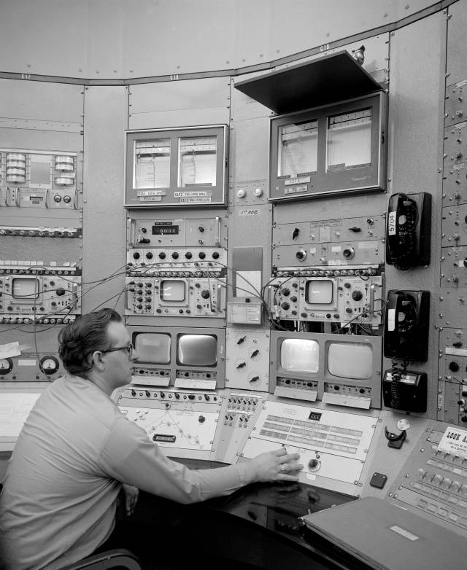
The Phenomenon of Memory
*Introduction
*Information Processing

Slide 7
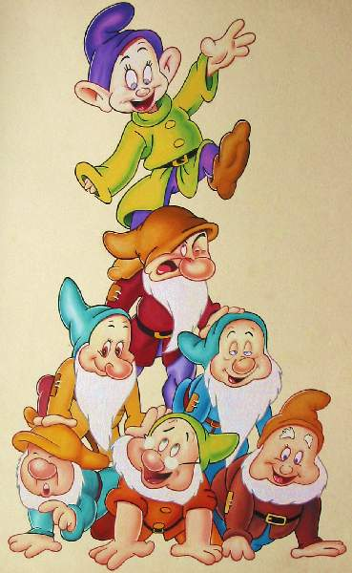
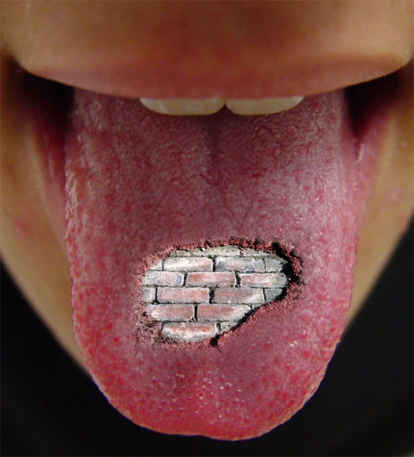
Can you name…
On paper, write down the 7 dwarfs BE SILENT!!!!
Difficulty of task
  Easy or hard for you…why?
Tip of the tongue phenomenon
  Did you feel that you knew a name but couldn’t retrieve it?
  What did you know about it?
    Syllables?
    Beginning letter? (s and d occur most frequently)
    Meaning / connotation?

Slide 8
7 Dwarfs
Organization by sound, letter, and meaning
  Were wrong responses similar in sound? 5 of 7 end in y-sound & have 2 syllables
  Did you recall Lazy, Clumsy, Droopy, or Grouchy? They are similar in meaning to the real names!
  Most likely to be recalled vs. least = Sleepy, Dopey, Grumpy, Sneezy, Happy, Doc, and Bashful
  Most likely to recall the 5 rhymers in a row (orgo by sound)
Recall vs. Recognition
  Recall is a 2-step process (generation of targets and identification of correctness)
  Recognition eliminates the 1st step

Slide 9
7 Dwarfs
Which “store” of memory did we access when I asked you this question?
LTM
What is this process of accessing this info called?
RETRIEVAL
Now, turn paper over and write down the 7 dwarfs again!
Now, which “store” of memory is the information being “retrieved” from?

Slide 10
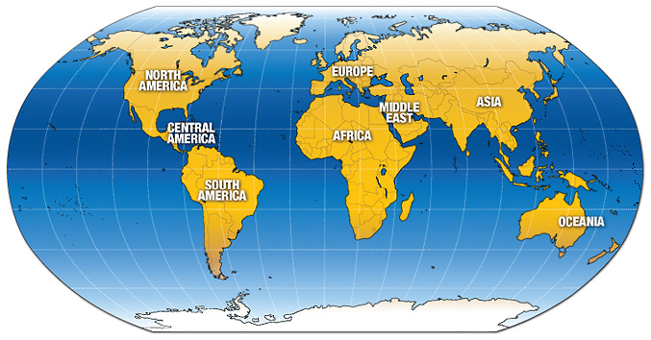
World Memory Championships
10 events over 2 days
Records:
  Single deck of cards = 34 seconds
  Random digits in 1 hour = 1620!
  Random cards in 1 hour = 22.5 packs
  Binary numbers in 30 minutes = 2745
  Jr. Record: 7-year-old David Seidel of Germany 630 binary digits in 30 minutes

Slide 11
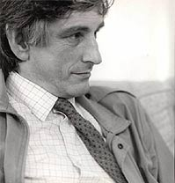
The Case of Clive Wearing
Mind 11-2
Types of Memory
  Episodic is totally gone
  Procedural is still there though!

Slide 12

Flashbulb Memories
Write down in a sentence or two each of your most vivid memory from your life.
How many remember the moment when:
9/11 occurred
Princess Diana’s death
Often, these societal event type of memories can be somewhat constructed (inaccurate) in our minds because of other people’s accounts of the same events
Actually, however, most flashbulb memories (and more accurate ones) are of personal events:
  Car accident
  Early romantic experience
  First public speaking performance
  First airplane flight
  First time your parents left you alone
Defined: clear memories of emotionally significant moments or events and thus differ from other memories in their striking clarity

Slide 13
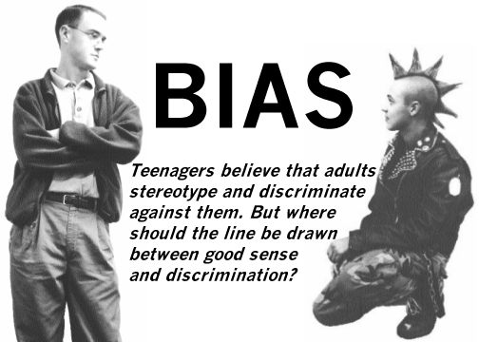
Bias in Memory
Close your eyes
Imagine a standard loaf of bread
Estimate its size with your hands and freeze
Open your eyes
Near and Far Sighted individuals both overestimate the object’s size
Blind participants are the MOST ACCURATE!
WHY?
Blind ppl do not rely on visual memory! Rather, they rely on manual representations. Therefore, we can assume then that visual memory is not a true reflection of reality.

Slide 14
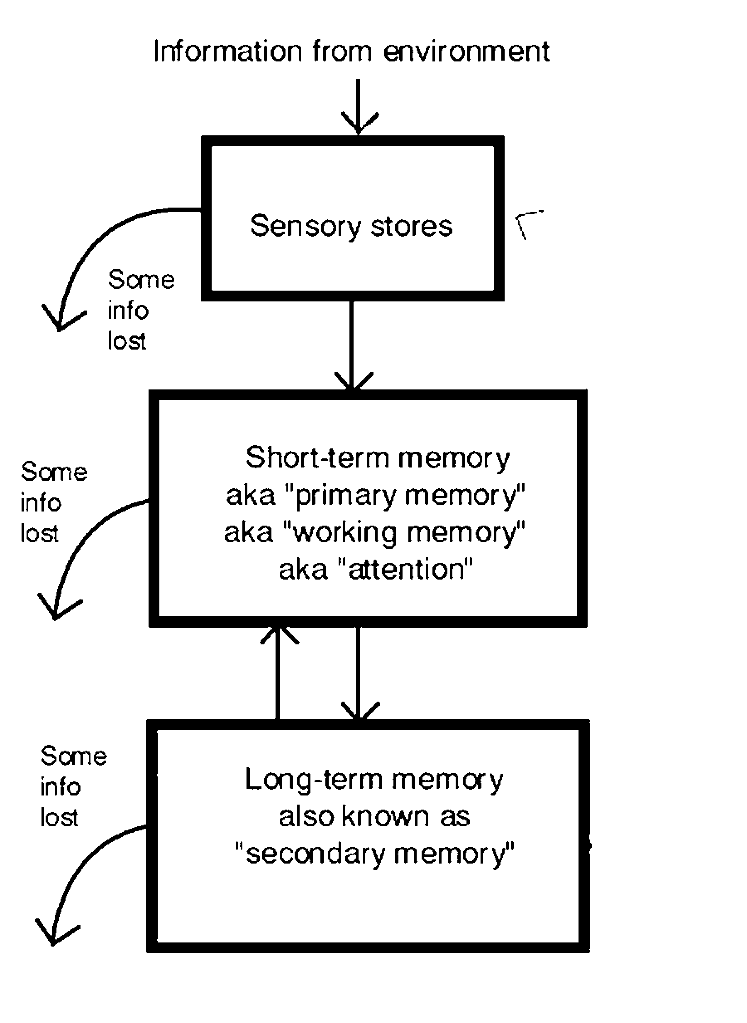
INFO PROCSSING:
3 Box Model
Atkinson & Shriffrin (1968)
Sensory stores = split second holding tank

Slide 15
Memory Stores &
The 3 Stages of Memory
Storage is at the heart of memory. Three stores of memory are shown below:
Sensory
Memory
Working
Memory
Long-term
Memory
Notice: Working memory is the new name of STM because it emphasizes a more active role of REHEARSAL and association with existing memories
Encoding
Events
Encoding
Retrieval
Retrieval

Slide 16
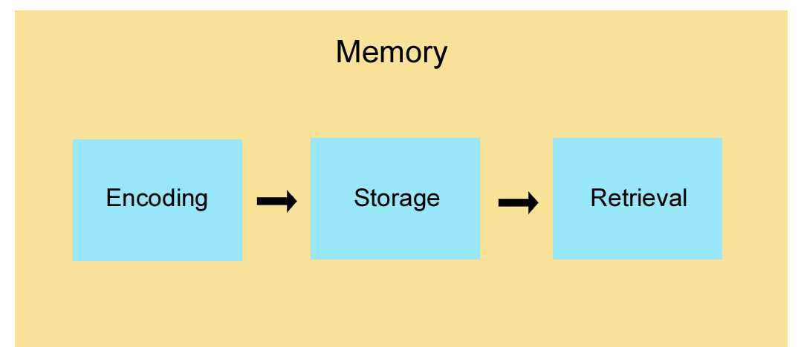

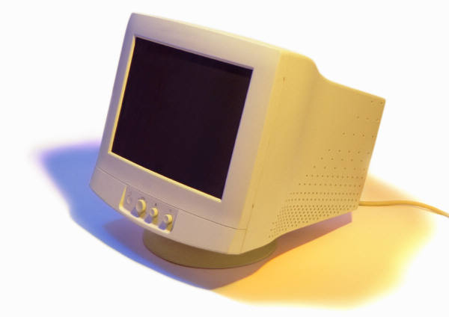
Stages of Memory: 3 Processes
Keyboard
(Encoding)
Disk
(Storage)
Monitor
(Retrieval)
Sequential Process

Slide 17
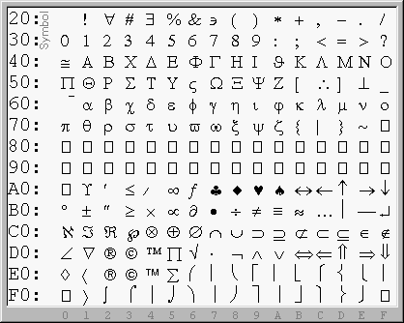
Encoding:
Getting Information In
*How We Encode
*What We Encode

Slide 18
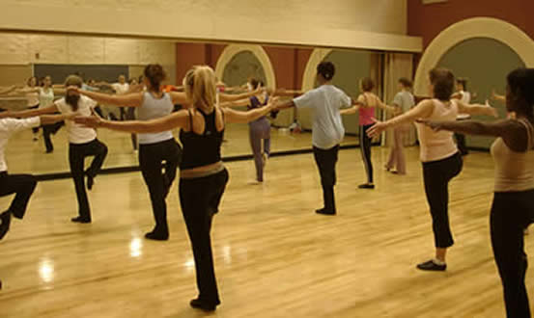
Rehearsal
An executive process (effortful rather than automatic) in working memory
In other words, its consciously controlled
Example in Gray
Can you name all the presents in the “12 Days of Christmas?”
Let’s create a frequency chart (pg.8)

Slide 19

Serial Position Effect
Remember the following list of groceries:
(pg9)
Which did you recall?
First 1/few = Primacy effect
Last 1/few = Recency effect
Together, this makes up the serial position effect
Similar effects include:
  Next-in-line effect: tendency to forget what the person ahead of us in line has said b/c we are focusing on what we will say in our upcoming turn to speak
  Spacing effect: given equal amounts of time, it is easier to retain info if we practice it repeatedly vs. 1 long session (TRY IT OUT w/ AP Psych vs. some other less important class!)

Slide 20
Encoding
Handout 9-3 (pg.9-10)
DON’T GO ON UNTIL THE EXPERIMENT IS COMPLETE!
Control: 2-14 typically right
Imagery Group: 12-20 typically right
Lesson: visual encoding (imagery) is usually better than acoustic encoding

Slide 21
The Self-Reference Effect
Number a scrap sheet of paper 1-18.
I will read a list of adjectives.
CIRCLE the # of any of the adjectives if you feel it describes you.
Read list on 9-4
Good…we’ll come back to this later…put it away.
LATER
Write down any of the 18 adjectives I read aloud, regardless of whether you circled its corresponding circle.
Distribute 9-4 (overhead to demonstrate the process)
WHY?
Even more elaborate than visual or auditory or semantic! The self is one of the most highly elaborated structures in memory…therefore, tying the adjective to your self would provide the most access points to that info later
DEFINED: making info “relevant to me” forces deeper processing and therefore allows for easier access

Slide 22
Meaning and Memory
Now, we’ll do an exercise about encoding based on meaning.
I will read a passage. When I say so, write down as much as you can remember (word for word as much as possible)
Half the room GET OUT!
DON’T GO ON UNTIL THEY ARE OUT!
Tell students in room “THE CONTEXT IS KITE FLYING.”
Have other students come back in
Read page 11 italics
Even a simple sentence is easier to recall with context and meaning.
Read page 11 bottom (1), (2), and (3)

Slide 23
Semantic Encoding of Pictures
(SKIP !)
Distribute Handout 9-5
KEEP UPSIDE DOWN…
Turn the handout over and study the two figures (briefly)
B is, “An early bird who caught a very strong worm.”
Give me back the pictures
DON’T GO ON UNTIL LATER!
LATER: recall them both by writing the figures down on a scrap paper
Which one is recalled better? WHY?

Slide 24

Imagery
1st Trial: Remember this list: tiger, butterfly, iced tea, sweat, monkey, flag, newspaper, iPOD, fire, Iraq, dwarf
2nd Trial: B: Remember this list: time, peace, store, clean, arrogant, stereo, principle, deserve, love, direction, science
Which is easier to remember? WHY?
DEFINED: We remember words that lend themselves to picture images better than we remember abstract, low-image words

Slide 25

Mnemonic Devices
I need some volunteers to orally create a list of 10 concrete objects.
1 at a time please
As each is said, I need a volunteer to write each in order behind the screen. WRITE CLEARLY!
SILENTLY!!! Remember them.
Recall them by writing them down in order.
Does Mr. Filipowicz remember them? Let’s find out.

Slide 26
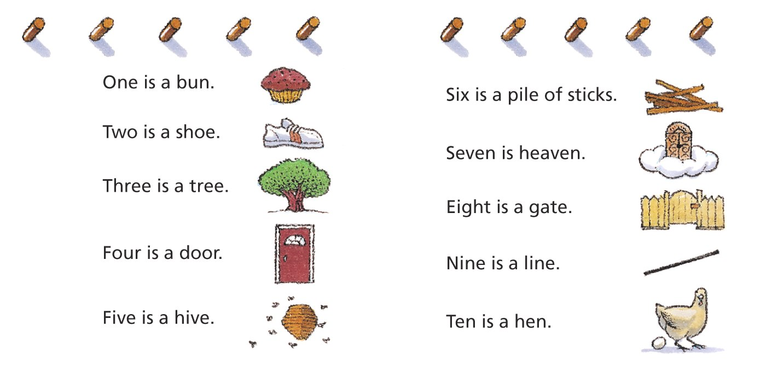
Peg Word System
Peg Word System

Slide 27
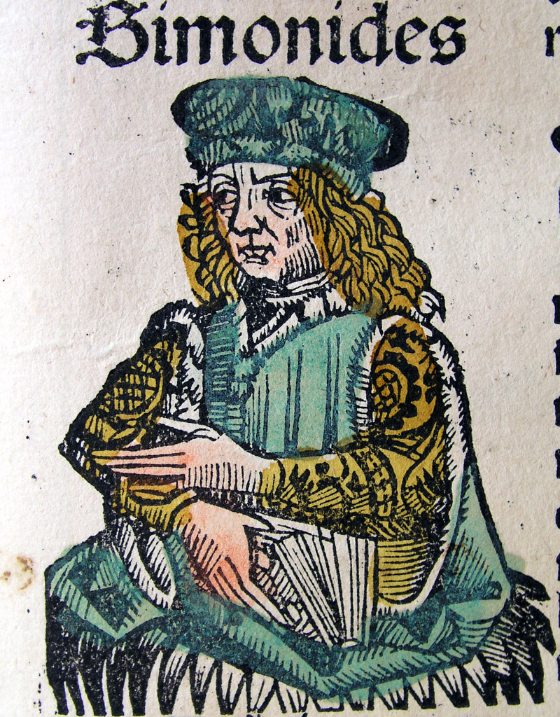
Method of Loci: Simonides
Read pg. 12
Places: baseball field positions (or any sport), rooms of your house, places along your drive to school

Slide 28
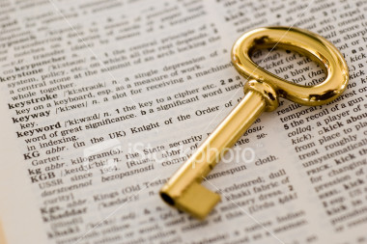
The Key Word Method
Useful for parts of the brain perhaps?
USE IT if you can remember the mental pictures
Distribute copies of page. 13 chart

Slide 29
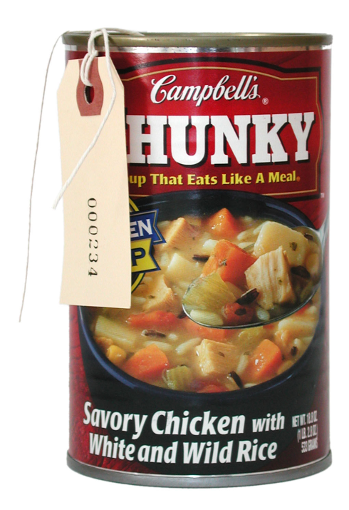
Chunking
How many sentences are there in the Pledge of Allegiance?
1!!!
Half the room leave…(13)
Control: Remember the following list of 12 numbers…recall on paper when I say so
Experimental: Other half also remember the list…recall on paper when I say so
Defined: clustering of info into familiar, manageable units, such as 757-867-5309

Slide 30
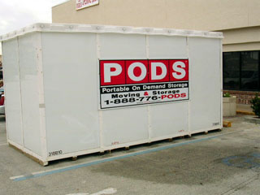
Storage: Retaining Information
*Sensory Memory
*Working / Short-Term Memory
*Long Term Memory
* Storing Memories in the Brain

Slide 31
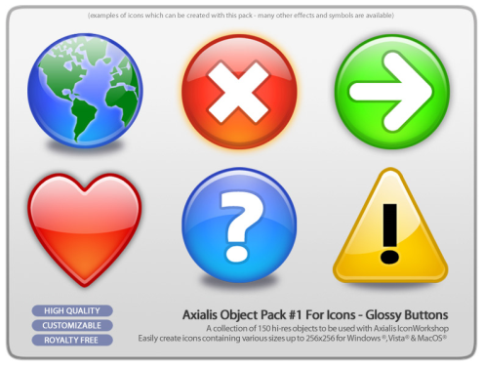
Iconic Memory
Time Dependent: PSYCH SIM 5 or other powerpoint
KNOW THIS EXPERIMENT: George Sperling’s 3x3 matrix of letters
Free recall of all 9, 44% accuracy
Directed recall (through a tone) = approaches 100% accuracy
Time delayed directed recall = 33%
What does it prove exactly?
  We have a sensory memory store that allows iconic memories to be stored for a very brief period
  If it is not processed immediately, it is erased / never makes it to working or long term memory
DEFINED: momentary sensory memory of visual stimuli, a photographic or picture-image memory lasting less than a second

Slide 32
Whole Report
George Sperling (1960)
R G T
F M Q
L Z S
“Recall”
R T M Z
(44% recall)
50 ms (1/20 second)
The exposure time for the stimulus is so small
that items cannot be rehearsed.

Slide 33
Partial Report
S X T
J R S
P K Y
Low Tone
Medium Tone
High Tone
“Recall”
J R S
(100% recall)
50 ms (1/20 second)
Sperling (1960) argued that sensory memory capacity was larger than what was originally thought.

Slide 34
Time Delay
A D I
N L V
O G H
Low Tone
Medium Tone
High Tone
“Recall”
N _ _
(33% recall)
Time
Delay
50 ms (1/20 second)

Slide 35
Sensory Memory
The longer the delay, the greater the memory loss.
80
60
Percent Recognized
40
20
0.15
0.30
0.50
1.00
Time (Seconds)

Slide 36
Sensory Memories
The duration of sensory memory varies for the different senses.
Echoic Memory Example:
Person 1: “What time is it?”
Person 2: “What did you say? Oh, 2:30”
Echoic memory holds the sound of the question for 3-4sec. You can “hear” the words when you turn your attention to them!
THIS IS ANNOYING!
Iconic
0.5 sec. long
Echoic
3-4 sec. long
Hepatic
< 1 sec. long

Slide 37
Working Memory
Sensory
Memory
Working
Memory
Long-term
Memory
Encoding
Events
Encoding
Retrieval
Retrieval
Notes:
OBJECTIVE 9| Describe the duration and working capacity of short-term memory.

Slide 38
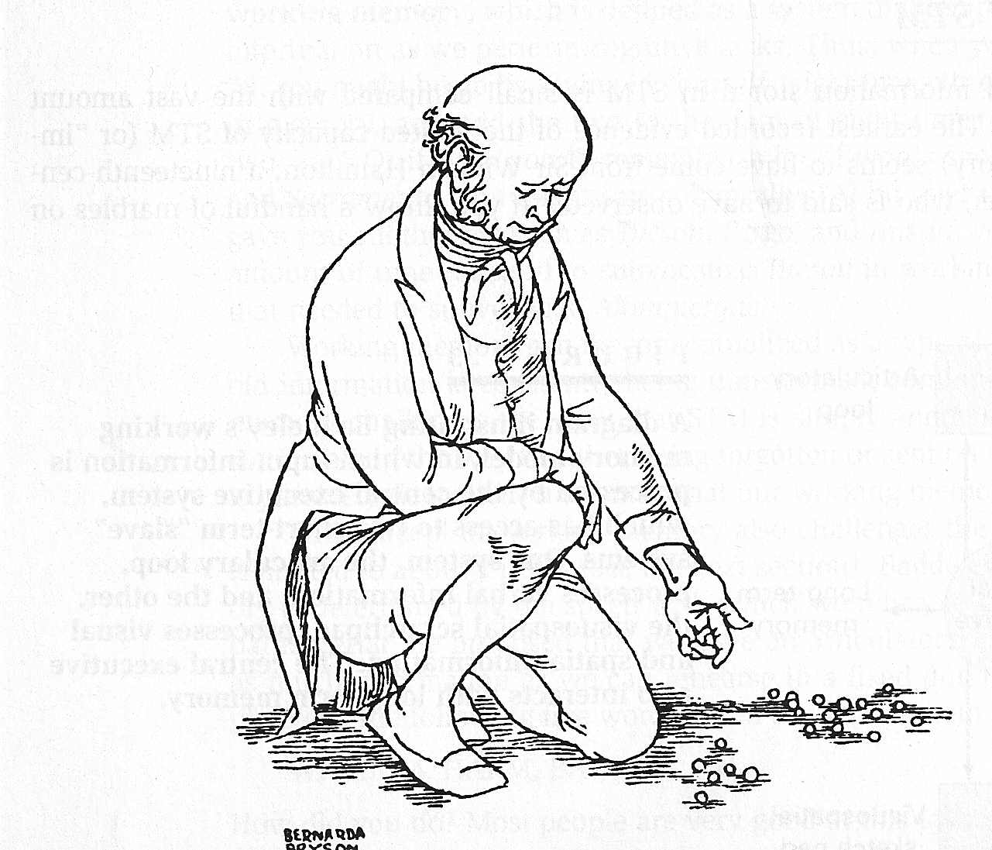
Working Memory
Working memory, the new name for short-term memory, has a limited capacity (7±2) and a short duration (10-30 seconds).
Sir George Hamilton observed that he could accurately remember up
to 7 beans thrown on the floor. If there were more beans, he guessed.

Slide 39
Memory Capacity
I will read a series of numbers.
Your job is to remember them as I say them and them recall and write them all down in order when I say so
“Ready?” “Recall,” are the cues (14)
Mean for the class should approach 7+/- 2
  Recall for random digits is slightly better than for random letters (also slightly better for info we hear vs. see)
Time Dependent: Psych Sim 5: STM
Memento: We will watch this at the end of the year!
  Chapter 3 (6:25 to 11:05) It’s Like Waking
  Chapter 6 (22:15-28:28) Memories Can be Distorted

Slide 40
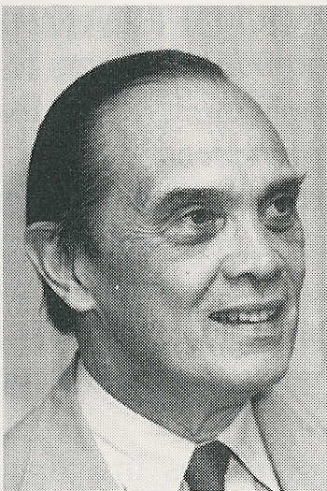
Capacity
The Magical Number Seven, Plus or Minus Two: Some Limits on Our Capacity for Processing Information (1956).
Ready?
M U T G I K T L R S Y P
You should be able to
recall 7±2 letters.
But, you can get more if you practice!!! "Example in Gray“
Need another example?: pg. 14 list of numbers
George Miller

Slide 41
Rajan Mahadevan
Who can recite the most digits of Pi?
U of Tennessee psychologist from India can recite the first 31,811 digits of Pi !! (Read 15)
Says he can’t explain how he does it, but observationally we see that he rocks his chair rhythmically and taps his feet
Strangely, it’s over for #’s. He is quite average for faces, names, words
Please remember the following sequence of 30 numbers in order! (Lift the screen) (15)
4-9 average
10-19 good to extraordinary
20-30 brilliant
Brain: #20 “A Super-Memorist Advises on Study Strategies”

Slide 42
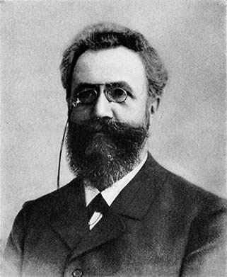
Rehearsal
KNOW THIS GUY & His study with nonsense syllables
Effortful learning usually requires rehearsal or conscious repetition.
Ebbinghaus studied rehearsal by using nonsense syllables: TUV YOF GEK XOZ
http://www.isbn3-540-21358-9.de
Hermann Ebbinghaus
(1850-1909)

Slide 43
Storing Memories
Brain 2-16: The Locus of Learning and Memory
Brain 2-18: Living with Amnesia: The Hippocampus and Memory
Brain 2-17: Learning as Synaptic Change
Psych Sim: When Memory Fails

Slide 44
Long-Term Memory
Sensory
Memory
Working
Memory
Long-term
Memory
Encoding
Events
Encoding
Retrieval
Retrieval
Notes:
OBJECTIVE 10| Describe the capacity and duration of long-term memory.

Slide 45
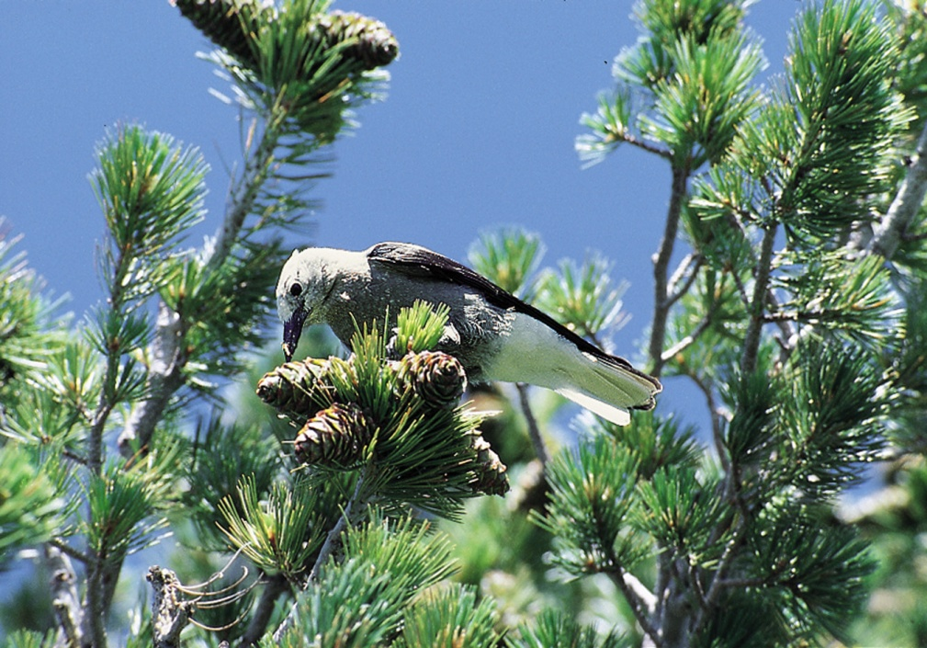
Long-Term Memory
Unlimited capacity store. Estimates on capacity range from 1000 billion to 1,000,000 billion bits of information (Landauer, 1986).
R.J. Erwin/ Photo Researchers
The Clark’s nutcracker can locate 6,000 caches of
buried pine seeds during winter and spring.

Slide 46
Memory Stores
Feature | Sensory Memory | Working Memory | LTM
Encoding | Copy | Phonemic Visual Rehearsal Attention | Semantic
Capacity | Unlimited | 7±2 Chunks | Very Large
Duration | 0.25 sec. | 10-30 sec. | Years

Slide 47
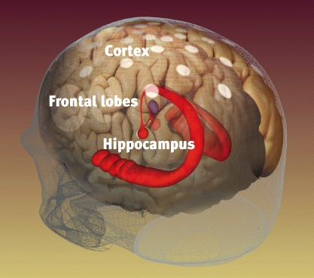
Hippocampus
Hippocampus / temporal lobe :
a neural center in the limbic
system that processes explicit memories.
Remember Clive Wearing? He had encephalitis. Lost explicit, but not implicit memory
Weidenfield & Nicolson archives

Slide 48
LT Explicit Memories
Explicit memories (declarative) = conscious memories of facts or events we actively try to remember
Types of explicit:
Semantic = general knowledge of the world, stored as facts, meanings, or categories (What is the meaning of the word “dubious?” or What is the capital of Florida?)
Episodic = specific events (When did you last go out on a date?), information linked to their identity (think: This was an event in my life.)

Slide 49
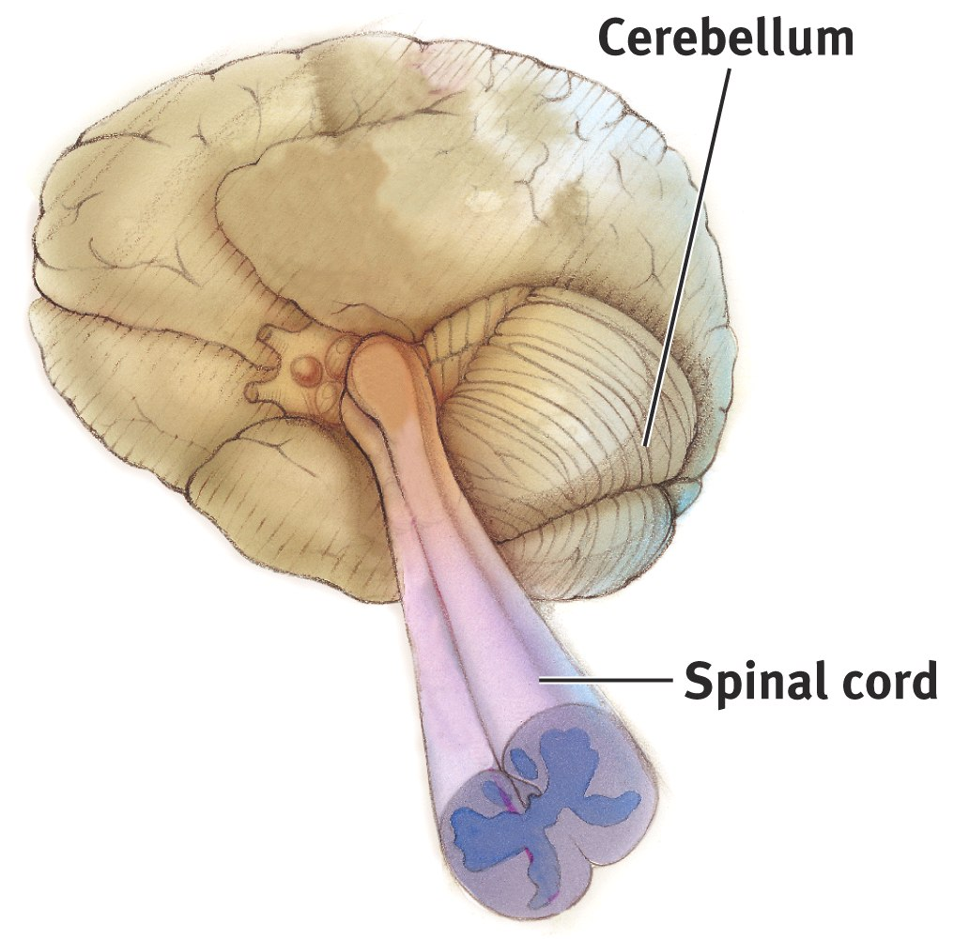
Cerebellum
Cerebellum – a neural center in the hindbrain
that processes implicit memories.

Slide 50
LT Implicit Memories
Implicit memories (nondeclarative)= unintentional memories that we might not even realize we have
Types of Implicit:
Procedural = skills and how to perform them, often difficult to put into words (How does one shoot a free throw?)
A Golf Story (pg. 16)

Slide 51
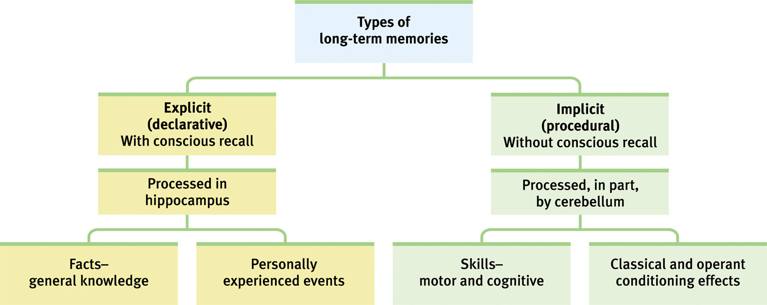
Storing Implicit & Explicit Memories
Explicit Memory refers to facts and experiences that one can consciously know and declare. Implicit memory involves learning an action while the individual does not know or declare what she knows.
Notes:
OBJECTIVE 13| Distinguish between implicit and explicit memory, and identify the main brain structure associated with each.

Slide 52
Eidetic (Photographic) Memory
Alexandra Luria studied this
Found a patient who could repeat a list of 70 letters or digits up to 15 years after hearing it ONCE!!!
This occurs extremely rarely!

Slide 53
Anterograde Amnesia
After losing his hippocampus in surgery, patient Henry M. (HM) remembered everything before the operation but cannot make new memories. We call this anterograde amnesia.
WHAT ARE YOU BEING TESTED ON???? THAT WILL TELL YOU WHETHER IT’S ANTERO OR RETRO GRADE AMNESIA
Memory Intact
No New Memories
Anterograde
Amnesia
(HM)
Surgery

Slide 54


Implicit Memory
HM is unable to make new memories that are
declarative (explicit), but he can form new
memories that are procedural (implicit).
A
B
C
HM learned the Tower of Hanoi (game) after his surgery. Each time he plays it, he is unable to remember the fact that he has already played the game.

Slide 55
Retrieval:
Getting Information Out
*Retrieval Cues

Slide 56
Recognition vs. Recall
Distribute 9-7a to everyone…
Study for 1 minute
Distribute 9-7b to ½ of students
Recall as many of the sentences as possible

Slide 57
Recall Experiment
I will show you a set of words. Try to remember as many as possible. (pg. 18)
DON’T GO ON UNTIL THIS IS DONE!
How many remember the word aardvark?
How many remember the word tired?
How many remember the word sleep?
Perhaps, this created for you an experience of deja-vu.
Defined: when associations cause a person to feel that an event has occurred when really it has not

Slide 58
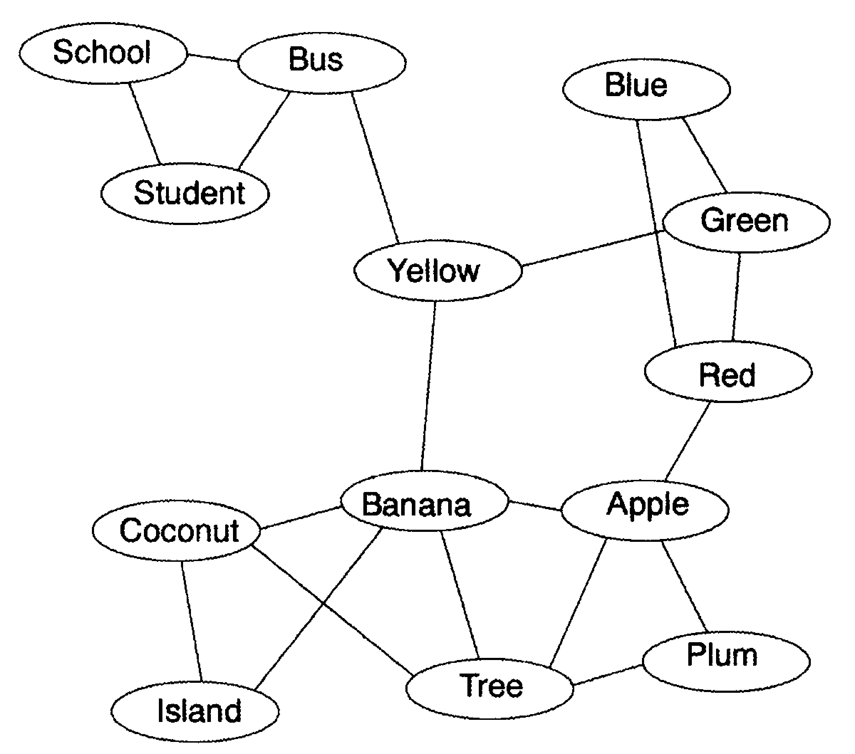
Priming

Slide 59
Some Interesting Facts
About Deja-Vu
Decreases with age
Increases with educational level
More common among those who travel, remember their dreams, or have liberal political and religious beliefs
Is most likely to be triggered by a generally physical context, though spoken words are enough to produce the illusion
Is relatively brief (10-30s) and is more frequent in the evening than in the morning; more on weekend than weekdays

Slide 60
State and Context
Dependent Learning
DEFINED: When memory retrieval is influenced by body state and environmental factors; if your body state / environment is the same at the time of learning AND the time of retrieval, retrievals will be improved
  If Robert is drunk and forgets where his car is parked, it will be easier to recall the location if he gets drunk again!
  Take your Physics test in your English room? Won’t do as well!
So, when studying for the AP PSYCH EXAM, here are some helpful hints:
  Use smells to remember different things, then reproduce those smells in the test room
  Wear the same clothes while studying and taking the exam

Slide 61
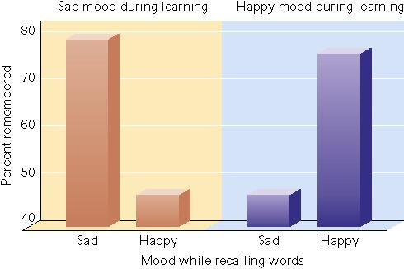
Fig. 9.15 The effect of mood on memory. Subjects best remembered a list of words when their mood during testing was the same as their mood was when they learned the list. (Adapted from Bower, 1981.)
Table of Contents
Exit

Slide 62
3 Explanations of It (18-19)
Biological dysfunction
Divided perception
Implicit familiarity in the absence of explicit recollection

Slide 63
Forgetting
*Encoding Failure
*Storage Decay
*Retrieval Failure

Slide 64
Change Blindness
Page 231 of book: Remember the switch-a-roo the people with the billboard pulled?
The experimenters were all college students
College students tended to notice the change more than older people
WHY? College students noticed the differences in people most like them
Change the participants to construction workers, now the college students perform equally badly

Slide 65
More Encoding Failures
(21)

Slide 66
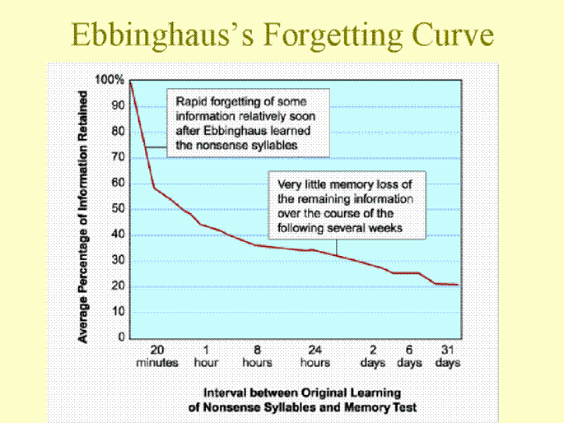

Slide 67
Memory Stores
Feature | Sensory Memory | Working Memory | LTM
Encoding | Copy | Phonemic | Semantic
Capacity | Unlimited | 7±2 Chunks | Very Large
Duration | 0.25 sec. | 10-30 sec. | Years

Slide 68
Retrieval Failures
How is that forgetting journal going?
PsychSim 5: Forgetting

Slide 69
Repressed Memories
Clean sheet of paper
I will read a word and say “first, second, or third”.
You write down the 1st, 2nd, or 3rd answer that comes to mind
Fold and save for next time
LATER: write down as many of your answers as possible
Next, on a separate list, I’ll say the original stimulus.
How many “repressed memories” did we recover?
It’s not necessarily repressed memories, but rather we had to create the proper context for you to recall your answers
For therapists, the trick to “recovering repressed memories” is to elicit the proper feelings, moods, images, and so forth of their patients’ pasts

Slide 70
Even More (!) Theories of Encoding & Retrieval Failures
Retroactive Interference: Tendency for new learning to interfere with retrieval of old learning
Proactive Interference: Prior learning inhibits (interferes with) recall of later learning
WHAT ARE YOU BEING TESTED ON? THAT IS THE KEY TO RETRO VS. PRO
A Different Way to Think About it / Some Examples

Slide 71
Memory Construction
*Misinformation and Imagination Effects
*Source Amnesia
*Discerning True and False Memories
*Children’s Eyewitness Recall
*Repressed or Constructed Memories

Slide 72
The Misinformation Effect
Young children and elderly are particularly susceptible to the misinformation effect.
Ways to get the misinformation effect:
Exposure to subtle misinformation
Asking leading questions can plant false memories
  Ppl fill in gaps in memory with plausible guesses
Vivid retellings may implant false memories
Repeated imaging and rehearsing nonexistent events

Slide 73
Source Amnesia
Source Monitoring = ability to recall the source of a fact
Develops between 3 & 5, mature by 6
Psychologists orally teach children a bunch of novel facts (Nile is the longest river in the world)
1 day later, 70% of 4 year olds remember the facts
Almost all, though, were unable to recall where they learned this information. Most said from a parent, teacher, or the media. 6-8 year olds knew they were just taught that yesterday by the psychologists.

Slide 74
Source Amnesia
Ppl w/damage to prefrontal cortex have difficult in identifying sources
Apparent more in the elderly
Kids have poor episodic memory. WHY?
Inability to bind together specific combos of memory characteristics (perceptual, contextual, affective info)…memories for real events vs. imagined generally include more perceptual info (color), more spatial-temporal info, and more meaningful details than memory for an imagined event

Slide 75
STORY TIME!!!

Slide 76
Demonstration of Superiority of Recognition over Recall
Read list on page 28
Recall as many as possible (1 min)
Handout 9-9 (Recognition: 1 min)
pain / thread VS point / sharp= Serial Position Effect
How many recalled (3/4) sharp? Recognized?
How man recalled (3/4) hurt? Recognized?
How many recalled (3/4) needle? Recognized?
That’s funny, needle wasn’t one of the words!!!

Slide 77
Repressed Memories
Childhood abuse happens
Current estimates say 18-59% of these cases are not remembered
Taking Sides: Discussion & Debate: Something about Repressed Memories

