Slide 1
New Understandings of Operant Conditioning: The Role of Cognition: Latent, Observational, Abstract, and Insight Learning

Slide 2
Skinner & Thorndike
Believed that cognitions (thoughts), perceptions and expectations have no place in psychology.
This is because they cannot be studied through observation and therefore were seen as not being objective.

Slide 3

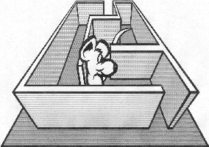
Latent Learning
Learning that takes place in absence of an apparent reward
Idea developed by E.C. Tolman

Slide 4

E.C. Tolman’s Rat Maze Experiment
3 rat groups
The control group, Group 1, was fed upon reaching the goal beginning on day 1.
Group 2 fed beginning on 7th day.
Group 3 fed beginning on 3rd day.
?Group 2 compared to Group 1 on day 7?
?Group 3 compared to Group 1 on day 3?
“Latent Learning” created a “cognitive map” called upon when a reward becomes apparent.

Slide 5
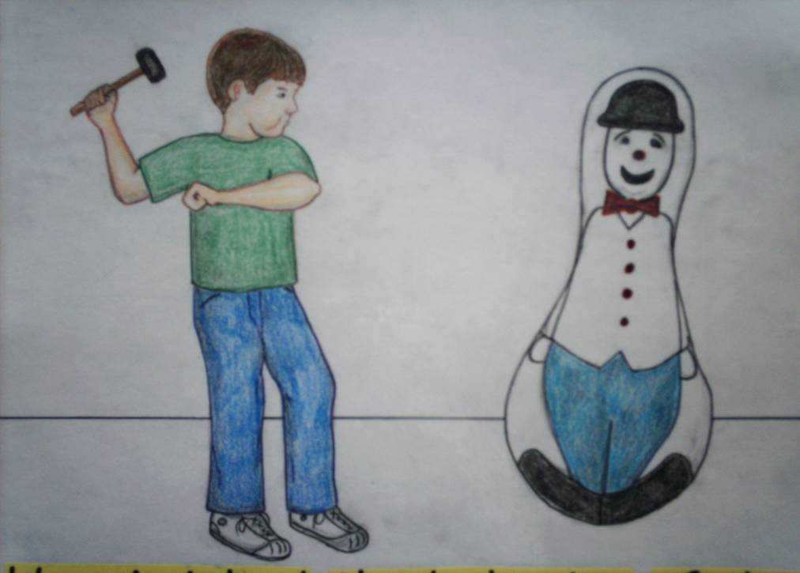
Observational Learning
1965 Bandera's Bobo Dolls (starts @ 1:17)

Slide 6
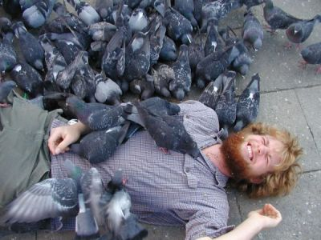

Abstract Learning
Not simple S-R
Pigeons know tree?
Pigeons may learn to peck pictures they have never seen before if asked to pick out the “tree”
Schemas are part of “cognitive psychology”

Slide 7
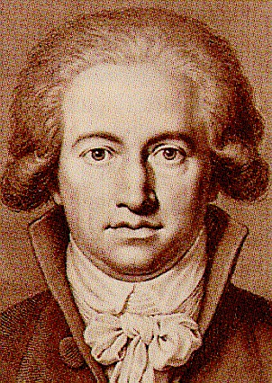
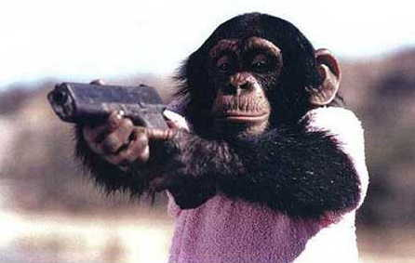
Insight Learning
Wolfgang Kohler & chimpanzees
“ah-hah!” moments in learning
Insight NOT due to gradual strengthening of the S-R connection
Chimps, bananas, and boxes
Apes Problem Solving
Ape plays PacMan
http://www.pigeon.psy.tufts.edu/psych26/kohler.htm

Slide 8

Overjustification Effect
The effect of promising a reward for doing what someone already likes to do
May destroy natural motivation (intrinsic)
“If I have to be bribed into doing this, then it’s not worth doing for its own sake.”
Rewards do help increase interest when used to indicate a job well done

Slide 9
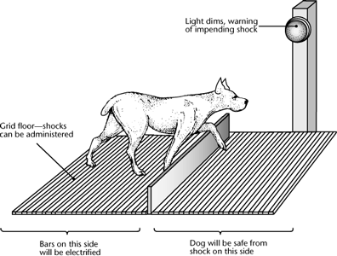
Learned Helplessness
Dogs in electrified cage at first not able to escape the impending shock.
Later, all they had to do was cross to the other side but they didn’t even try.

Slide 10
New Understandings of Operant Conditioning: The Role of Biology

Slide 11
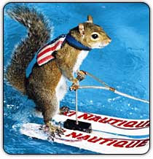
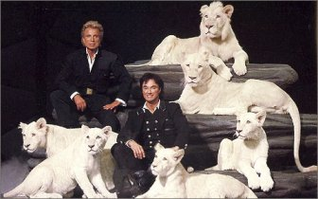
Biological Predispositions
Animal training issues – easier to train behaviors that are closer to natural behaviors using a natural reinforcer (food).
Instinctive drift—naturally occurring behaviors that interfere with operant responses.
What happens when a trained tiger shows instinctive drift?

Slide 12
Instinctive Drift
Animals will not perform certain behaviors that go against their natural inclinations.
Rats will not walk backward
A pig was once trained to put a coin in a piggy bank for a TV commercial,
But, despite rewards, pig started to attempt to bury the coin in the ground
Raccoons, in the same situation, began washing the coin (which is apparently the raccoon thing to do)

Slide 13
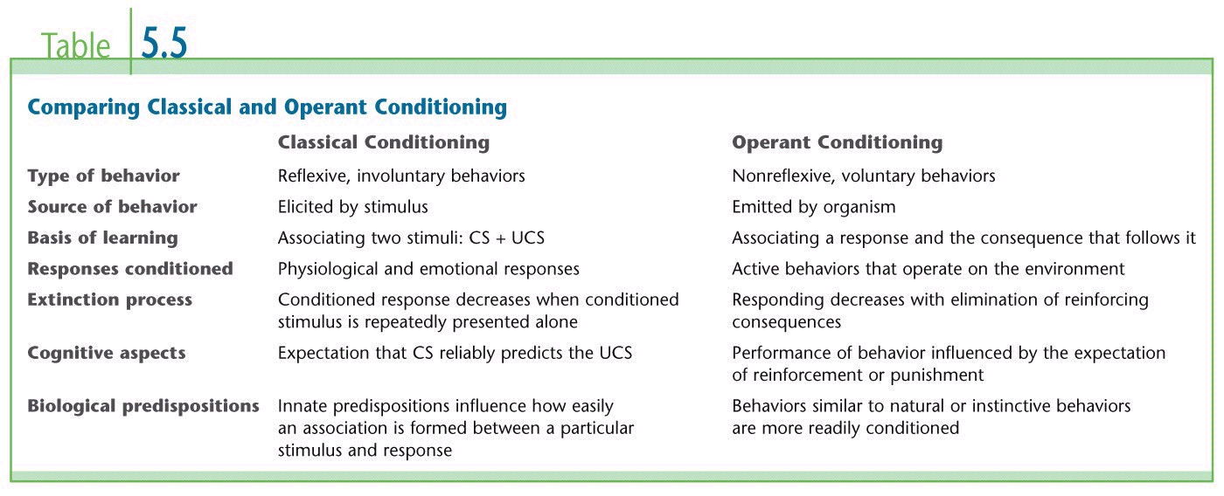
Classical Conditioning vs. Operant Conditioning
Notes:
DiscPsy .193

