Slide 1
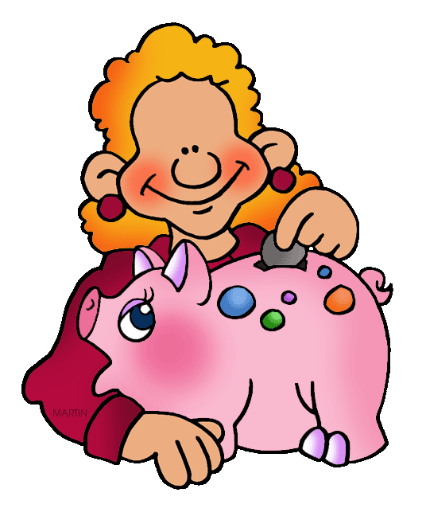
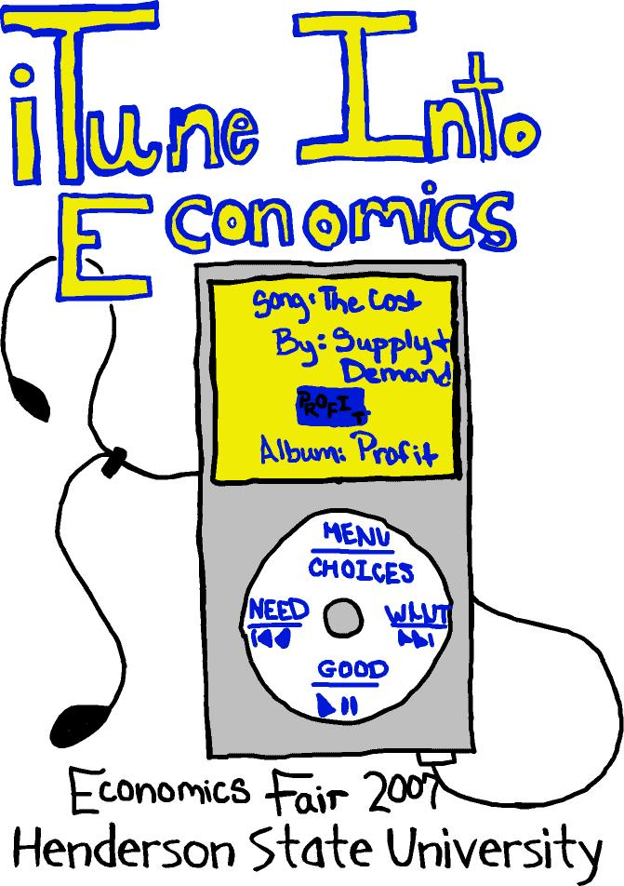
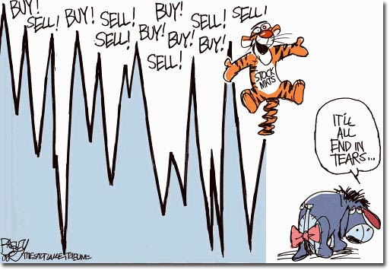
Economics 1
Mr. Filipowicz

Slide 2
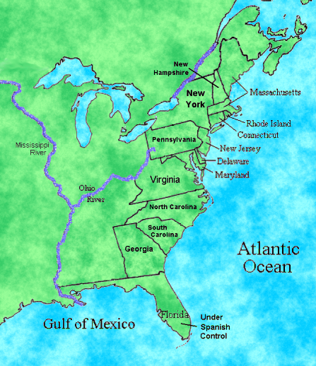
LET’s COLOR!

Slide 3
Colonial Economy Game

Slide 4
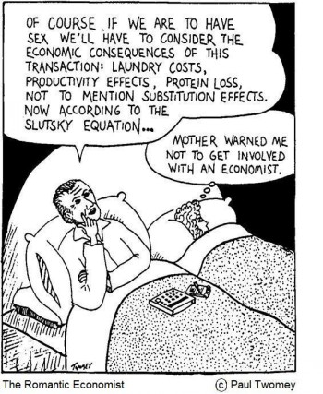

Slide 5

Economic Characteristics
Split South into:
Plantation East
Small Scale West: Appalachian mnts
EVERYONE:
Private Property
Free Trade
Geographically, where would crops best grow? WHY?
Motivations → who cared about making $$?
Place the following:
Cash crops (tobacco, rice, and indigo)
Small scale (subsistence) farming, hunting, and trading x 3
Fishing
Shipbuilding (x2)
Seaports/Commercial Centers
Lumbering
Cities, such as New York and Philly
Manufacturing
Trading
Prosperous, thanks to strong Puritan worth ethic
Notes:
How did the economic activity and political institutions of the three colonial regions reflect the resources, or the European origins of their settlers?

Slide 6
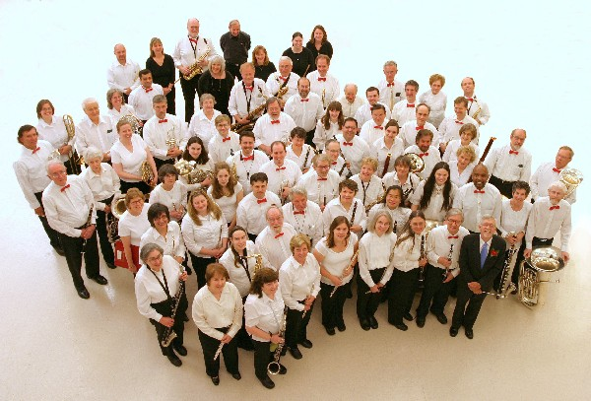
What did Society Look Like?
Split NE:
All Intolerant
RI not (fleeing persecution by Puritans in Mass.
Words to Place (on notes):
Catholics of Maryland
Quakers of Pennsylvania
Religious tolerance
Middle Class (skilled artisans, entrepreneurs, small farms)
Intolerant of other religions / dissenters
Family status and ownership of land
Allegiance to Church of England
Notes:
How did their motivations influence their settlement patterns and colony structures?

Slide 7
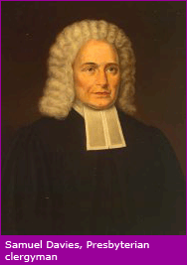
Puritanism
Do you really know what it means & who these people are?
Originally, part of Church of England, wanted to reform it (cleanse or purify it)
Associated with radicals in English Civil War which brought Oliver Cromwell, military dictator
2 Groups:
Congregationalists went to Plymouth (1620s)
Presbyterians: New York, New Jersey (1700s)

Slide 8
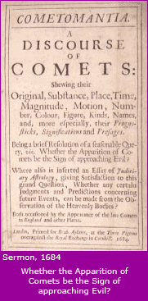
Puritans
Govt should enforce public morality
No drunkenness, gambling, swearing,
Obey Sabbath
Hated Catholicism – ceremonies, hierarchies
Relied upon the Bible, not interpretations
Required a “conversion” experience
All humans are sinful
Some humans are pre-destined for heaven
How do you know? Have you had the conversion?
God does not give extra credit
Why not plunge into despair and give up?

Slide 9
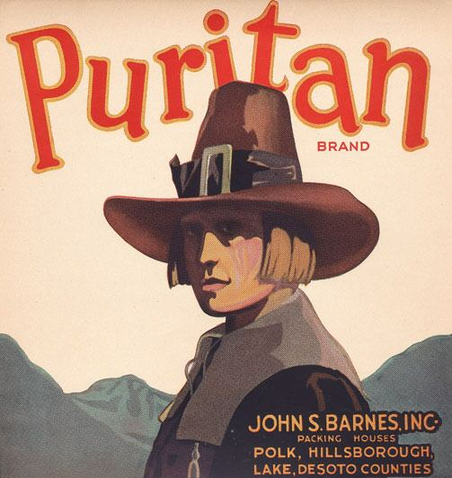
Puritans
“comfortable doctrine” – solace, security, ease of life (don’t worry, be happy)
The roughness of life caused by industrialization / capitalism (rich getting richer, poor getting poorer) was all part of God’s plan, so fear not
No free will, but all must play their part in the meaningful story of God
Good works were an EFFECT of salvation, not a CAUSE

Slide 10
Social Characteristics
Motivations !!!!!!!!! →
So, one religion for all of society = New England
Where would greedy people go? Why would these guys be the closest to England?
Plantations
Church of England (Anglican Church, today known as Episcopalianism)
Religious toleration (vs. religious freedom), with economic opportunity produces MIDDLE CLASS (skilled artisans, entrepreneurs, and middle farmers)
Huguenots (NY)
Presbyterians (NJ)
Catholics (Maryland)
Poor People? Not quite the cities, yet (not enough jobs)
Notes:
How did the social activity of the three colonial regions reflect the resources, or the European origins of their settlers?

Slide 11
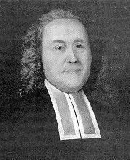
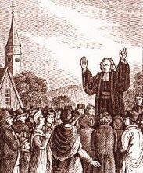
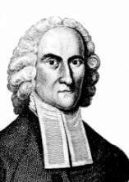
Great Awakening
Religious movement, mid1700s
Evangelical religions challenge traditional order
Methodists
Baptists
“Play-like”

Slide 12
Election of 1828
John Q Adams (National Party) vs. Andrew Jackson (Democratic Party)
Property qualifications eliminated for voting = more people (free white men) vote = Jackson is seen as a man of the people
Jackson easily wins popular (56%) and electoral vote (178-83) against John Q Adams’ reelection bid
Jackson claimed he was a president of the people

Slide 13
FYI
FYI: mudslinging on both sides:
Adams calls Jackson “incompetent both by his ignorance and by the fury of his passions:
Jackson calls Adams a gambling addict at the billiard table and chess set (Adams had bought both for the White House) and an out-of-touch aristocrat

Slide 14
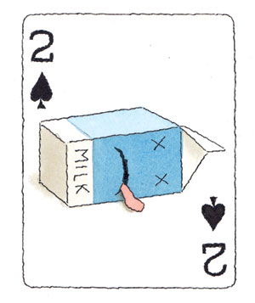
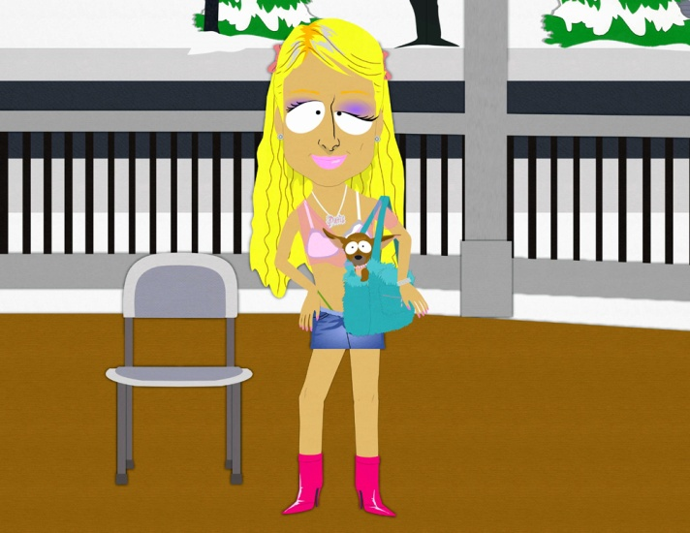
Spoils System
Jackson considered the election a mandate to select officials as he saw fit from his own ranks
Defined = a practice of using public offices to benefit members of the victorious party
Jackson puts his friends and people who were loyal to him in the Cabinet, as judges, all up in the government !!!
Major parties: Democrats led by Jackson, Whig Party (National Republican Party) led by Henry Clay

Slide 15
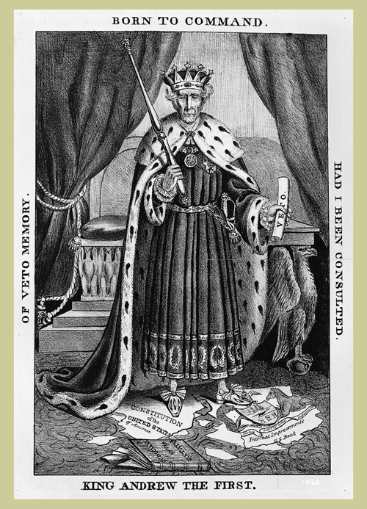

Slide 16

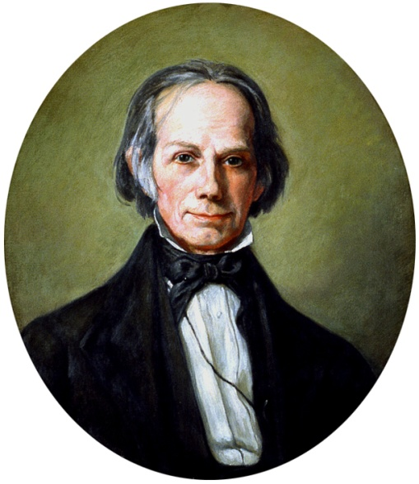
1830s – Emergence of the Whigs
Named after an English political party that attempted to limit the king’s power (Whig )
Platform:
Larger federal government
Industrial and commercial development
Centralized economy
Pro National Bank and Roads
Wanted to limit the power of the executive
Who? Clay, Calhoun, Harrison, Tyler

Slide 17
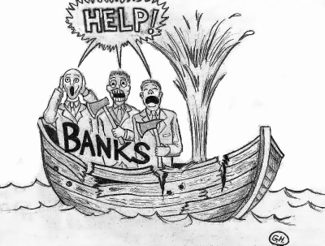
The National Bank
The National Bank (2nd) had been authorized by James Madison for 20 years back in 1816…
Jackson strongly opposed the idea of a national bank because he believed:
it was unconstitutional
it concentrated an excessive amount of the nation's financial strength into a single institution
it exposed the government to control by "foreign interests"
it served mainly to make the rich richer
it exercised too much control over members of the Congress
it favored Northeastern states over Southern and Western states
Americans agreed and Jackson won the Election of 1832
Following victory, he dissolved the Bank of its $$$ and moved the money to state banks instead
Blamed for the Panic of 1837 to follow

Slide 18


Panic of 1837
He had refused to renew the charter of the National Bank
Government withdraws its funds in it
Jackson had stated during his presidency that Gold and Silver were going to replace paper $$$
850 banks in the U.S.
343 closed entirely
62 partially closed
VanBuren is blamed for this because he refused to make the federal government have anything to do with the banking system
This was the 2nd major economic depression (like the Great Depression of the 1920-30s and the Panic of 1819 & maybe the one we’re having now?)
Both Jackson and the next president (Martin Van Buren) are typically blamed for this, but scholars have shown it really had nothing to do with either of them

Slide 19
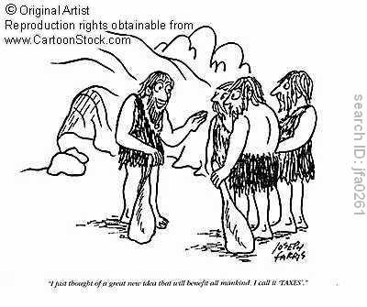
Economic Divisions
North likes tarrifs, South doesn’t.
Why and why not?

Slide 20
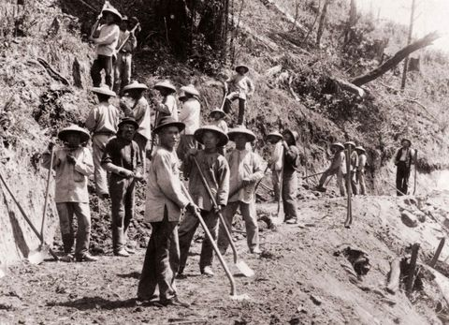
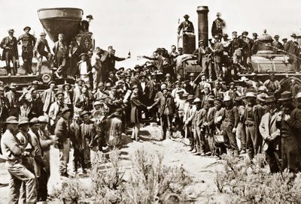
Economic and Social Impact
South destroyed
The few cities that existed were totaled
Richmond, Atlanta
North/MidWest strong, industrial economy
Industrialization will occur here first and fast
Helps to create U.S. as an economic global superpower in the early 20th century
Transcontinental Railroad
Econ Book 21: Growth of the U.S. Economy After the Civil War

Slide 21
