Slide 1
Discussion Topic
Should there be a limit placed on how much money people can make? For example should we cap the salaries of celebrities, sports athletes, and CEOs who make millions and sometimes billions of dollars?
CEOs and BigBucks

Slide 2
Do Celebrities and CEOs Make Too Much Money?
View the "CEOs and Celebs: Making Big Bucks" video and discussion ideas
If the CEO is earning several more times for their companies than they are paid, are they really “overpaid” regardless of how much they make?

Slide 3
Industrial inventions, leaders, and reasons for economic transformations; Creation of international markets
Economics 2

Slide 4

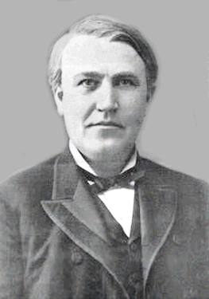
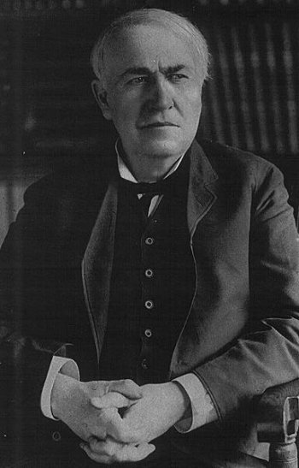
Key inventions
Electricity
Thomas Edison
The Bessemer Process =
Henry Bessmeer, William Kelly
Mass-produce steel from pig iron
Blow air through molten iron…temp raises and oxidation occurs, removing impurities from the iron

Slide 5
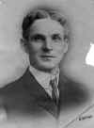
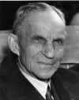
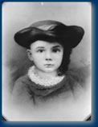
Some key inventions…
Assembly Line
1901: Ransome Eli Olds (Oldsmobile = 1st commercially successful American car)
Henry Ford = 1913-1914: 1st conveyor belt style assembly line
Econ Lesson 23: Bigger is Better: The Economics of Mass Production
(my page 263)

Slide 6
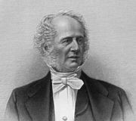
What industry caused the rapid expansion of all other industries?
Railroad
http://www.pleasval.k12.ia.us/juniorhigh/TRRR/transcontinental_railroad.htm: 2 videos
Chief developer: Cornelius Vander “BUILT the Railroads!”
Used steel instead of iron
Married his mother’s sister’s daughter
13 children
Econ Lesson 26: Could the Economy Have Grown without the Railroads?

Slide 7
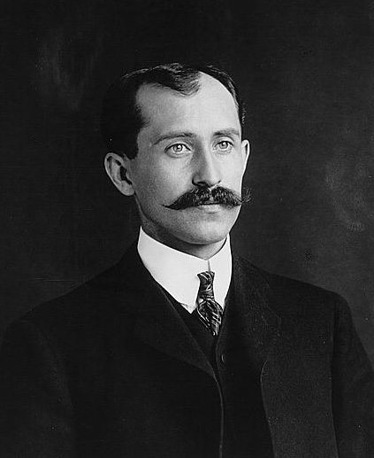
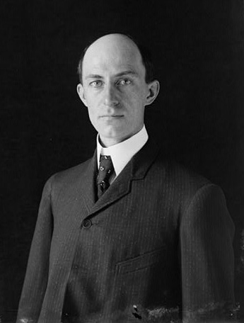
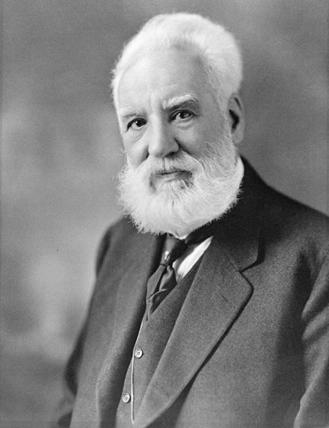
Some key inventions…
1st flight: Orville Wright (and brother Wilbur)
Kitty Hawk, NC
Built bicycles before that
12 seconds
120 feet
Very important to WWI
Telephone: Alexander Graham Bell
Brings women into the workplace

Slide 8
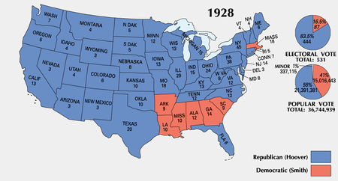
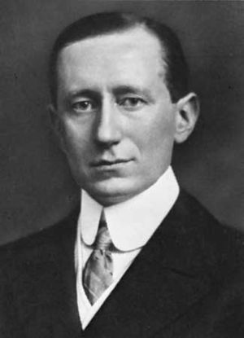
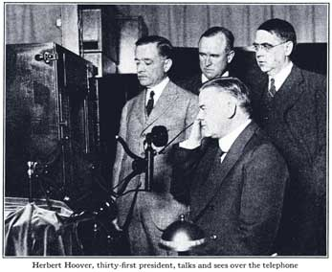
Some key inventions…
Guglielmo Marconi = radio
Won Nobel prize in physics in 1909
Very important to WWI long range communication
1920…1st voice broadcast (the news)
1928 Presidential Election HOOVER!
HOOVER runs for election!
(SMITH sounded too southern!)

Slide 9


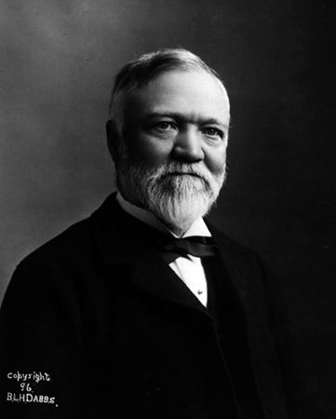
INVENTIONS
Clearly TV and Radio were huge!
Horizontal
The Gap = Banana Republic, Old Navy, and Gap itself
Vertical
Carnegie Steel = mills where steel is manufactured, mines where iron ore is extracted, coal mines that supplied coal, ships that transported the iron ore, the railroads, the coke ovens…etc.

Slide 10
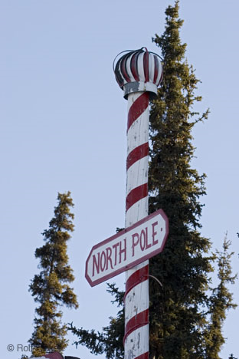
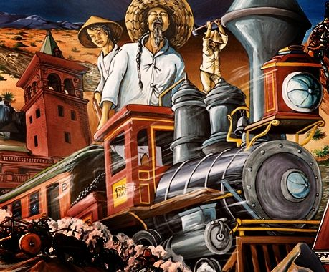
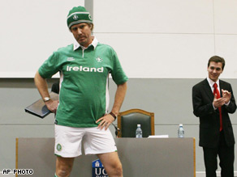
Some Key Immigrants
Chinese
Poles = coal mines of PA, Buffalo, Chicago, Pittsburgh, Milwaukee, Cleveland
Irish / Italians = textile mills (clothing industry)
Supply and demand
high supply of workers = low demand = low wages

Slide 11
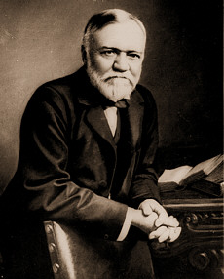
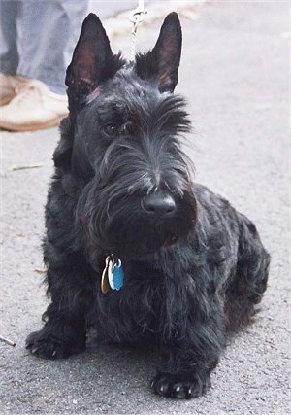


Andrew Carnegie
CARNE “GEEE” STEEL
Poor Scottish immigrant following others to Pittsburgh
1870, Congress passed a $28/ton tariff on imported steel
Millionaire before age 30
The Gospel of Wealth
Gave away $350 million mostly to public libraries and universities
Scottish Terrier→

Slide 12
Price Gouging
Should people be permitted to charge any price they want in a disaster?
What if it’s the best way to get resources to people?
What will enforcement laws capping prices do to the supply of supplies needed following a disaster?

Slide 13
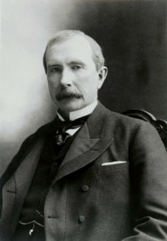
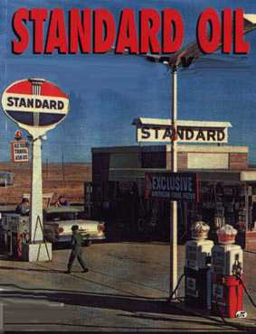
"I had no ambition to make a fortune; mere moneymaking has never been my goal. I had an ambition to build." - John D. Rockefeller.
OIL = John David Rockefeller
Standard Oil Company of Ohio
Cleveland
Demand skyrocketed after 1901…
Standard Oil became a monopoly (aka trust)
Became the wealthiest man in the world (1st billionaire)
Huge Philanthropist
Foundations for medicine, education, and scientific research

Slide 14
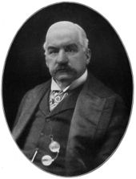
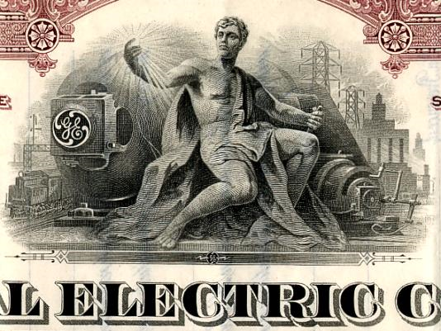
JP MORGAN
formed U.S. Steel Corp. by buying Carnegie Steel from Carnegie for $480 million
Carnegie personally received $225,639,000
Became a huge oil investor and made millions more
Formed General

Slide 15
Why the Growth?
1 Reason: Land Grants given by…
The Homestead Act
Econ Activity Lesson 20:
Was Free Land a Good Deal?

Slide 16
Wow, this makes it easy!

Slide 17
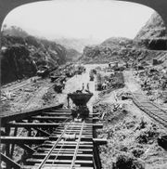
Federal Reserve Act (1913)
12 national banks
Panama Canal
1534: Charles V, Holy Roman Emperor and King of Spain wanted a canal to make sailing between Atlantic and Pacific very easy
French began building it 1880, but gave up due to disease (22,000 died)
1904, U.S. tells Panama it will help them declare independence from Colombia in exchange for control of the area
Mosquitoes spread Yellow fever and malaria spread through that had killed so many French were eliminated thanks to new treatments
Only 5609 US workers died
1977, Jimmy Carter began process of giving up the land to Panama who had student protests arguing that the canal was rightfully theirs
Dec 31, 1999, 12pm, it officially becomes Panama’s possession
Tolls are expensive!! Avg = $54,000

Slide 18
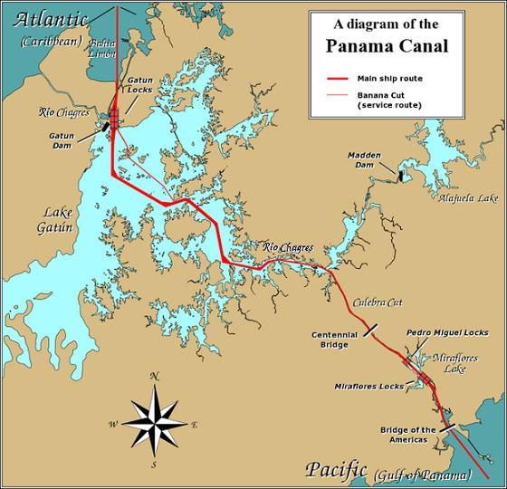
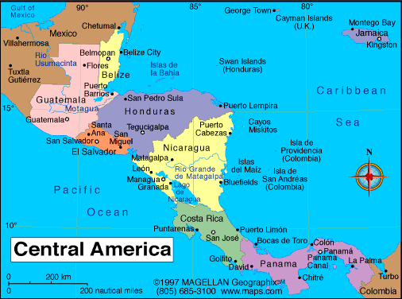

Slide 19
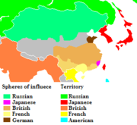
Open Door Policy
1899, we acquired the Philippine Islands and wanted to trade with China
China, though, was controlled by England and other major powers
Taft’s Dollar Diplomacy
Secretary of State: Philander Knox, a lawyer, committed to promote U.S. businesses overseas
JP Morgan threw in a bunch of money

Slide 20
Outsourcing
What does “outsourcing” mean, why are so many American companies doing it?
How can outsourcing jobs overseas allow for those same companies to then hire more workers in the U.S.?
How can outsourcing be good for consumers?
Is the media biased in covering outsourcing?

