Slide 1
World War II Economics
Economic, Human, &
Military Resources

Slide 2
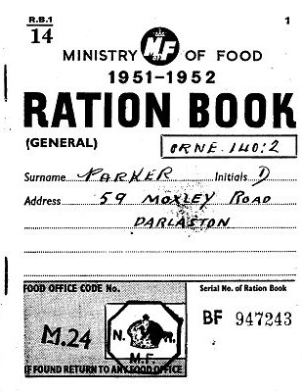
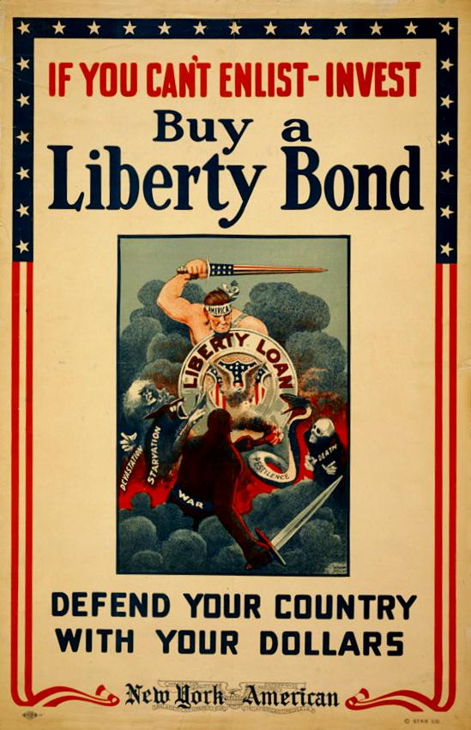
Economic Resources
Govt & Business working together
Rationing to control Supply of Goods
War bonds, income tax = $ for the war.
Business retooled from peacetime to wartime production (e.g., car manufacturing to tank manufacturing).

Slide 3
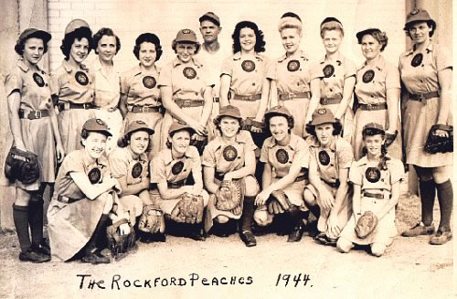
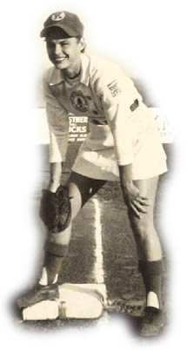
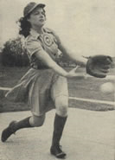
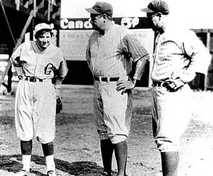
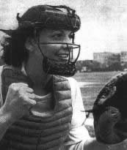
Human Resources
More women & minorities working as men joined military

Slide 4
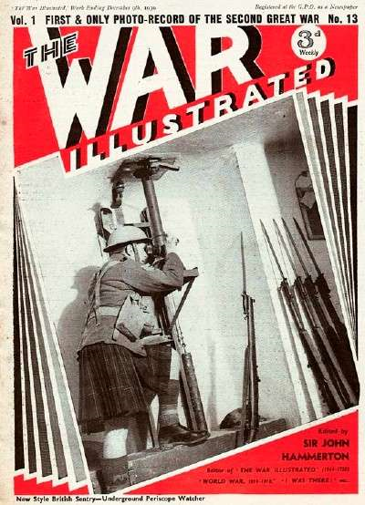
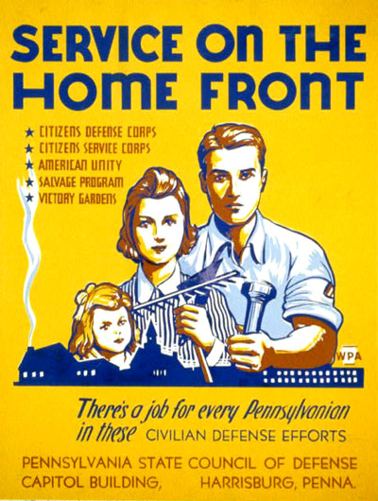
Human Resources
Citizens volunteered in support of the war effort

Slide 5
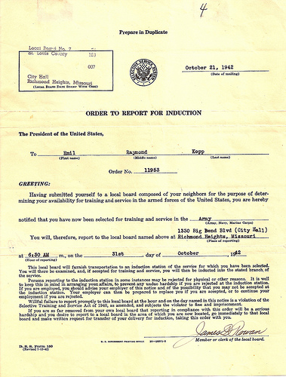
Military Resources
Selective Service Act of 1940
  Required all men age 21 to 35 to register with local draft board
  First peace-time draft in US History
When war began, DRAFT started
  18 to 45 eligible
  18 to 65 had to register
  Could “Conscientiously Object” from combat

Slide 6

Women in the Workforce

Slide 7
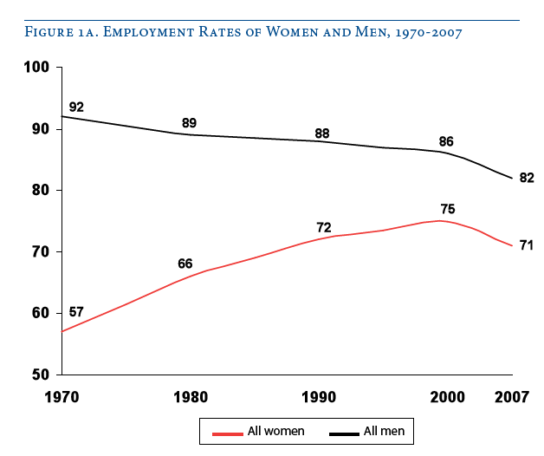

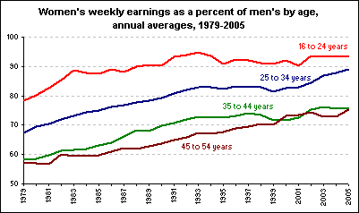
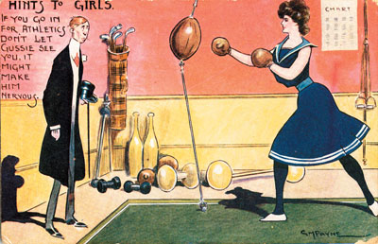
Increased Parp
Ever more women present
How many have working moms?
Non-Traditional Jobs

Slide 8
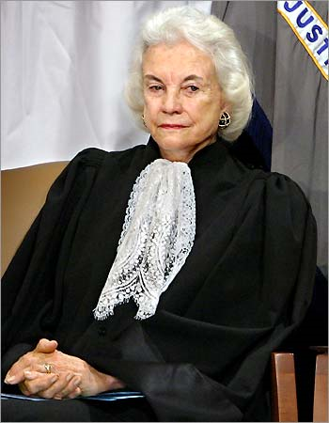
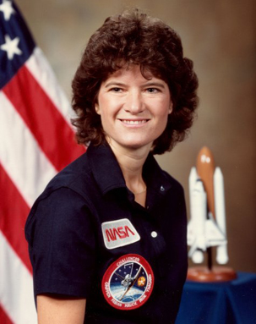
Firsts…
Sandra Day O’Connor
  FWOTSC
  Appointed by Reagan (1981)
  Left in 2006
  Chancellor of W&M!
Sally Ride
  1st woman, youngest astronaut in space (1983)

Slide 9
Remaining Issues for Women in the Workplace

Slide 10

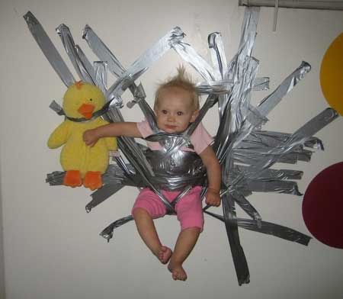
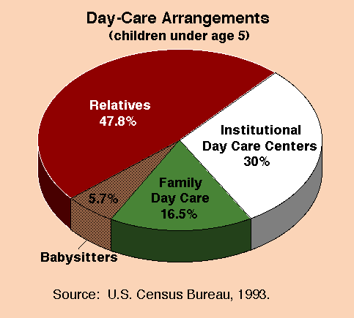
Affordable Day Care

Slide 11
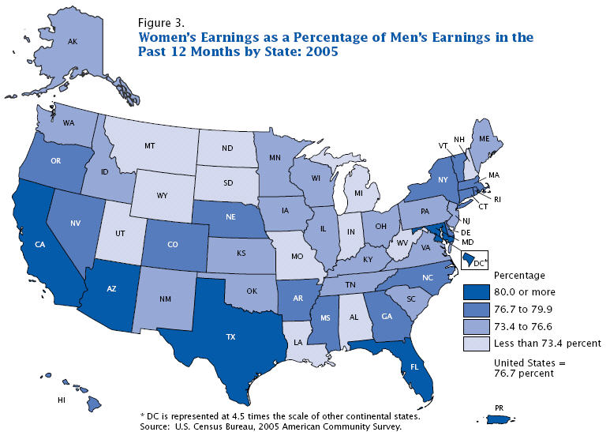
Equitable Pay

Slide 12

Pink Collar Ghetto Jobs
Coined in 1983 to mean:
  Low Prestige
  Low Pay
Airline flight attendants, nurses, secretaries
Hard to escape / advance
Estimated 55% of women working outside the home are in this kind of job

Slide 13
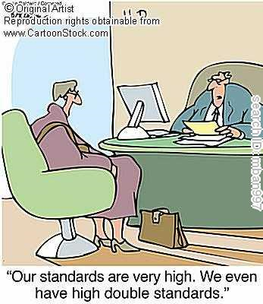
Glass Ceiling
Career Advancement not equal to men

