Slide 1
JOURNAL :
Should there be age restrictions on whether you are allowed to obtain and hold a job (both young and old people)? If so, what age would be the appropriate age to allow/prevent individuals to work? WHY do you choose that/those age(s)?
What about other restrictions?
  Safety?
  Length of work day?
  Anything else!?

Slide 2
Journal:
Today, there are numerous limits to how much any one person can contribute to Presidential candidates and their political parties:
  $2000 limit for an individual to a candidate
  $25,000 limit for an individual to a political party
Some consider the right to give money to any candidate(s) they wish a freedom of speech. Others consider it an unfair principle in a democracy where all individuals are supposedly equal.
Should we allow individuals to contribute to candidates and parties as much money as they would like? Why or why not?

Slide 3
Progressive Movement:
Child Labor
Lewis W. Hine
From 1908 to 1912, Hine took his camera across
America to photograph children as young as three
years old working for long hours, often under dangerous
conditions, in factories, mines, and fields. Hine was an
immensely talented photographer who viewed his young
subjects with the eye of a humanitarian

Slide 4
I want you to take a moment to look at each one of these
pictures and take an educated guess on what type of job these
children are performing.
-- What is their job?
-- How old do they look?
-- What are they wearing?

Slide 5
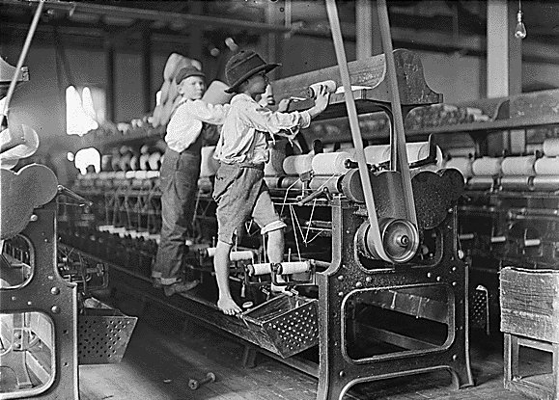

Slide 6
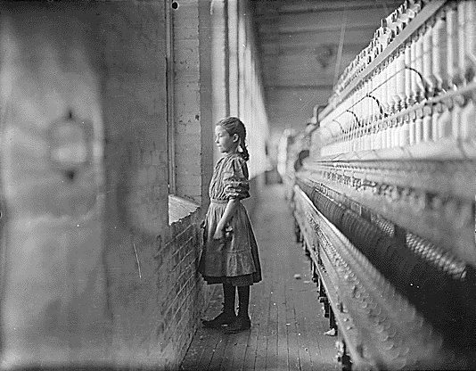

Slide 7
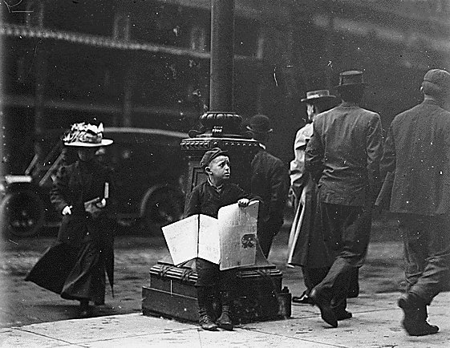

Slide 8
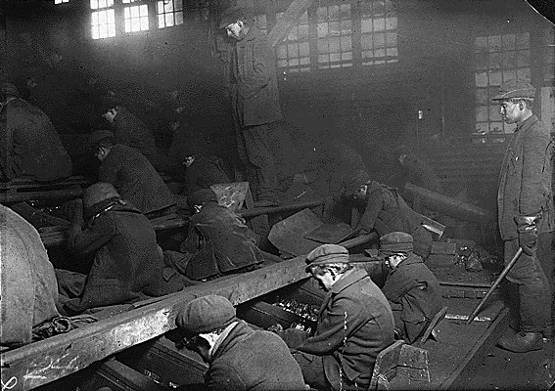

Slide 9
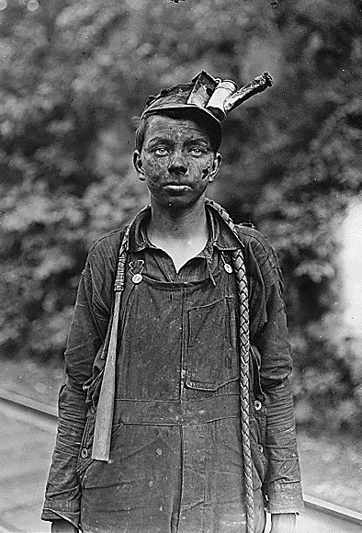

Slide 10
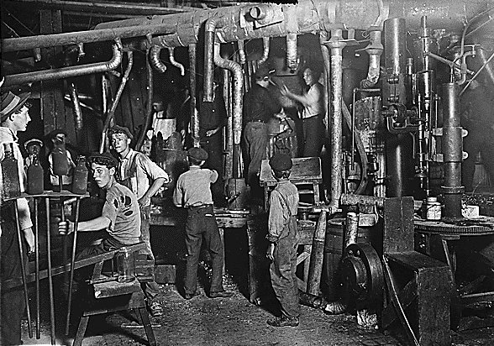

Slide 11
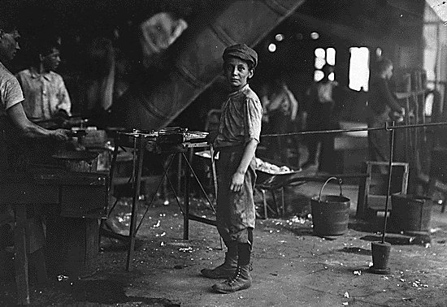

Slide 12
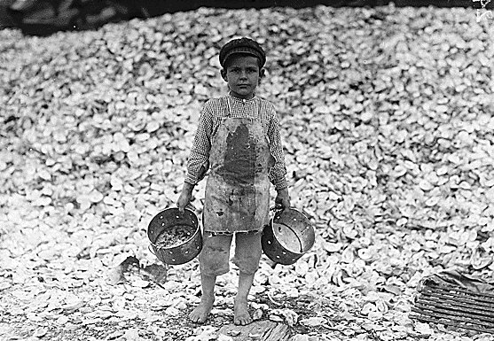

Slide 13
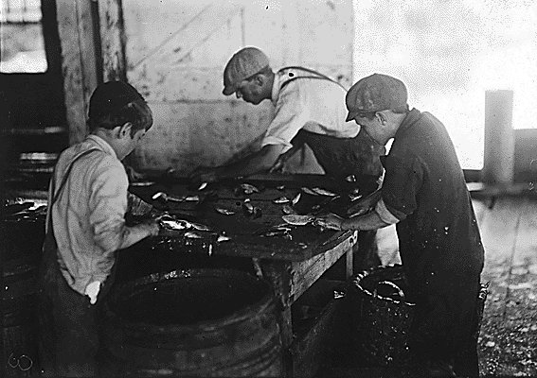

Slide 14
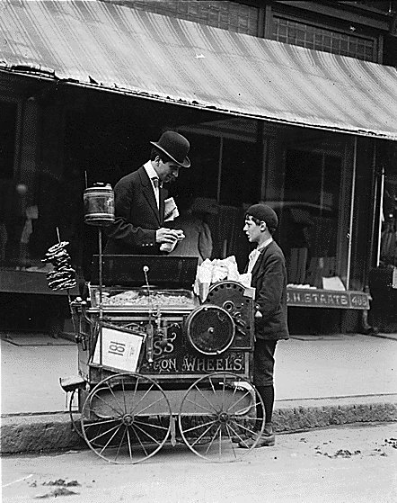

Slide 15
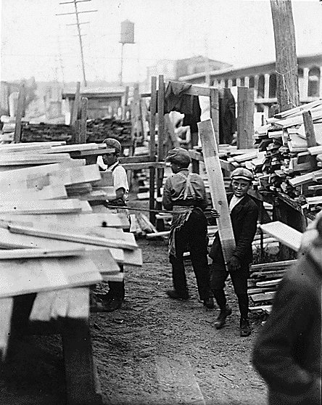

Slide 16
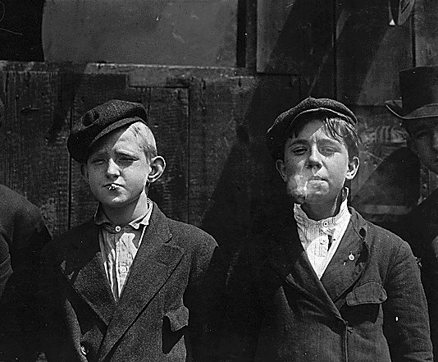

Slide 17
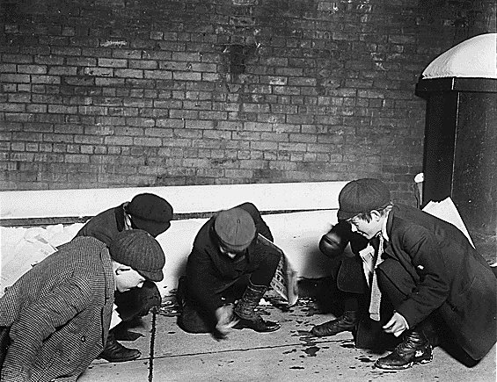

Slide 18
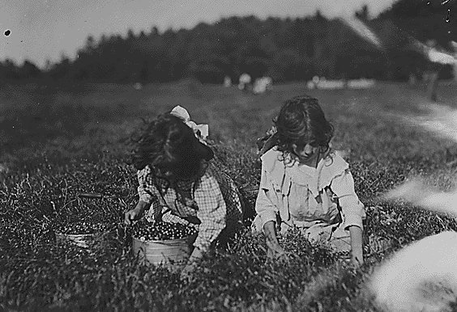

Slide 19
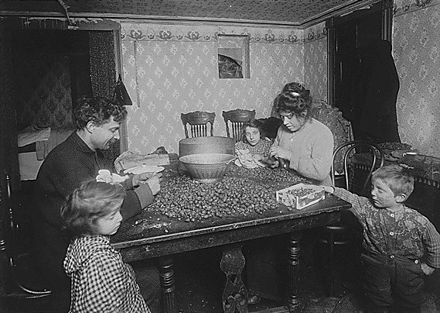
Why Work!!!

Slide 20
Stossel: Sweatshops
Are Sweatshops Allowable?

Slide 21
Progressive Era Goals
Let’s fix this mess!?

Slide 22
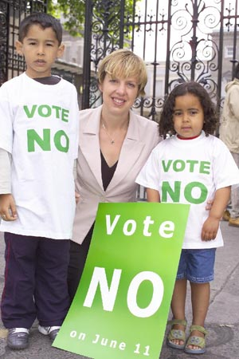

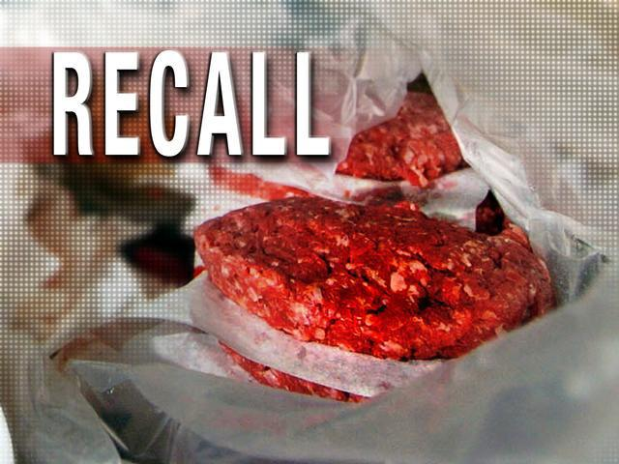
In State Governments
Referendum
Initiative
Recall

Slide 23
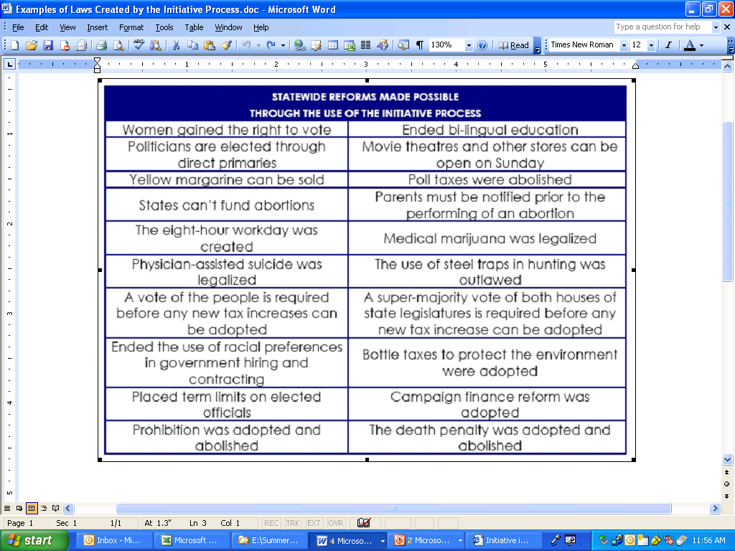

Slide 24
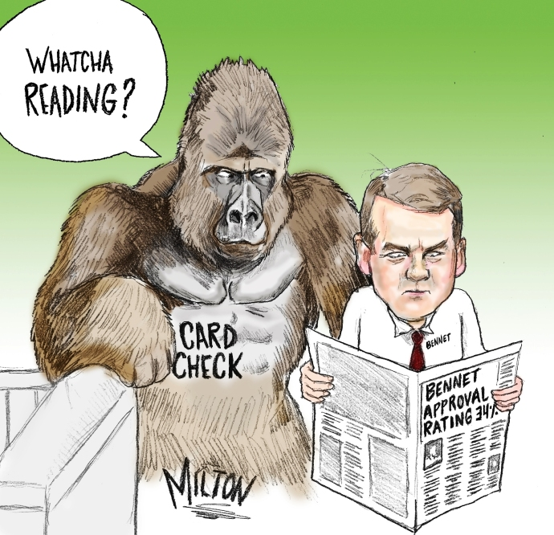
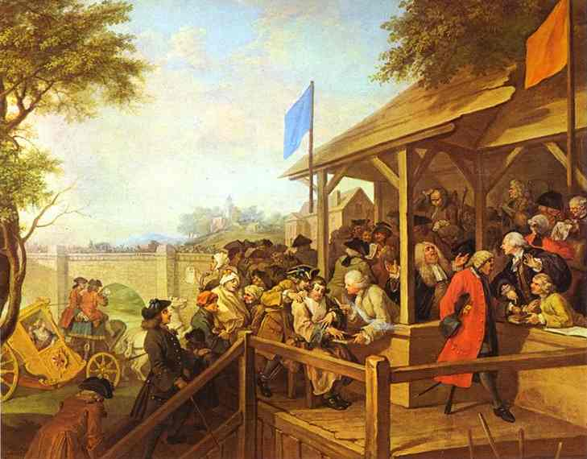
In Elections
Primaries
  Driver's Licenses for Illegals?
  Arizona Initiatives Today
17th amendment
Secret ballots

Slide 25
The Dirty Stuff
Muckraking – Upton Sinclair – The Jungle; meatpacking; Pure Food and Drug Act
  Now, it is known as the FDA (Food and Drug Administration); Recent Recalls
Laws: Keating-Owen Child Labor Act of (1916)
  Attempts to ban interstate commerce of any products produced by children…
    Ruled unconstitutional by the Supreme Court b/c it “overstepped the purpose of the government’s powers to regulate interstate commerce”

Slide 26
Labor Unions

Slide 27
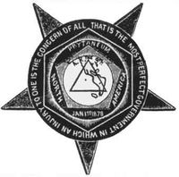
Knights of Labor
Early labor organization = Knights of Labor = designed to protect ALL WHO WORKED for a living
  Dangerous working conditions
  Child labor
  Long hours, low wages, no job security, no benefits
  Company towns
  Employment of women

Slide 28
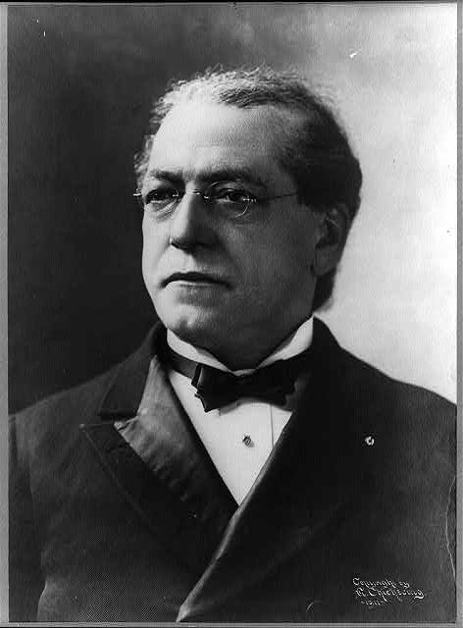
American Federation of Labor (Samuel Gompers)
Working conditions
Higher pay
Job security
Wanted an “American standard of living”

Slide 29
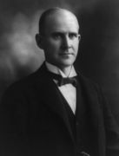
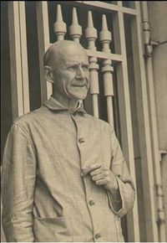
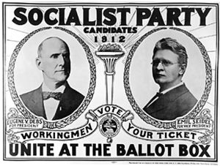
American Railway Union (Eugene Debs)
    Arrested for obstructing the traffic of US Mail during a strike; while there, read Karl Marx
    Ran for president from Jail = 3.4% of the vote = most ever for a socialist candidate
Working conditions
Higher pay
Job security

Slide 30

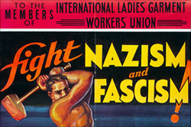
International Ladies’ Garment Workers Union
1st to have primarily female membership
Started in NYC

Slide 31
Strikes
Haymarket Square
Homestead Strike
Pullman Strike

Slide 32
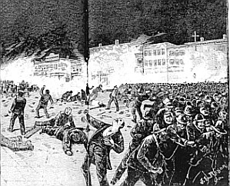
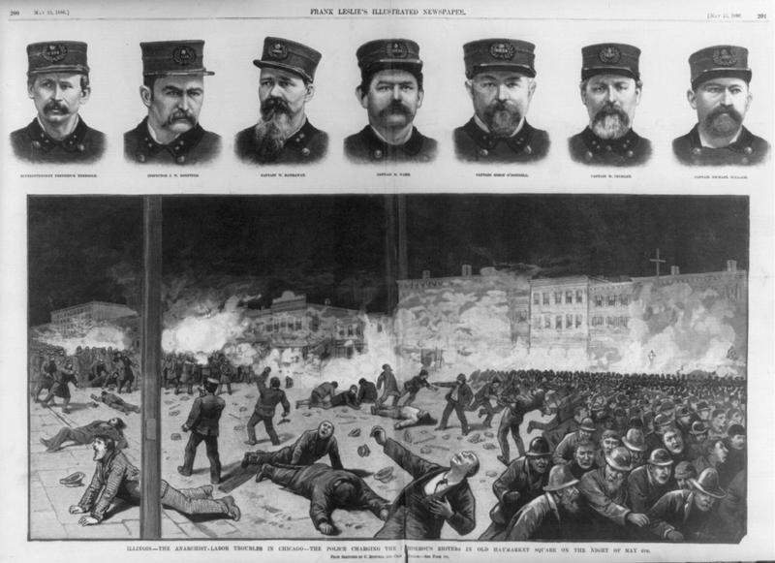
Haymarket Square
  May 4, 1886
  Chicago
  Strike for 8 hour work days
  80,000 march
  As days go on, 350k join them from 1200 factories
  Some broke, caused a fight, police intervened, 4 died

Slide 33
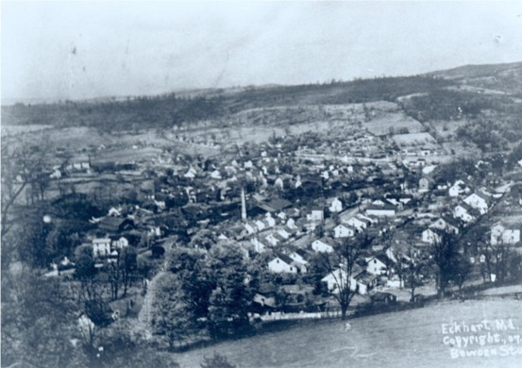
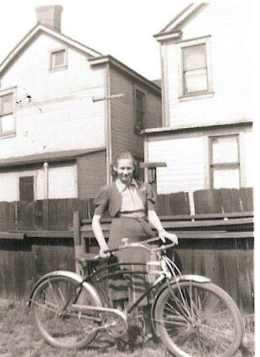
Stuff…
Company towns, scrips
Homestead, PA
  About 12,554 people in 1900 working at a Carnegie steel mill
  Today population is 3569 and there are numerous outbursts of violence; mills are abandoned

Slide 34
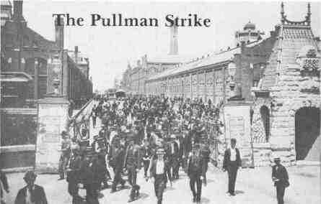
Pullman Palace
Car Company
30% wage cut
3000 workers strike in Illinois
May 11, 1894

Slide 35
AntiTrust Laws
Sherman
Clayton

Slide 36
Anti Trust Laws
Sherman Anti-Trust Act (1890)
  Prevents any business structure that “restrains trade” aka monopolies or trusts
  Standard Oil, Microsoft, Starbucks
  President Benjamin Harrison
Clayton Anti-Trust Act (1914)
  President Woodrow Wilson
  Outlaws Price Fixing
  Exempts labor unions from Sherman

