Slide 1
The South’s Answer to the Reconstruction Amendments: Jim Crow Laws
A legal way to
achieve segregation

Slide 2
Reconstruction Amendments
13 = No slavery or indentured servitude
14 = Due Process
No state can infringe upon the rights of citizens of the U.S.
All people born on U.S. soil are citizens
15 = Right to vote cannot be denied b/c of race or previous condition of servitude

Slide 3
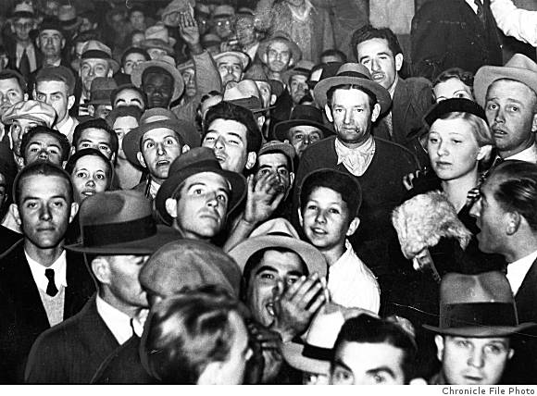
Comply or Else
After reconstruction, many Southern state governments passed “Jim Crow” laws forcing separation of the races in public places.
Intimidation and crimes were directed against African Americans (lynchings).

Slide 4
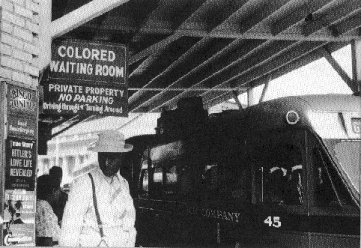
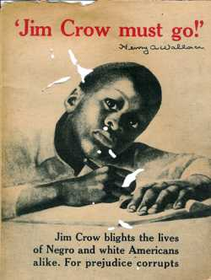
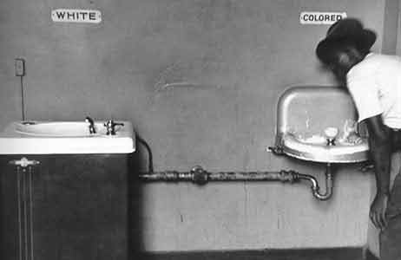
Jim Crow in the 1960s
Notes:
4

Slide 5
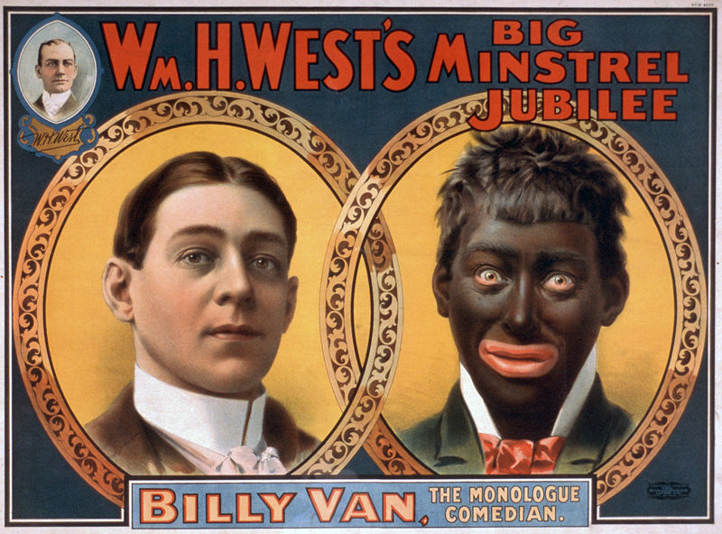
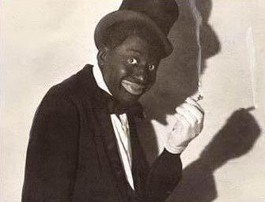
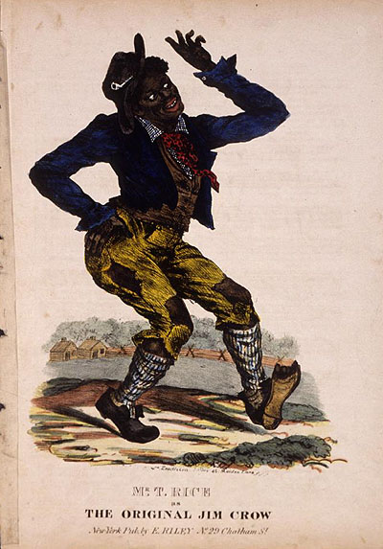
ORIGIN
Bert Williams was the only black member of the Ziegfeld Follies when he joined them in 1910. Shown here in blackface, he was the highest-paid African American entertainer of his day.[45]
1828
Thomas Dartmouth T.D “Daddy” Rice
Traveling white comedian
Inspired by the song and dance of a crippled African in Cincinnati called either Jim Cuff or Jim Crow

Slide 6
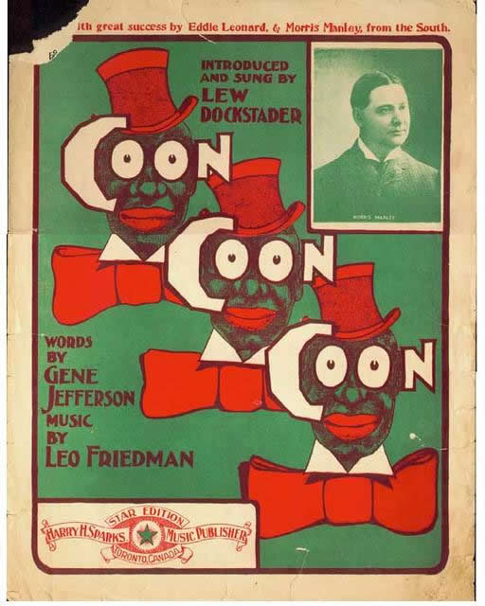
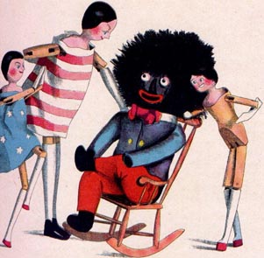

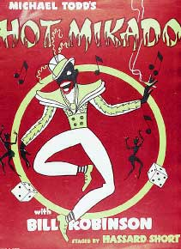

Slide 8
Create Your Own
Develop a list of “modern” Jim Crow Laws…
In other words, if Jim Crow existed today, how might it be implemented given the world we live in today?
You may segregate any group of people, not just blacks

Slide 9
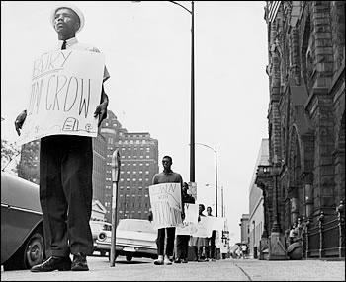

Slide 10
Plessy v. Ferguson (1896)
Original case is Plessy v. Louisiana
HOMER PLESSY had boarded a white car on the East Louisiana Railroad train
Homer was 1/8 black, 7/8 white = African American!
Arrested and Jailed
Sued claiming his 14th amendment rights were violated (citizenship with equal protection under the law)
Judge in this case was John Howard FERGUSON
Guess what he ruled?
Appealed to LA Supreme Court, upheld
Appealed to U.S. Supreme Court, upheld
Supreme Court rules it does NOT violate the 14th amendment, therefore Jim Crow laws (separate but equal laws) ARE constitutional.

Slide 11
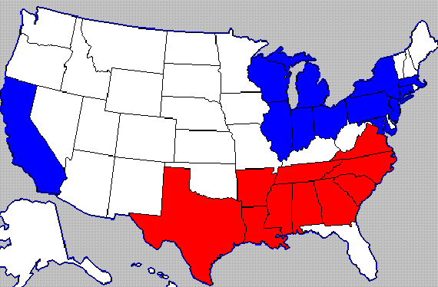
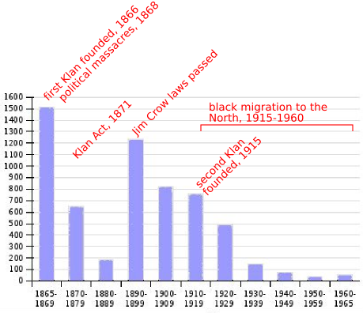
Great Migration

Slide 14
African-American Responses
W.E.B. DuBois
Ida B Wells
Booker T Washington

Slide 15
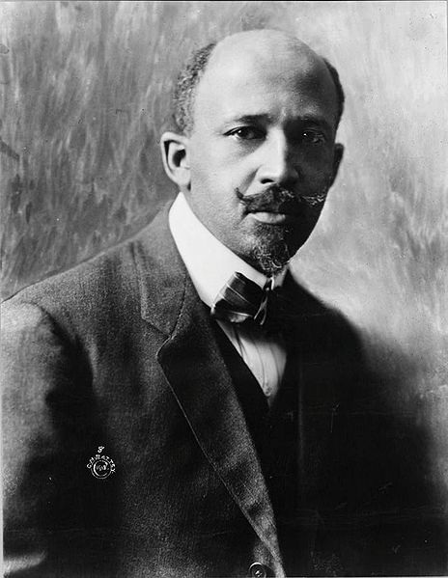
W.E.B. DuBois
“Education without equality is meaningless”
Founder of the NAACP

Slide 16
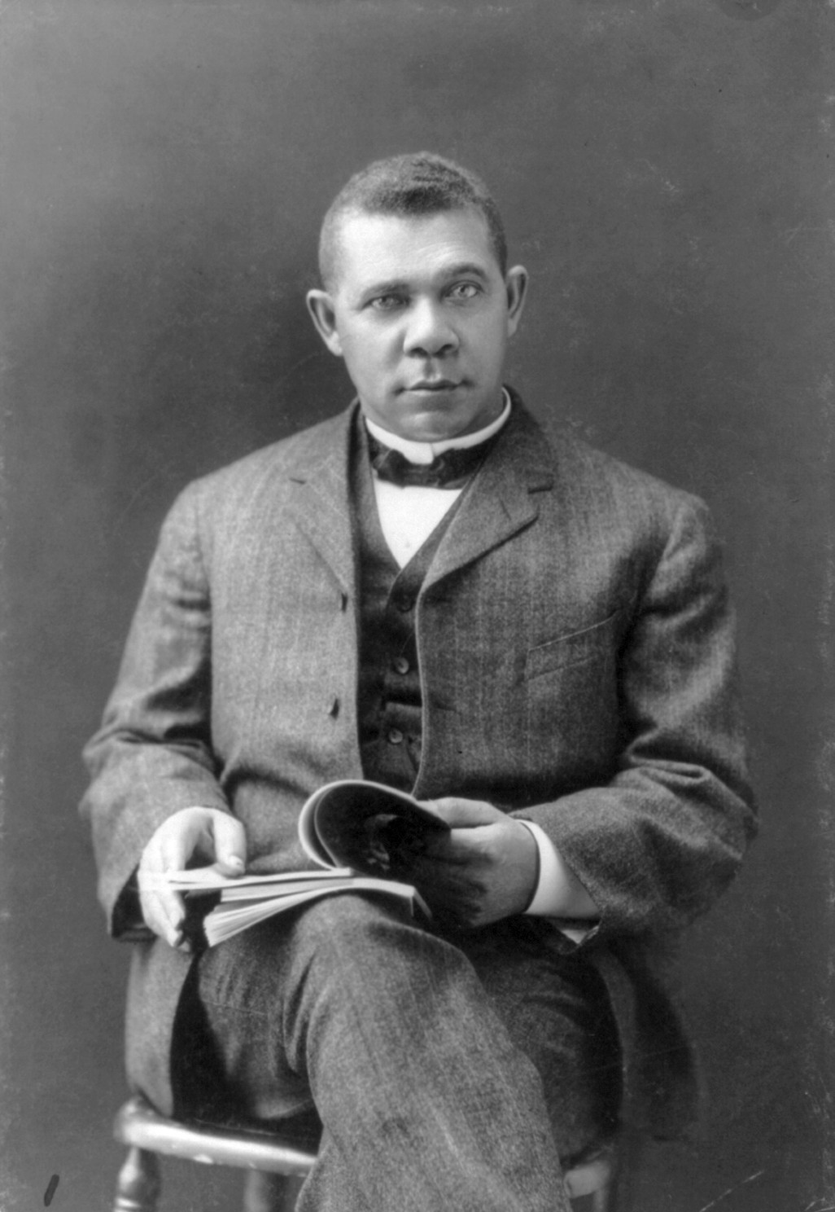
Booker T Washington
Equality through vocational education
Accepted social segregation as natural, preferable

Slide 17
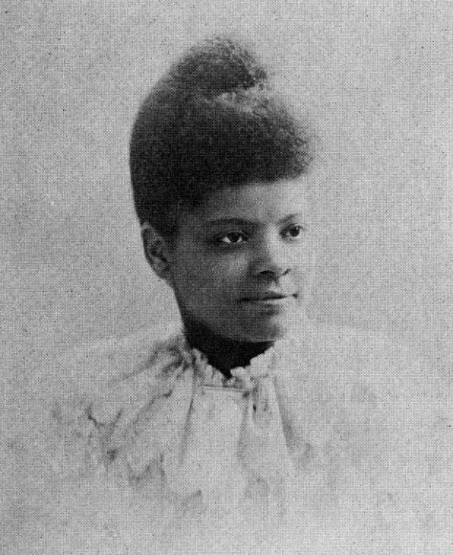
Ida B Wells
Anti-lynching crusade
Calls on federal govt to do SOMETHING!

