Slide 1
Guinea Pig Breeds

Slide 2
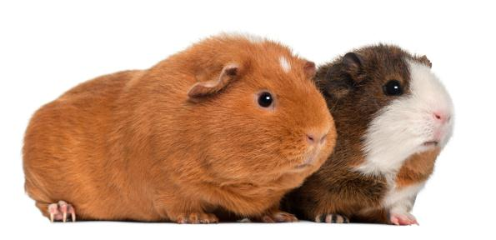
American
This breed is also known as the English Cavy. The coat is smooth and short and lies flat to the body. This is the most popular and commonly seen breed.

Slide 3
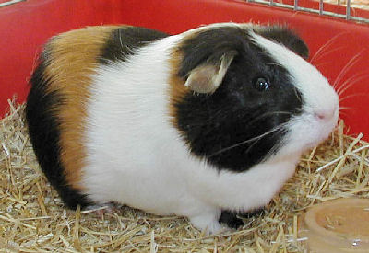
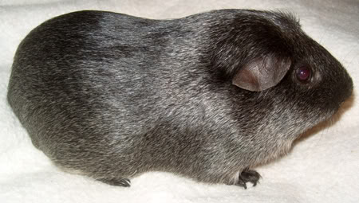
American Satin
The American Satin is also recognized by the American Cavy Breeders Association (ACBA). Satin refers to the sheen of the coat; the satin breeds have very shiny, sleek coats.

Slide 4
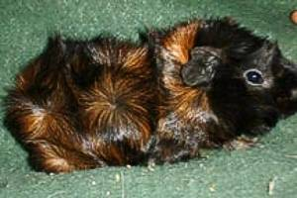
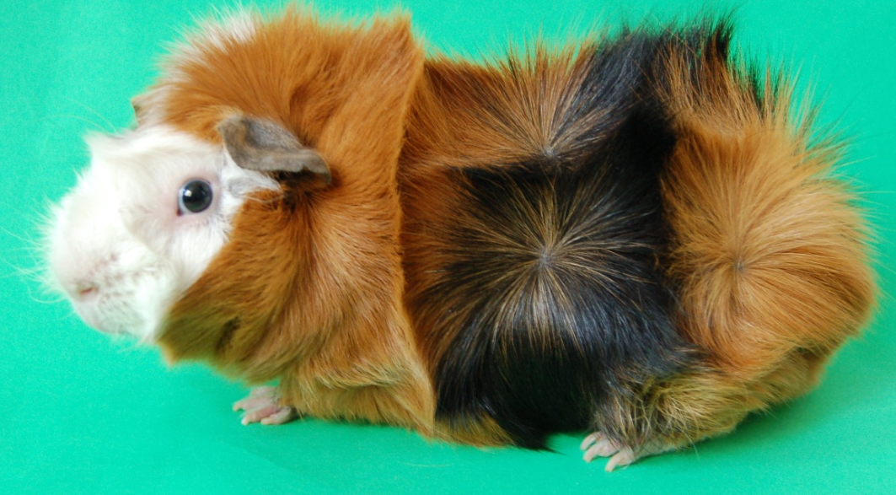
Abyssinian
The Abyssinian has a very distinctive appearance. The coat is made up of multiple swirls of hair referred to as rosettes. Their hair is quite dense and coarse, and it radiates in circles from multiple points on the body to make up a series of whirls and ridges. For show purposes, Abyssinian must have a minimum of 8 rosettes, in a symmetrical pattern. These guinea pigs always look somewhat dishevelled.

Slide 5
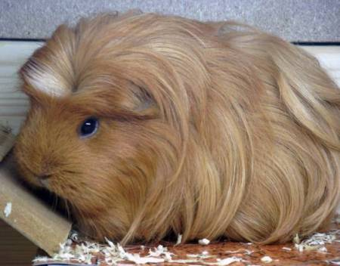
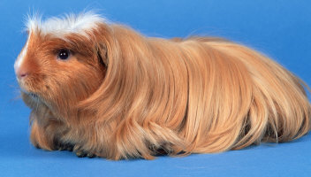
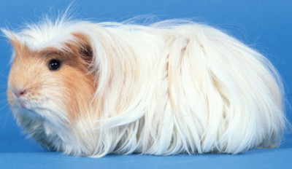
Coronet
The Coronet Guinea Pig is also long-haired, but has a single rosette ("coronet") in the center of the forehead. Like other long haired guinea pigs, Coronets need lots of grooming.

Slide 6
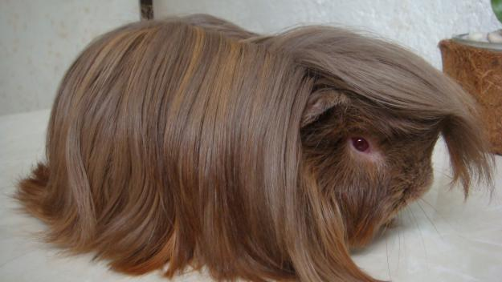
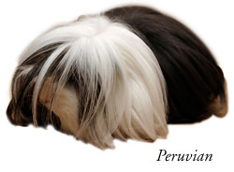
Peruvian
The Peruvian coat is smooth and straight, and grows to several inches in length. The hair naturally parts down the center of the back, and also grows forward over the head. The dense, soft coat of the Peruvian requires a great deal of grooming, and many owners of Peruvian guinea pigs end up trimming the hair to keep it manageable (if the guinea pig is to be shown, wraps can be used to keep the hair from getting tangled or soiled).

Slide 7
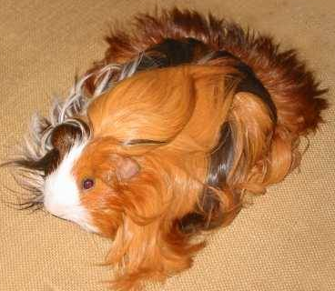
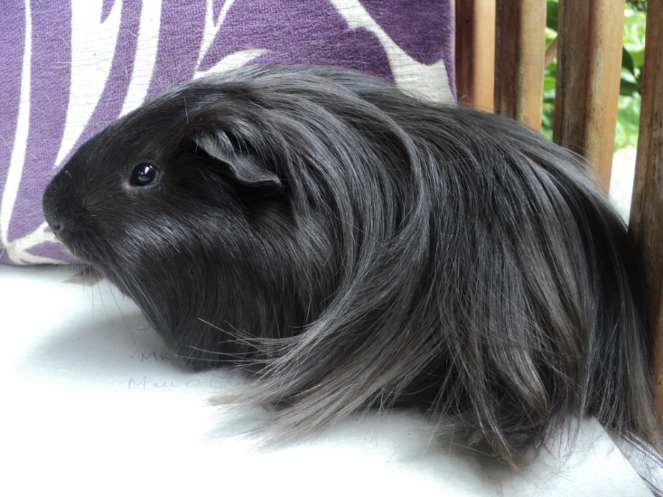
Silkie
The Silkie is also known as the Sheltie, and has a very silky long coat. In contrast to the Peruvian, the Silkie's soft coat does not naturally part along the back, and grows backwards from the head.

Slide 8
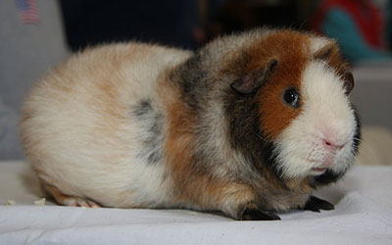
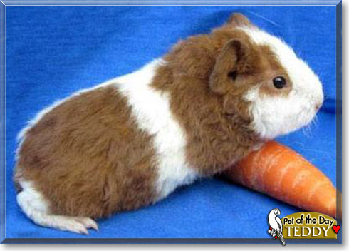
Teddy
This short haired guinea pig is characterized by a short dense coat with bent (kinked) hair shafts that makes the coat stand on end, giving a very fuzzy appearance.There is also a Satin Teddy, where the coat has a deep sheen.

Slide 9
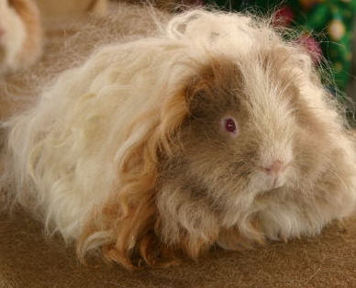
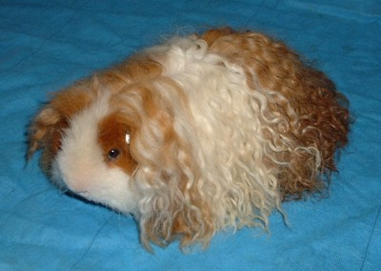
Texel
This uncommon guinea pig has a very distinctive long curly coat. The Texel guinea pig is another very high-maintenance pet.

Slide 10
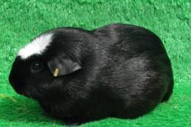
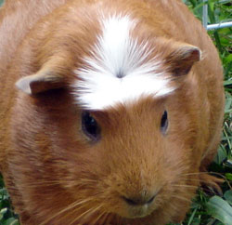
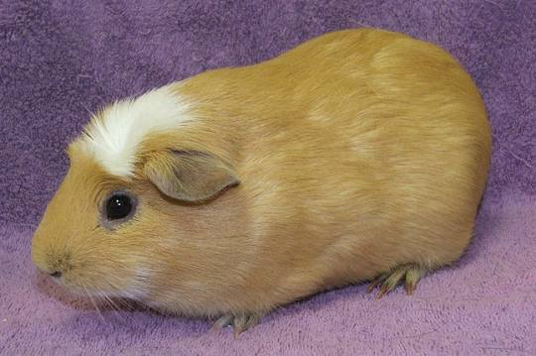
White-crested
This is a short haired guinea pig with a single rosette (swirl) on the forehead. The White Crested Guinea Pig (also called American Crested) has a crest that is white in contrast with the rest of the coat (no other white on the body).

