Slide 1
DOGS!!
Herding Group

Slide 2
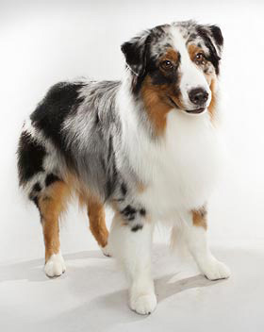
Australian Shepherd

Slide 3
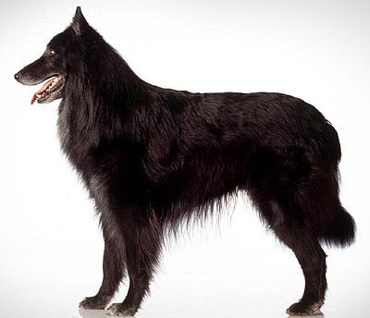
Belgian Sheepdog

Slide 4
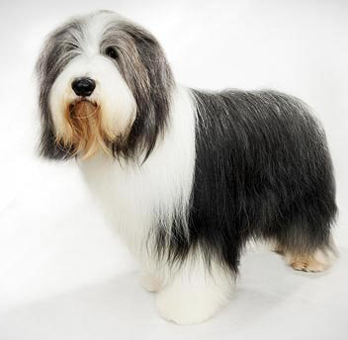
Bearded Collie

Slide 5
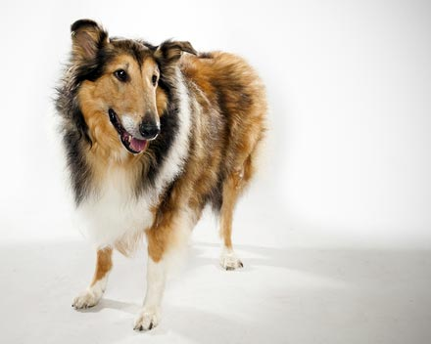
Collie

Slide 6
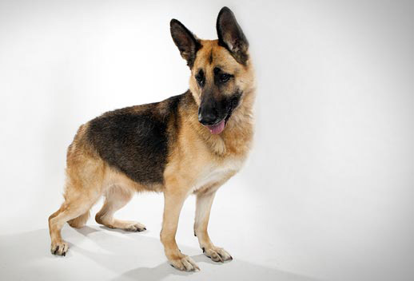
German Shepherd Dog

Slide 7
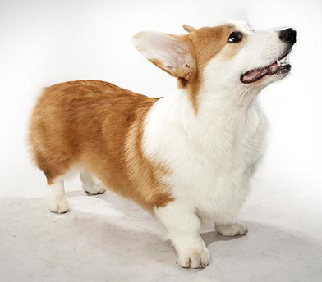
Pembroke Welsh Corgi

Slide 8
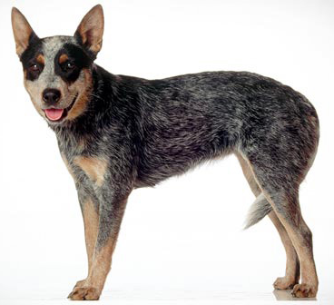
Australian Cattle Dog

Slide 9
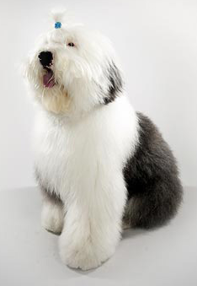
Old English Sheepdog

Slide 10
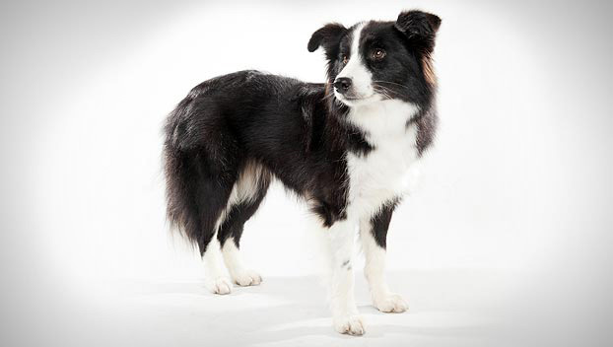
Border Collie

