Slide 1
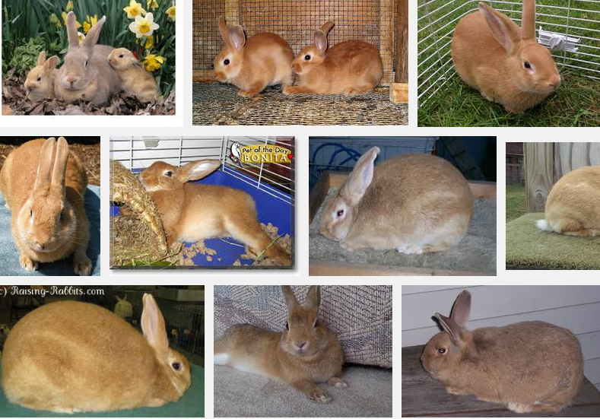
Palomino

Slide 2
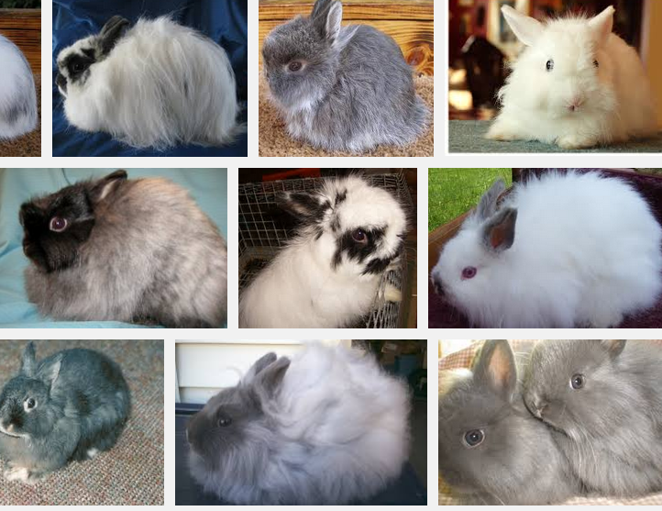
Jersey Wooly

Slide 3
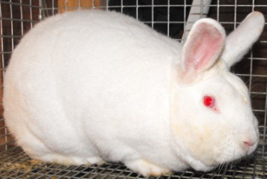
New Zealand

Slide 4

Himalayan

Slide 5

Californian

Slide 6
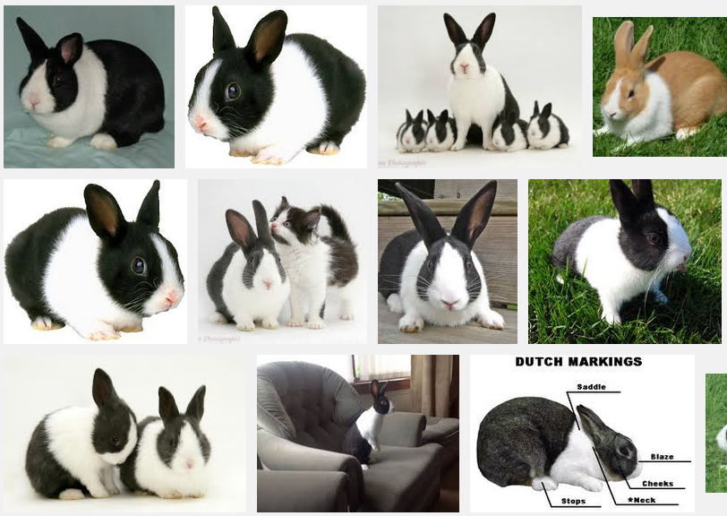
Dutch

Slide 7
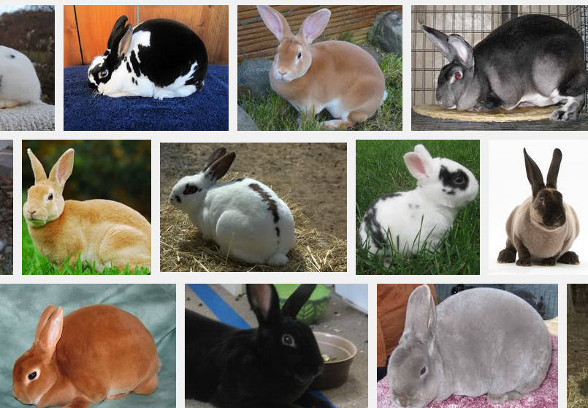
Rex

Slide 8
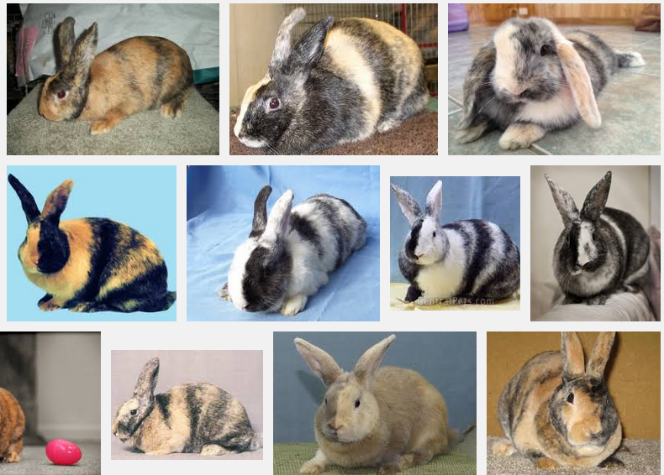
Harlequin

Slide 9

French Angora

Slide 10
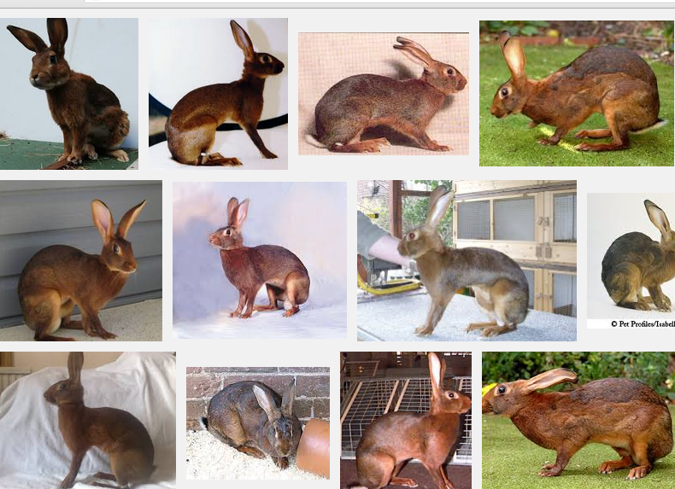
Belgian Hare

Slide 11
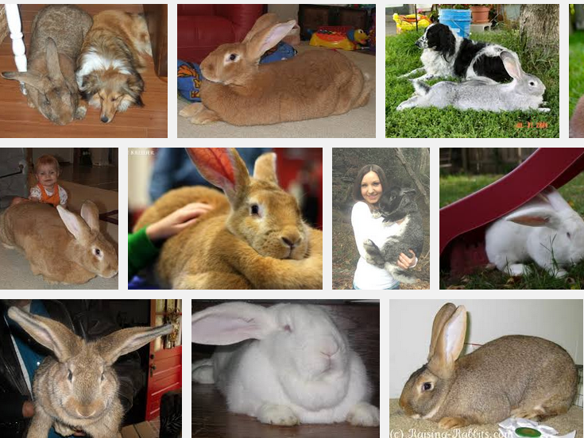
Flemish Giant

Slide 12

Holland Lop

