Slide 1
Dogs
Terrier

Slide 2
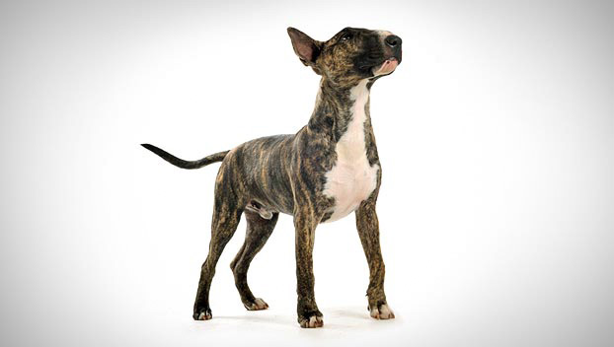
Bull Terrier

Slide 3
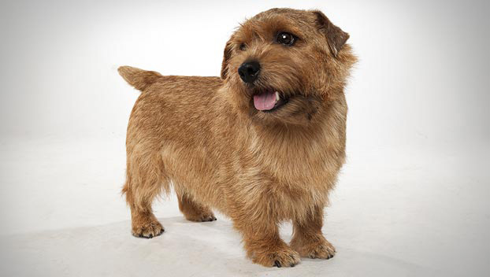
Norfolk Terrier

Slide 4
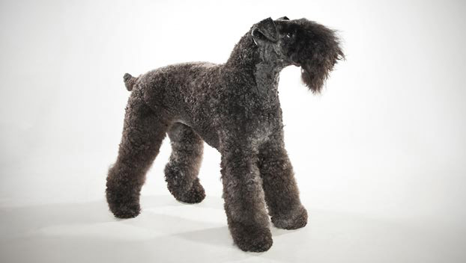
Kerry Blue Terrier

Slide 5
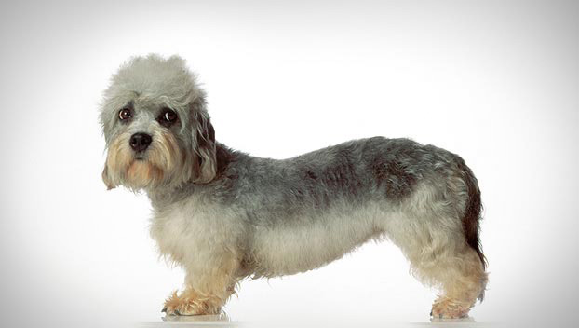
Dandie Dinmont Terrier

Slide 6
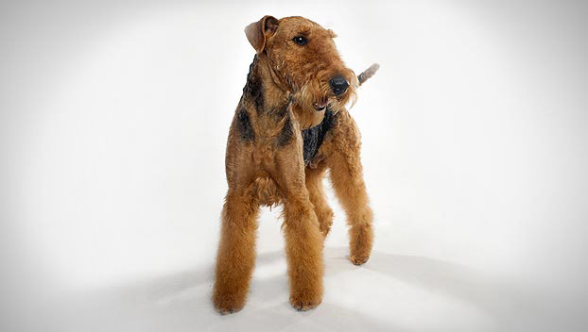
Airedale Terrier

Slide 7
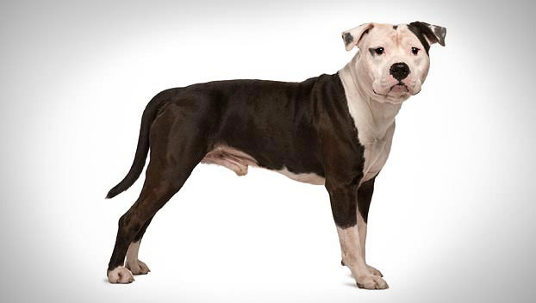
American Staffordshire Terrier

Slide 8
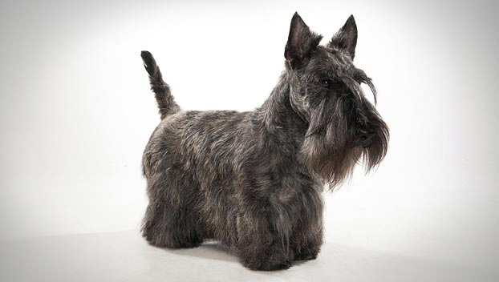
Scottish Terrier

Slide 9
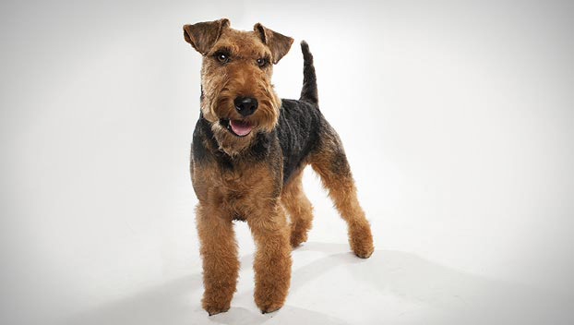
Welsh Terrier

Slide 10
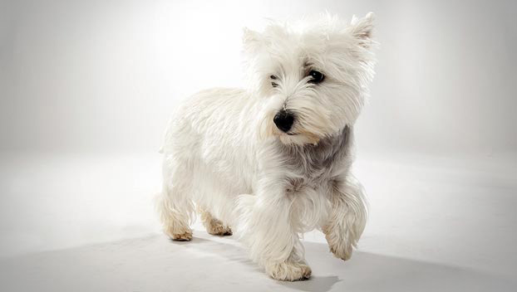
West Highland White Terrier

Slide 11
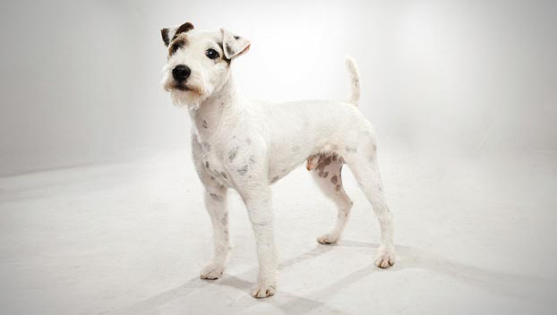
Parson Russell Terrier

Slide 12
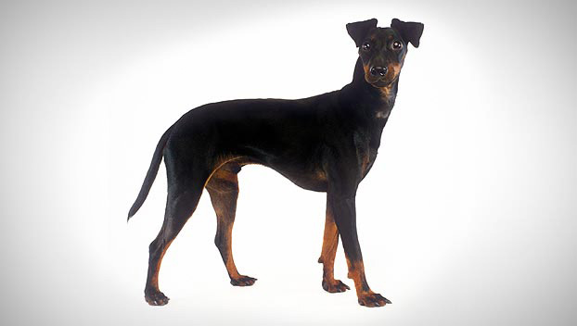
Manchester Terrier (Standard)

