Slide 1
Scientists All Around You
You wouldn’t even realize

Slide 2
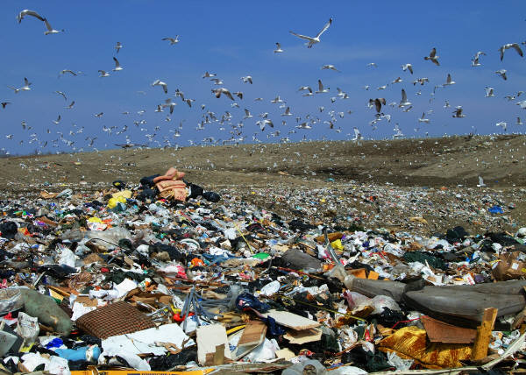
Environmental Scientist
The study how humans interact with their environment. They can find out if humans are damaging the environment. They help people save Earth’s resources and use these resources more wisely.

Slide 3

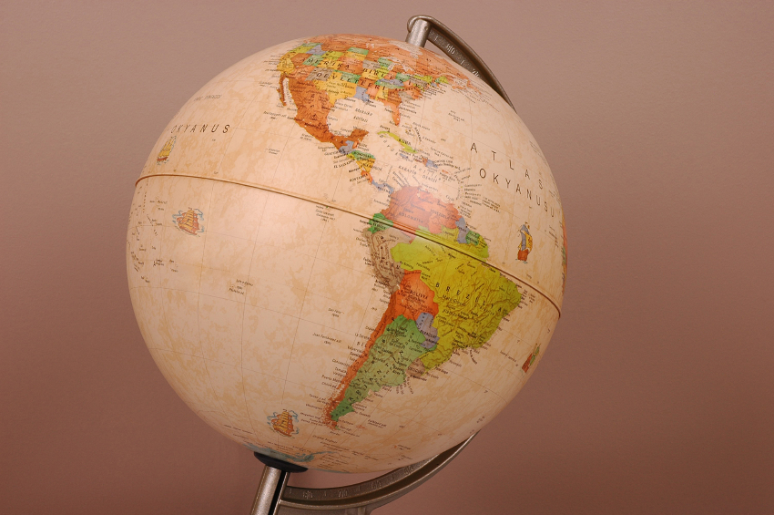
Cartographer
They make maps of the surface of the Earth. For example these maps can be used to plan how cities can grow.

Slide 4
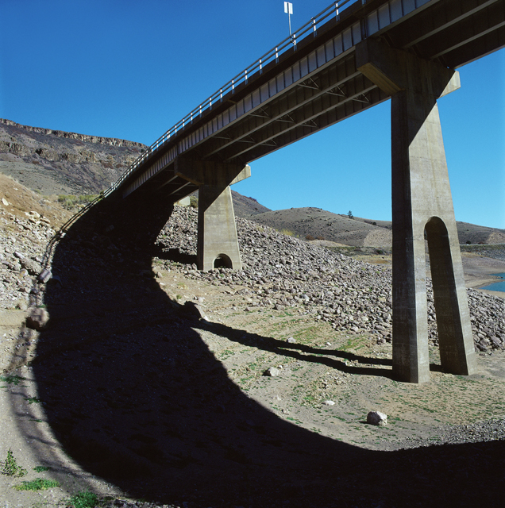
Engineer
They put scientific knowledge to practical use. They design and build buildings, roads, and bridges that make up cities.

Slide 5
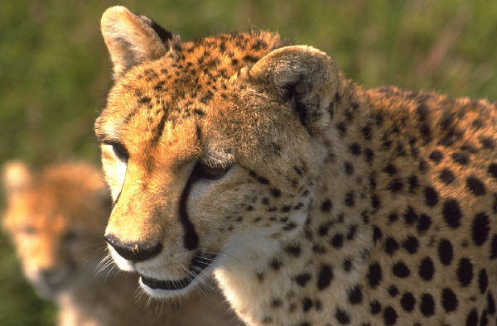
Zoologist
They study animals and the needs these animals have.

Slide 6
Science Educator
A person who teaches others about science. Learning about science can help people understand how the world works.

Slide 7
Botanist
They study plants. For example a botanist may work with a farmer to help increase crop yields.

Slide 8
Marine Biologist
Marine biologists study living things that are found in oceans, such as fish, plants and other species that live in the ocean.

Slide 9
Park Ranger
A park ranger works in a government park. They may attach tags to birds or lead tours that educate park visitors.

Slide 10
Forestry Technician
Forestry technicians mostly work outdoors. They determine which trees can be cut down for lumber.

Slide 11


Health Care Workers
Health Care workers do jobs such as examine patients, treat injuries, and research cures for diseases. Doctors and nurses are health care workers.

Slide 12
Geologist
Geologists study the solid Earth. They study the forces that have shaped Earth throughout its long history. They study rocks and the work of natural forces that slowly build up and wear down the land.

Slide 13
Meteorologist
A meteorologist studies earth’s atmosphere. They gather information about conditions in the atmosphere from around the world. A meteorologist is simply called a “weatherman.”

Slide 14
Astronomer
An astronomer studies the universe beyond Earth. Some astronomers focus on the Solar System, others observe stars and galaxies.

Slide 15
Now what kind of scientist would you like to be?
Tell what kind of scientist you would like to be and why!!

