Slide 1
Mendelian Genetics

Slide 2
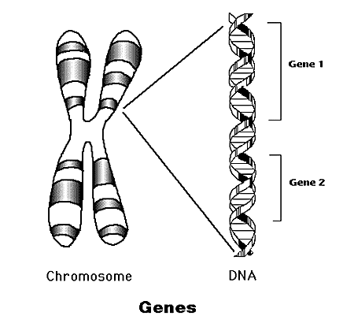
Mendel’s Principle of Heredity
Science of heredity- passage of traits from parents to offspring
Heredity material (genes) carried on chromosomes
Offspring is a mixture of both parents’ traits but has own identity as individual

Slide 3
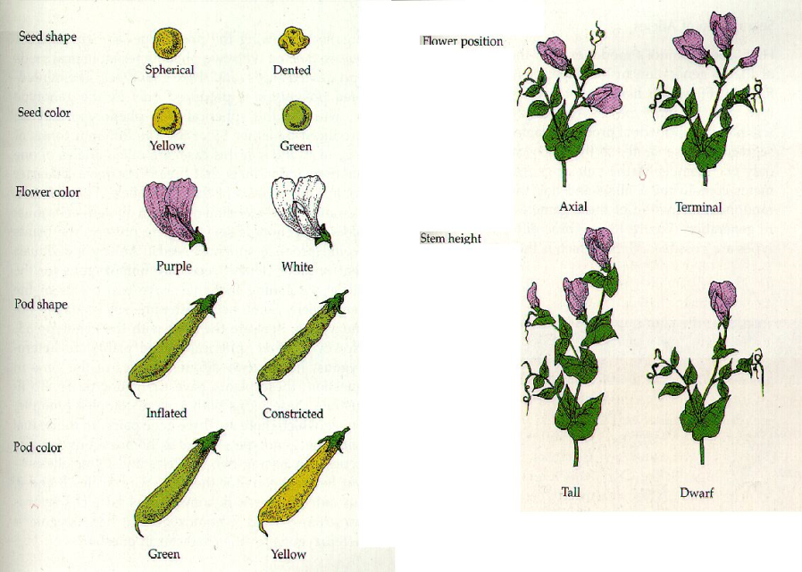
Gregor Mendel 1860s
His work was the basis for knowledge of heredity
Worked with garden peas
  Easy to grow
  Sharply contrasting traits (green v yellow)
  Easy to self-pollinate

Slide 4
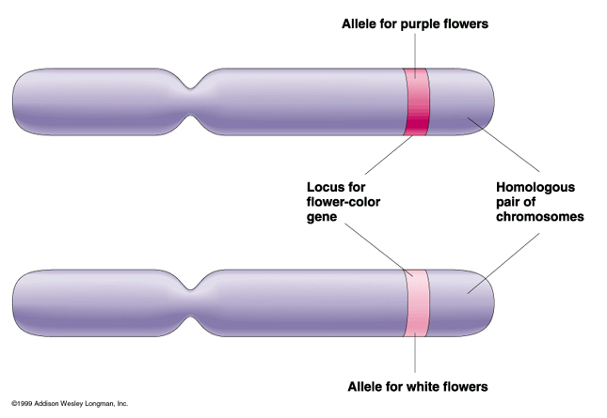
Mendel’s conclusions
Each trait is caused by factors (genes)
Genes occur in pairs
One of each pair is from each parent
Each trait has alternate forms (alleles)
  One is dominant and the other is recessive

Slide 5
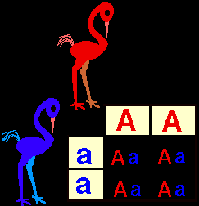
Principle of Dominance
Alternate forms of traits (alleles) are crossed and offspring represent the dominant form
Recessive trait is
hidden
What color will the
offspring be?
This is complete dominance.
Homo z
y g o u
s
Homozygous
Heterozygous

Slide 6
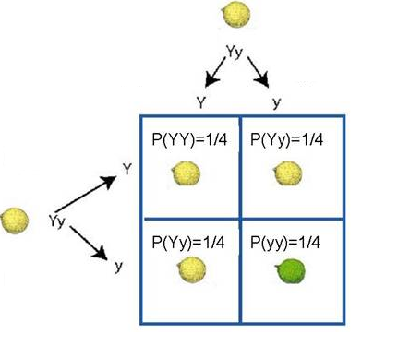
Punnet Square

Slide 7


Let's say that in seals, the gene for the length of the whiskers has two alleles. The dominant allele (W) codes long whiskers & the recessive allele (w) codes for short whiskers.
a) What percentage of offspring would be expected to have short whiskers from the cross of two long-whiskered seals, one that is homozygous dominant and one that is heterozygous?
b) If one parent seal is pure long-whiskered and the other is short-whiskered, what percent of offspring would have short whiskers?

Slide 8
AA = normal
Aa = normal (called sickle-cell trait)
aa = sickle-cell anemia
A couple, both of whom have the sickle cell trait, are considering having children. They want to know the odds of having a child with sickle cell disease. What would you tell them?

Slide 9
Genotype vs. Phenotype
Genotype: actual genetic make-up of an individual
  Example: Ww
Phenotype: actual appearance of the individual
  Example: long whiskers

Slide 10
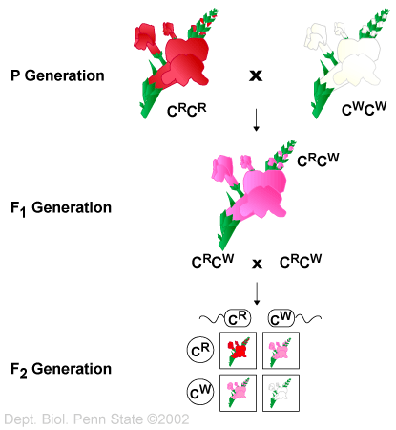
Incomplete dominance
Heterozygous offspring looks like a combination of both traits
  blending
Punnet Square for monohybrid cross

Slide 11

In northeast Kansas there is a creature know as a wildcat. It comes in three colors, blue, red, and purple. This trait is controlled by a single locus gene with incomplete dominance. A homozygous (BB) individual is blue, a homozygous (bb) individual is red, and a heterozygous (Bb) individual is purple. What would be the genotypes and phenotypes of the offspring if a blue wildcat were crossed with a red one?

Slide 12

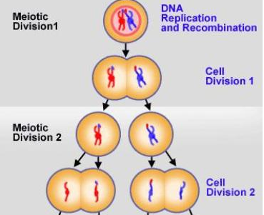
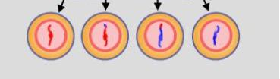
Principle of Segregation
The 2 alleles that control the same trait do not stay together during gamete formation
Gametes randomly unite at fertilization

Slide 13
Test Cross
Used to prove if individual showing dominant trait is pure or hybrid (heterozygous)
Cross unknown genotypes with pure recessive

Slide 14
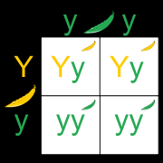
In peas, yellow (Y) is dominant to green (y). A yellow plant of unknown genotype was crossed with a green plant to produce 2 yellow plants and 2 green plant.

Slide 15
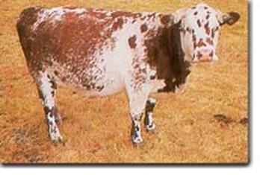
Codominance
“recessive” and “dominant” traits appear together in the heterozygous individual
Cattle can be red (RR = all red hairs), white (WW = all white hairs), or roan (RW = red & white hairs together)

Slide 16
Multiple Alleles
More than 2 alleles exist for a specific trait
Example: blood type
Alleles: I^{A} I^{B} i
I^{A} I^{A} =A bloodtype
I^{A} I^{B} =AB bloodtype
I^{B} I^{B} =B bloodtype
I^{A}i = A bloodtype
I^{B}i = B bloodtype
ii = O bloodtype

Slide 17
In human blood types, the “A” and “B” allele are both dominant, and the “O” allele is recessive. The genotype of someone with blood type “A” can either be AA or AO. Likewise, a “B” blood type person can be either BB or BO.
  If a man of blood type AB marries a woman of blood type A, what are the possible blood types of their offspring if the woman’s mother was blood type O?
  A man heterozygous for blood type A marries a woman with blood type AB. The blood type of their offspring could NOT be…

Slide 18
Mom has type O blood. Dad has type AB blood. What percentage of their kids will inherit type B blood?

Slide 19
A woman sues a man for child support, claiming he is the father of her illegitimate child. The woman is type A blood, the man is type B blood, and the child is type O blood. Show how it is possible for this man to be the father of this child.

Slide 20
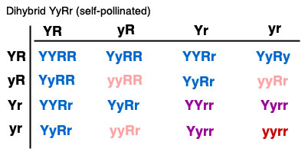
Dihybrid Cross
Punnet square with more than one trait

Slide 21
Sex Linked Traits
Phenotypic expression of an allele that is related to the chromosomal sex of the individual
Most common is X-linked recessive
In men, possession of a recessive X-linked allele is usually expressed in the male phenotype because there are no corresponding genes on the Y chromosome
In women, a recessive allele on one X chromosome is often masked in their phenotype by a dominant normal allele on the other
  This explains why women are frequently carriers of X-linked traits but more rarely have them expressed in their own phenotypes

Slide 22
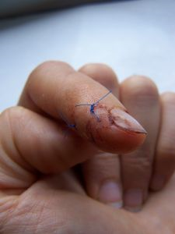
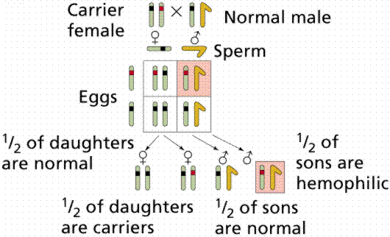
Example: Hemophilia

Slide 23
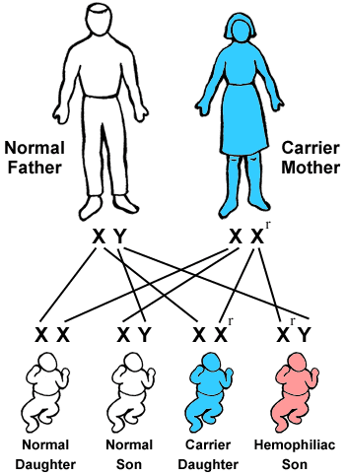
Carrier: possesses
the gene but
does not show
signs

Slide 24
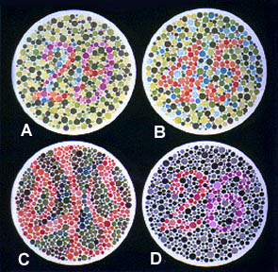

Slide 25
Example: Color Blindness
4 Sex-Linked Traits:
Normal Color Vision:
A: 29, B: 45, C: --, D: 26
Red-Green Color-Blind:
A: 70, B: --, C: 5, D: --
Red Color-blind:
A: 70, B: --, C: 5, D: 6
Green Color-Blind:
A: 70, B: --, C: 5, D: 2

Slide 26
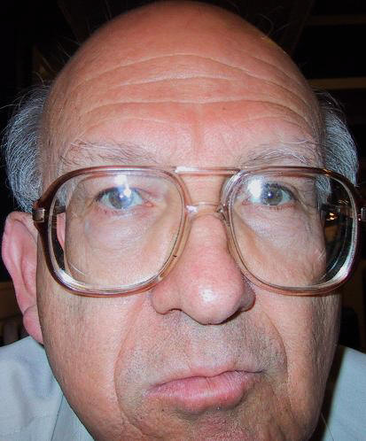
Baldness
Baldness is sex-linked
Carried on X chromosome
B= normal b= bald
Parents: X^{B}X^{b} x X^{B}Y
What is the probability of their son going bald?

Slide 27
Pedigree
is a diagram of family relationships that uses symbols to represent people and lines to represent genetic relationships
often used to determine the mode of inheritance (dominant, recessive) of genetic diseases.

Slide 28
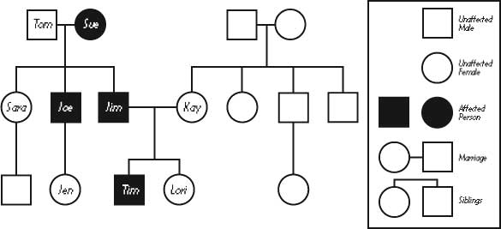
squares represent males and circles represent females
Horizontal lines connecting a male and female represent mating
Vertical lines extending downward from a couple represent their children

