Slide 1
Critical Thinking 1: Universal intellectual standards
EN112 Winter, 2010
Melis

Slide 2
What’s the point?
These standards are agreed upon by a large number of scientists, professionals and educators
These standards help you “debunk” bad science, biased opinion, or outright evil brainwashing
The se standards help you make decisions in your own life (What college to attend? Which job to take? What person to marry? What car to buy? Etc.)

Slide 3

Universal standard 1: Clarity
Is this claim clear?
Is she trying to say that science is biased?
Or: Science is biased when it comes to gender issues?
Or: Journalists are biased when it comes to gender issues in reporting science?

Slide 4

Universal standard 2: Accuracy
Is it really so?
Is science really biased?
Is science really biased when it comes to gender issues?
Is journalism biased when it comes to gender issues?

Slide 5
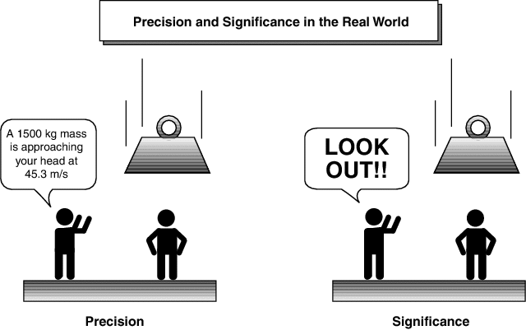
Universal standard 3: Precision
Were there enough details to support the claim?
She said preference for pink was reported as caused by women looking at berries and faces
She said cheetah behavior was reported as “promiscuous” for both males and females, but in the newspapers, cheetahs were turned into sluts
She said the cancer and exercise research was never conducted; housework was not considered exercise until British researches apologized

Slide 6
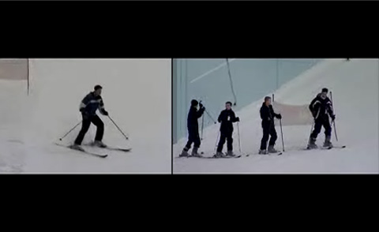
Universal standard 4: Relevance
Did all details relate to the claim?
Did we have to know that IQ tests have been revised for gender bias?

Slide 7
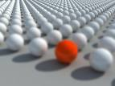
Universal standard 5: Depth
Do we see clearly how complex this issue is?
Journalists need to catch the audience’s attention
Science is too hard for most of us to understand

Slide 8

Universal standard 6: Breadth
Was I given a chance to examine at least one opposing opinion?
Maybe there is bias other than gender related?
Are all scientists men?

Slide 9
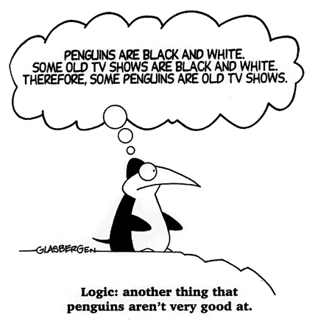
Universal standard 7: Logic
Was good thinking demonstrated?
Were there any logical mistakes (fallacies)?
False generalization
Either or argument
Red herring

Slide 10
Universal standard 8: Significance
Why is this issue important to me right ?
I am a college student
I want to be able to read well
I want to be able to find good sources of information and get good knowledge of the world

Slide 11

Universal standard 9: Fairness
What bias was involved? Was the bias upfront and honestly presented, or was it manipulative?

