Slide 1
Critical Thinking: Good reasoning
EN112 Fall, 2009
Melis

Slide 2
Types of thinking
Thinking that is not thinking (daydreaming, hesitating)
Thinking that is reasoning: using known information to reach conclusions following logical steps
The way you do everything you do is based on thinking
Critical thinking is thinking about our thinking

Slide 3
Thinking that is reasoning
The classical example
All men are mortal
Socrates is a man
THEREFORE
Socrates is mortal

Slide 4
Not all valid reasoning is true
My cousin lives in Texas
Texas is in France
THEREFORE
My cousin lives in France

Slide 5
Two kinds of detectives:
Detective 1: Sherlock Holmes
Inductive logic:
“There is a half smoked Camel in the ashtray; the cigarette was not put out right; the captain smokes Camel; THEREFORE, the captain might have been in the room and must have left the room in a hurry.”

Slide 6
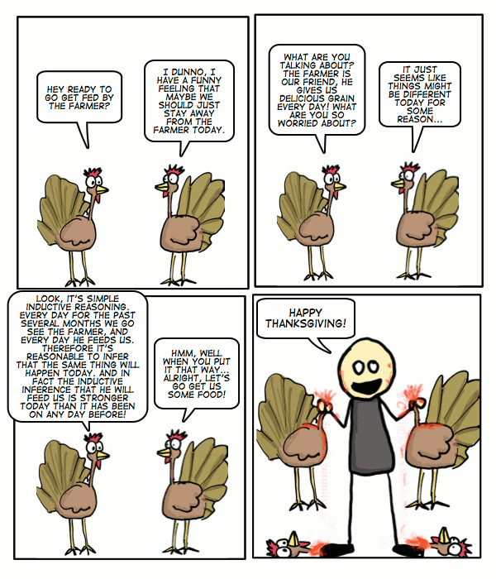

Slide 7
Detective 2: Father Brown
Deductive logic:
“No self-respecting Frenchman would eat caviar with Dijon mustard. The man sitting over there claims to be French, but he is eating caviar with Dijon mustard. THEREFORE, the gentleman must be an imposter.”

Slide 8
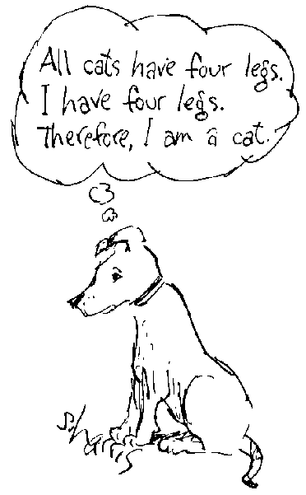

Slide 9
Scientific thinking
Data and theory
Replicable and controlled experiments
Mathematical procedures
Observations
Surveys, interviews
Statistical analysis
Validity can be proved by several independent and credible sources
Falsifiable (other explanations are not valid)

Slide 10
If I pay cash more often, will I spend less?
In 2008, the Journal of Experimental Psychology found that people spend less if they use cash than if they write checks or use credit cards because they “feel the outflow of money”
Another study published in April, 2009, also found that people spend a $20 bill more hesitantly than a $5 bill
(Source: AARP Bulletin)

