Slide 1
From DNA analysis to Native studies
Marilyn Pellar
Tara Tremblay
Caroline Kennedy

Slide 2
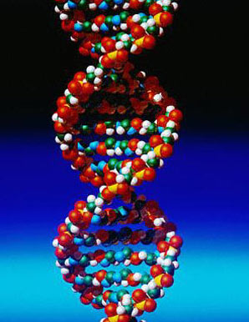
DNA Analysis
Marilyn Pellar
DNA is the basic building block of life
Every persons DNA is unique except for identical twins
DNA can be found as hair, skin, or any bodily fluids

Slide 3
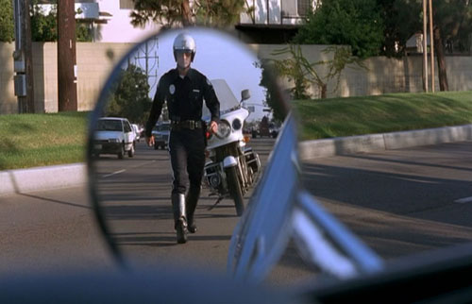
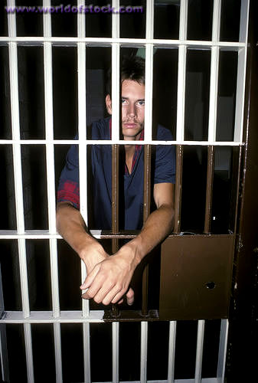
Can be used to identify diseases
Can be used to identify criminals and link them to crime scenes
Increases public safety by catching serial burglars who tend to also be guilty of more violent crimes such as rape and murder

Slide 4
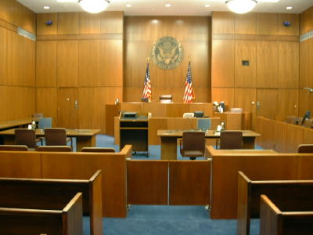
Helps free wrongly convicted people
Solves many cold case files and finds the criminals who have ran free for years
Some oppose DNA analysis because they believe it invades privacy and its not always reliable because it could be contaminated

Slide 5
DNA Analysis can be used to prove the ethnicity of Native Americans.

Slide 6
Native American Blood Quantum
Tara Tremblay
What is blood quantum law?
  This is the system that measures the degree of Native American blood one has in order to claim their ethnicity
Equation
  Divide the number of generations – all ancestors– pure-blood by the number of marriages that aren’t pure-blood

Slide 7
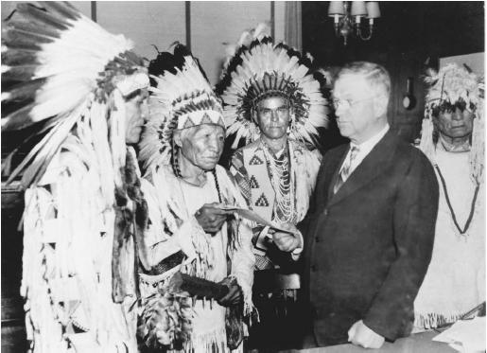
The U.S. government and Native American tribes don’t like how the system is set up but no one can agree on another way
This system was created by European Americans in the 1700’s but wasn’t in full operation by all tribes until the Indian Reorganization Act of 1934

Slide 8

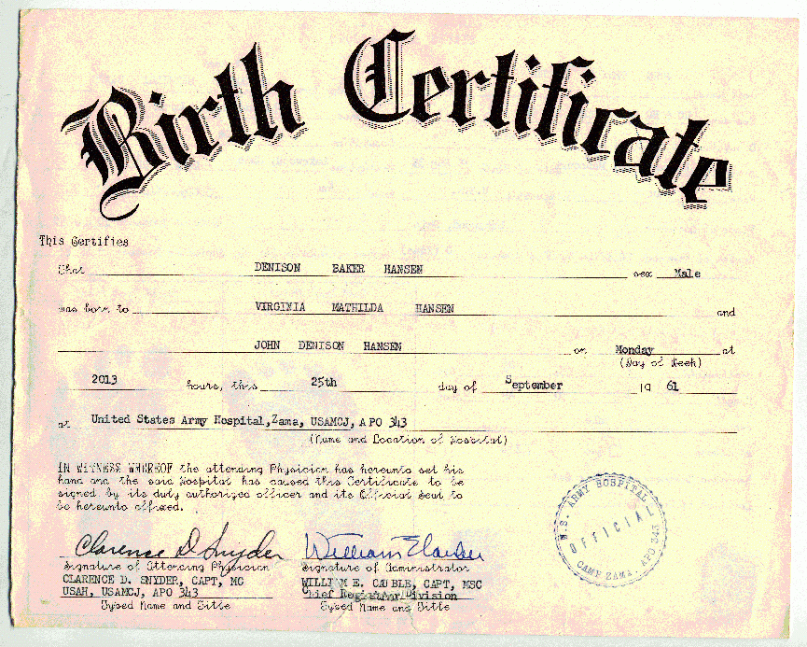
To apply to the BIA (Bureau of Indian Affairs) a person needs
  an entire family line to show proof
  Birth Certificate
  Social Security number

Slide 9
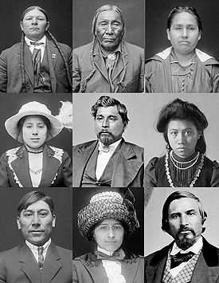
No other ethnicity has to use this type of system in order to claim ethnicity and receive benefits from it
This system has shown to have errors and can be untrue due to past records not being recorded correctly

Slide 10
The blood quantum system may be a hard way to give proof if a person is Native American and that’s why the best way to know is looking at ones cultural beliefs or traditions.

Slide 11
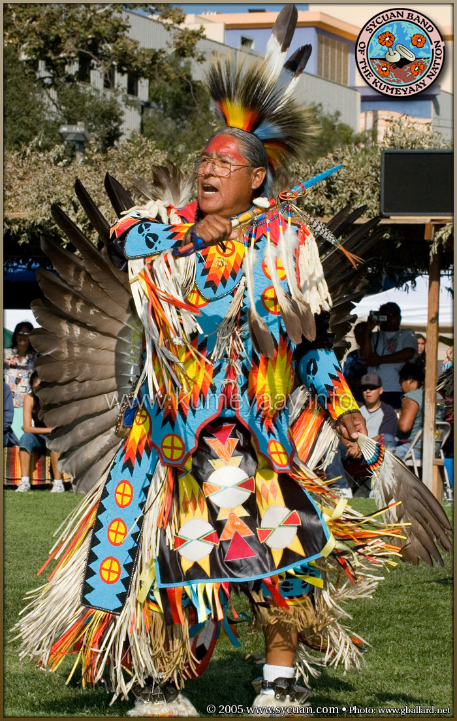
Native Studies
Caroline Kennedy
Native Americans have been in America longer than most other cultures
Their culture is rich, full of wisdom and spirituality
Native Americans and their traditions have influenced American culture

Slide 12
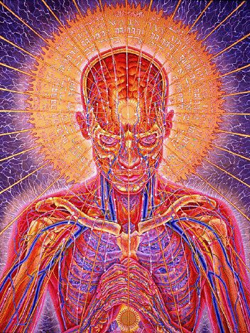
Native American spirituality have influenced many American’s beliefs
  Taking care of the environment
  Keeping connected with the body and surroundings

Slide 13
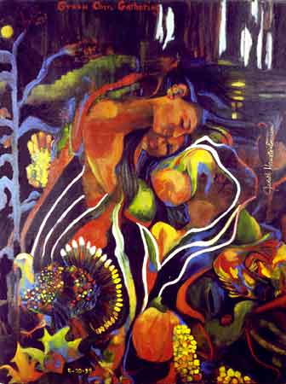
Native American art
  Influenced many popular fashion designers and paved the way for unknown designers
  Their music influenced bands, such as Fever Ray a small band from Sweden whose roots are in America

Slide 14
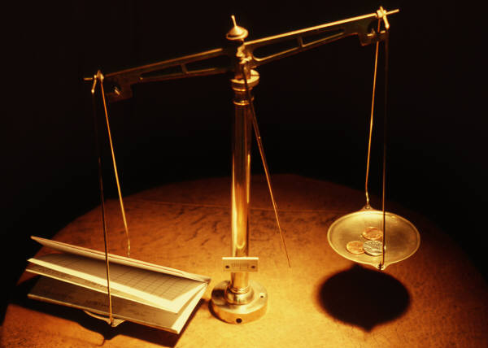
As well the Native American Governmental beliefs have influenced our Government
  Checks and balances taken from Native culture
  Our governments system is similar to the Native Americans

