Slide 1
H1N1 virus
Keshia Soza
En112
Fall 2009
Bay Mills Community College

Slide 2
H1N1 virus: Definition & History
H1N1 virus is a new type A influenza that has been affecting humans since April 2009 (WebMD, 2009).
3 months affected 74 different countries, but Antarctica.
However, many people are very concerned whether the new H1N1 vaccine is safe.
After doing my research I concluded that many people believe the H1N1 vaccine is not safe, but health officials say it is and recommend that high risk groups become vaccinated because H1N1 virus has harmful effects ad can be deadly.
Kori Buro (mom) refuses to give her daughters H1N1 vaccine because the vaccine is not 100 percent safe (LaPook, 2009).
I argue that H1N1 vaccine is safe because this vaccine has been through many clinical tests and show that the H1N1 vaccine is safe (WebMD).

Slide 3
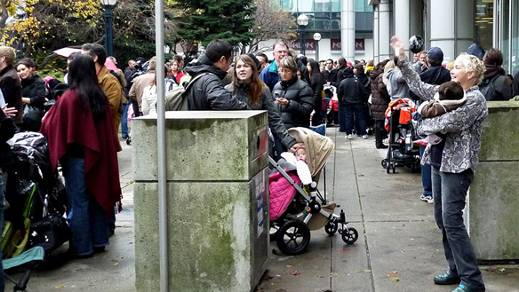
High Risk Groups
Pregnant women
Children under 4 years of age
Health care workers
Active duty military
Range from age is Newborn to 25 years of age.

Slide 4
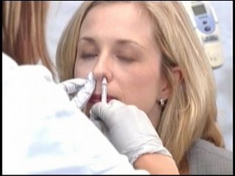
Types of H1N1 Vaccines: Nasal
There are two different types of H1N1 vaccine (WebMD).
First, is the nasal spray vaccine, which contains vaccine contains live attenuated H1N1.
Recommended for 2-49 years of age, but pregnant women

Slide 5
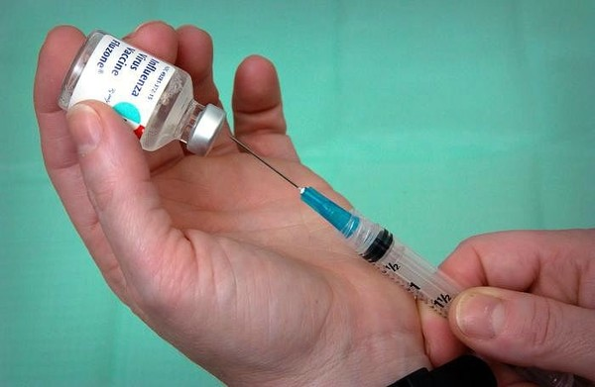
Types of H1N1 Vaccines: Injectables
Second, is the “injectable vaccine, which is made from killed H1N1” (WebMD, 2009, p. 3).
Recommended for everybody

Slide 6
References
LaPook, J. (2009). Parents worry vaccine will be rushed to market without adequate safely
testing. Some say ‘No’ to H1N1 vaccine for kids. Retrieved November 16, 2009, from
http://www.cbsnews.com/stories/2009/07/30/eveningnews/main5199314.shtml
WebMD. (2009). Answer to your questions about swine flu. Swine flu FAQ. Retrieved
November 9, 2009, from http://www.webmd.com/cold-and-flu/flu-guide/swine-flu-faq-1

