Slide 1
Mental health, Physical Health, and Healthy Water
By Chris Wollam, Shavon McKerchie, and William Bernier
Bay Mills Community College
Fall 2009
EN 112-1

Slide 2

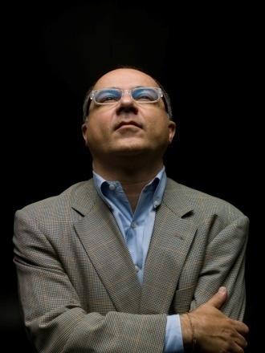
The H1N1 Virus
According to the CDC (2009) the H1N1 virus is a virus that is made up of four different identifiable genes.
These genes include two different swine flu genes, avian (bird flu) genes, and human-type virus genes.

Slide 3
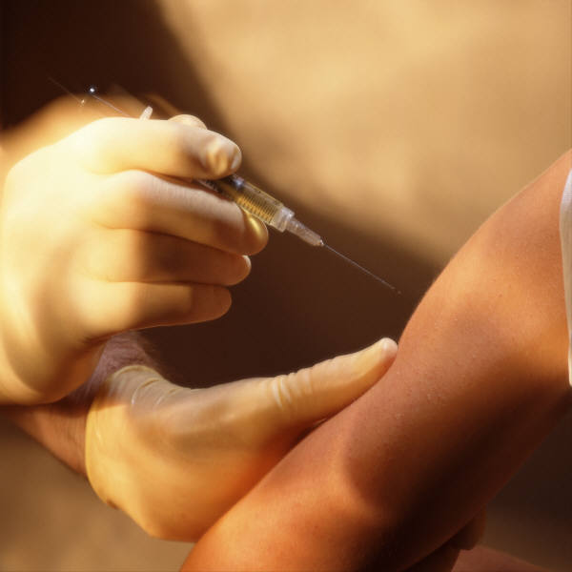
A vaccine is available
Vaccines have been created
Vaccines help develop antibodies
May also come with later side effects
In 1976 millions of people were vaccinated for an earlier swine flu, later several hundred developed a paralytic condition called Guillain Barre Syndrome.
No vaccines are 100% effective according to Dr. Paul Offit.

Slide 4

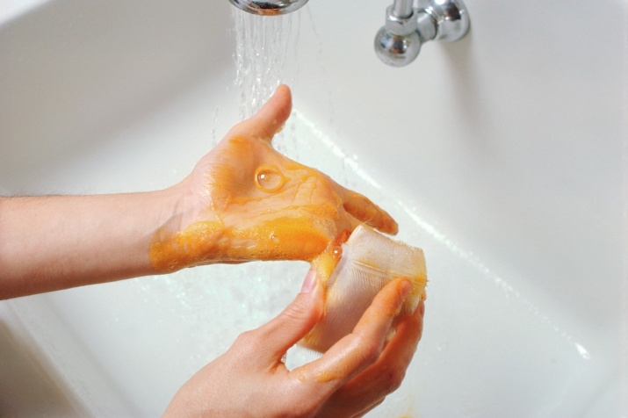
Alternative Defenses
Avoid public places
  also called social distancing
Wash surfaces
  The H1N1 virus can live on surfaces 2-8 hours
Wash your hands frequently
  With warm water and soap

Slide 5
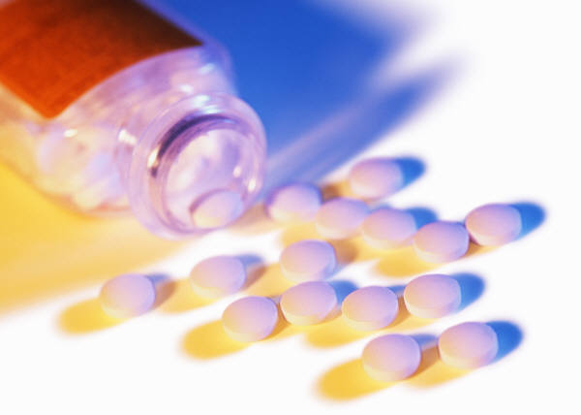
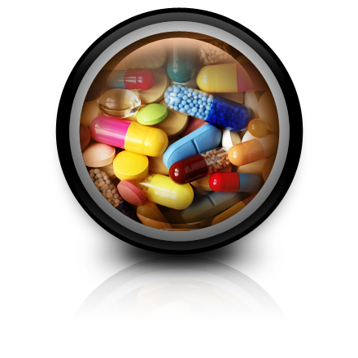

Mental Health
Prescription pain medications are the type of drug most commonly abused
  Most become addicted accidentally: the body develops tolerance and a bigger dose is needed to get the same effect
Vicodin is a strong pain reliever, and is easy to become addicted to.
  Severe withdrawal symptoms: nausea, dizziness, possibility of stroke

Slide 6
What treatment isn’t
With most drug addictions, people need medical help
  In times gone by, addiction and mental problems in general were seen as a weakness, and it was expected that people could just decide to stop using a drug and be fine.
    Ernest Hemingway committed suicide; he might have had clinical depression but it was never diagnosed during his time.

Slide 7
Addiction Treatment
Best idea is an inpatient rehab program
  Medical detox—remove substance from the body with medical supervision to reduce withdrawal symptoms
  Group and individual instruction on life without drugs
  Therapy for patient and support group
  At least 3 months long, to prevent a relapse

Slide 8

Healthy Water
There are three ways to receive drinking water
  Tap water
  Bottled water
  And Filtered water
Comparing the quality and purity between tap water, bottled water, and filtered water, filtered water is the purest.

Slide 9
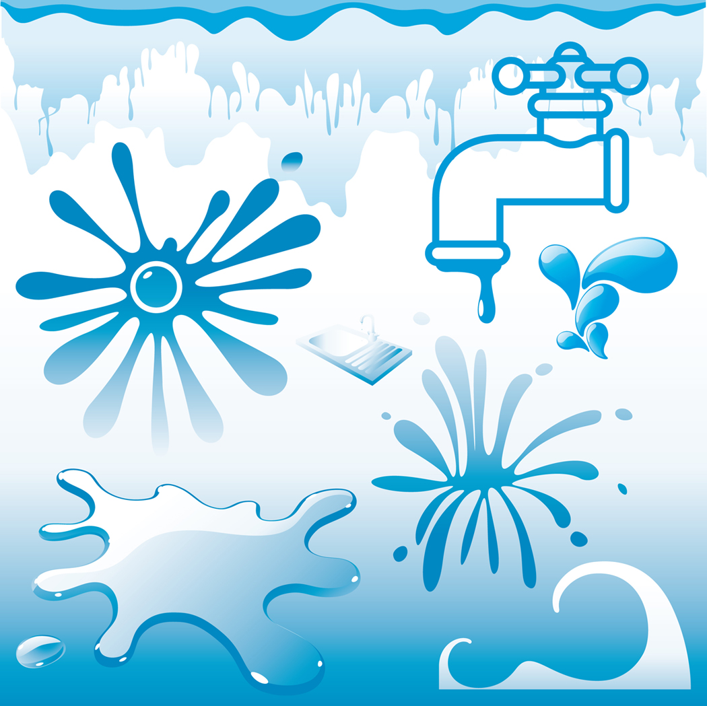

Tap water
Comes from either individual wells or from a public water system: a network of pipes underneath cities
Purity is regulated by Environmental Protection Agency
But problems arise by leaks in pipes, contamination from “negative pressure spikes,” and pipes flowing alongside of sewage pipelines

Slide 10
Bottled Water
Bottled water consumption is increasing because of distrust for tap water. (Matvienko, Schafer, and Nelson)
Purity is regulated by Food and Drug Administration
Water comes from Artesian water, processed bottled water, well water, natural mineral water, distilled water, spring water, and sparkling water.

Slide 11

Cons of bottled water
Plastic bottles can add to pollution
The bottles can leech out chemicals into the water if stored above room temperature
May not be sterile (except for baby drinking water)
More expensive than tap water
Can pick up bacteria through being processed

Slide 12
Filtered Water
According to the Drinking Water Research Foundation, Filtered water is tap water that has been treated with a device that removes impurities.
Can get bottled filtered water, or buy the device and attach it to the home faucet.
Filters consist of granular activated carbon filters, metallic ally filters, micro-pourous ceramic filters, carbon block resin, and ultra-filtration membranes.
Some consist of many of these individual filters

Slide 13


Filtered Water Cont…
Filters usually need to be changed every 6 months, depending on how much water is used and how many contaminants are present.
Filters are not cheap. They can range to hundreds of dollars, but according to ConsumedConsumer.org a 10 gallon system that costs less than $400 can annually save a person using 3 gallons a day $843, when compared to bottled water.
Plus the plastic waste is eliminated helping the world remain green.

