Slide 1
Bay Mills Community College English 112 Section 1
By Alicia Clark, Amy Wieczorek, and Amanda Hoolsema

Slide 2
The future of our Economy and Environment
Organic food, foreign investment, and endangered species

Slide 3

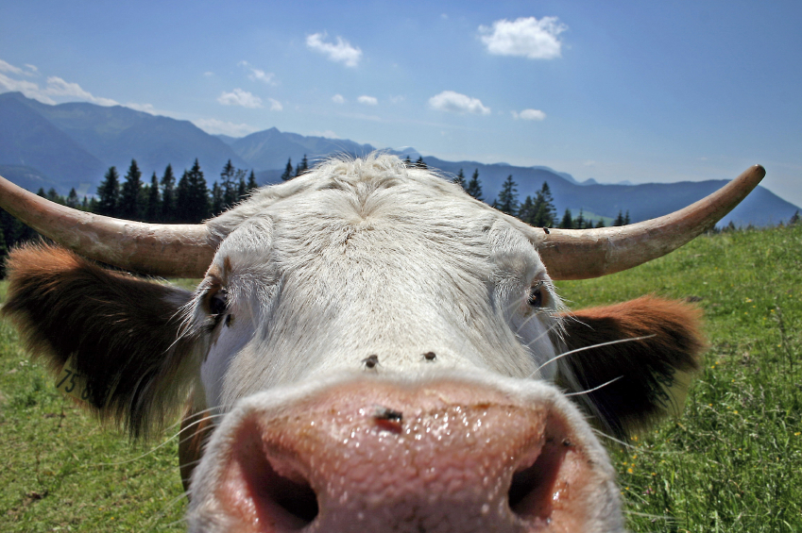
Organic Food
Organic food is better for the environment
Non organic food has pesticides and fertilizers that are causing harm to the environment.
Organic food refers to food items that are produced, processed and packaged with out chemicals
Notes:
www.organicfoodinfo.net (2009)

Slide 4



Foreign Investment
Creates more and better paying jobs
Boosts the economy
Volunteer to help the communities that they are locating their business
Labor costs are less to come to America with this they pay more to their employees
Notes:
www.thetakeaway.org/stories/2009/oct/28/good-side-foreign-companies-america/(radio address)

Slide 5

Endangered Species
Chippewa Area
Canada Lynx
Grey Wolf
Kirtland’s Warbler
Piping plover
American Hart’s tongue Fern
Dwarf Lake Iris
Houghton’s Goldenrod
Pitcher’s Thistle
Number one issue is litter
Litter is harmful to the environment
Litter can cause wildfires and sickness to the animals that get in to it
Don’t be a litter bug
Notes:
www.fws.gov/endangered/esa/sec4.html (2008)

Slide 6
The Connection
Foreign Investments cause more jobs
Jobs = Money
Money that can clean up and help the endangered species
Money can be used to buy organic food
Organic food is good for the environment
Good environment = happy people, animals, and plants

Slide 7
Organic Food Statistics
U.S. sales of organic food and beverages have grown from $1 billion in 1990 to an estimated $20 billion in 2007
Organic food sales are anticipated to increase an average of 18 percent each year from 2007 to 2010.
Mass market grocery stores represent the largest single distribution channel, accounting for 38 percent of organic food sales in 2006. The natural food channel is still strong.
The sales of larger grocery natural food stores combined with smaller independent natural food stores and chains accounts for 44 percent of organic food and beverage sales.
Mass merchandisers and club stores, food service, internet/mail order and farmers’ markets represent 8 percent, 4 percent, 2.2 percent, and 2 percent of organic food sales, respectively.
Notes:
Source: 2007 OTA Manufacturer Survey

Slide 8
AMERICAN ENVIRONMENT STATS: Top
Areas under protection 3,481 [8th of 146]
Current issues air pollution resulting in acid rain in both the US and Canada; the US is the largest single emitter of carbon dioxide from the burning of fossil fuels; water pollution from runoff of pesticides and fertilizers; limited natural fresh water resources in much of the western part of the country require careful management; desertification
Endangered species protection 87.5% [39th of 141]
Forest area > % of land area 33.08 % of land area [84th of 195]
Known mammal species 428 [4th of 145]
Municipal waste generation 760 kgs per person per year [1st of 17]
Pollution > Carbon dioxide 1999 1,499,850 [1st of 199]
Pollution > Carbon Dioxide from fossil fuels 2000 1,571 [1st of 25]
Pollution > Carbon Dioxide per capita 20 [1st of 29]
Pollution > Municipal Waste per capita 720 [1st of 29]
Pollution > Nuclear waste 2,100 [1st of 16]
Protected area 13.4 [26th of 147]
Waste generation 460 kgs per person per year [4th of 16]
Water > Availability 7.09 thousand cubic meters [47th of 141]
Water > Freshwater pollution 1.14 tons/cubic km [30th of 69]
Wildness 35.89% [32nd of 141]

Slide 9
Foreign Investment Statistics
Foreign companies invest over $1.6 trillion in the U.S.
More than 90% of investments come from Europe, Japan, Canada and Australia
Foreign companies employ more than 5 million Americans
Notes:
Source: http://www.uschamber.com/issues/index/international/investment.htm

