Slide 1
Introduction to 3D Printing and prototyping
Everything you wanted to know about 3D printing…

Slide 2
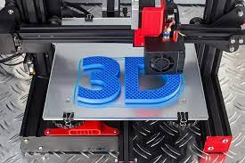
Applications of 3D Printing
Prototyping
Modeling – art or activity of making 3D models
Custom Parts
Design
Research

Slide 3
What is 3-D Printing? How does it work?
3D printing refers to a technology that
allows someone to design a three dimensional object in a computer aided design (CAD) program.
Software translates that 3D object taking many slices of the object
the 3D object is built by laying down hundreds of thin layers on top of one another of melted filament

Slide 4
3D modeling or design
AutoCAD
SolidWorks
Google SketchUp
Tinkercad

Slide 5
STL file
The computer software translates the object or objects into “slices” in which the printer lays down each layer or slice building the object from bottom to top – each layer builds on the layer underneath it

Slide 6
Subtractive Manufacturing
Additive Manufacturing
Creates a product by removing sections from a block of material
Generates waste through the excess material that is removed.
Limited design capabilities
An example would be a CNC machine cutting or drilling excess material away.
Creates a product through adding materials to the object.
Adds material layer by layer until printing is finished.
Allows for complex and intricate designs.

Slide 7
Most 3D printers use a process called additive manufacturing to create an object in three dimensions.
With this process, the printer follows instructions to lay down thin layers of melted plastic on a flat platform.
There are many types of plastic that printers can use, but the most common types are PLA and ABS plastics. PLA plastic is made from plant material, while ABS plastic is petroleum based. The plastic starts as a solid strand, called filament, on a spool.
It is then fed through an extruder, which melts the plastic and uses a computer to place it at exactly the right spot.
The process of extruding molten plastic is very similar to a hot glue gun that hobbyists and crafters use.
The molten plastic quickly solidifies and is cool enough to handle immediately after printing.

Slide 8
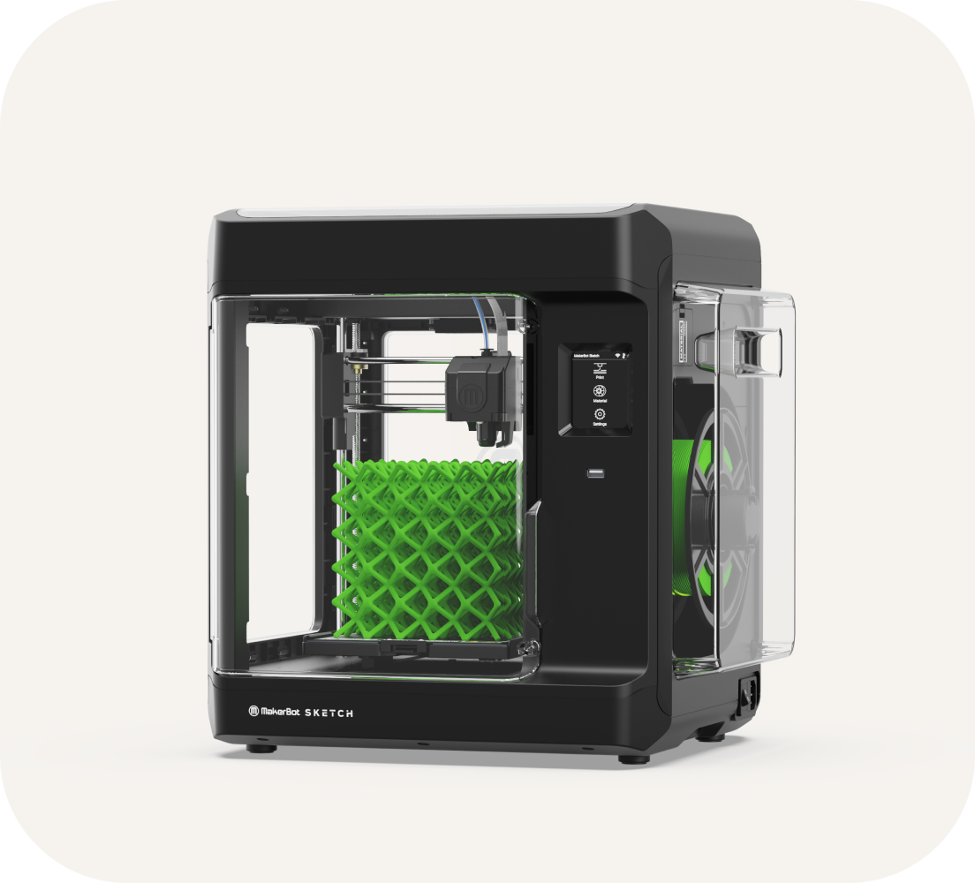
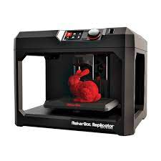

Slide 9
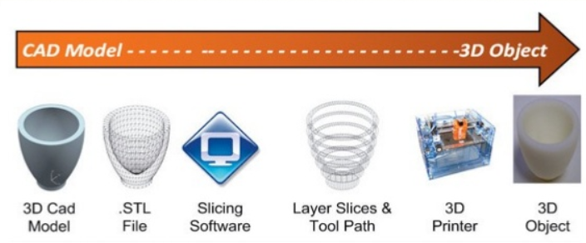
3D Printing Process
It all starts with a 3D CAD model
Model gets converted to an .STL file
Slicing software creates printable layers
Slices turn into toolpaths
3D printer prints the object

Slide 10
3D Printing and Sustainability
3D printing with non harmful materials
3D printing generates almost no waste during manufacturing, and does not require lubricants (oil based product)
Can be used to create replacement parts

Slide 11
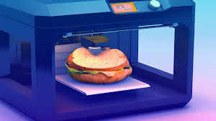
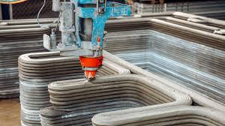
What can be printed?
Organs
Food
Music instruments
Furniture
Clothing and shoes
Optics

Slide 12

Some Challenges Facing 3D Printing
Intellectual property rights of the 3D printer users.
Nearly anything can be printed by them and this is a troubling prospect if criminals use them to create illegal products

Slide 13
3D Printing
SAFETY

Slide 14
Understanding your role in safety
identify the parts of a 3D printer
to explain what each part of a 3D printer is used for
to identify the risks involved in 3D printing
to explain how to safely use a 3D printer

Slide 15
Parts of the 3D printer:
Control Panel/Screen - computer screen that lets you customize settings and start your print.
Filament - material inserted into the printer and melted down to create the model.
Print Head - component that does a lot of the work - moves around the model and contains a motor, extruder, cooling fan

Slide 16
Filament
Many different types of filament: PLA, ABS, nylon, etc.; each type is made from different materials
Filament emits fumes when heated and melted
PLA - safest/healthiest known as of now (2020) This is what we use and is made from corn

Slide 17
Print Head
Moves around quickly, and not always predictably
Risk of pinching and burning
Has very hot parts attached, such as the extruder nozzle

Slide 18
Parts of the 3D printers
Extruder - machinery inside the print head that processes and melts the filament
Nozzle - hot tip at end of extruder the deposits melted filament onto print bed
Build Plate/Print Bed - heated surface on which the 3d model is adhered to and built

Slide 19
Extruder & Nozzle
Exposed end of the extruder (the nozzle part) gets very HOT - depending on the printer, may reach up to 600℉!
Nozzle is made of metal, and can shock you when touched
Nozzle gets clogged and requires unclogging; can burn you if not cool enough

Slide 20
Build Plate/Print Bed
Heated to an extremely high temperature to help with adhesion
Moves up and down; risk of pinching
Often requires tools to help remove finished model; tools vary, but have their own safety risks

Slide 21
3D printers use electricity, which means the risk of electric shock if not used properly
The extreme heat used in 3D printing can create a potential fire hazard.
There are many different tools used to finish and clean up a 3d printed model. Each tool poses its own risks.

Slide 22
Printing Checklist
Remove any objects away from the table the 3D printer is on
Printer should have space to “breathe”
Check electrical cords and outlets for any problems.
DO NOT TOUCH MOVING PARTS WHILE MOVING

Slide 23
Beware of very hot parts, such as the extruder nozzle and print bed/build plate.
Print in a well-ventilated area.
Always print with guards (doors) closed
Do not start print by yourself – a teacher must send and set the print
Wait for the printer to stop completely and cool before removing the print.
Be careful with tools used to remove and clean up the print.

