Slide 1
Atomic Structure
Chapter 4

Slide 2
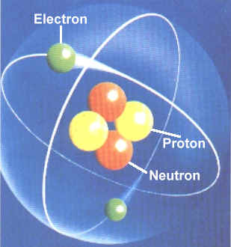
Section 4.1 – Defining the Atom
Write down the objectives and vocabulary words. Tonight for homework please write the words and the definitions out.
Objective –
Compare and contrast the major atomic models over history.
Vocabulary
1.) atom
2.) cathode ray
3.) electrons
4.) nucleus
5.) proton
6.) nucleus
7.) proton
8.) neutron
9.) atomic number
10.) isotopes
11.) mass number
12.) Atomic mass unit (amu)
13.) atomic mass

Slide 3
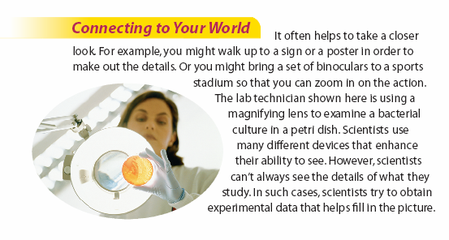
What are some objects that require experimental data in order to “picture” them, either because they are small or inaccessible?

Slide 4
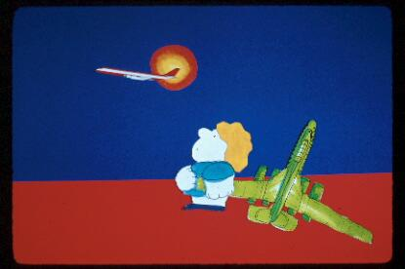
What is a model
Notes:
‹#›

Slide 5

It is a representation of reality, but only a partial representation. It is not as complex as the real world.
Notes:
‹#›

Slide 6
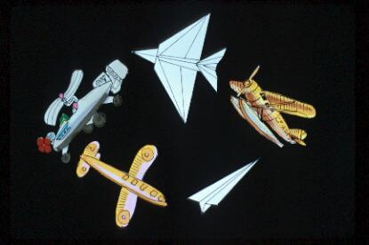
There are many kinds of models so you could have many different models of the same thing.
Notes:
‹#›

Slide 7
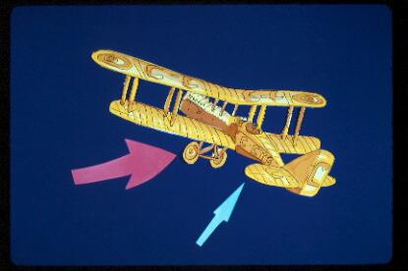
Some models look very much like the real thing, that is they are visually or structurally descriptive. They are good for learning about parts and relationships between parts; that is the structure of a system.
Notes:
‹#›

Slide 8
Models
A model car would be an example of a physical model
Models of an atom are intellectual models based on information that has been gathered
Notes:
‹#›

Slide 9
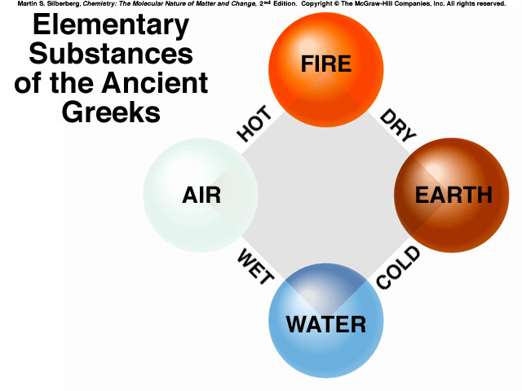
The Philosophers
Earliest ideas of matter was that all things were made up of four elements: Earth, Air, Fire, and Water

Slide 10
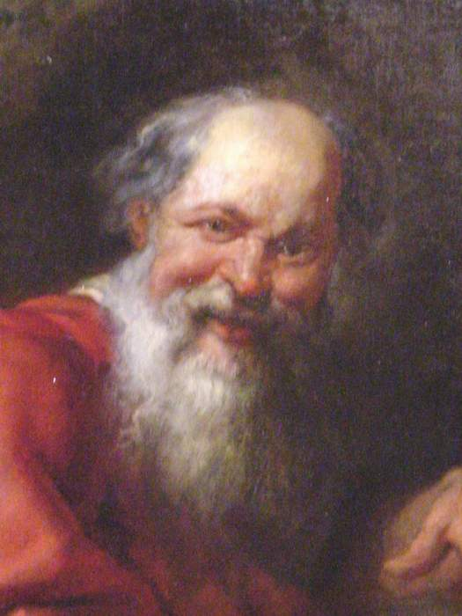
The Philosophers
Democritus – Greek philosopher; first to propose idea of atoms; 400 B.C.
Proposed all matter made of tiny, indivisible and indestructible particles he called atoms (from Greek word atomos which means indivisible).
Ideas rejected largely due to Aristotle’s beliefs, did not explain chemical behavior, and the lack of scientific evidence.

Slide 11
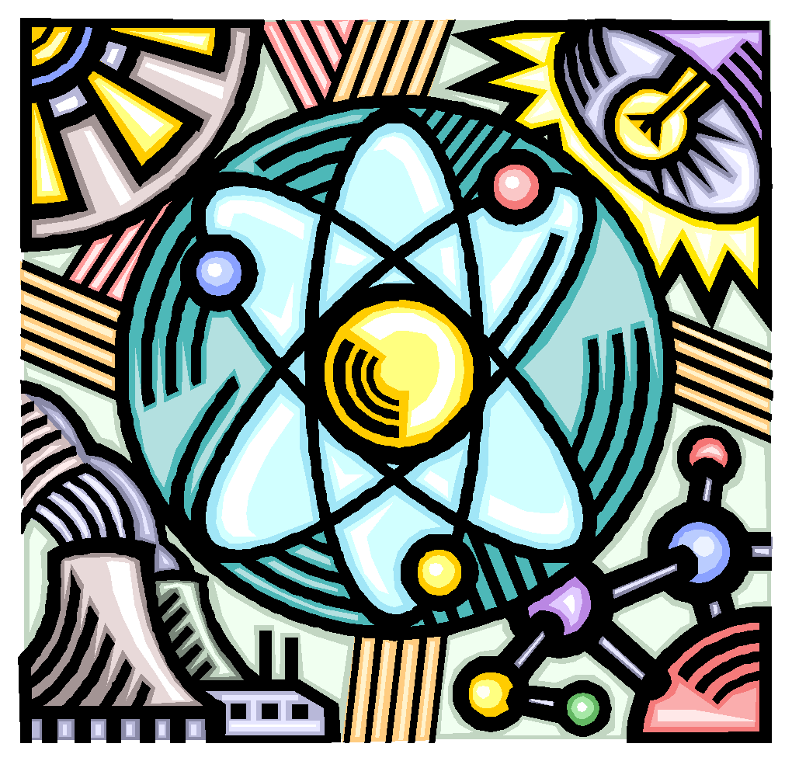
Development of Modern Atomic Theory
Based on 3 laws
Law of Conservation of Mass
Law of Multiple Proportions
Law of Definite Composition

Slide 12
Modern Atomic Theory
Originally developed by John Dalton in 1803
Postulates of Dalton’s Atomic Theory
All matter made of indivisible atoms
Atoms of same element identical, atoms of different elements different
Atoms cannot be created, destroyed or subdivided in chemical reactions
Different atoms combine in simple, whole-number ratios to form compounds
In chemical reactions atoms are separated, combined, or rearranged

Slide 13
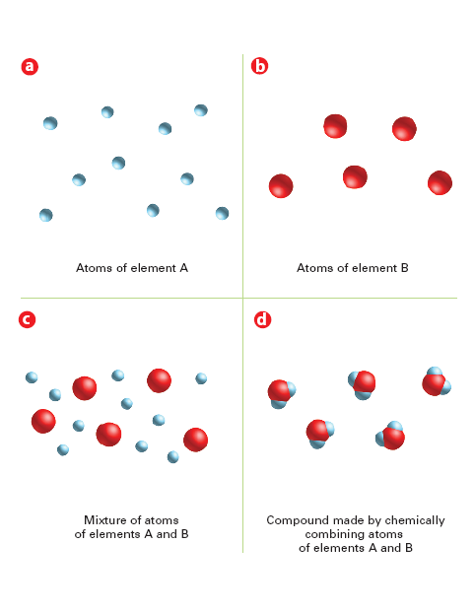
According to Dalton’s theory, an element is composed of only one kind of atom, and a compound is composed of particles that are chemical combination of different kinds of atoms.
How does a mixture differ from a compound?
According to Dalton’s theory, an element is composed of only one kind of atom, and a compound is composed of particles that are chemical combination of different kinds of atoms.
How does a mixture differ from a compound?

Slide 14
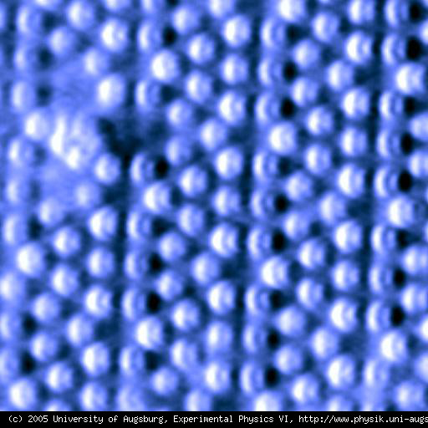
Modern View of Atom
Atoms are smallest part of an element that retains characteristics of that element
Seen only with the aid of STM’s
Made up of smaller particles

Slide 15
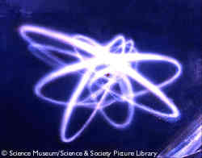
Section 4.2 – Structure of the Nuclear Atom
Objectives –
1.) Define atoms
2.) Distinguish between the subatomic particles in terms of relative charge and mass
3.) Describe the structure of the atom, including the locations of the subatomic particles

Slide 16
The discovery of the electron
Mid-1800s – scientists began to question whether the atom was really invisible
Why atoms of different elements had different properties
Scientists knew that some substances conducted electricity while others did not
Unlike charges attract – like charges repel
Notes:
‹#›

Slide 17
Cathode-ray tube
A high voltage electrical current is driven through a nearly empty tube near a vacuum
The tube contains two pieces of metal called electrodes attached by a wire to the source of electric current
The source has two terminals – positive and negative
Notes:
‹#›

Slide 18
In a cathode ray tube, the anode is the positive terminal where electrons flow out of the device, i.e., where positive electric current flows in.
An electrode through which current flows the other way (out of the device) is termed a cathode.
Notes:
‹#›

Slide 19
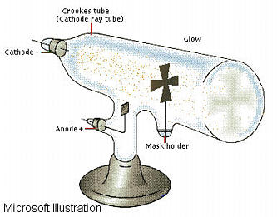
Discovery of the Electron
1897 J.J. Thompson
1899 Charge of the Electron Measured
^{Electrons Missing Target}
^{Electrons Hitting}
^{Target}
Crookes Tube
Vacuum Tube
Notes:
‹#›

Slide 20
Crookes showed that when the current was turned on, a beam moved from the cathode to the anode (from negative to positive)
Because the beam originated in the negative and was attracted to the positive (remember attract – unlike / repel –like)
The beam was negative in nature
Notes:
‹#›

Slide 21
Wave or particles
If the beam was composed of negative particles a magnet would deflect them
If the beam was a wave – a magnet would cause no deflection
J.J. Thomson – used both techniques to show that the ray was composed of particles – electrons
Notes:
‹#›

Slide 22
Photoelectric effect
1902 – Lenard showed that under ultraviolet light metals emit electrons
1911 – Millikan calculated the mass of an electron
Notes:
‹#›

Slide 23
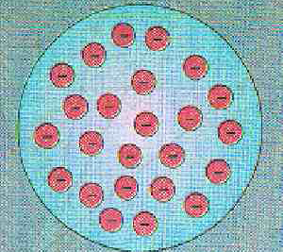
The Plum Pudding Model
J.J. Thompson- 1904
Electrons
(Negativly Charged)
Field
(Positively Charged)
In Today's Vernacular- The Chocolate Chip Model
Notes:
‹#›

Slide 24
Rutherford
Worked with alpha particles
Used gold foil and shot a stream of positive particles
One in 20,000 ricocheted
Devised a new model – nuclear model
Atom must have a center of positive charge – the nucleus of the atom
Nucleus small compared to overall size
Where mass is concentrated
Notes:
‹#›

Slide 25
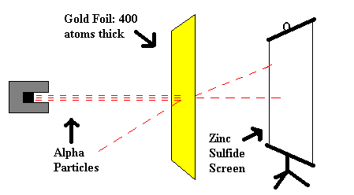
Discovery of the Nucleus
Earnest Rutherford-1911
Rutherford called it a“Central Charge
(1920 called it a Proton)
Notes:
‹#›

Slide 26
Chadwick
Was able to prove the existence of a new subatomic particle called the neutron
Added mass without affecting charge
Think of neutrons as atomic glue to hold the like charged protons together
Proton | p | +1
Electron | e | -1
Neutron | n | 0
Notes:
‹#›

Slide 27
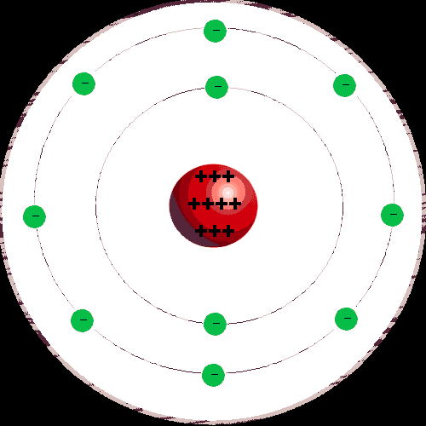
Bohr’s Model
1913 – Atomic Model with Fixed Orbits proposed –
Modeled after the Solar System
The Atom has No Charge
Number of Protons =
Number of Electrons
Protons
Electrons
Inner Orbit
Nucleus
Outer Orbit
Nucleus
Notes:
‹#›

Slide 28
How Big is It, (Are They)?
1 Proton ( or Neutron)----1.67 x10⁻²⁴ Grams
=0.000000000000000000000001.67 Grams
1 electron-----9.1x10⁻²⁸ Grams
=0.0000000000000000000000000009.1Grams
The Proton weighs 1800 x the Electron
The Atom is about 5 X 10⁻⁸ Cm
Notes:
‹#›

Slide 29
Lets Try Analogies
If the Nucleus were the size of a Garbage Can
The Atom would be the size of LA
If an electrons weighed as much as a watermelon
The proton would weigh as much as an elephant
Conclusion; It’s mostly nothing
Notes:
‹#›

Slide 30
Discovery of the Neutron
James Chadwick - 1935
A Unique Particle, (not an electron or a proton )
Essentially the same mass as an Proton
Has no Charge
With the Proton, Makes up the Nucleus
Notes:
‹#›

Slide 31
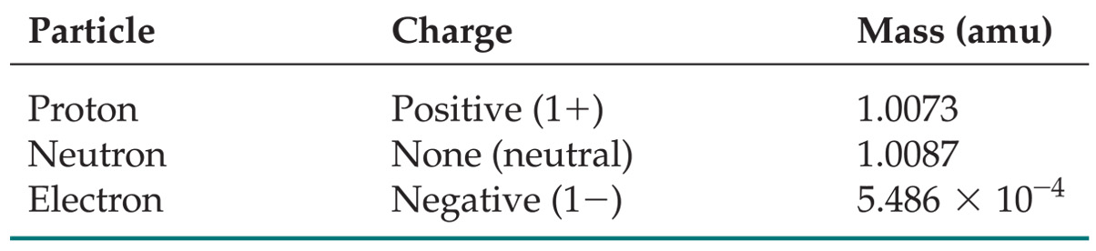
Subatomic Particles
Protons and electrons are the only particles that have a charge.
Protons and neutrons have essentially the same mass.
The mass of an electron is so small we ignore it.
Notes:
‹#›
Table 2.1

Slide 32
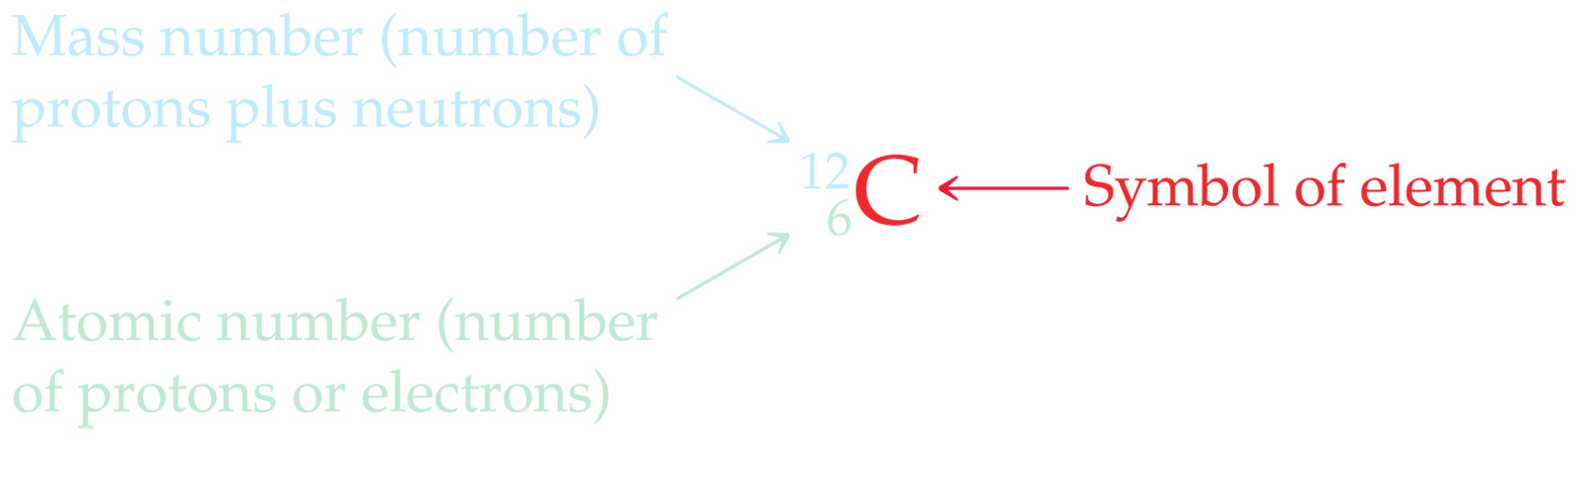
Symbols of Elements
Elements are symbolized by one, two, or letters.
Notes:
‹#›

Slide 33
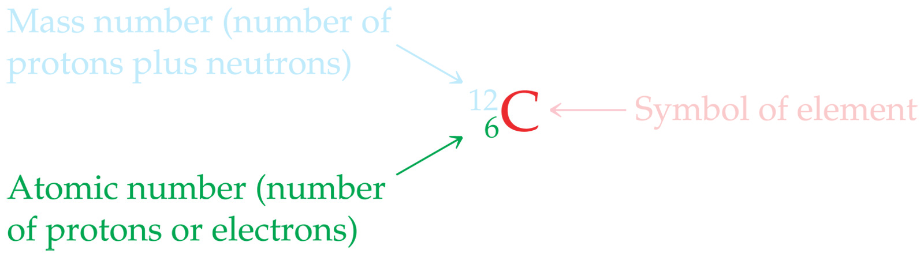
Atomic Number
All atoms of the same element have the same number of protons:
The atomic number (Z)
Notes:
‹#›

Slide 34
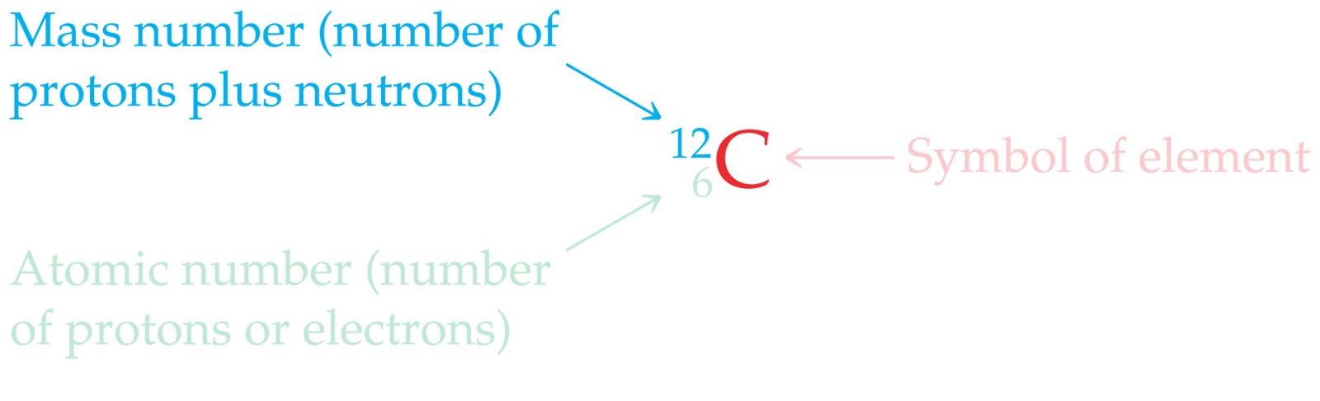
Atomic Mass
The mass of an atom in atomic mass units (amu) is the total number of protons and neutrons in the atom.
Notes:
‹#›

Slide 35
Isotopes:
Atoms of the same element with different masses.
Isotopes have different numbers of neutrons.
11
6
12
6
13
6
14
6
C
C
C
C
Notes:
‹#›

Slide 36
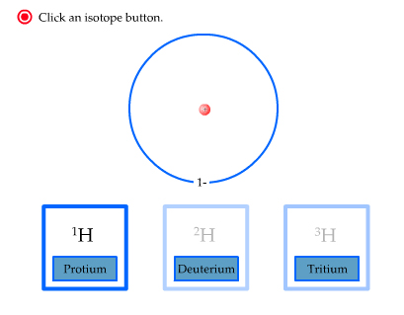
Isotopes of Hydrogen
Notes:
‹#›

Slide 37
Practice
Give the number of protons, electrons and neutrons of each of the isotopes
238/92 U
235/92 U
84/36 Kr
Notes:
‹#›

Slide 38
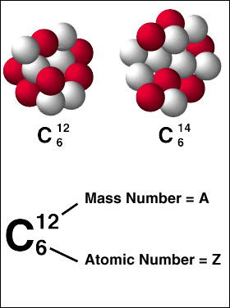
Section 4.3 – Distinguishing Among Atoms

Slide 39
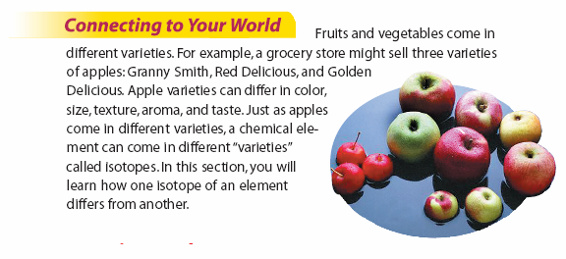
What characteristics can you use to classify different apples?
Which of these involve the apple’s chemistry?

Slide 40
Atomic Number
Henry Moseley discovered that each atom contains a unique number of protons
Elements are different because they contain different numbers of protons.
This number of protons is the atomic number
For neutral atoms this equals number of electrons
# PROTONS = # ELECTRONS

Slide 41
Mass Number
The total number of protons and neutrons in an atom is the MASS NUMBER.
The number of neutrons is the difference between the mass number and atomic number.
# NEUTRONS = MASS # - ATOMIC #
or
# PROTONS + # NEUTRONS = MASS #

Slide 42
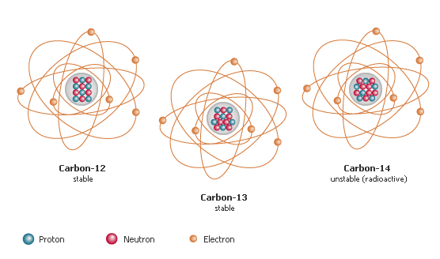
Isotopes
ISOTOPES are atoms of the same element with different numbers of neutrons.
Because isotopes of an element have different numbers of neutrons, they also have different mass numbers.

Slide 43
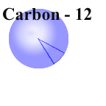
Mass of Individual Atoms
The masses of individual atoms are expressed in terms of atomic mass units
Relative scale based on the Carbon-12 nuclide
1 a.m.u. = 1/12 the mass of C-12

Slide 44
Calculating Average Atomic Mass
Also called atomic weight
Mass listed on periodic table
Based on the percent occurrence of natural isotopes of an atom
The “weighted average” of the masses
Must know number of isotopes, masses, and percent occurrence to calculate average atomic mass
To calculate, multiply the mass of each isotope by it percent occurrence (natural abundance), expressed as a decimal, and then add the products.

Slide 45
Calculate Average Atomic Mass - Step 1 Write Down all Isotopes of each atom
Example – Find the average atomic mass of boron
¹⁰B = 19.6% with an isotope atomic mass of 10.013 amu
¹¹B = 80.4% with an isotope atomic mass of 11.009 amu
Average Atomic Mass of Boron
Isotope Name
¹⁰B
¹¹B

Slide 46
Calculate Average Atomic Mass - Step 2- Write down the percent abundance of each of the isotopes
Example – Find the average atomic mass of boron
¹⁰B = 19.6% with an isotope atomic mass of 10.013 amu
¹¹B = 80.4% with an isotope atomic mass of 11.009 amu
Average Atomic Mass of Boron
Isotope Name | Percent Composition
¹⁰B | 19.6%
¹¹B | 80.4%

Slide 47
Calculate Average Atomic Mass - Step 3 - Divide the Percent Composition by 100 to get the decimal form of the percent
Example – Find the average atomic mass of boron
¹⁰B = 19.6% with an isotope atomic mass of 10.013 amu
¹¹B = 80.4% with an isotope atomic mass of 11.009 amu
Average Atomic Mass of Boron
Isotope Name | Percent Composition | % Comp /100 Decimal form of percent
¹⁰B | 19.6% | .196
¹¹B | 80.4% | .804

Slide 48
Calculate Average Atomic Mass - Step 4 Write down the isotopes atomic mass
Example – Find the average atomic mass of boron
¹⁰B = 19.6% with an isotope atomic mass of 10.013 amu
¹¹B = 80.4% with an isotope atomic mass of 11.009 amu
Average Atomic Mass of Boron
Isotope Name | Percent Composition | % Comp /100 Decimal form of percent | Isotope Mass(if not given use Mass Number) amu
¹⁰B | 19.6% | .196 | 10.013
¹¹B | 80.4% | .804 | 11.009

Slide 49
Calculate Average Atomic Mass - Step 5 - Multiply the decimal percent composition by the isotope mass number
Example – Find the average atomic mass of boron
¹⁰B = 19.6% with an isotope atomic mass of 10.013 amu
¹¹B = 80.4% with an isotope atomic mass of 11.009 amu
Average Atomic Mass of Boron
Isotope Name | Percent Composition | % Comp /100 Decimal form of percent | Isotope Mass(if not given use Mass Number) amu | Multiple Decimal percent comp x Isotope Mass Number
¹⁰B | 19.6% | .196 | 10.013 | (.196 x 10.013)
¹¹B | 80.4% | .804 | 11.009 | (.804 x 11.009)

Slide 50
Calculate Average Atomic Mass - Step 1 Write Down all Isotopes of each atom
Example – Find the average atomic mass of boron
¹⁰B = 19.6% with an isotope atomic mass of 10.013 amu
¹¹B = 80.4% with an isotope atomic mass of 11.009 amu
Average Atomic Mass of Boron
Isotope Name | Percent Composition | % Comp /100 Decimal form of percent | Isotope Mass(if not given use Mass Number) amu | Multiple Decimal percent comp x Isotope Mass Number
¹⁰B | 19.6% | .196 | 10.013 | (.196 x 10.013) | 1.96 amu
¹¹B | 80.4% | .804 | 11.009 | (.804 x 11.009) | 8.85 amu
Average Atomic Mass - 10.81 amu

Slide 51
Calculate Average Atomic Mass - Step 1 Write Down all Isotopes of each atom
Example – Find the average atomic mass of boron
¹⁰B = 19.6% with an isotope atomic mass of 10.013 amu
¹¹B = 80.4% with an isotope atomic mass of 11.009 amu
Average Atomic Mass of Boron
Isotope Name | Percent Composition | % Comp /100 Decimal form of percent | Isotope Mass(if not given use Mass Number) amu | Multiple Decimal percent comp x Isotope Mass Number
¹⁰B | 19.6% | .196 | 10.013 | (.196 x 10.013) | 1.96 amu
¹¹B | 80.4% | .804 | 11.009 | (.804 x 11.009) | 8.85 amu
Average Atomic Mass - 10.81 amu

Slide 52
Atomic Mass of isotope
[A * (%abundance)] + [B * (%abundance)] +…. =
100 100
Where A, B, … are the atomic masses
Example – Find the average atomic mass of boron
¹⁰B = 19.6% with an atomic mass of 10.013 amu
¹¹B = 80.4% with an atomic mass of 11.009 amu
Notes:
‹#›

Slide 53
The atomic mass of the isotope Boron =
= (10.013 amu)(0.196) + (11.009 amu)(0.804)
= 1.96 amu + 8.85 amu = 10.81 amu
Notes:
‹#›

Slide 54
% Abundance
Again atomic mass=
[A * (%abundance)] + [B * (%abundance)] +…. =
100 100
Bromine exists in two isotopes Br 79 and 81. The atomic mass of bromine is 79.90 amu. Calculate the % abundance of each isotope. The exact isotopic mass =
⁷⁹Br is 78.9183
⁸¹Br is 80.9163
Notes:
‹#›

Slide 55
Bromine exists in two isotopes Br 79 and 81. The atomic mass of bromine is 79.90 amu. Calculate the % abundance of each isotope. The exact isotopic mass =
⁷⁹Br is 78.9183
⁸¹Br is 80.9163
79.90 amu = (78.9183)(x) + (80.9163)(1-x)
79.90 amu = 78.9183x + 80.9163 – 80.9163x
-1.0163 = -1.998x
X = .5086 = 50.86%
1-x = .4914 = 49.14%
Notes:
‹#›

Slide 56
Table of Relative abundance
How many 17-O atoms there are in a sample of 1,000,000 atoms
=(natural abundance in decimal form) (atoms)
=(.00037)(1,000,000)
Notes:
‹#›

Slide 57
Example II
How many 20-Ne atoms are there in a sample of 1,000,000
=(natural abundance in decimal form) (atoms)
=(.9092)(1,000,000)
Notes:
‹#›

