Slide 1
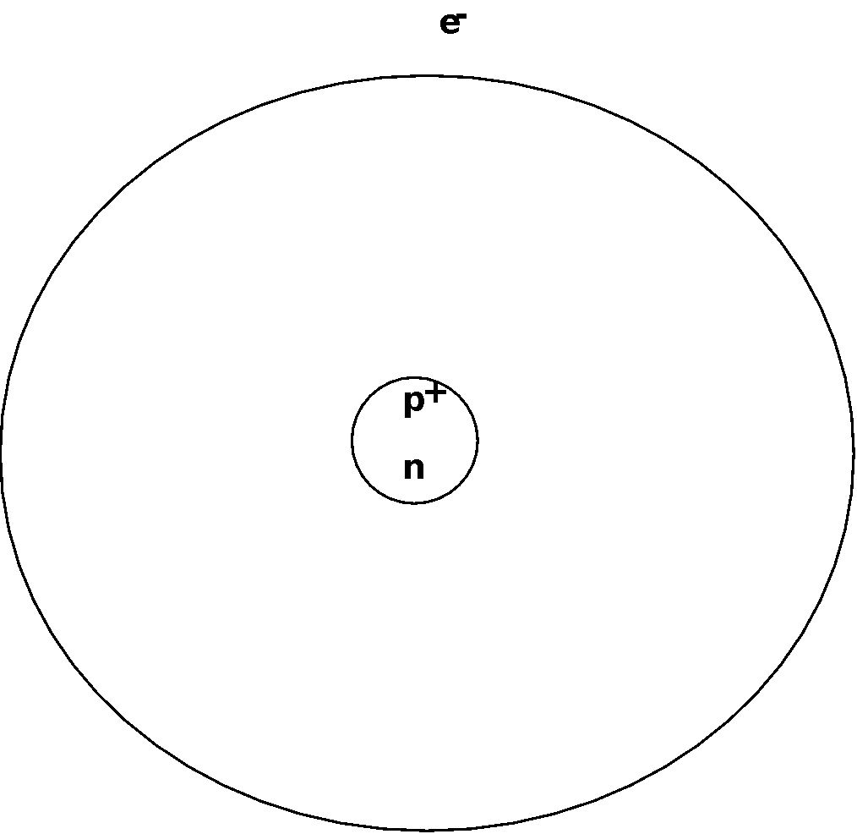
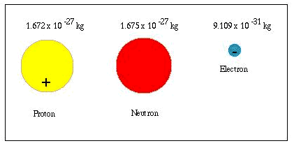
SUBATOMIC PARTICLES IN AN ATOM!
3 main particles in the atom:
  Neutrons
  Protons
  Electrons
LOCATION
In physics, we will learn that even these particles are made of smaller particles!
SIZE

Slide 2
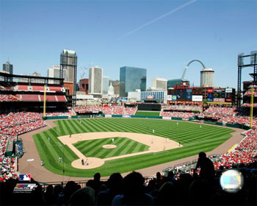
REMEMBER, MOST OF AN ATOM IS EMPTY SPACE!
An atomic model the size of a Stadium and parking would contain a pea sized nucleus containing 95.95% of the atom's mass.
The pea at the pitcher’s mound would be the nucleus, and an ant crawling on the parking lot outside would be an electron!

Slide 3
ELECTRONS
Discovered by JJ Thompson, RA Millikan
  Located around nucleus
  Negatively (-) charged particles
  Mass = essentially zero - only 1/2000 of a proton or neutron
  Charge = -1
  Occupies the majority of space in an atom, but contributes NOTHING to the mass of an atom!
-

Slide 4
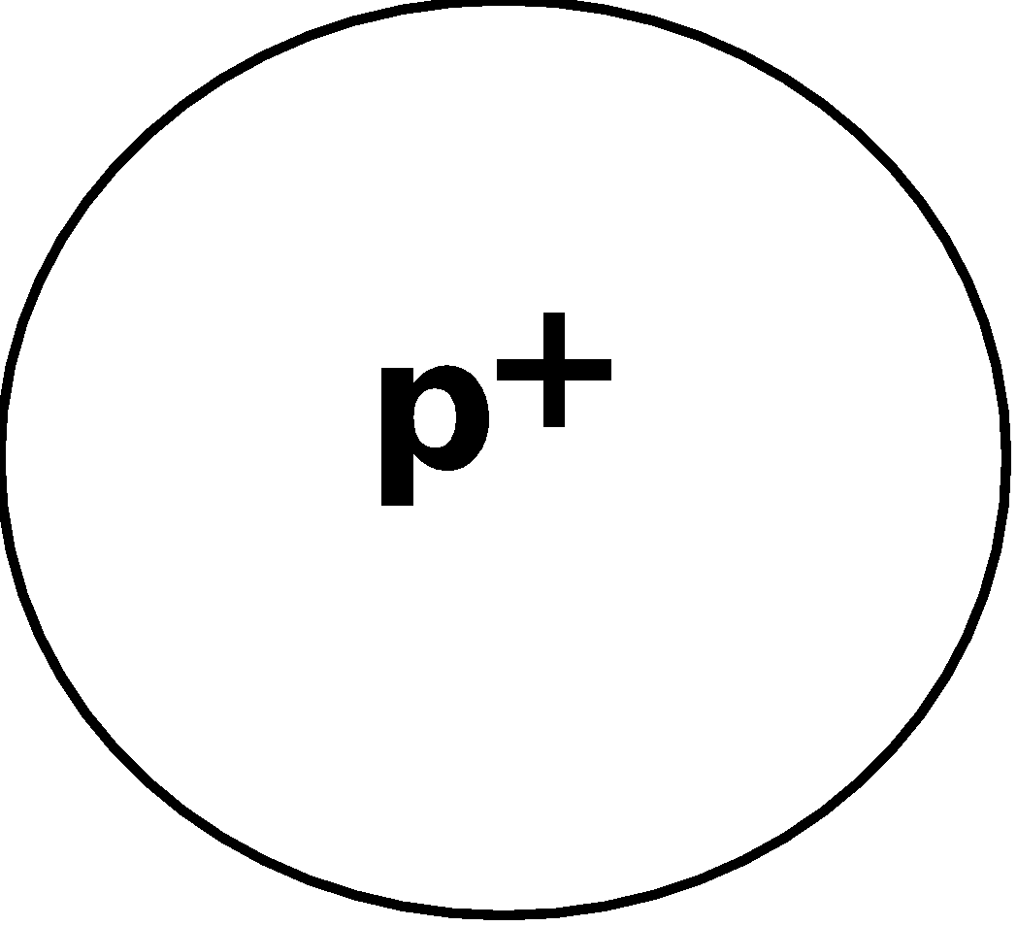
PROTONS
  Located in….nucleus!
  Mass of 1.67 x 10⁻²⁴ grams
  We call that 1 amu, or a mass of 1
  Charge = +1

Slide 5
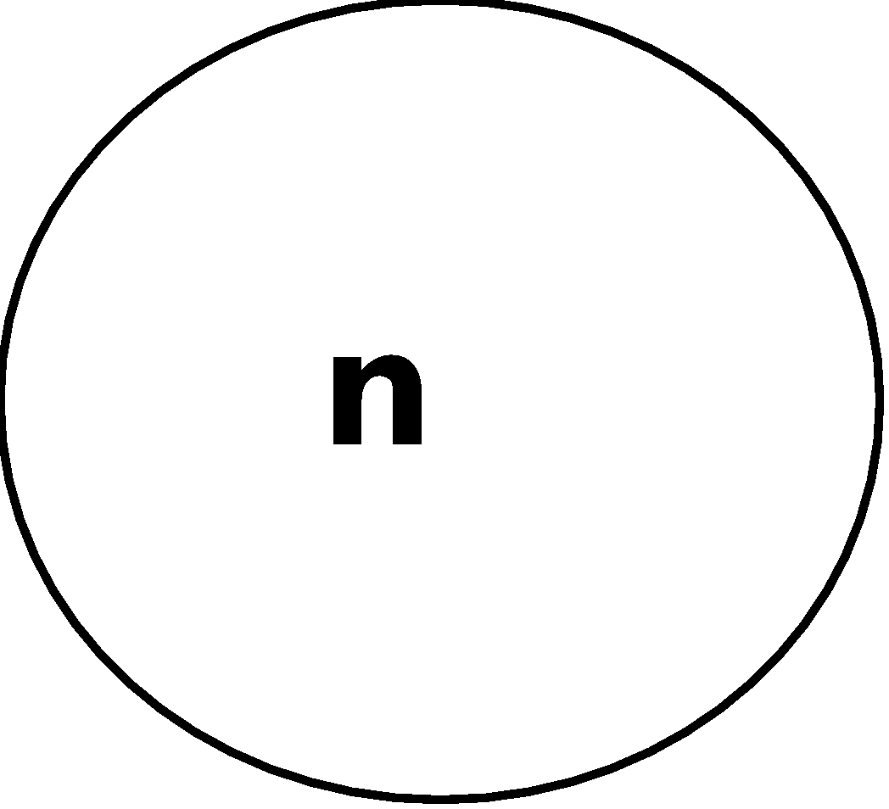
NEUTRONS
James Chadwick (1932)
  Located in….
  The tiny, dense nucleus!
  Mass of 1.67 x 10⁻²⁴ grams
  We call that 1 amu, or a mass of 1
  Charge = 0

Slide 6
NUCLEAR SYMBOLS
X = element symbol
Z = mass number
= # protons + # neutrons
A = atomic number
= # protons
(gives an element its identity!!)
So… # neutrons = Z-A
Z
charge
X
A

Slide 7
ATOMIC NUMBER
Number of protons
Number on bottom of symbol
Gives an atom its identity!
If 6 p⁺ in nucleus, the atom is….
Carbon!
It 7 p⁺ in nucleus, the atom is….
Nitrogen!
14
N
7
12
C
6

Slide 8
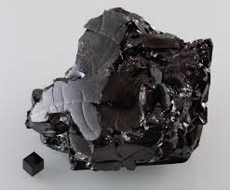
ISOTOPES
Atoms of the same element that weigh different amounts!
These are both isotopes of carbon!
They both have 6 protons, so they are both carbon!
The first atom weighs 12, the second weighs 14!
12
14
C
C
6
6

Slide 9

ELECTRONS AND ATOM CHARGE
If the number of p⁺ = number of e⁻
Then atom is NOT CHARGED
Charge = #p⁺ - #e-
If If the number of p⁺ > number of e⁻
Then the atom is + charged (cation)
If If the number of p⁺ < number of e⁻
Then the atom is - charged (cation)
ALL ELEMENTS ARE NEUTRAL, AND NOT CHARGED - AN ELEMENT HAS TO REACT IN ORDER TO BE CHARGED!
A CHARGED ATOM IS CALLED AN ION

Slide 10
HOW MANY P⁺, N, E⁻ ??
Ca⁺²
108
41
Ag
47
20
p⁺ =
e⁻ =
n =
Charge on atom….
p⁺ =
e⁻ =
n =
Charge on atom….
20
47
47
18
61
21
+2
0

Slide 11
WRITE THE NUCLEAR SYMBOL FOR…
An atom containing 18 e-, 16 P, and 17 N.
What element is it??
Atomic number = 16
# p⁺ = 16
Element is….
Sulfur
Number of electrons tells us…
There are two more electrons than protons
The electrons are winning by 2!
Charge is -2!
Mass Number = #p⁺ + #n
33
-2
S
16

Slide 12
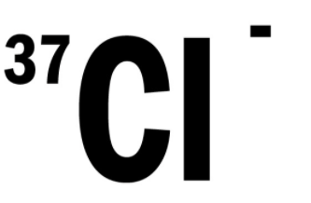

Slide 13
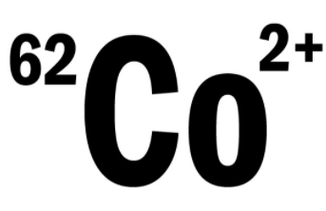

Slide 14
