Slide 1
Chapter 10

Slide 2
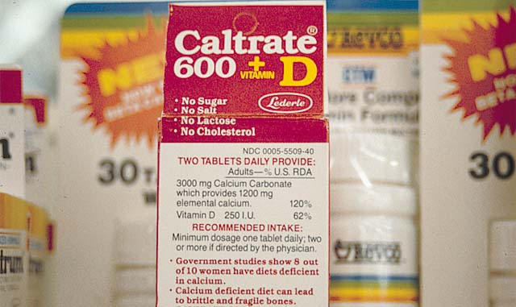
If you know the name of an ingredient, you can write a chemical formula

Slide 3
Empirical Formula
The empirical formula of a substance simply gives the ratio of the combination of the constituent elements.

Slide 4
Which of the following is not an empirical formula? A. CH₄ B. CO₂ C. C₆H₆ D. H₂CO₃
The subscripts are divisible by 6 so the empirical formula is
CH
CH doesn’t give you very much information about the compound

Slide 5
Chemical Equations

Slide 6
Introduction
Chemical reactions occur when bonds between the outermost parts of atoms are formed or broken
Chemical reactions involve changes in matter, the making of new materials with new properties, or energy changes.
Chemical Reactions are described using a shorthand called a chemical equation

Slide 7
Balancing equations
Chemical equations show the conversion of reactants (the molecules traditionally shown on the left of the arrow) into products (the molecules traditionally shown on the right of the arrow).
A + sign shows that the compounds on the left of the arrow combine to form the product or products on the right of the arrow.
The arrow is read as “reacts to yield”
Example
C + O₂ 🡪 CO₂
This reads carbon plus oxygen reacts to yield carbon dioxide

Slide 8
An equation is balanced when the total number of atoms of each element occur the same number of times on both sides of the equation.
Law of conservation of mass.
Atoms are neither created nor destroyed in a chemical reaction.

Slide 9
When balancing a chemical reaction you may add coefficients in front of the compounds to balance the reaction, but you may not change the subscripts.
Changing the subscripts changes the compound.

Slide 10
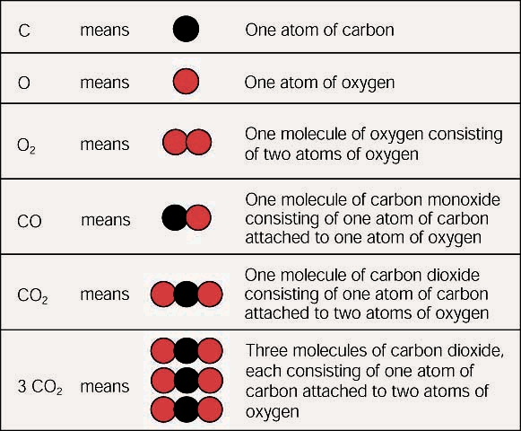

Slide 11
There are four basic steps to balancing a chemical equation.
1 - Write the correct formula for the reactants and the products in an unbalanced equation.
2 - Inventory the number of each kind of atom on both sides of the unbalanced equation.
3 - Determine where to place coefficients in front of formulas to balance the equation.
4 - Take another inventory to determine if:
The numbers of atoms on both sides of the equation are now balanced.
The coefficients are in the lowest possible whole number ratios.

Slide 12
When balancing equations remember the following:
Atoms are neither lost nor gained during a chemical reaction.
A correct formula of a compound cannot be changed by altering the number or placement of subscripts.
A coefficient in front of a formula multiplies everything in the formula by that number.

Slide 13
CH₄(l) + O₂(g) → CO₂ (g) + H₂O(l)
Count the number of same elements on both sides
ELEMENT | REACTANT | PRODUCT
C | 1 | 1
H | 4 | 2
O | 2 | 3
C is balanced by H and O are not…H is off by 2 and O is off by 1

Slide 14
CH₄(l) + O₂(g) → CO₂ (g) + H₂O(l)
C is balanced by H and O are not…H is off by 2 and O is off by 1
For H: What number do you multiply the 2 H on the product by to get 4H?
CH₄(l) + O₂(g) → CO₂ (g) + 2 H₂O(l)
So now there are 4 H’s on both sides
Now there are 2 O on the reactant side and 4 O on the product side
For O: what number do you multiply the 2O on the reactant side to get 4O?
2
CH₄(l) + 2 O₂(g) → CO₂ (g) + 2 H₂O(l)

Slide 15
CH₄(l) + 2 O₂(g) → CO₂ (g) + 2 H₂O(l)
ELEMENT | REACTANT | PRODUCT
C | 1 | 1
H | 4 | 4
O | 4 | 4
Reaction is balanced

Slide 16
Practice Balancing Equations
1 | H₂ + O₂ => H₂O
2 | H₃PO₄ + KOH => K₃PO₄ + H₂O
3 | K + B₂O₃ => K₂O + B
4 | HCl + NaOH => NaCl + H₂O
5 | Na + NaNO₃ => Na₂O + N₂

Slide 17
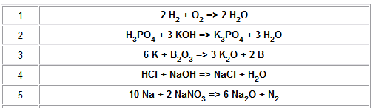

Slide 18
TYPES OF CHEMICAL REACTIONS

Slide 19
Types of Reactions
Reactions are classified by their products.
There are five types of chemical reactions we will talk about:
Synthesis reactions
Decomposition reactions
Single displacement reactions
Double displacement reactions
Combustion reactions
You need to be able to identify the type of reaction and predict the product(s)

Slide 20
Steps to Writing Reactions
Some steps for doing reactions
Identify the type of reaction
Predict the product(s) using the type of reaction as a model
Balance it
Don’t forget about the diatomic elements! (BrINClHOF) For example, Oxygen is O₂ as an element.

Slide 21
Synthesis or Combination reactions
Synthesis (meaning to make) or combination reactions are typified by their single product.
If you have a reaction in which at least 2 elements or compounds are reacted and produce a single product, the reaction is a synthesis reaction.

Slide 22
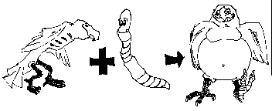
1. Synthesis reactions
Synthesis reactions are sometimes called combination or addition reactions.
reactant + reactant 🡪 1 product
Basically: A + B 🡪 AB
Example: 2H₂ + O₂ 🡪 2H₂O
Example: C + O₂ 🡪 CO₂
Note: Single Product! This is your clue that this is a synthesis or combination reaction.

Slide 23
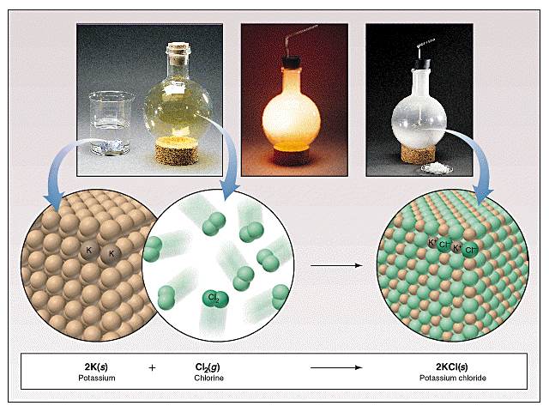
Synthesis Reactions
Here is another example of a synthesis reaction

Slide 24
Practice
Predict the products. Write and balance the following synthesis reaction equations.
Sodium metal reacts with chlorine gas
Na_{(s)} + Cl_{2(g)} 🡪
Solid Magnesium reacts with fluorine gas
Mg_{(s)} + F_{2(g)} 🡪
Aluminum metal reacts with fluorine gas
Al_{(s)} + F_{2(g)} 🡪
2
2
NaCl_{(s)}
MgF_{2(s)}
Balanced
2
3
2
AlF_{3(s)}

Slide 25
2. Decomposition Reactions
Decomposition reactions are really just the opposite of a synthesis reaction. Remember, if you can make a substance, you should be able to break it back apart into its components.
A good way to remember decomposition reactions to to remember what happens when something decomposes. It falls apart!

Slide 26
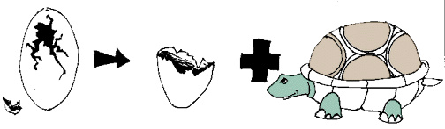
Decomposition Reactions
Decomposition reactions occur when a compound breaks up into the elements or in a few to simpler compounds
1 Reactant 🡪 Product + Product
Basically: AB 🡪 A + B
Example: 2 H₂O 🡪 2H₂ + O₂
Example: 2 HgO 🡪 2Hg + O₂
Note: Single Reactant! The single reactant is your clue that this is a decomposition reaction.

Slide 27
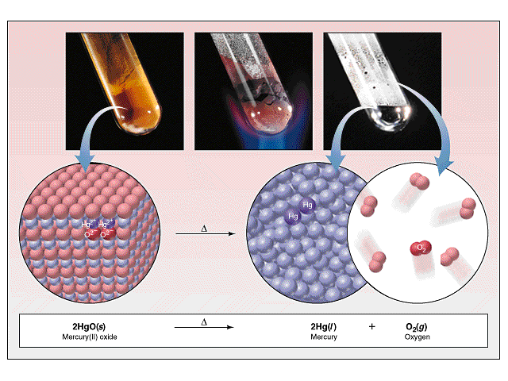
Decomposition Reactions
Another view of a decomposition reaction:

Slide 28
Decomposition Exceptions
Carbonates and chlorates are special case decomposition reactions that do not go to the elements.
Carbonates (CO₃²⁻) decompose to carbon dioxide and a metal oxide
Example: CaCO₃ 🡪 CO₂ + CaO
Chlorates (ClO₃⁻) decompose to oxygen gas and a metal chloride
Example: 2 Al(ClO₃)₃ 🡪 2 AlCl₃ + 9 O₂
There are other special cases, but we will not explore those in this class

Slide 29
Practice
Predict the products. Then, write and balance the following decomposition reaction equations:
Solid Lead (IV) oxide decomposes PbO_{2(s)} 🡪
Aluminum nitride decomposes
AlN_{(s)} 🡪
Pb_{(s)} + O_{2(g)}
2
2
Al_{(s)} + N_{2(g)}

Slide 30
Practice
Identify the type of reaction for each of the following synthesis or decomposition reactions, predict the products and balance the equation:
N_{2(g)} + O_{2(g)} 🡪
BaCO_{3(s)} 🡪
Co_{(s)}+ S_{(s)} 🡪
NH_{3(g)} + H₂CO_{3(aq)} 🡪
NI_{3(s)} 🡪
NO _{(g)}
BaO_{(s)} + CO_{2 (g)}
Co₂S_{3 (s)}
(NH₄)₂CO_{3(s)}
N_{2 (g)} + I_{2 (s)}

Slide 31
3. Single Replacement Reactions
Single replacement reactions occur when one chemical takes the place of another in a reaction.
In the typical single replacement reaction, an element trades places with one of the ions in a compound.

Slide 32
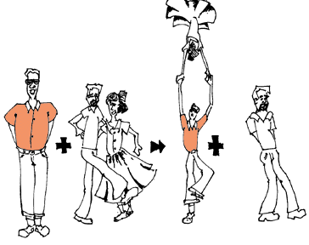
Single Replacement Reactions
Single Replacement Reactions occur when one element replaces another in a compound.
A metal can replace a metal (+) OR a nonmetal can replace a nonmetal (-).
element + compound🡪 product + product
A + BC 🡪 AC + B (if A is a metal) OR
A + BC 🡪 BA + C (if A is a nonmetal)
(remember the cation always goes first!)
When H₂O splits into ions, it splits into
H⁺ and OH⁻ (not H+ and O⁻² !!)

Slide 33
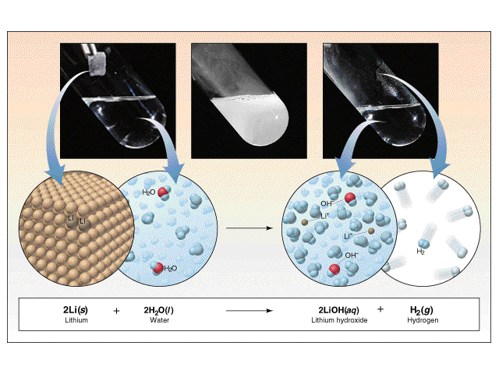
Single Replacement Reactions
Another view:

Slide 34
Single Replacement Reactions
Write and balance the following single replacement reaction equation:
Zinc metal reacts with aqueous hydrochloric acid
Zn_{(s)} + HCl_{(aq)} 🡪 ZnCl₂ + H_{2(g)}
Note: Zinc replaces the hydrogen ion in the reaction
[If ZnCl₂ + H_{2(g)} 🡪 Zn_{(s)} + HCl_{(aq)} the reaction WOULD NOT OCCUR because Hydrogen is below zinc on the activity series]
2

Slide 35
Single Replacement Reactions
Sodium chloride solid reacts with fluorine gas
NaCl_{(s)} + F_{2(g)} 🡪 NaF_{(s)} + Cl_{2(g)}
Note that fluorine replaces chlorine in the compound
Aluminum metal reacts with aqueous copper (II) nitrate
Al_{(s)}+ Cu(NO₃)_{2(aq)}🡪 Cu_{(s)} + Al(NO₃)_{3(aq)}
2
2
2
3
3
2

Slide 36
4. Double Replacement Reactions
Double replacement reactions are identified by two ions trading places and forming new compounds.

Slide 37
Double Replacement Reactions
Double Replacement Reactions occur when a metal replaces a metal in a compound and a nonmetal replaces a nonmetal in a compound
Compound + compound 🡪 product + product
AB + CD 🡪 AD + CB
Notice that one ion from compound AB replaces one ion from compound CD.

Slide 38
Double Replacement Reactions
Think about it like “foil”ing in algebra, first and last ions go together + inside ions go together
Example:
AgNO_{3(aq)} + NaCl_{(s)} 🡪 AgCl_{(s)} + NaNO_{3(aq)}
Another example:
K₂SO_{4(aq)} + Ba(NO₃)_{2(aq)} 🡪 KNO_{3(aq)} + BaSO_{4(s)}
2

Slide 39
Solubility
For a double replacement reaction to have occurred, a solid (precipitate) MUST be formed
There are rules to determine which of the materials formed is the solid
If no solid is formed, there is said to be no reaction.

Slide 40
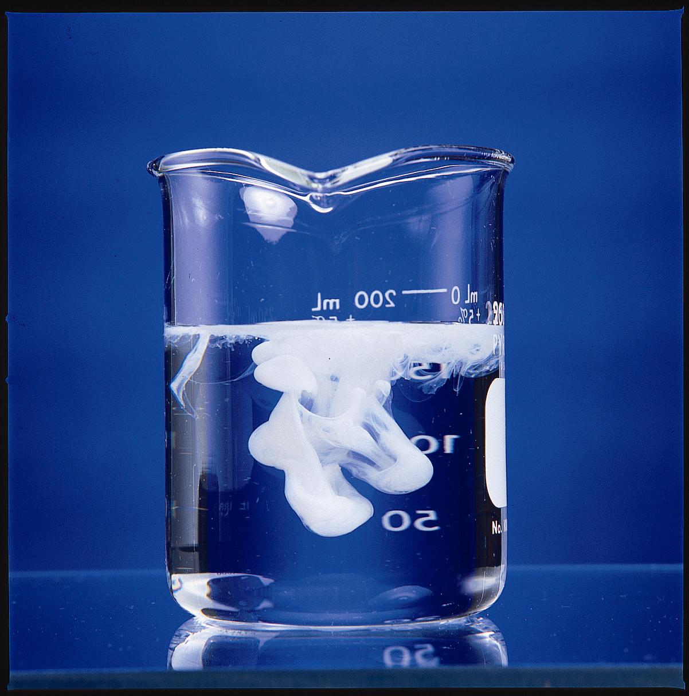
The forming of solid AgCl.

Slide 41
Solubility Tables
Solubility tables help determine which materials are soluble in water and which are not
In general, Solubility Rules can be summarized as follows
All compounds containing alkali metal cations and the ammonium ion are soluble.
All compounds containing NO₃⁻, ClO₄⁻, ClO₃⁻, and C₂H₃O₂⁻ anions are soluble.
All chlorides, bromides, and iodides are soluble except those containing Ag⁺, Pb²⁺, or Hg₂²⁺.
All sulfates are soluble except those containing Hg₂²⁺, Pb²⁺, Sr²⁺, Ca²⁺, or Ba²⁺.
All hydroxides are insoluble except compounds of the alkali metals, Ca²⁺, Sr²⁺, and Ba²⁺.
All compounds containing PO₄³⁻, S²⁻, CO₃²⁻, and SO₃²⁻ ions are insoluble except those that also contain alkali metals or NH₄⁺.
You will be given a copy of this!!!!

Slide 42
Practice
Predict the products. Balance the equation
HCl_{(aq)} + AgNO_{3(aq)} 🡪
Pb(NO₃)_{2(aq)} + BaCl_{2(aq)} 🡪
FeCl_{3(aq)} + NaOH_{(aq)} 🡪
H₂SO_{4(aq)} + NaOH_{(aq)} 🡪
HNO_{3(aq)} + AgCl_{(s)}
PbCl_{2(s)} + Ba(NO₃)_{2(aq)}
Fe(OH)_{3(s)} + NaCl_{(aq)}
H₂O_{(l)} + Na₂SO_{4(aq)}

Slide 43
The Activity Series
Not all single replacement reactions will occur.
This depends upon the location of the elements present in the activity series
Elements above MAY replace elements below; elements below MAY NOT replace elements above them on the series

Slide 44
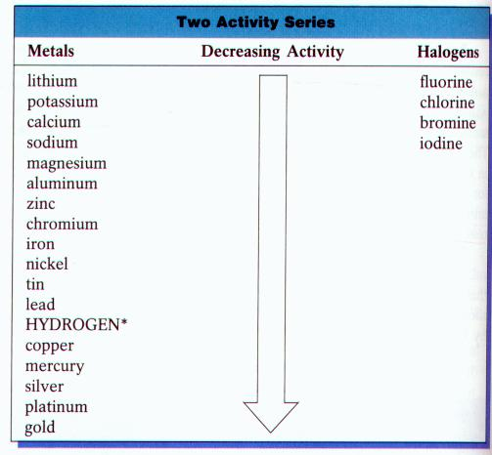
You will be given a copy of this!!!!

Slide 45
Electron Transfer Reactions
Electron transfer reactions are oxidation-reduction or redox reactions.
Results in the generation of an electric current (electricity) or be caused by imposing an electric current.
Therefore, this field of chemistry is often called ELECTROCHEMISTRY.

Slide 46
Electrochemical processes are oxidation-reduction reactions in which:
the energy released by a spontaneous reaction is converted to electricity or
electrical energy is used to cause a nonspontaneous reaction to occur
0
0
2+
2-
2Mg (s) + O₂ (g) 2MgO (s)
2Mg 2Mg²⁺ + 4e⁻
Oxidation half-reaction (lose e⁻)
O₂ + 4e⁻ 2O²⁻
Reduction half-reaction (gain e⁻)
19.1

Slide 47
Terminology for Redox Reactions
OXIDATION—loss of electron(s) by a species; increase in oxidation number; increase in oxygen.
REDUCTION—gain of electron(s); decrease in oxidation number; decrease in oxygen; increase in hydrogen.
OXIDIZING AGENT—electron acceptor; species is reduced. (an agent facilitates something; ex. Travel agents don’t travel, they facilitate travel)
REDUCING AGENT—electron donor; species is oxidized.

Slide 48
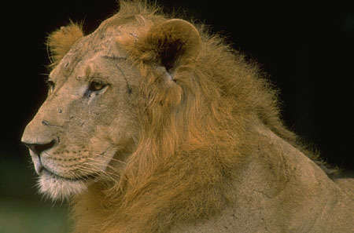
You can’t have one… without the other!
Reduction (gaining electrons) can’t happen without an oxidation to provide the electrons.
You can’t have 2 oxidations or 2 reductions in the same equation. Reduction has to occur at the cost of oxidation
LEO the lion says GER!
ose
lectrons
xidation
ain
lectrons
eduction
GER!

Slide 49

Another way to remember
OIL RIG
xidation
s
ose
eduction
s
ain

Slide 50


Predict oxidation or reducing

