Slide 1
Nomenclature of
Inorganic Compounds
Chapter 6
Hein and Arena
Version 2.0
12th Edition
Eugene Passer
Chemistry Department
Bronx Community College
© John Wiley and Sons, Inc

Slide 2
Chapter Outline
6.1 Common and Systematic
Names
6.4 Naming Binary Compounds
6.5 Naming Compounds
Containing Polyatomic Ions
6.2 Elements and Ions
6.3 Writing Formulas from
Names of Ionic Compounds
6.6 Acids

Slide 3
6.1
Common and Systematic Names

Slide 4
Chemical nomenclature is the system of names that chemists use to identify compounds. Two classes of names exist: common names and systematic names.

Slide 5
Common names are arbitrary names.
  They are not based on the composition of the compound.
  They are based on an outstanding chemical or physical property.
Chemists prefer systematic names.
  Systematic names precisely identify the chemical composition of the compound.
  The present system of inorganic chemical nomenclature was devised by the International Union of Pure and Applied Chemistry (IUPAC).

Slide 6
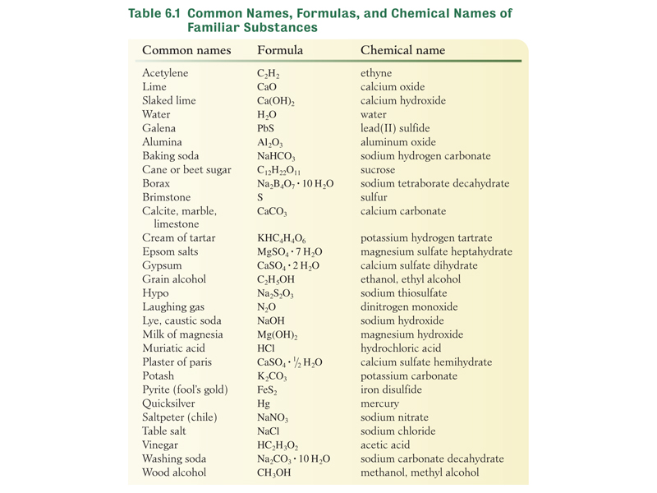

Slide 7
6.2
Elements and Ions

Slide 8
The formula for most elements is the symbol of the element.
Sodium Na
Potassium K
Zinc Zn
Argon Ar
Mercury Hg
Lead Pb
Calcium Ca

Slide 9
These 7 elements are found
in nature as diatomic molecules.
Hydrogen H₂
Nitrogen N₂
Oxygen O₂
Fluorine F₂
Chlorine Cl₂
Bromine Br₂
Iodine I₂

Slide 10
Two elements are commonly polyatomic.
Sulfur S₈
Phosphorous P₄

Slide 11
Ions

Slide 12
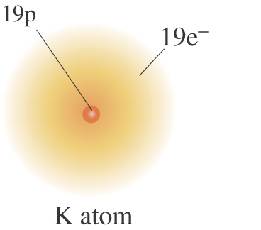
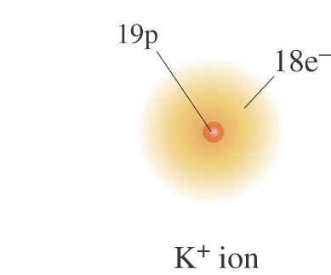
A charged particle known as an ion can be produced by adding or removing one or more electrons from a neutral atom.
If one or more electrons are removed from a neutral atom a positive ion is formed. A positive ion is called a cation.
remove e⁻
→
neutral atom
cation

Slide 13
Positive Ion Formation:
Loss of Electrons From a Neutral Atom
Na → Na⁺ + e⁻
Ca → Ca²⁺ + 2e⁻
Al → Al³⁺ + 3e⁻

Slide 14
Naming Cations

Slide 15
Cations are named the same as their parent atoms.

Slide 16
Atom
Cation
Name of Cation
sodium (Na)
Na⁺
sodium ion

Slide 17
Atom
Cation
Name of Cation
calcium (Ca)
Ca²⁺
calcium ion

Slide 18
Atom
Cation
Name of Cation
lithium (Li)
Li⁺
lithium ion

Slide 19
Atom
Cation
Name of Cation
magnesium (Mg)
Mg²⁺
magnesium ion

Slide 20
Atom
Cation
Name of Cation
strontium (Sr)
Sr²⁺
strontium ion

Slide 21
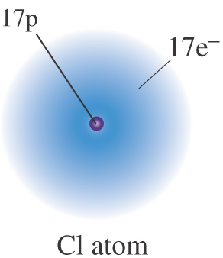
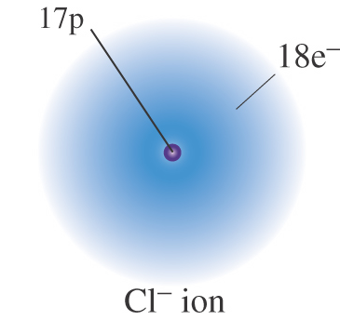
A charged particle known as an ion can be produced by adding or removing one or more electrons from a neutral atom.
If one or more electrons are added to a neutral atom a negative ion is formed. A negative ion is called an anion.
add e⁻
→
neutral atom
anion

Slide 22
Naming Anions

Slide 23
An anion consisting of one element has the stem of the parent element and an –ide ending

Slide 24
Atom
Anion
Name of Anion
fluorine (F)
F⁻
stem
fluoride ion

Slide 25
Atom
Anion
Name of Anion
chlorine (Cl)
Cl⁻
stem
chloride ion

Slide 26
Atom
Anion
Name of Anion
bromine (Br)
Br⁻
stem
bromide ion

Slide 27
Atom
Anion
Name of Anion
nitrogen (N)
N³⁻
stem
nitride ion

Slide 28
Atom
Anion
Name of Anion
phosphorous (P)
P³⁻
stem
phosphide ion

Slide 29
Atom
Anion
Name of Anion
oxygen (O)
O²⁻
stem
oxide ion

Slide 30
Ions are always formed by adding or removing electrons from an atom.

Slide 31
Most often ions are formed when metals combine with nonmetals.

Slide 32
The charge on an ion can be predicted from its position in the periodic table.

Slide 33
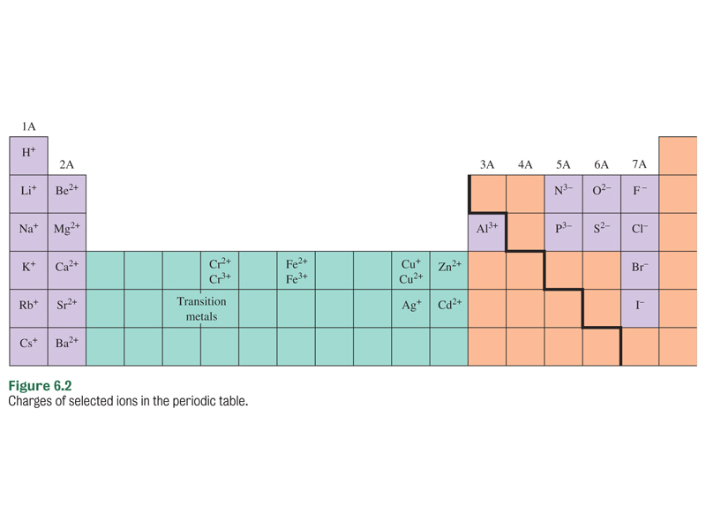
elements of
Group 6A have a
-2 charge
elements of
Group 2A have a
+2 charge
elements of
Group 5A have a
-3 charge
elements of
Group 7A have a
-1 charge
6.2

Slide 34
6.3
Writing Formulas From
Names of Ionic Compounds

Slide 35
A chemical compound must have a net charge of zero.

Slide 36
If the compound contains ions, then the charges on all of the ions must add to zero.

Slide 37
Write the formula of calcium chloride.
Step 1. Write down the formulas of the ions.
Ca²⁺ Cl⁻
Step 2. Combine the smallest numbers of Ca²⁺ and Cl⁻ so that the sum of the charges equals zero.
The cation is written first.
The anion is written second.
(Ca²⁺) + 2(Cl⁻) = 0
(2+) + 2(1-) = 0
The lowest common multiple of +2 and –1 is 2
The correct formula is CaCl₂

Slide 38
Write the formula of barium phosphide.
Step 1. Write down the formulas of the ions.
Ba²⁺ P³⁻
Step 2. Combine the smallest numbers of Ba²⁺ and P³⁻ so that the sum of the charges equals zero.
The cation is written first.
The anion is written second.
3(Ba²⁺) + 2(P³⁻) = 0
The lowest common multiple of +2 and –3 is 6
3(2+) + 2(3-) = 0
The correct formula is Ba₃P₂

Slide 39
Write the formula of magnesium oxide.
Step 1. Write down the formulas of the ions.
Mg²⁺ O²⁻
Step 2. Combine the smallest numbers of Mg²⁺ and O²⁻ so that the sum of the charges equals zero.
(Mg²⁺) + (O²⁻) = 0
(2+) + (2-) = 0
The lowest common multiple of +2 and –2 is 2
The correct formula is MgO

Slide 40
6.4
Naming Binary Compounds

Slide 41
Binary compounds contain only two different elements.

Slide 42
Binary ionic compounds consist of a metal combined with a non-metal.

Slide 43
A. Binary Ionic Compounds Containing a Metal Forming Only One Type of Cation

Slide 44
The chemical name is composed of the name of the metal followed by the name of the nonmetal which has been modified to an identifying stem plus the suffix –ide.
Using this system the number of atoms of each element present is not expressed in the name.

Slide 45
Name of Metal
+ Stem of Nonmetal
plus -ide ending

Slide 46
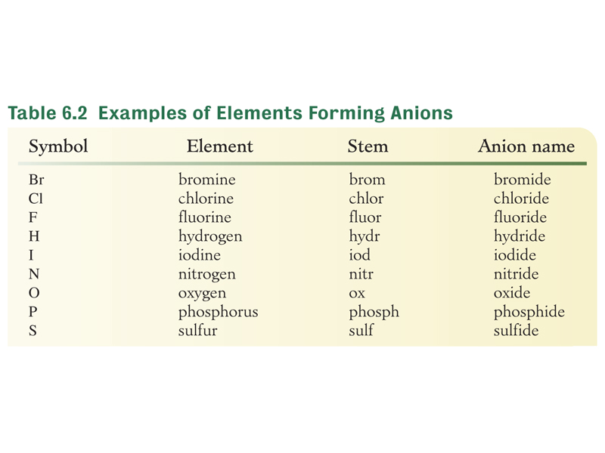
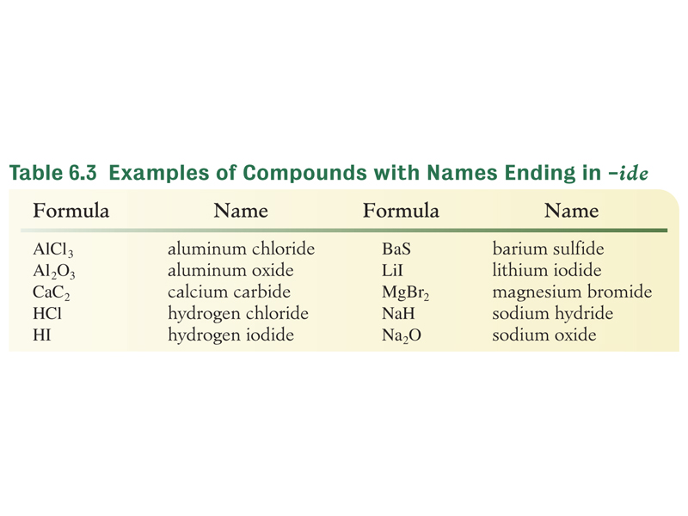

Slide 47
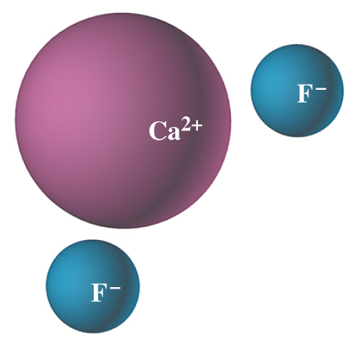
Name the Compound CaF₂
Step 1 From the formula it is a two-element compound and follows the rules for binary compounds.

Slide 48
Name the Compound CaF₂
Step 2 The compound is composed of Ca, a
metal, and F, a nonmetal. Ca forms only a +2 cation. Thus, call the positive part of the compound calcium.

Slide 49
Name the Compound CaF₂
Step 3 Modify the name of the second element to the stem fluor- and add the binary ending –ide
to form the name of the negative part, fluoride.

Slide 50
Name the Compound CaF₂
Step 4 The name of the compound is therefore calcium fluoride.

Slide 51
Examples

Slide 52
Compound
Name
NaCl
name of metal
sodium
chloride
nonmetal stem

Slide 53
Compound
Name
MgCl₂
name of metal
magnesiumchloride
nonmetal stem

Slide 54
Compound
Name
K₂O
name of metal
potassium
oxide
nonmetal stem

Slide 55
Compound
Name
Na₃P
name of metal
sodium
phosphide
nonmetal stem

Slide 56
B. Binary Ionic Compounds Containing a Metal
That Can Form Two or More Types of Cations

Slide 57
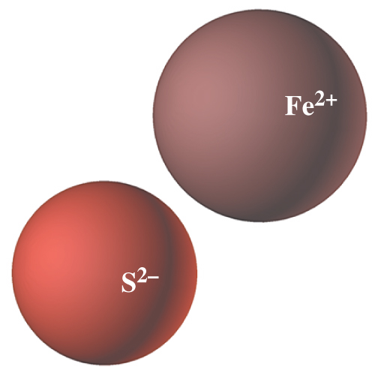
Name the Compound FeS
Step 1 This compound follows the rules for a binary compound.

Slide 58
Name the Compound FeS
Step 2 It is a compound of Fe, a metal, and S, a nonmetal. Fe is a transition metal that has more than one type of cation.
Step 2 In sulfides, the charge on S is –2. Therefore the charge on Fe must be +2, and the name of the positive
part of the compound
is iron(II).

Slide 59
Name the Compound FeS
Step 3 We have already determined that the name of the negative part of the compound will be sulfide.

Slide 60
Name the Compound FeS
Step 4 The name of FeS is iron(II) sulfide.

Slide 61
The Stock System

Slide 62
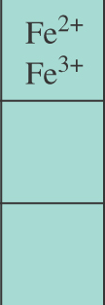
The metals in the center of the periodic table (including the transition metals) often form more than one type of cation.
6.2

Slide 63
Each ion of iron forms a different compound with the same anion.
Fe²⁺
FeS
Fe³⁺
Fe₂S₃
6.2

Slide 64
In the Stock System the charge on the cation is designated by a Roman numeral placed in parentheses immediately following the name of the metal.
IUPAC devised the Stock System of nomenclature to name compounds of metals that have more than one type of cation.
Cation Charge | +1 | +2 | +3 | +4 | +5
Roman Numeral | (I) | (II) | (III) | (IV) | (V)
The nonmetal name ends in -ide.

Slide 65
Stock System
Lower Charge Higher Charge
Element Formula Name Formula Name
Stock System
Higher Charge
Element Formula Name Formula Name
Lower Charge
Copper Cu⁺ copper (I) Cu²⁺ copper (II)
Iron Fe²⁺ iron(II) Fe³⁺ iron(III)
Lead Pb²⁺ lead (II) Pb⁴⁺ lead(IV)
Mercury mercury(I) Hg²⁺ mercury(II)
Tin Sn²⁺ Tin(II) Sn⁴⁺ Tin (IV)

Slide 66
Examples

Slide 67
iron(II) chloride
FeCl₂
+2
-1
iron(II)
chloride
compound name
ion charge
ion name
iron(III) chloride
FeCl₃
+3
-1
iron(III)
chloride

Slide 68
tin(II) bromide
SnBr₂
+2
-1
tin(II)
bromide
compound name
ion charge
ion name
tin(IV) bromide
SnBr₄
+4
-1
tin(IV)
bromide

Slide 69
The Classical System

Slide 70
In the Classical System the name of the metal (usually the Latin name) is modified with the suffixes -ous and ic.

Slide 71
Metal name ends in
-ous lower charge
-ic higher charge
Nonmetal name ends in
-ide

Slide 72
Examples

Slide 73
ferrous chloride
FeCl₂
+2
-1
ferrous
chloride
ion charge
ion name
compound name
ferric chloride
FeCl₃
+3
-1
ferric
chloride

Slide 74
stannous bromide
SnBr₂
+2
-1
stannous
bromide
compound name
ion charge
ion name
stannic bromide
SnBr₄
+4
-1
stannic
bromide

Slide 75
Ion Names: Classical System
Lower Charge Higher Charge
Element | Formula | Name | Formula | Name
Copper | Cu⁺ | cuprous | Cu²⁺ | cupric
Iron | Fe²⁺ | ferrous | Fe³⁺ | ferric
Lead | Pb²⁺ | plumbous | Pb⁴⁺ | plumbic
Mercury | Hg | mercurous | Hg²⁺ | mercuric
Tin | Sn²⁺ | stannous | Sn⁴⁺ | stannic
²⁺
²

Slide 76
Binary Compounds Containing Two Nonmetals

Slide 77
Compounds between nonmetals are molecular, not ionic.

Slide 78
In a compound formed between two nonmetals, the element that occurs first in this series is named first.
Si
B
P
H
C
S
I
Br
N
Cl
O
F

Slide 79
Prefixes

Slide 80
A Greek prefix is placed before the name of each element to indicate the number of atoms of the element that are present.

Slide 81
Mono is never used when naming the first element.
mono = 1
hexa = 6
hepta = 7
octa = 8
nona = 9
deca = 10
di = 2
tri = 3
tetra = 4
penta = 5

Slide 82
Prefix Rules
Never Repeat the same vowel.
  Triiodide should be Triodide
If the prefix ends in a plus the name is oxygen or oxide drop the a from the prefix.
  fluorine tetraoxide should be fluorine tetroxide.

Slide 83
Examples

Slide 84
dinitrogen trioxide
N₂O₃
indicates two
nitrogen atoms
indicates three
oxygen atoms

Slide 85
phosphorous pentachloride
PCl₅
indicates one
phosphorous atom
indicates five
chlorine atoms

Slide 86
dichlorine heptoxide
Cl₂O₇
indicates two
chlorine atoms
indicates seven
oxygen atoms

Slide 87
Determine the Name of PCl₅
Step 1
There are 2 elements present.
The compound is binary.
Phosphorous and chlorine are nonmetals so the rules for naming binary compounds of 2 nonmetals apply.
Phosphorous is named first. Therefore the compound is a chloride.

Slide 88
Determine the Name of PCl₅
Step 2
No prefix is needed for phosphorous because each molecule of PCl₅ has only one phosphorous atom. The prefix penta- is used with chloride because there are 5 chlorine atoms present in one molecule.
Step 3
The name is phosphorous pentachloride.

Slide 89
Examples

Slide 90
Cl₂O₃
dichlorine trioxide

Slide 91
N₂O₃
dinitrogen trioxide

Slide 92
CCl₄
carbon tetrachloride

Slide 93
CO
carbon monoxide

Slide 94
Name CO₂
carbon dioxide

Slide 95
Name PI₃
phosphorous triiodide

Slide 96
D. Acids Derived from Binary Compounds

Slide 97
Certain binary hydrogen compounds, when dissolved in water, form solutions that have acid properties.
The aqueous solutions of these compounds are given acid names.
The acid names are in addition to their –ide names.
Hydrogen is typically the first element of a binary acid formula.

Slide 98
Acid Formation
binary hydrogen compound (not an acid).
water
acid

Slide 99
Pure compound
HCl
-ide
HCl
Dissolved in water
acid

Slide 100
To name binary acids write the symbol of hydrogen first.
After hydrogen write the symbol of the second element.
Place the prefix hydro- in front of the stem of the nonmetal name.
Place the suffix -ic after the stem of the nonmetal name.

Slide 101
Examples

Slide 102
HCl
hydrogen chloride
Pure Compound

Slide 103
Dissolved in Water
HCl
hydrochloric acid

Slide 104
HI
hydrogen iodide
Pure Compound

Slide 105
Dissolved in Water
HI
hydroiodic acid

Slide 106
H₂S
hydrogen sulfide
Pure Compound

Slide 107
Dissolved in Water
H₂S
hydrosulfuric acid

Slide 108
H₂Se
hydrogen selenide
Pure Compound

Slide 109
Dissolved in Water
H₂Se
hydroselenic acid

Slide 110
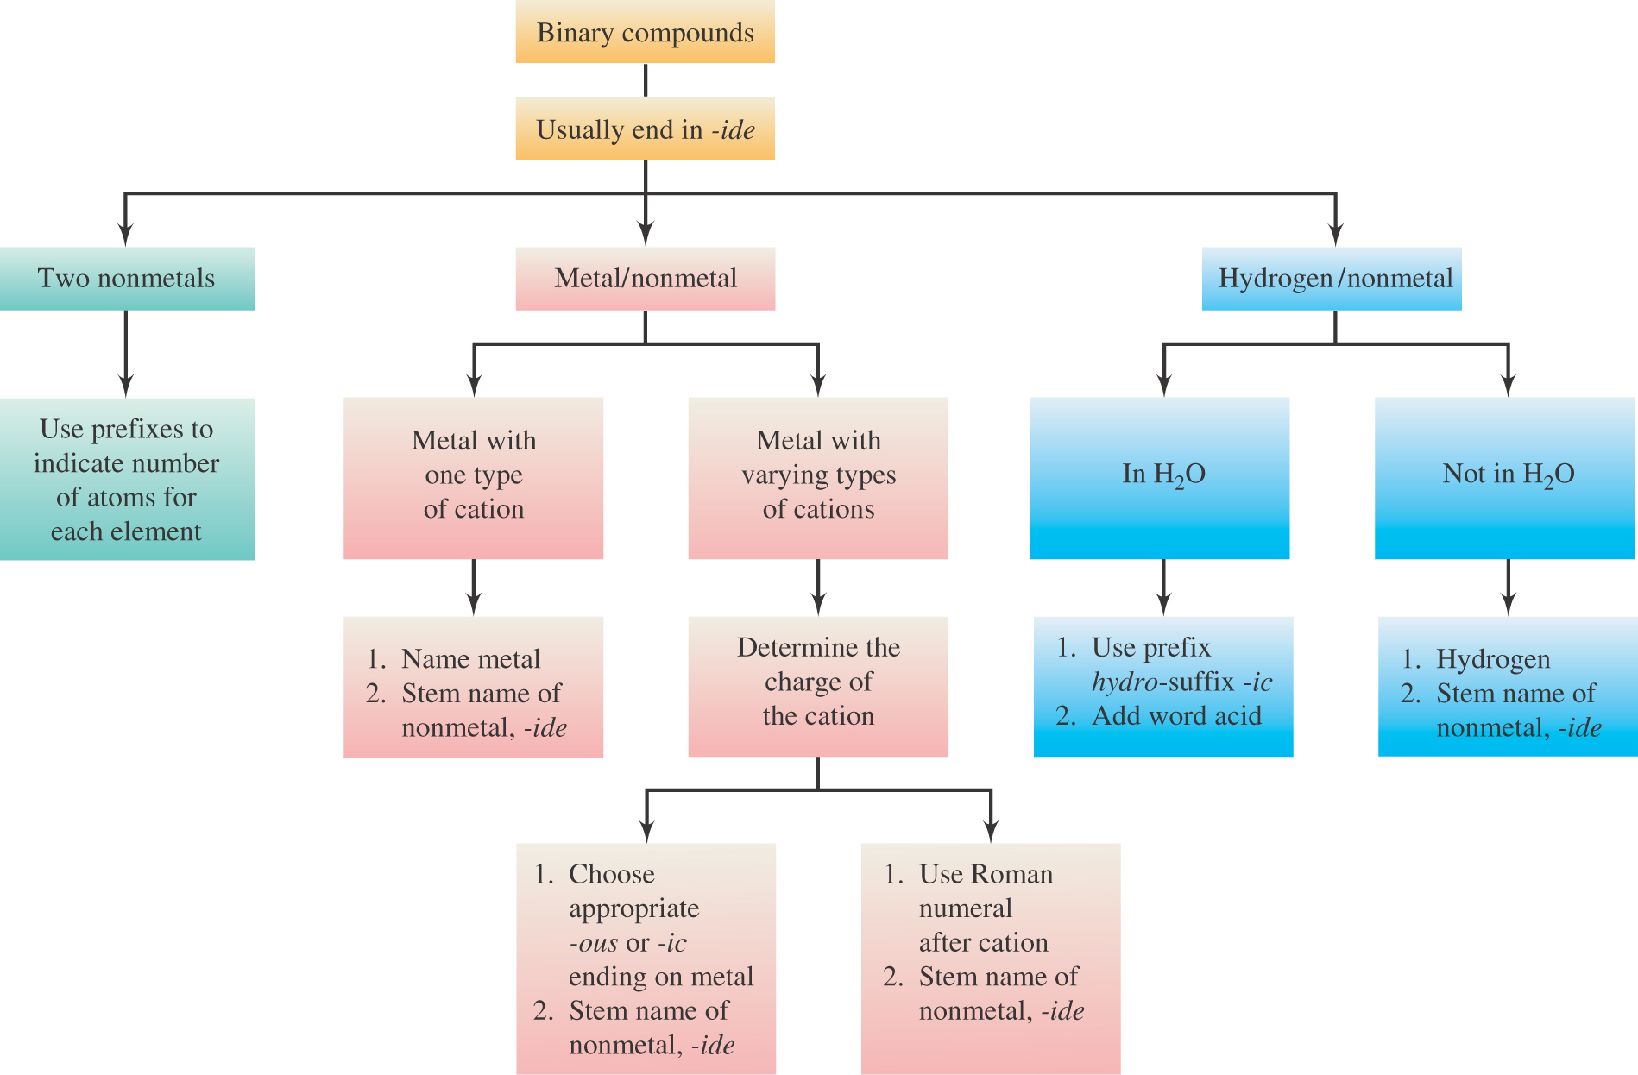

Slide 111
6.5
Naming Compounds Containing Polyatomic Ions

Slide 112
A polyatomic ion is an ion that contains two or more elements.

Slide 113
Compounds containing polyatomic ions are composed of three or more elements.
They usually consist of one or more cations combined with a negative polyatomic ion.

Slide 114
When naming a compound containing a polyatomic ion, name the cation first and then name the anion.
sodium carbonate

Slide 115
This is the way the
formula is written.
The ions are what is
actually present.

Slide 116
This is the way the
formula is written.
The ions are what is
actually present.

Slide 117
Prefixes and Suffixes
Elements that Form More than One Polyatomic Ion with Oxygen

Slide 118
Anions ending in -ate always contain more oxygen than ions ending in -ite.
nitrite
nitrate

Slide 119
Anions ending in -ate always contain more oxygen than ions ending in -ite.
phosphite
phosphate

Slide 120
Anions ending in -ate always contain more oxygen than ions ending in -ite.
sulfite
sulfate
-ate and –ite do not indicate
the number of oxygen atoms.

Slide 121
per- denotes anions with more oxygen than the -ate form.
chlorate
perchlorate

Slide 122
-per is a short form of hyper, meaning more.

Slide 123
hypo- denotes anions with less oxygen than the -ite form.
hypochlorite
chlorite

Slide 124
-hypo means less.

Slide 125
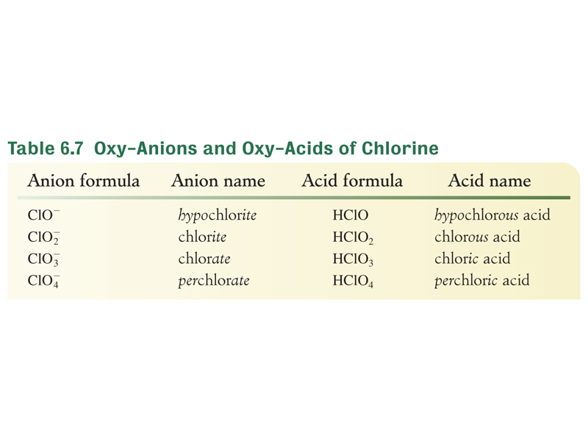

Slide 126
Four polyatomic ions do not use
the –ate/ite system.
hydroxide
cyanide
hydrogen sulfide
peroxide

Slide 127
There are three common positively charged polyatomic ions.
mercury(I)
hydronium
ammonium

Slide 128
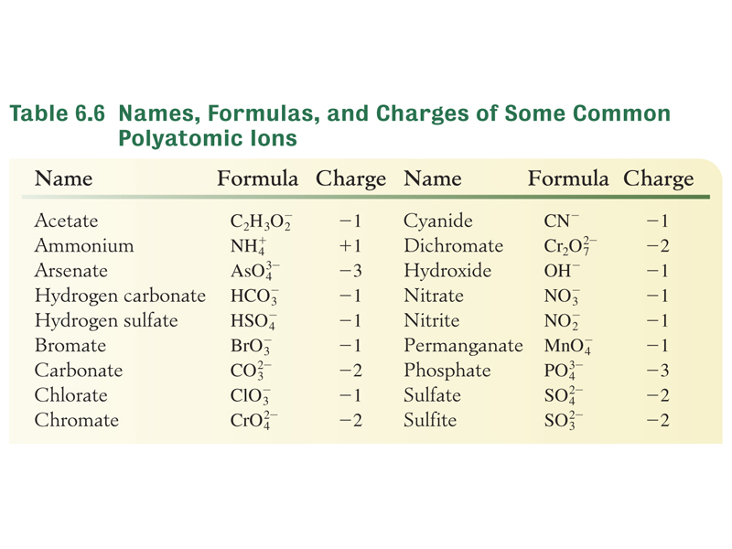

Slide 129
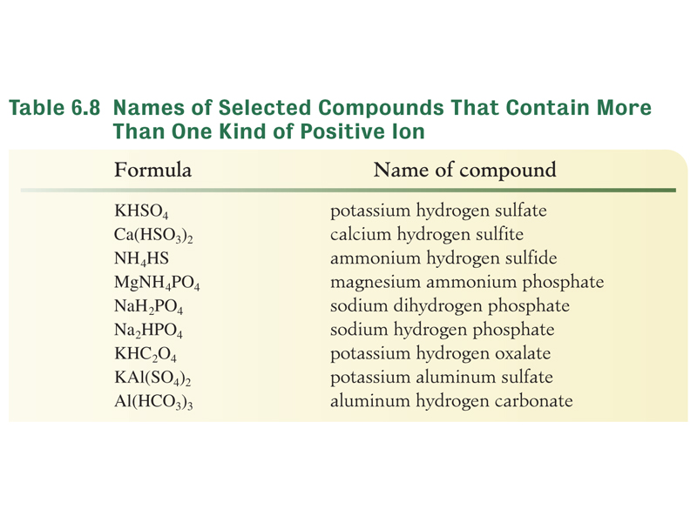

Slide 130
6.6
Acids

Slide 131
Oxy-acids contain hydrogen, oxygen and one other element.

Slide 132
Hydrogen in an
oxy-acid is not expressed in the acid name.
  The word acid in the name indicates the presence of hydrogen.

Slide 133
indicates hydrogen
contains hydrogen
contains sulfur
contains oxygen
sulfuric acid

Slide 134
Anions ending in -ate always contain more oxygen than ions ending in -ite.
phosphite
phosphate

Slide 135
Naming the Acid Based on the Name of the Polyatomic Ion
Ending of Polyatomic Ion
Ending of Acid
ite
ous
less oxygen
ate
ic
more oxygen

Slide 136
Examples

Slide 137
sulfite
sulfurous acid

Slide 138
sulfate
sulfuric acid

Slide 139
nitrite
nitrous acid

Slide 140
nitrate
nitric acid

Slide 141
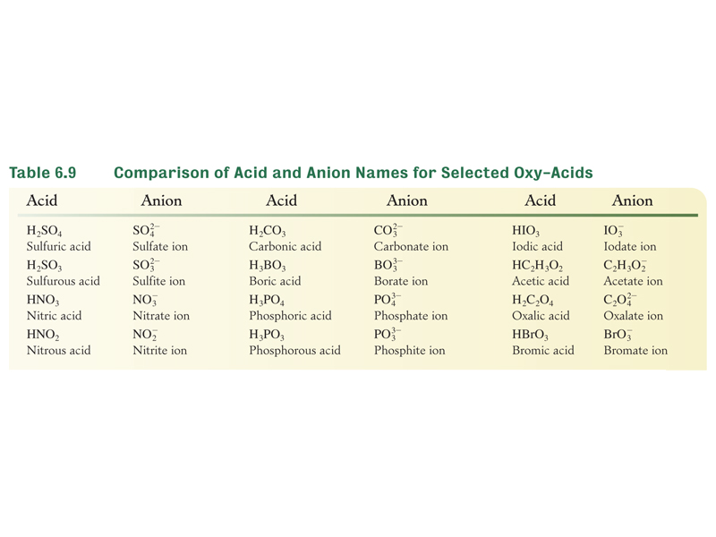

Slide 142
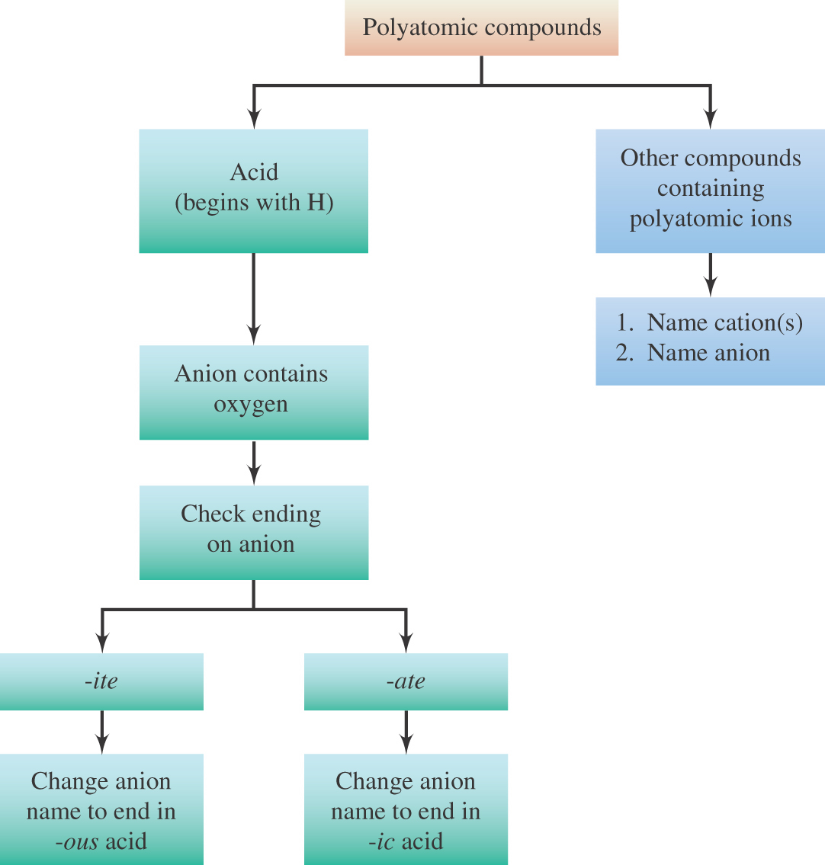
6.5

Slide 143
The End

