Slide 1
Chapter 36
Care of Patients with Dysrhythmias

Slide 2
Review of Cardiac Electrophysiology
Automaticity
Excitability
Conductivity
Contractility

Slide 3
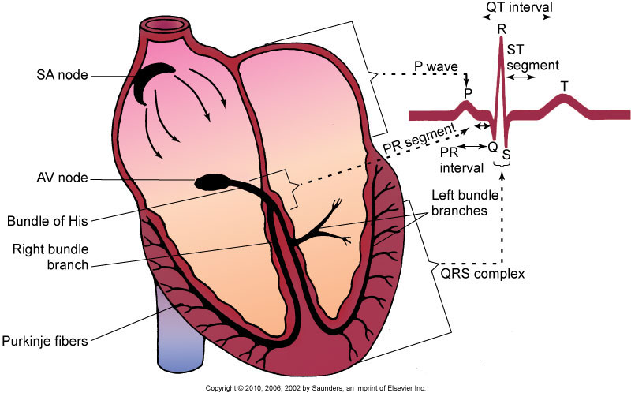
Cardiac Conduction System

Slide 4
Cardiac Conduction System (Cont’d)
Sinoatrial node:
  Electrical impulses at 60 to 100 beats/min
  Reflected in a P wave on the ECG
Atrioventricular junctional area
reflected in the PR segment on the ECG
contraction known as “atrial kick”
Bundle of His:
  Right bundle branch system
  Left bundle branch system

Slide 5
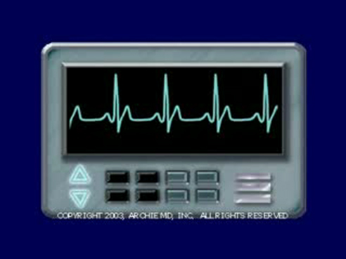
Electrocardiography
Copyright © 2010, 2006, 2002 by Saunders, an imprint of Elsevier Inc.

Slide 6
Electrocardiography (Cont’d)
Electrocardiogram (ECG)
Lead systems
Limb leads
Chest leads
Continuous electrocardiographic monitoring
Telemetry

Slide 7
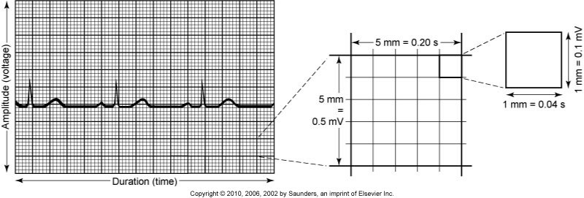
Electrocardiographic Waveforms

Slide 8
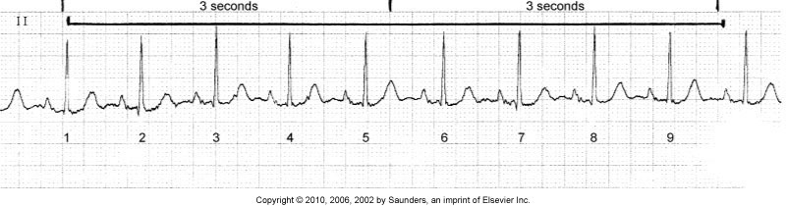
Electrocardiographic Waveforms (Cont’d)

Slide 9
Electrocardiographic Complexes, Segments, and Intervals
P wave
PR segment
PR interval
QRS complex
QRS duration
ST segment
T wave
U wave
QT interval

Slide 10
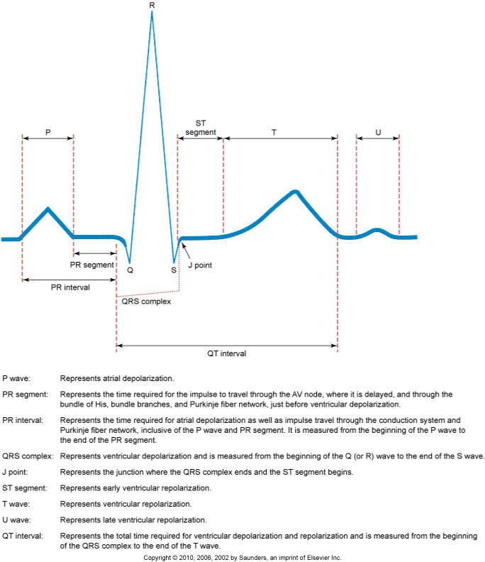
Normal ECG

Slide 11
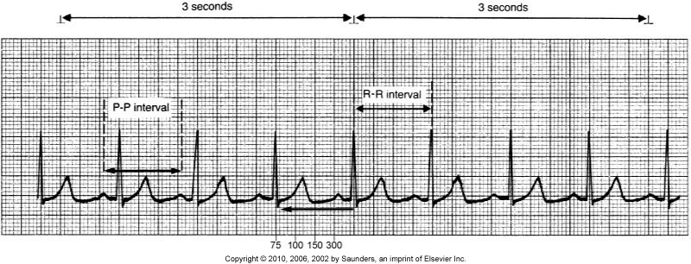
Determining Heart Rate

Slide 12
Electrocardiographic Rhythm Analysis
Determine the heart rate.
Determine the heart rhythm.
Analyze the P waves.
Measure the PR interval.
Measure the QRS duration.
Interpret the rhythm.

Slide 13
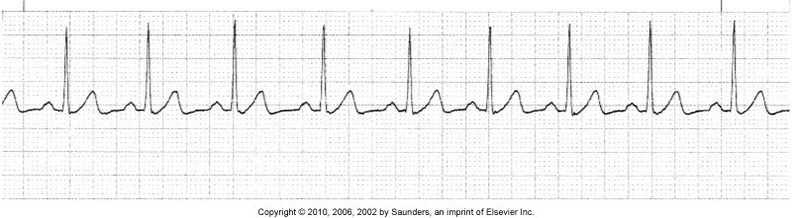
Normal Rhythms—Normal Sinus Rhythm

Slide 14
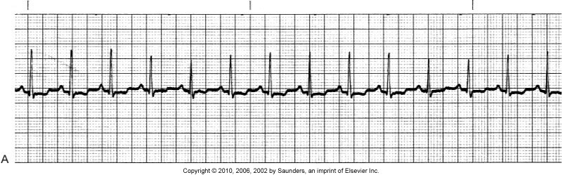
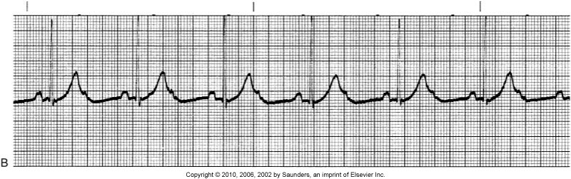
Sinus Rhythms

Slide 15
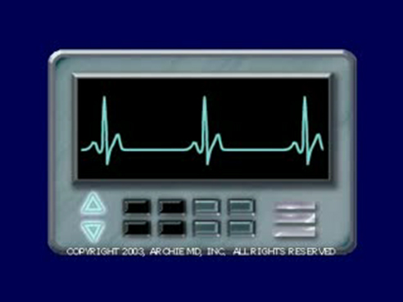
Sinus Bradycardia
Copyright © 2010, 2006, 2002 by Saunders, an imprint of Elsevier Inc.

Slide 16
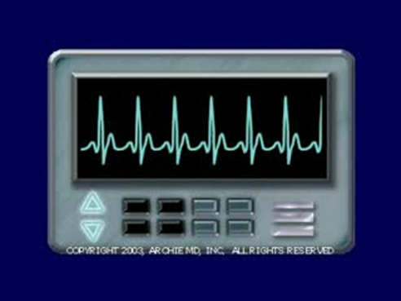
Sinus Tachycardia
Copyright © 2010, 2006, 2002 by Saunders, an imprint of Elsevier Inc.

Slide 17
Sinus Arrhythmia
Variant of NSR
Results from changes in intrathoracic pressure during breathing

Slide 18
Dysrhythmias
Tachydysrhythmias
Bradydysrhythmias
Premature complexes
Repetitive rhythm complexes:
  Bigeminy
  Trigeminy
  Quadrigeminy
Escape complexes and rhythms

Slide 19
Sinus Dysrhythmias
Sinus tachycardia
Patient-centered collaborative care

Slide 20
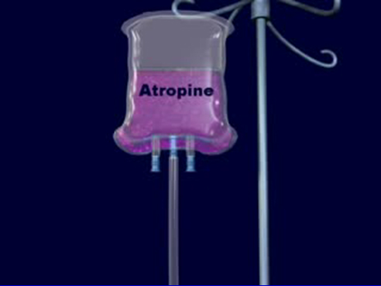
Sinus Bradycardia

Slide 21
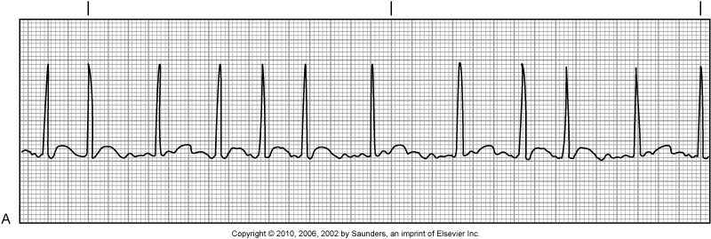
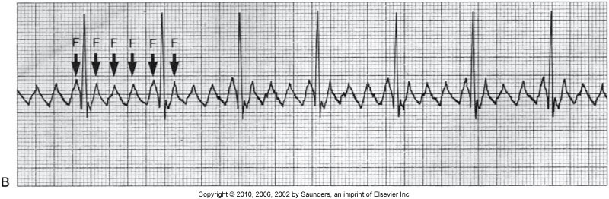
Atrial Dysrhythmias

Slide 22
Premature Atrial Complexes
Ectopic focus of atrial tissue fires an impulse before the next sinus impulse is due.

Slide 23
Supraventricular Tachycardia
Rapid stimulation of atrial tissue occurs at a rate of 100 to 280 beat/min with a mean of 170 beats/min in adults.
Paroxysmal supraventricular tachycardia rhythm is intermittent and terminated suddenly with or without intervention.

Slide 24
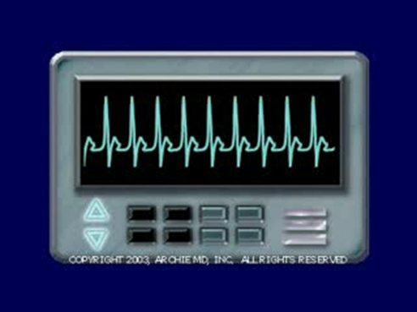
Supraventricular Tachycardia (Cont’d)
Copyright © 2010, 2006, 2002 by Saunders, an imprint of Elsevier Inc.

Slide 25
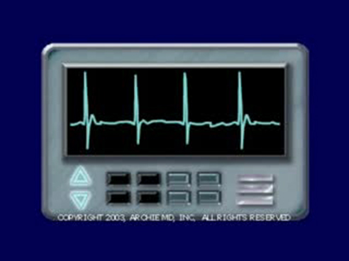
Atrial Fibrillation

Slide 26
Atrial Fibrillation (Cont’d)
Patient-centered collaborative care:
  Risk for emboli
  Antiarrhythmic drugs
  Cardioversion
  Radiofrequency catheter ablation
  Pacing
  Maze procedure

Slide 27
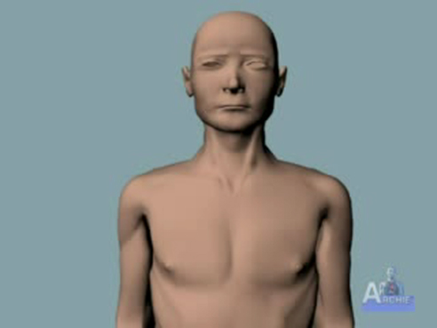
Atrial Fibrillation Compared with Normal Sinus Rhythm

Slide 28
Atrial Flutter
Rapid atrial depolarization occurring at a rate of 250 to 350 times per minute

Slide 29
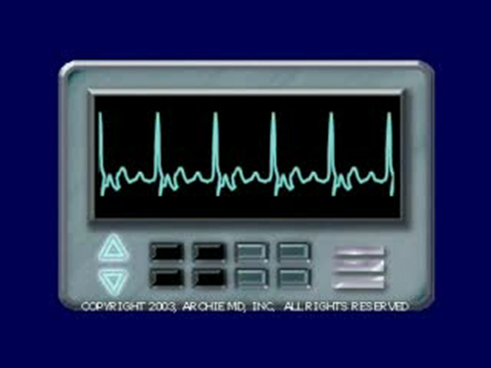
Atrial Flutter at 100 beats/min
Copyright © 2010, 2006, 2002 by Saunders, an imprint of Elsevier Inc.

Slide 30
Junctional Dysrhythmias
Nodal cells in the AV junctional area that generate electrical impulses and are therefore latent pacemaker cells
40 to 60 beats/min
These rhythms are most commonly temporary and the patients usually remain stable

Slide 31
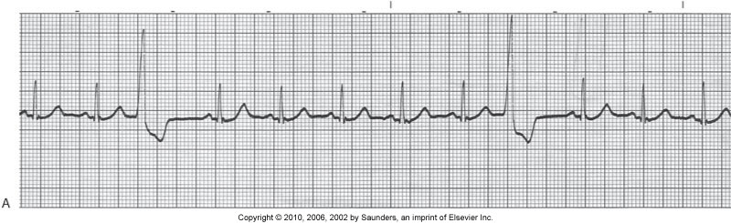
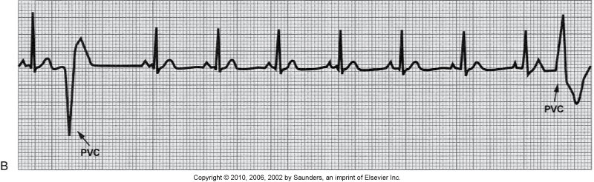
Ventricular Dysrhythmias

Slide 32
Idioventricular Rhythm
Also called ventricular escape rhythm—ventricular nodal cells pace the ventricles. P waves are independent of the QRS complex (AV dissociation).
Idioventricular rhythm is seen as a rhythm in the dying heart.
Emergency care.

Slide 33
Premature Ventricular Complexes
A result of increased irritability of ventricular cells—early ventricular complexes followed by a pause

Slide 34
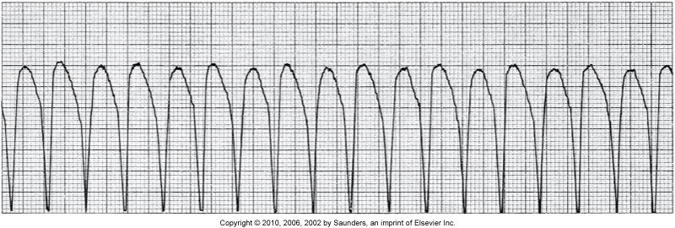
Ventricular Tachycardia
Also called V tach—repetitive firing of an irritable ventricular ectopic focus, usually at a rate of 140 to 180 beats/min

Slide 35
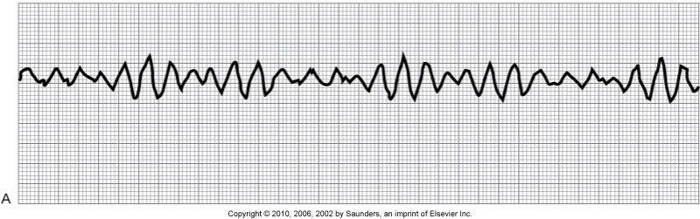
Ventricular Fibrillation
Also called V fib—a result of electrical chaos in the ventricles

Slide 36
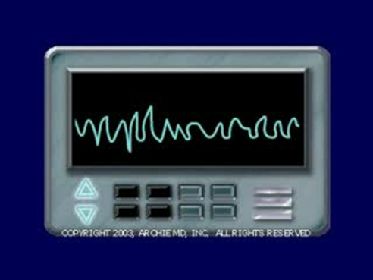
Ventricular Fibrillation (Cont’d)
Copyright © 2010, 2006, 2002 by Saunders, an imprint of Elsevier Inc.

Slide 37
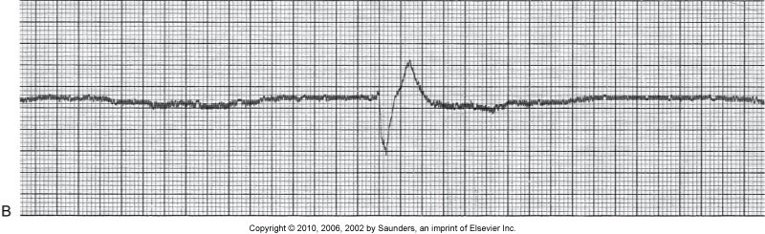
Ventricular Asystole
Also called ventricular standstill—complete absence of any ventricular rhythm

Slide 38
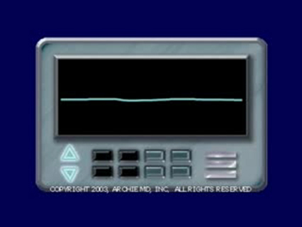
Asystole
Emergency care

Slide 39
Atrioventricular Blocks
Atrioventricular blocks are differentiated by their PR interval:
  First-degree atrioventricular block
  Second-degree atrioventricular block
  Third-degree atrioventricular block

Slide 40
Bundle Branch Blocks
Conduction delay or block within one of the two main Bundle of His branches

Slide 41
Dysrhythmias: Nonsurgical Management
Antidysrhythmic agents
Other drugs
Drugs used during cardiac arrest
Vagal maneuvers—carotid sinus massage, vagal reflex

Slide 42
Pacemakers
Temporary pacing—invasive and noninvasive
Permanent pacemakers

Slide 43
Management of Cardiac Arrest
Cardiopulmonary resuscitation
Advanced cardiac life support

Slide 44
Cardioversion
Synchronized countershock that may be performed in emergencies for unstable ventricular or supraventricular tachydysrhythmias or electively for stable tachydysrhythmias that are resistant to medical therapies

Slide 45
Defibrillation
Asynchronous countershock depolarizes a critical mass of myocardium simultaneously to stop the re-entry circuit and allow the sinus node to regain control of the heart

Slide 46
Other Therapies
Automatic external defibrillation
Radiofrequency catheter ablation
Surgical procedures:
  Permanent pacemaker
  Coronary artery bypass grafting
  Aneurysmectomy
  Insertion of implantable cardioverter/defibrillator
  Open-chest cardiac massage

Slide 47
Community-Based Care
Home care management
Health teaching
Health care resources

