Slide 1
Chapter 37
Care of Patients with Cardiac Problems

Slide 2
Heart Failure
Also called pump failure, general term for the inability of the heart to work effectively as a pump
Left-sided heart failure
Right-sided heart failure
High-output failure

Slide 3
Left-Sided Heart Failure
Typical causes—hypertensive, coronary artery, valvular disease
Formerly known as congestive heart failure
Two types of left-sided heart failure:
  Systolic heart failure
  Diastolic heart failure

Slide 4
Right-Sided Heart Failure
Typical causes—left ventricular failure, right ventricular MI, pulmonary hypertension
Right ventricle not able to empty completely
Increased volume and pressure in the venous system and peripheral edema

Slide 5
High-Output Failure
Cardiac output remains normal or above normal
Caused by increased metabolic needs of hyperkinetic conditions such as:
  Septicemia
  Anemia
  Hyperthyroidism

Slide 6
Compensatory Mechanisms
Sympathetic nervous system stimulation
Renin-angiotensin system (RAS) activation
Other chemical responses:
  B-type natriuretic peptide (BNP)
Myocardial hypertrophy

Slide 7
Etiology
Heart failure is caused by systemic hypertension in 75% of cases.
About one third of patients experiencing myocardial infarction also develop heart failure.
Structural heart changes, such as valvular dysfunction, cause pressure or volume overload on the heart.

Slide 8
Left-Sided Heart Failure
Manifestations include:
  Weakness
  Fatigue
  Dizziness
  Confusion
  Pulmonary congestion
  Breathlessness

Slide 9
Left-Sided Heart Failure (Cont’d)
  Oliguria
  Death

Slide 10
Right-Sided Heart Failure
Manifestations include:
  Distended neck veins, increased abdominal girth
  Hepatomegaly (liver engorgement)
  Hepatojugular reflux
  Ascites
  Dependent edema
  Weight—the most reliable indicator of fluid gain or loss

Slide 11
Assessments
Psychosocial assessment
Laboratory assessment
Imaging assessment
Electrocardiography
Pulmonary artery catheters

Slide 12
Impaired Gas Exchange
Interventions include:
  Ventilation assistance
  Position
  Oxygen

Slide 13
Decreased Cardiac Output
Interventions include:
  Improved and increased cardiac pump effectiveness
  Hemodynamic regulation
  Drugs that reduce afterload—ACE inhibitors, ARB, human B-type natriuretic peptides

Slide 14
Interventions That Reduce Preload
Nutrition therapy
Drug therapy—diuretics and venous vasodilators
Drugs that enhance contractility—digoxin, other inotropic drugs, beta-adrenergic blockers

Slide 15
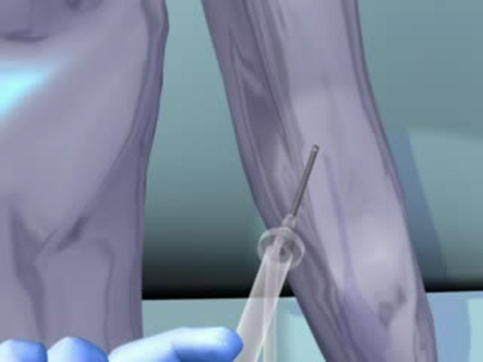
Treatment of Congestive Heart Failure

Slide 16
Other Nonsurgical Options
Continuous positive airway pressure
Cardiac resynchronization therapy
Gene therapy

Slide 17
Surgical Management
Heart transplantation
Ventricular assist devices
Other surgical therapies:
  Partial left ventriculectomy
  Endoventricular circular patch
  Acorn cardiac support device
  Myosplint

Slide 18
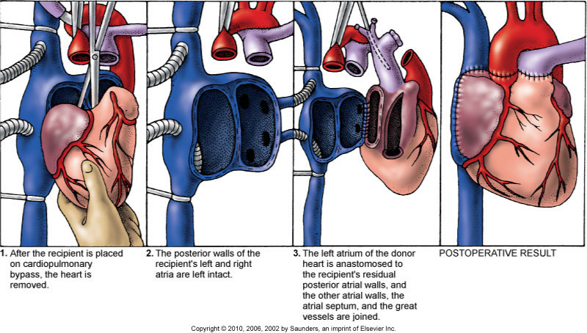
Heart Transplantation

Slide 19
Activity Intolerance
Interventions include:
  Balance activity and rest.
  Nap to restore energy.
  Recognize energy limitations.
  Conserve energy.
  Adapt lifestyle to energy level.
  Report adequate endurance for activity.

Slide 20
Potential for Pulmonary Edema
Interventions include:
  Assess for early signs, such as crackles in the lung bases, dyspnea at rest, disorientation, and confusion.
  High-Fowler’s
  Oxygen therapy
  Nitroglycerine, rapid-acting diuretics, IV morphine sulfate
  Continual assessment

Slide 21
Community-Based Care
Home care management
Health teaching
Health care resources

Slide 22
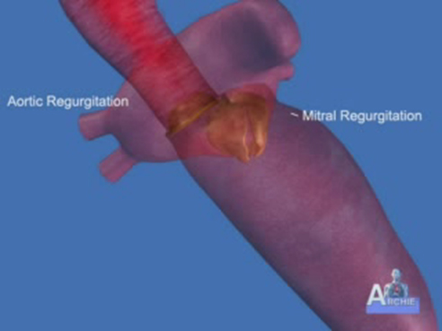
Heart Valves

Slide 23
Valvular Heart Disease
Mitral stenosis
Mitral regurgitation (insufficiency)
Mitral valve prolapse
Aortic stenosis
Aortic regurgitation (insufficiency)

Slide 24
Assessment
Patient may become suddenly ill or slowly develop symptoms over many years.
Question patient about attacks of rheumatic fever and infective endocarditis and about possibility of IV drug abuse.
Obtain chest x-ray, echocardiogram, and exercise tolerance test.

Slide 25
Common Nursing Diagnoses
Decreased Cardiac Output related to altered stroke volume
Impaired Gas Exchange related to ventilation perfusion imbalance
Activity Intolerance related to inability of the heart to meet metabolic demands during activity
Acute Pain related to physiologic injury agent (hypoxia)

Slide 26
Nonsurgical Management
Nonsurgical management focuses on drug therapy and rest
Drug therapy, including diuretics, beta blockers, digoxin, oxygen, and sometimes nitrates
Prophylactic antibiotic
Management of atrial fibrillation
Anticoagulant
Rest with limited activity

Slide 27
Surgical Management
Reparative procedures
Balloon valvuloplasty
Direct, or open, commissurotomy
Mitral valve annuloplasty
Replacement procedures

Slide 28
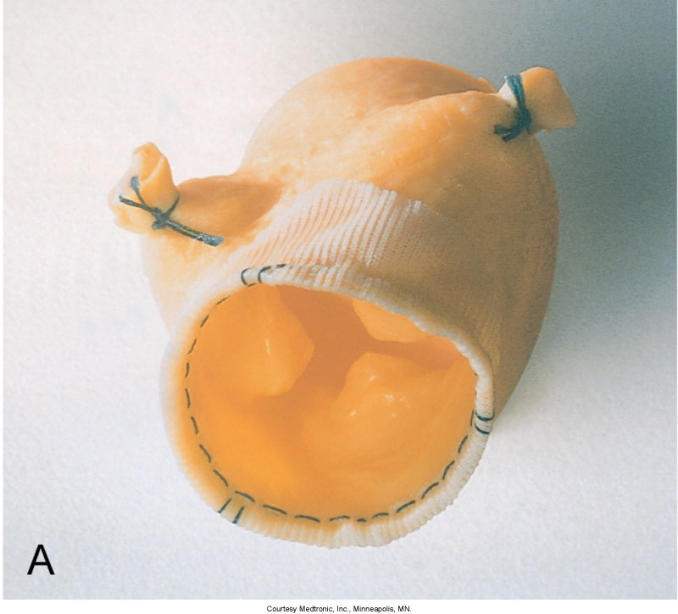
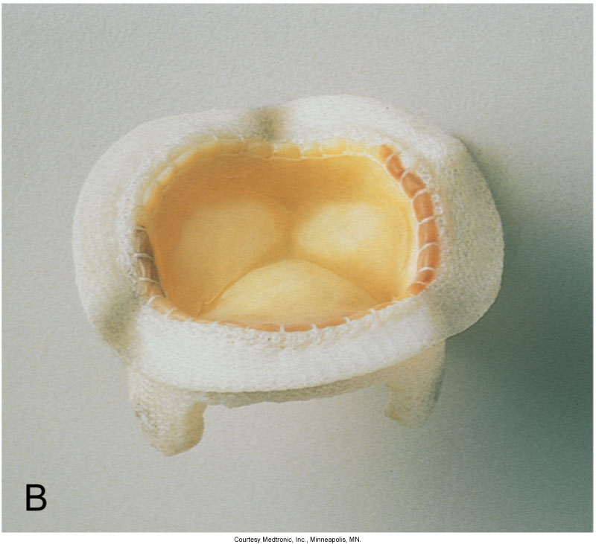
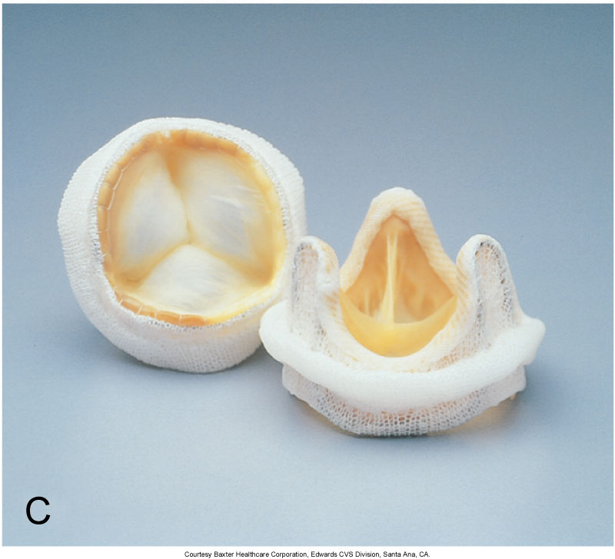
Heart Valves

Slide 29
Community-Based Care
Home care management
Health teaching
Health care resources

Slide 30
Infective Endocarditis
Microbial infection involving the endocardium
Occurs primarily in patients who abuse IV drugs, have had valve replacements, have experienced systemic infections, or have structural cardiac defects
Possible ports of entry—oral cavity, skin rash, lesion, abscess, infections, surgery, or invasive procedures including IV line placement

Slide 31
Manifestations
Murmur
Heart failure
Arterial embolization
Splenic infarction
Neurologic changes
Petechiae (pinpoint red spots)
Splinter hemorrhages

Slide 32
Diagnostic Assessment
Blood culture
Echocardiography
The most reliable criteria for diagnosing endocarditis include positive blood cultures, a new regurgitant murmur, and evidence of endocardial involvement by echocardiography

Slide 33
Interventions
Antimicrobials.
Anticoagulants are of no value in preventing embolization from vegetations.
Patient’s activities are balanced with adequate rest.

Slide 34
Surgical Management
Removing the infected valve
Repairing or removing congenital shunts
Repairing injured valves and chordae tendineae
Draining abscesses in the heart or elsewhere

Slide 35
Pericarditis
Inflammation or alteration of the pericardium, the membranous sac that encloses the heart
Dressler’s syndrome
Post-pericardiotomy syndrome
Chronic constrictive pericarditis

Slide 36
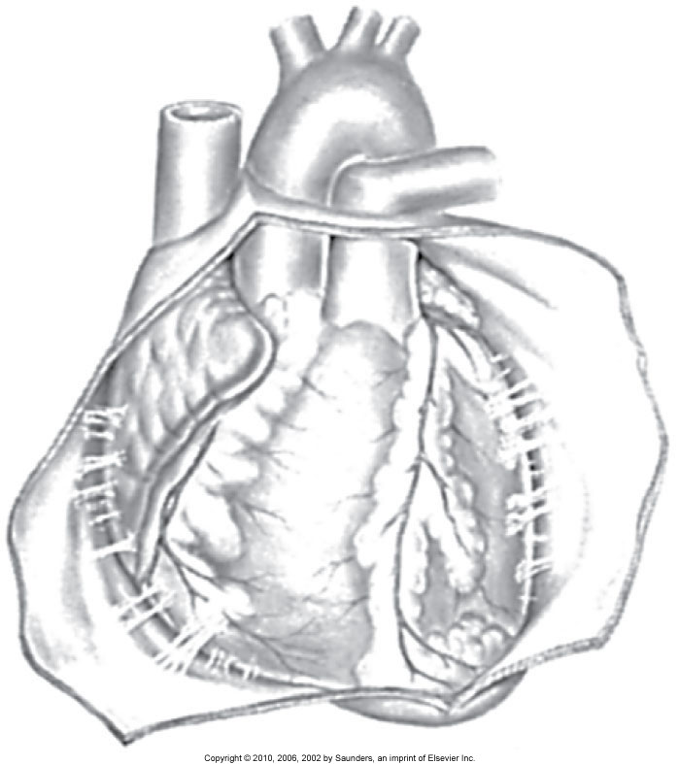
Pericarditis (Cont’d)

Slide 37
Assessment
Substernal precordial pain radiating to left side of the neck, shoulder, or back
Grating, oppressive pain, aggravated by breathing, coughing, swallowing
Pain worsened by the supine position; relieved when the patient sits up and leans forward
Pericardial friction rub

Slide 38
Interventions
Pain management
Pericardiectomy

Slide 39
Pericardial Effusion
Cardiac tamponade:
  JVD
  Paradoxical pulse
  Decreased CO
  Muffled heart sounds
  Circulatory collapse

Slide 40
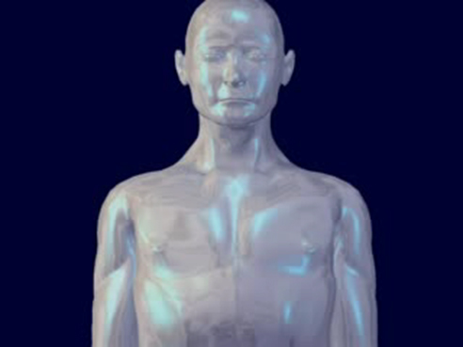
Pericardial Tamponade
Copyright © 2010, 2006, 2002 by Saunders, an imprint of Elsevier Inc.

Slide 41
Acute Cardiac Tamponade: Emergency Care
Cardiac tamponade—an extreme emergency
Increased fluid volume
Hemodynamic monitoring
Pericardiocentesis
Pericardial window
Pericardiectomy

Slide 42
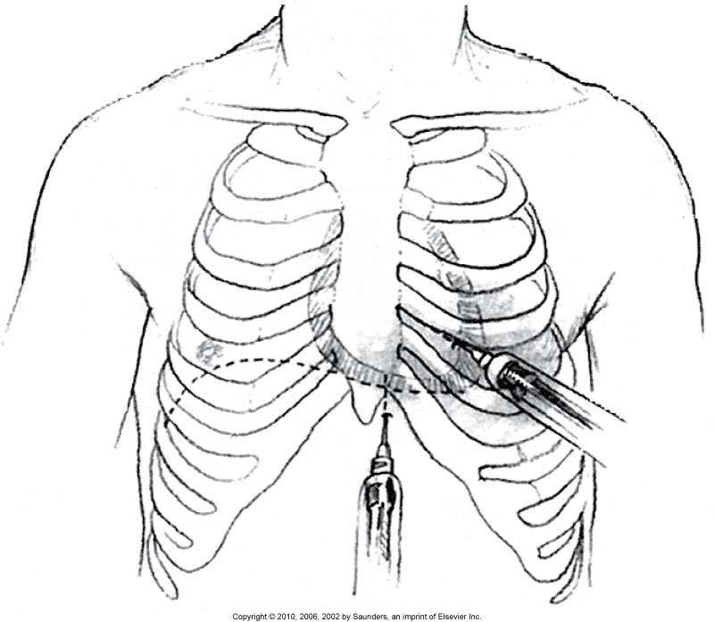
Pericardiocentesis

Slide 43
Rheumatic Carditis
Sensitivity response that develops after an upper respiratory tract infection with group A beta-hemolytic streptococci
Inflammation in all layers of the heart
Formation of Aschoff bodies, small nodules in the myocardium that are replaced by scar tissue
Impaired contractile function of the myocardium, thickening of the pericardium, and valvular damage

Slide 44
Clinical Manifestations
Tachycardia
Cardiomegaly
New or changed murmur
Pericardial friction rub
Precordial pain
Changes in electrocardiogram
Indications of heart failure
Existing streptococcal infection

Slide 45
Cardiomyopathy
Subacute or chronic disease of cardiac muscle
Dilated cardiomyopathy
Hypertrophic cardiomyopathy
Restrictive cardiomyopathy
Arrhythmogenic right ventricular cardiomyopathy

Slide 46
Interventions
Drug therapy
Implantable cardiac defibrillators
Toxin exposure avoidance
Alcohol avoidance
Ventriculomyomectomy
Percutaneous alcohol septal ablation
Heart transplantation

