Slide 1
Chapter 40
Care of Patients with Acute Coronary Syndromes

Slide 2
Coronary Artery Disease
Includes stable angina and acute coronary syndromes
Ischemia—insufficient oxygen supply to meet the requirements of the myocardium
Infarction—necrosis or cell death that occurs when severe ischemia is prolonged and decreased perfusion causes irreversible damage to tissue

Slide 3
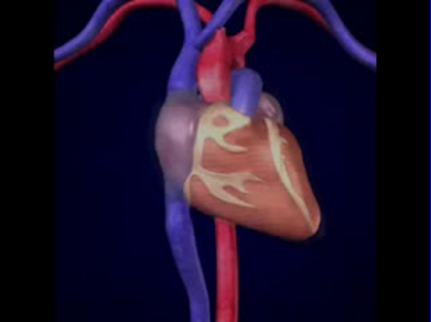
Coronary Blood Flow

Slide 4
Chronic Stable Angina Pectoris
“Strangling of the chest”
Temporary imbalance between the coronary artery’s ability to supply oxygen and the cardiac muscle’s demand for oxygen
Ischemia limited in duration and does not cause permanent damage to myocardial tissue
Chronic stable angina
Unstable angina

Slide 5
Acute Coronary Syndromes
Patients who present with either unstable angina or an acute myocardial infarction

Slide 6
ST Segment Elevation and MI
ST elevation MI (STEMI) traditional manifestation
Non–ST elevation MI (non-STEMI) common in women
Unstable angina

Slide 7
Unstable Angina Pectoris
New-onset angina
Variant (Prinzmetal’s) angina
Pre-infarction angina

Slide 8
Myocardial Infarction
Most serious acute coronary syndrome
Occurs when myocardial tissue is abruptly and severely deprived of oxygen
Occlusion of blood flow
Necrosis
Hypoxia
Subendocardial MI, transmural MI, inferior wall MI
Ventricular remodeling

Slide 9
Nonmodifiable Risk Factors
Age
Gender
Family history
Ethnic background

Slide 10
Modifiable Risk Factors
Elevated serum cholesterol
Cigarette smoking
Hypertension
Impaired glucose tolerance
Obesity
Physical inactivity
Stress

Slide 11
Laboratory Assessment
Troponin T and troponin I
Creatine kinase-MB (CK-MB)
Myoglobin
Imaging assessment
12-lead electrocardiograms
Cardiac catheterization

Slide 12
Acute Pain
Interventions include:
  Provide pain-relief modalities,
  drug therapy.
  Decrease myocardial oxygen demand.
  Increase myocardial oxygen supply.

Slide 13
Pain Management
Nitroglycerine
Morphine sulfate
Oxygen
Position of comfort; semi-Fowler’s position
Quiet and calm environment
Deep breaths to increase oxygenation

Slide 14
Ineffective Tissue Perfusion (Cardiopulmonary)
Interventions include:
  Drug therapy (aspirin, thrombolytic agents)
  Restoration of perfusion to the injured area often limits the amount of extension and improves left ventricular function.
  Complete sustained reperfusion of coronary arteries in the first few hours after an MI has decreased mortality.

Slide 15
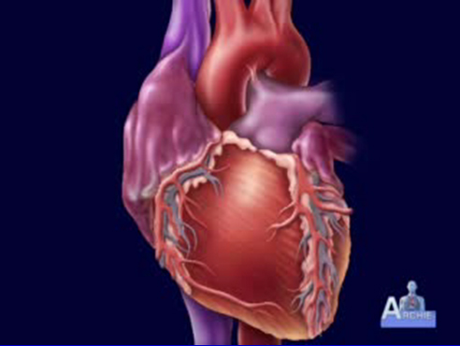
Heparin for Acute Coronary Syndrome

Slide 16
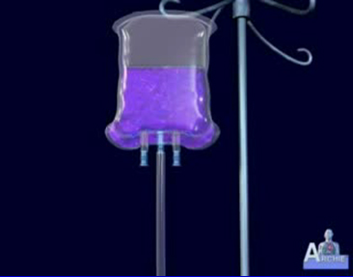
Thrombolytic Therapy
Fibrinolytics dissolve thrombi in the coronary arteries and restore myocardial blood flow.
  Tissue plasminogen activator
  Reteplase
  Tenecteplase

Slide 17
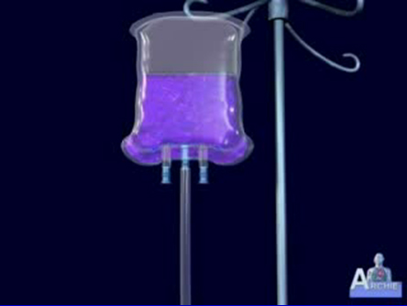
Thrombolytic Drugs; Clot Dissolving Drugs

Slide 18
Other Drugs
Glycoprotein (GP) IIB/IIIa inhibitors
Once-a-day beta-adrenergic blocking agents
Angiotensin-converting enzyme inhibitors or angiotensin receptor blockers
Calcium channel blockers
Ranolazine

Slide 19
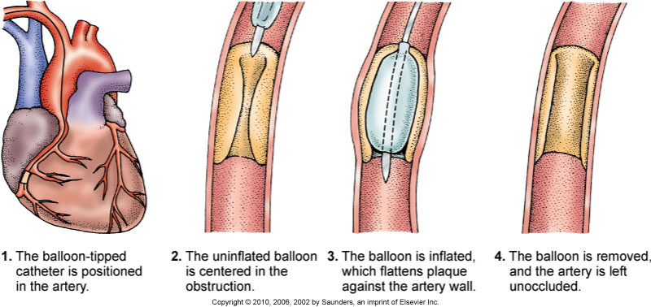
Percutaneous Transluminal Coronary Angioplasty (PTCA)

Slide 20
Activity Intolerance Interventions
Cardiac Rehabilitation:
  Phase 1
  Phase 2
  Phase 3

Slide 21
Ineffective Coping Interventions
Assess the patient’s level of anxiety, but allow expression of any anxiety and attempt to define its origin.
Give simple explanations of therapies, expectations, and surroundings and explanations of progress to help relieve anxiety.
Provide coping enhancement.

Slide 22
Potential for Dysrhythmias
Dysrhythmias are the leading cause of death in most patients with MI who die before they can be hospitalized.
Interventions include:
  Identify the dysrhythmias.
  Assess hemodynamic status.
  Evaluate for discomfort.

Slide 23
Cardiogenic Shock
Necrosis of more than 40% of the left ventricle
Tachycardia
Hypotension
Blood pressure <90 mm Hg or 30 mm Hg less than patient’s baseline
Urine output <30 mL/hr

Slide 24
Cardiogenic Shock (Cont’d)
Cold, clammy skin
Poor peripheral pulses
Agitation, restlessness, confusion
Pulmonary congestion
Tachypnea
Continuing chest discomfort

Slide 25
Medical Management
Pain relief and decreased myocardial oxygen requirements through preload and afterload reduction
Drug therapy
Intra-aortic balloon pump
Immediate reperfusion

Slide 26
Percutaneous Transluminal Coronary Angioplasty
Clopidogrel before the procedure
IV heparin after the procedure
IV or intracoronary nitroglycerine or diltiazem
Possible IV GP IIb/IIIa inhibitors
Long-term therapy, antiplatelet therapy, beta blocker, ACE inhibitor or ARB

Slide 27
Other Procedures
Arthrectomy
Stents
Rheolytic thrombectomy

Slide 28
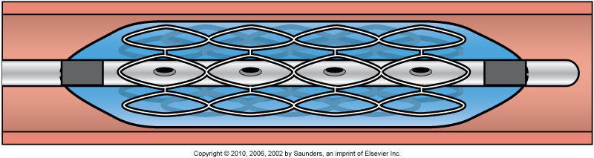
Coronary Stent

Slide 29
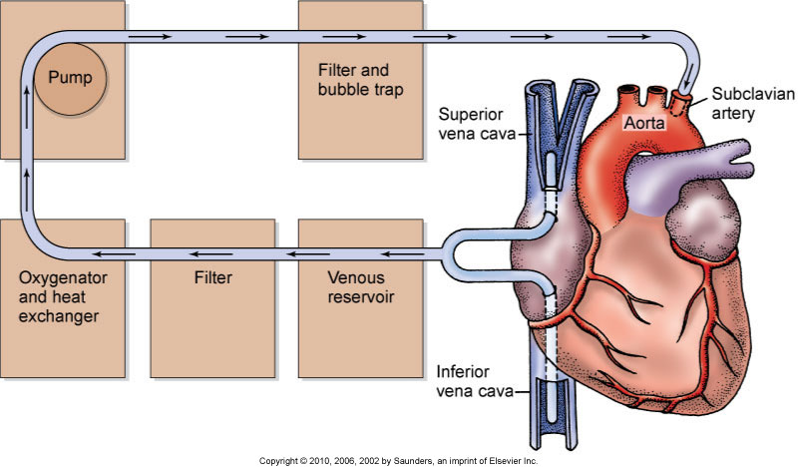
Coronary Artery Bypass Graft Surgery

Slide 30
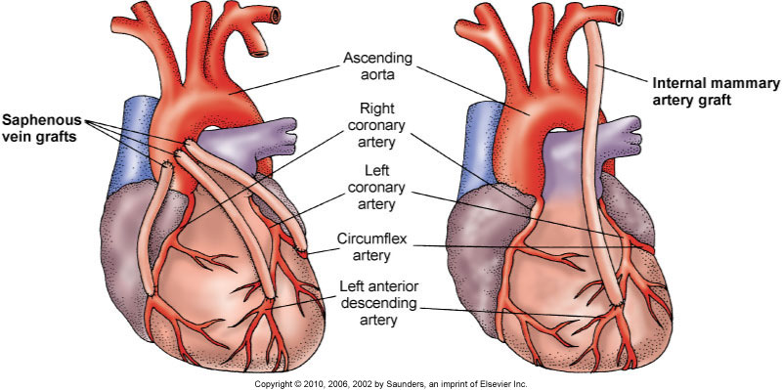
CABG

Slide 31
CABG (Cont’d)
Preoperative care
Operative procedures
Postoperative care:
  Management of F&E balance
  Management of other complications—hypotension, hypothermia, hypertension, bleeding, cardiac tamponade, change in level of consciousness

Slide 32
Community-Based Care
Home care management
Health teaching
Health care resources

