Slide 1
Chapter 47
Care of Critically Ill Patients with Neurologic Problems

Slide 2
Transient Ischemic Attack and Reversible Ischemic Neurologic Deficit
Warning signs that cause transient focal neurologic dysfunction resulting from a brief interruption in cerebral blood flow, possibly resulting from cerebral vasospasm or systemic arterial hypertension

Slide 3
Stroke (Brain Attack)
A change in the normal blood supply to the brain.
Ischemic—interruption in blood flow to the brain.
Hemorrhagic—bleeding within or around the brain.
The brain is unable to store oxygen or glucose and must receive a constant flow of blood to function.

Slide 4
Types of Strokes
Ischemic stroke
Thrombotic stroke
Embolic stroke
Hemorrhagic stroke resulting from ruptured aneurysm, arteriovenous malformation

Slide 5
Neurologic Assessment
Cognitive changes include aphasia, alexia, agraphia.
Motor changes include hemiplegia, hemiparesis, hypotonia, flaccid paralysis, hypertonia.
Sensory changes include agnosia, apraxia, neglect syndrome, ptosis, retinal ischemia causing a brief episode of blindness, hemianopsia.
Perform cranial nerve assessment.
Perform CV assessment.

Slide 6
Thrombolytic Therapy
IV (systemic) thrombolytic therapy
Retavase
Eligibility criteria
Intra-arterial thrombolysis

Slide 7
Drug Therapy
Thrombolytic therapy
Anticoagulants
Lorazepam and other antiepileptic drugs
Calcium channel blockers
Stool softeners
Analgesics for pain
Antianxiety drugs

Slide 8
Other Complications
Hydrocephalus
Vasospasms
Rebleeding or rupture

Slide 9
Management
Cooling
Thrombolytic therapy
Neuroprotective drugs
Ancrod
Carotid artery angioplasty with stenting
Endarterectomy
Extracranial-intracranial bypass

Slide 10
Management of Arteriovenous Malformations
Interventional therapy to occlude abnormal arteries or veins and prevent bleeding from the vascular lesion
Gamma radiation to produce fibrous thickening of the endothelial lining

Slide 11
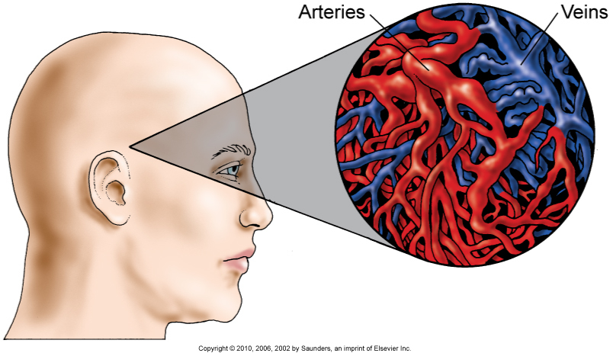
AVM

Slide 12
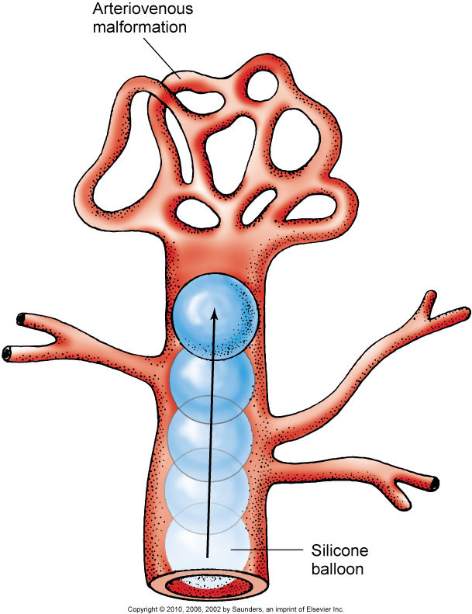
AVM Treatment

Slide 13
Management of Cerebral Aneurysms
Repair via craniotomy
Interventional radiology

Slide 14
Management of Intracranial Bleeding
Craniotomy to remove clots and relieve intracranial pressure

Slide 15
Impaired Physical Mobility and Self-Care Deficit
Interventions include:
Range-of-motion exercises for the involved extremities
Change of patient’s position frequently
Prevention of deep vein thrombosis
Therapy focused on patient performance of ADLs

Slide 16
Disturbed Sensory Perception
Interventions include:
Right hemisphere damage typically causing difficulty in the performance of visual-perceptual or spatial-perceptual tasks
ADLs
Ambulation
Left hemispheric damage generally causing memory deficits and changes in the ability to carry out simple tasks

Slide 17
Unilateral Neglect
This syndrome is most commonly seen with right cerebral stroke.
Teach patient to:
Observe safety measures.
Touch and use both sides of the body.
Use scanning technique of turning the head from side to side to expand the visual field.

Slide 18
Impaired Verbal Communication
Language or speech problems, usually the result of damage to the dominant hemisphere
Expressive aphasia, the result of damage in Broca’s area of the frontal lobe
Receptive (Wernicke’s or sensory) aphasia, due to injury in the temporoparietal area

Slide 19
Impaired Swallowing
Interventions include:
Assessment of patient’s ability to swallow
Patient positioning to facilitate the process of swallowing before feeding
Appropriate diet for the patient, including semisoft foods and fluids
Aspiration precautions

Slide 20
Urinary and Bowel Incontinence
Altered level of consciousness may cause incontinence or impaired innervation or an inability to communicate.
Develop a bladder and bowel training program.

Slide 21
Traumatic Brain Injury
Head injury occurs as a result of blow or jolt to the head or as a result of penetration of the head by a foreign object such as a bullet.

Slide 22
Primary Brain Injury
Open head injury occurs when there is a skull fracture or when the skull is pierced by a penetrating object; the integrity of the brain and the dura is violated, and exposure to outside contaminants occurs.
Closed head injury is the result of blunt trauma; the integrity of the skull is not violated.

Slide 23
Open Head Injury
Linear fracture—simple clean break; the impacted area of bone bends inward, and the area around it bends outward.
Depressed fracture—bone is pressed inward into the brain tissue to at least the thickness of the skull.

Slide 24
Open Head Injury (Cont’d)
Comminuted fracture—involves fragmentation of the bone, with depression of bone into brain tissue.
Open fracture—scalp is lacerated, creating a direct opening to brain tissue.

Slide 25
Basilar Skull Fracture
Occurs at the base of the skull
Usually extends into the anterior, middle, or posterior fossa and results in cerebrospinal fluid leakage from the nose or ears
Potential for hemorrhage, damage to cranial nerves, and infection

Slide 26
Types of Closed Head Injuries
Mild concussion
Diffuse axonal injury
Contusion (coup and contrecoup injury)
Laceration

Slide 27
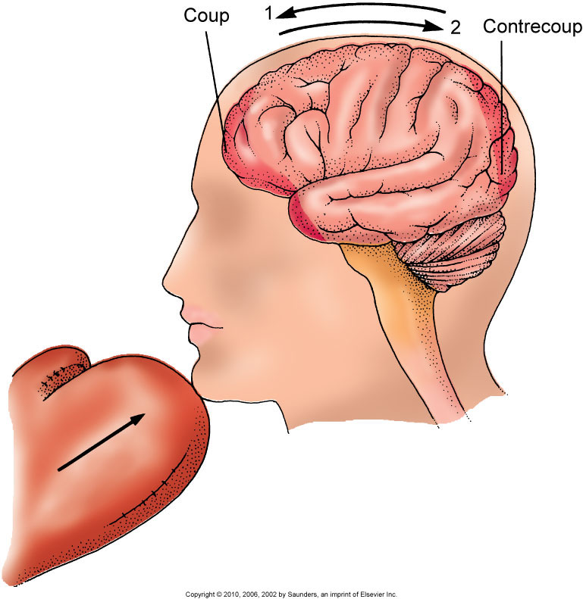
Coup and Contrecoup Injury

Slide 28
Types of Force
Acceleration injury is caused by an external force contacting the head, suddenly placing the head in motion.
Deceleration injury occurs when the moving head is suddenly stopped or hits a stationary object.

Slide 29
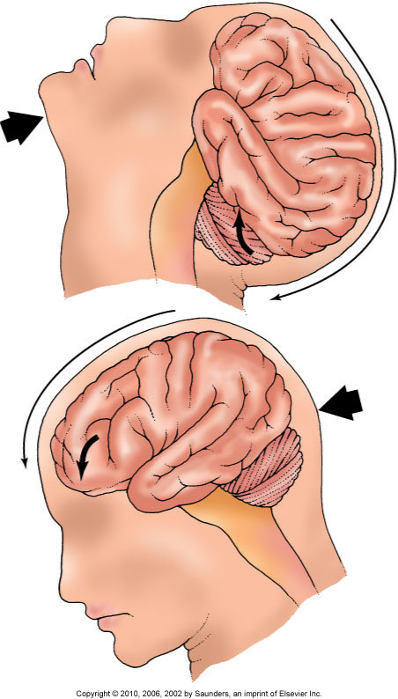
Acceleration-Deceleration Injury

Slide 30
Secondary Injury
Increased ICP
Hemorrhage:
Epidural
Subdural
Intracerebral
Hematoma development, hydrocephalus
Brain herniation

Slide 31
Epidural Hematoma
Neurologic emergencies with potentially catastrophic ICP elevation
Arterial bleeding into space between the dura and inner table of skull
Temporal bone fractures, middle meningeal artery
Momentary unconsciousness follows lucid interval within minutes of injury

Slide 32
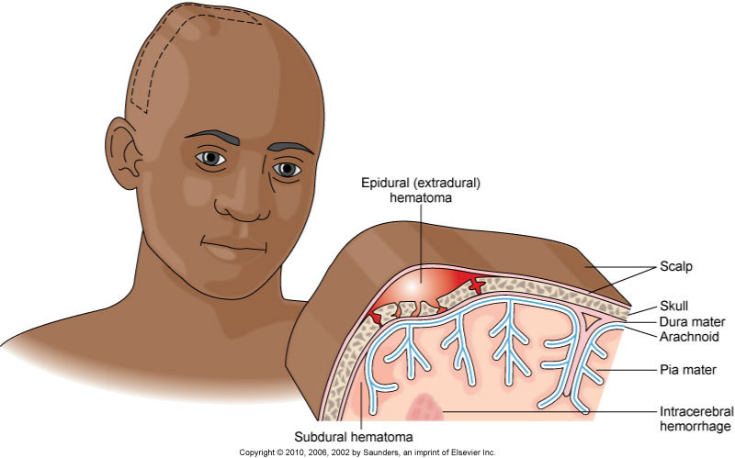
Epidural Hematoma (Cont’d)

Slide 33
Subdural Hematoma
Venous bleeding into the space beneath dura and above arachnoid
Most commonly from a tearing of the bridging veins within the cerebral hemispheres or from a laceration of brain tissue
Bleeding occurs more slowly, and symptoms mirror those of epidural hematoma

Slide 34
Complications
Hydrocephalus
Brain herniation

Slide 35
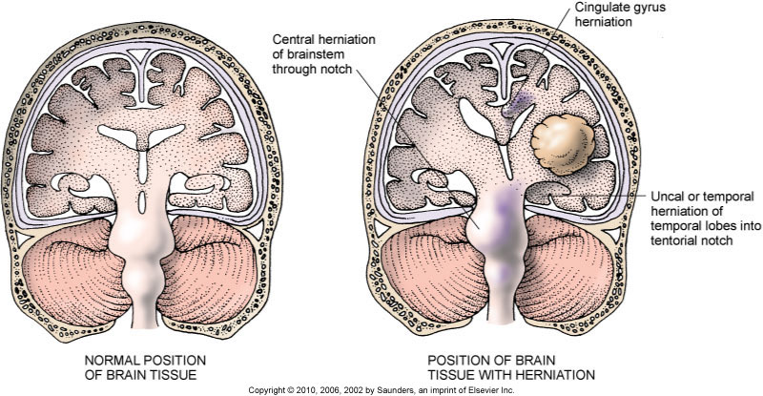
Herniation Syndromes

Slide 36
Nonsurgical Management of Head Injury
ABCs
Assessment of vital signs to prevent and detect increased ICP
Positioning
Pulmonary ventilation and management of oxygen and carbon dioxide levels
Suctioning
Chest physiotherapy and frequent turning

Slide 37
Brain Death Criteria
Glasgow coma scale <3
Apnea
No pupillary response
No cough and gag reflex
No oculovestibular reflex
No corneal reflex
No oculocephalic reflex

Slide 38
Drug Therapy
Glucocorticoids
Mannitol, furosemide
Opioids, naloxone
Neuromuscular blocking agents
Antiepileptic drugs
Acetaminophen and aspirin
Barbiturate coma

Slide 39
Surgical Management
ICP monitoring devices:
Intraventricular catheter (IVC)
Subarachnoid screw or bolt
Epidural catheter
Subdural catheter
Craniotomy may be performed in extreme instances of elevated ICP.

Slide 40
Brain Tumors
Brain tumors can arise anywhere within the brain structures:
Primary tumors originate within CNS.
Secondary tumors result from metastasis in other parts of the body.

Slide 41
Brain Tumors (Cont’d)
Tumors can lead to cerebral edema, brain tissue inflammation, increased ICP, focal neurologic deficits, obstruction of cerebrospinal fluid flow, pituitary dysfunction.

Slide 42
Classifications of Tumors
Tumors are classified as malignant or benign.
Tumor’s location places it in a class of supratentorial or infratentorial.
Tumor’s anatomic origins place it in a class of cellular, histologic, or anatomic.

Slide 43
Types of Tumors
Gliomas—malignant
Meningiomas—arise from the coverings of the brain
Pituitary tumors
Acoustic neuromas—arise from the sheath of Schwann cells
Metastatic or secondary tumors

Slide 44
Nonsurgical Management
Radiation therapy
Chemotherapy
Analgesics
Dexamethasone
Phenytoin
Ranitidine hydrochloride
Stereotactic radiosurgery

Slide 45
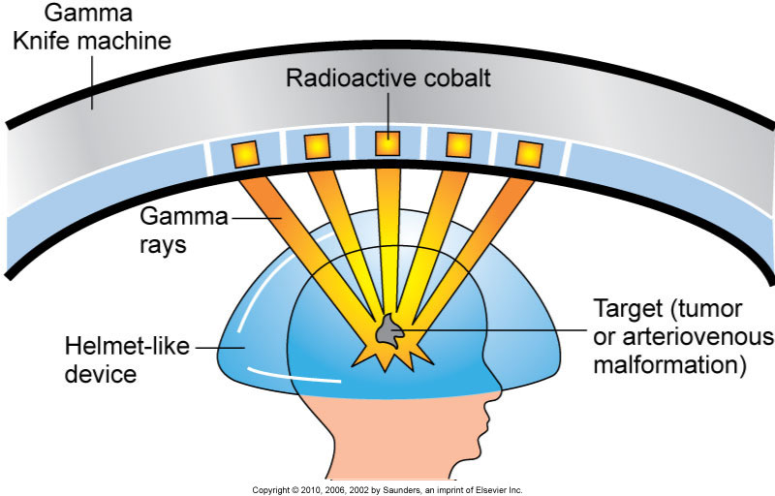
Gamma Knife

Slide 46
Surgical Management
Craniotomy more often used
Postoperative care—positioning, monitoring the dressing, monitoring laboratory values, ventilating the patient
Drug therapy—antiepileptic drugs, proton pump inhibitors, histamine blockers, corticosteroids, analgesics, acetaminophen, prophylactic antibiotics

Slide 47
Postoperative Complications
Increased ICP
Hematomas
Hydrocephalus
Respiratory problems
Wound infection
Meningitis
Fluid and electrolyte imbalances

Slide 48
Brain Abscess
In this purulent infection of the brain, pus forms in the extradural, subdural, or intracerebral area of the brain.
Findings may be atypical at presentation.
Treatment includes antibiotics, surgical drain.

