Slide 1
Chapter 53
Care of Patients with Musculoskeletal Problems

Slide 2
Osteoporosis
Chronic metabolic disease, in which bone loss causes decreased density and possible fracture
Osteopenia (low bone mass), which occurs when osteoclastic activity is greater than osteoblastic activity

Slide 3
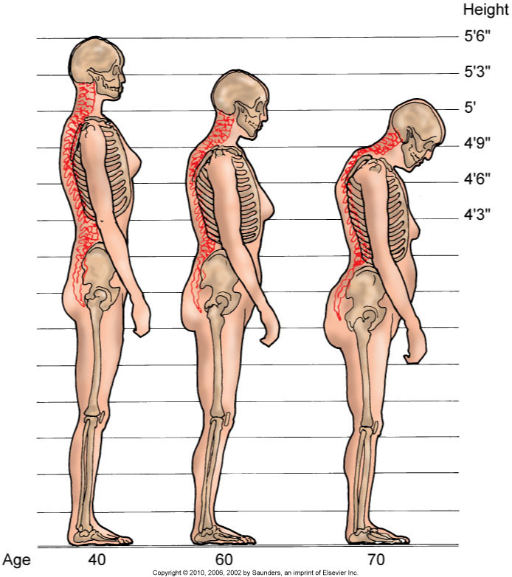
Osteoporosis (Cont’d)

Slide 4
Osteoporosis (Cont’d)
Etiology and genetic risk
Genetic considerations
Incidence/prevalence
Cultural considerations

Slide 5
Classification of Osteoporosis
Generalized osteoporosis occurs most commonly in postmenopausal women and men in their 60s and 70s.
Secondary osteoporosis results from an associated medical condition such as hyperparathyroidism, long-term drug therapy, long-term immobility.
Regional osteoporosis occurs when a limb is immobilized.

Slide 6
Health Promotion/Illness Prevention
Teaching should begin with young women who begin to lose bone after 30 years of age.
The focus of osteoporosis prevention is to decrease modifiable risk factors.
Ensure adequate calcium intake.
Avoid sedentary lifestyle.
Continue program of weight-bearing exercises.

Slide 7
Assessment
Physical assessment
Psychosocial assessment
Laboratory assessment
Imaging assessment:
DXA
QCT
QUS

Slide 8
Osteoporosis: Interventions
Nutrition therapy
Exercise
Other lifestyle changes

Slide 9
Osteoporosis: Drug Therapy
Calcium and vitamin D supplements
Estrogen or hormone therapy
Bisphosphonates
Selective estrogen receptor modulators
Calcitonin
Other agents used with varying results

Slide 10
Osteoporosis: Surgical Interventions
Vertebroplasty
Kyphoplasty

Slide 11
Osteomalacia
Loss of bone related to vitamin D deficiency
Bone softens because of inadequate deposits of calcium and phosphorus in the bone matrix
Rickets

Slide 12
Collaborative Care
Assessment
The major treatment for osteomalacia is vitamin D

Slide 13
Paget’s Disease of the Bone
Chronic metabolic disorder in which bone is excessively broken down and reformed
Genetic considerations
Collaborative care:
Physical assessment
Diagnostic assessment

Slide 14
Paget’s Disease: Nonsurgical Management
Analgesics
Decrease bone resorption
Selected bisphosphonates
Calcitonin
Plicamycin
Diet therapy
Nonpharmacologic pain-relief measures

Slide 15
Paget’s Disease: Surgical Management
Tibial osteotomy
Partial or total joint replacement
Surgical decompression and stabilization of the spine

Slide 16
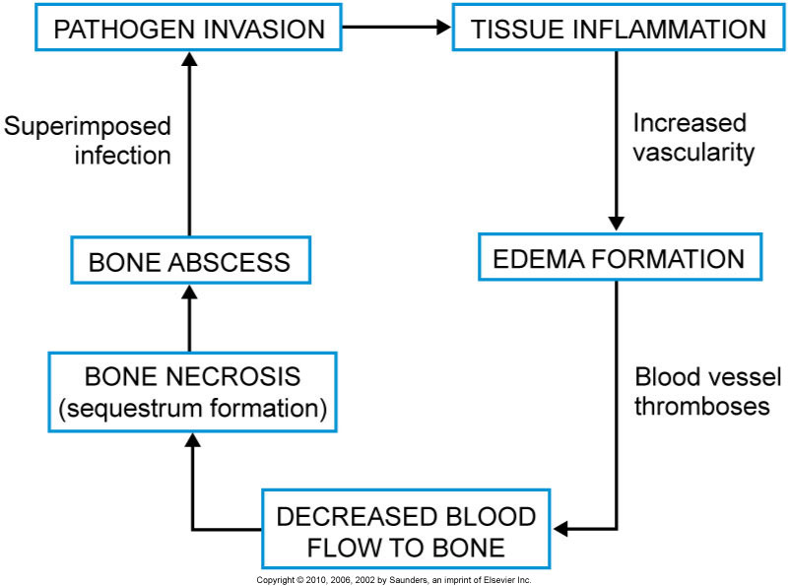
Osteomyelitis
Infection in bony tissue

Slide 17
Osteomyelitis: Collaborative Care
Assessment
Antibiotic therapy
Hyperbaric oxygen therapy
Surgical management:
Sequestrectomy
Microvascular bone transfers

Slide 18
Benign Bone Tumors
Often asymptomatic and may be discovered on routine x-ray or as a cause of pathologic fracture:
Chrondrogenic tumors—from cartilage
Osteogenic tumors—from bone
Fibrogenic tumors—from fibrous tissue; most commonly found in children

Slide 19
Interventions
Non-drug pain-relief measures
Drug therapy—analgesics, NSAIDs
Surgical therapy—curettage (simple excision of the tumor tissue), joint replacement, or arthrodesis

Slide 20
Bone Cancer
Primary tumors
Metastatic lesions
Pathophysiology
Assessment
Nonsurgical management:
Drug therapy
Radiation therapy

Slide 21
Bone Cancer: Surgical Management
Preoperative care
Operative procedure
Postoperative care

Slide 22
Bone Cancer: Community-Based Care
Home care management
Health teaching
Health care resources

Slide 23
Disorders of the Hand
Dupuytren's contracture—slowly progressive contracture of the palmar fascia resulting in flexion of the fourth or fifth digit of the hand

Slide 24
Ganglion
Round, benign cyst often found on a wrist or foot joint or tendon

Slide 25
Disorders of the Foot
Hallux valgus
Hammertoe
Morton’s neuroma
Tarsal tunnel syndrome
Plantar fasciitis
Other problems of the foot

Slide 26
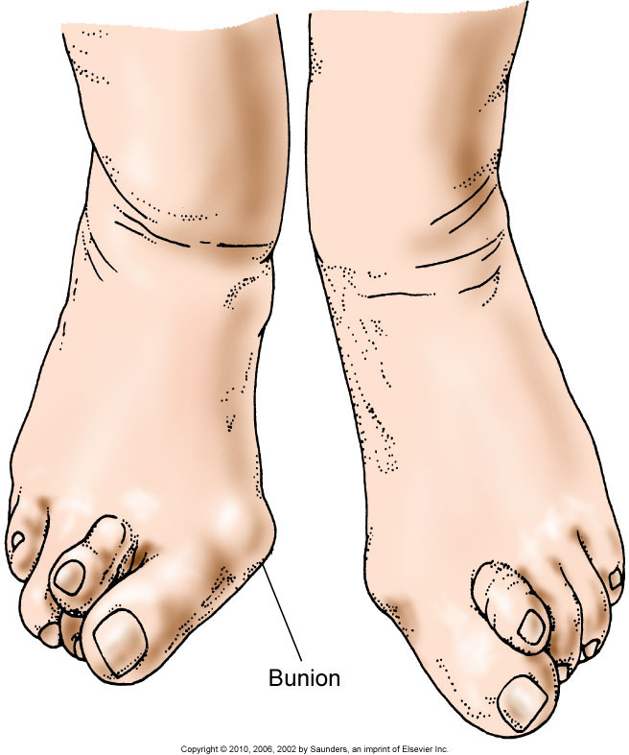
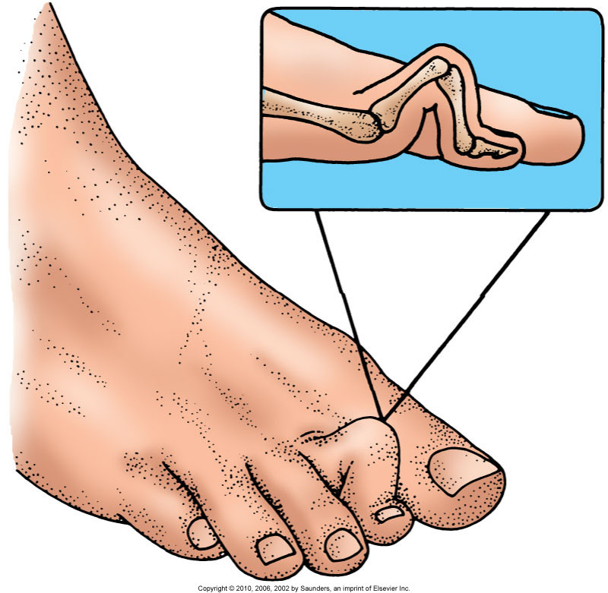
Foot

Slide 27
Scoliosis
Changes in muscles and ligaments on the concave side of the spinal column

Slide 28
Scoliosis (Cont’d)
Pathophysiology
History
Treatment of children
Treatment of adults

Slide 29
Progressive Muscular Dystrophies
Pathophysiology
Genetic considerations
Diagnosis
Management
Nursing interventions

