Slide 1
Chapter 54
Care of Patients with Musculoskeletal Trauma

Slide 2
Classification of Fractures
A fracture is a break or disruption in the continuity of a bone.
Types of fractures include:
Complete
Incomplete
Open or compound
Closed or simple
Pathologic (spontaneous)
Fatigue or stress
Compression

Slide 3
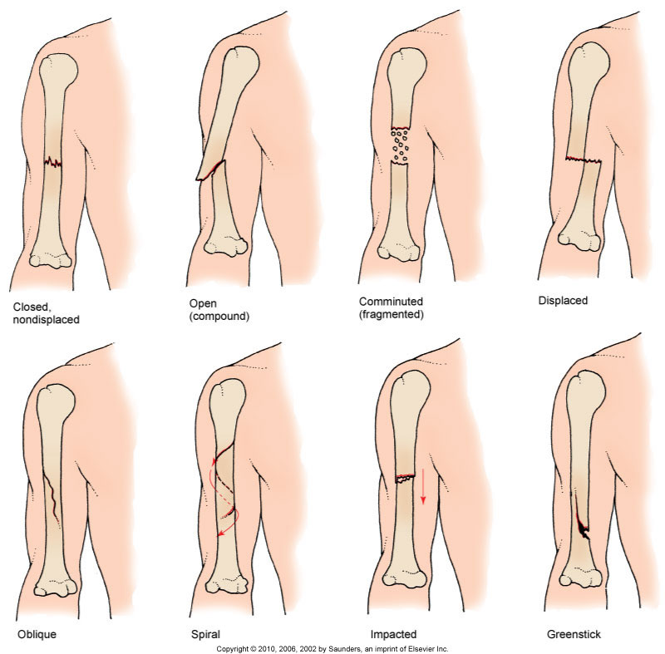
Common Types of Fractures

Slide 4
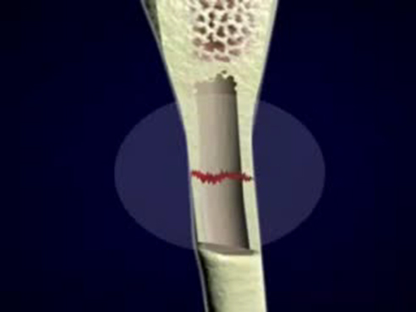
Fracture

Slide 5
Stages of Bone Healing
Hematoma formation within 48 to 72 hr after injury
Hematoma to granulation tissue
Callus formation
Osteoblastic proliferation
Bone remodeling
Bone healing completed within about 6 weeks; up to 6 months in the older person

Slide 6
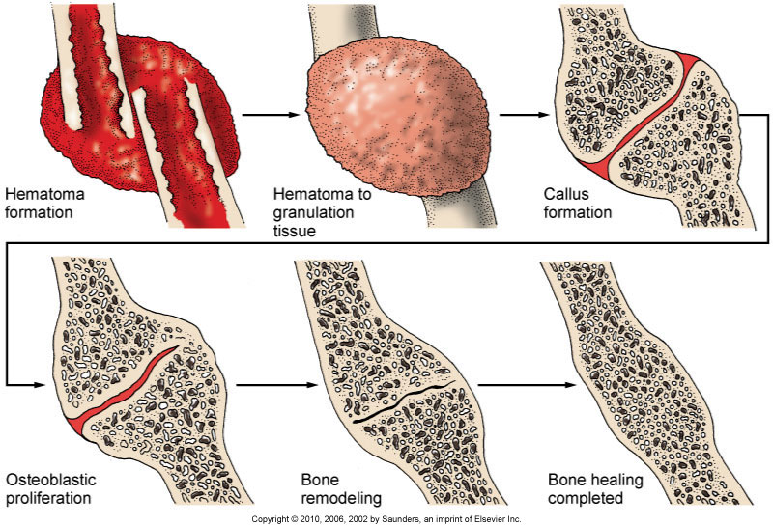
Stages of Bone Healing (Cont’d)

Slide 7
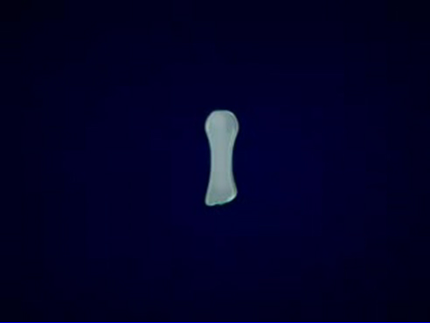
Bone Formation and Growth

Slide 8
Acute Compartment Syndrome
Serious condition in which increased pressure within one or more compartments causes massive compromise of circulation to the area
Prevention of pressure buildup of blood or fluid accumulation
Pathophysiologic changes sometimes referred to as ischemia-edema cycle

Slide 9
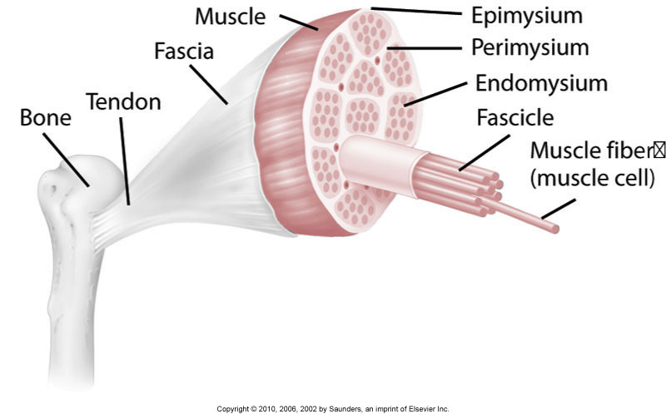
Muscle Anatomy

Slide 10
Emergency Care
Within 4 to 6 hr after the onset of acute compartment syndrome, neuromuscular damage is irreversible; the limb can become useless within 24 to 48 hr.
Monitor compartment pressures.
Fasciotomy may be performed to relieve pressure.
Pack and dress the wound after fasciotomy.

Slide 11
Possible Results of Acute Compartment Syndrome
Infection
Motor weakness
Volkmann’s contractures
Myoglobinuric renal failure, known as rhabdomyolysis
Crush syndrome

Slide 12
Other Complications of Fractures
Shock
Fat embolism syndrome—serious complication resulting from a fracture; fat globules are released from yellow bone marrow into bloodstream
Venous thromboembolism
Infection
Chronic complications—ischemic necrosis (avascular necrosis [AVN] or osteonecrosis), delayed bone healing

Slide 13
Musculoskeletal Assessment
Change in bone alignment
Alteration in length of extremity
Change in shape of bone
Pain upon movement
Decreased ROM
Crepitus
Ecchymotic skin

Slide 14
Musculoskeletal Assessment (Cont’d)
Subcutaneous emphysema with bubbles under the skin
Swelling at the fracture site

Slide 15
Special Assessment Considerations
For fractures of the shoulder and upper arm, assess patient in sitting or standing position.
Support the affected arm to promote comfort.
For distal areas of the arm, assess patient in a supine position.
For fracture of lower extremities and pelvis, patient is in supine position.

Slide 16
Risk for Peripheral Neurovascular Dysfunction
Interventions include:
Emergency care—assess for respiratory distress, bleeding, and head injury
Nonsurgical management—closed reduction and immobilization with a bandage, splint, cast, or traction

Slide 17
Casts
Rigid device that immobilizes the affected body part while allowing other body parts to move
Cast materials—plaster, fiberglass, polyester-cotton
Types of casts for various parts of the body—arm, leg, brace, body

Slide 18
Casts (Cont’d)
Cast care and patient education
Cast complications—infection, circulation impairment, peripheral nerve damage, complications of immobility

Slide 19
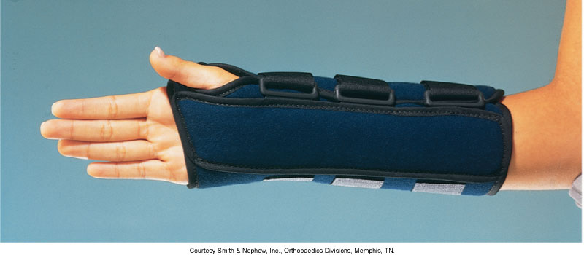
Immobilization Device

Slide 20
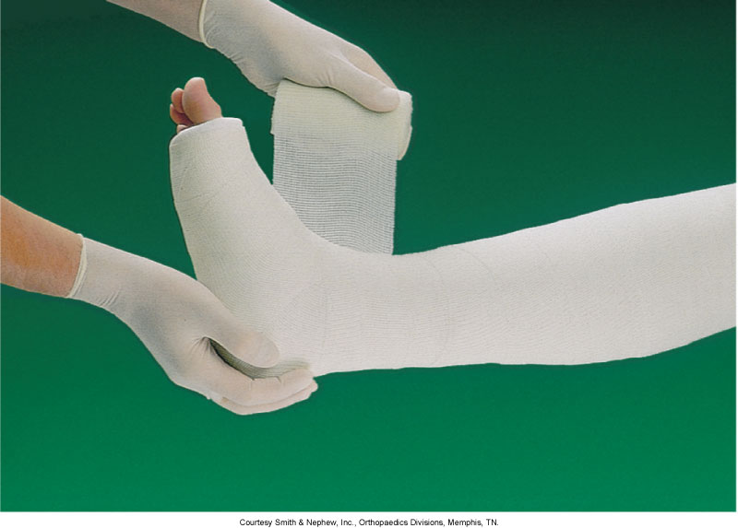
Fiberglass Synthetic Cast

Slide 21
Traction
Application of a pulling force to the body to provide reduction, alignment, and rest at that site
Types of traction—skin, skeletal, plaster, brace, circumferentialMM

Slide 22
Traction (Cont’d)
Traction care:
Maintain correct balance between traction pull and countertraction force
Care of weights
Skin inspection
Pin care
Assessment of neurovascular status

Slide 23
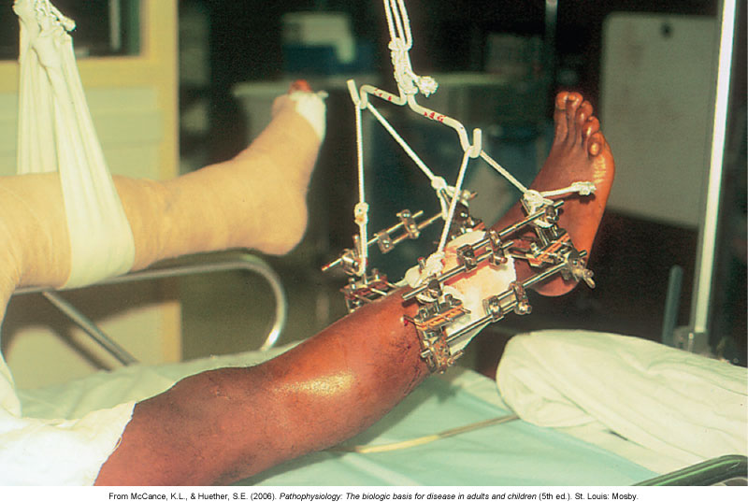
External Fixation Device

Slide 24
Operative Procedures
Open reduction with internal fixation
External fixation
Postoperative care—similar to that for any surgery; certain complications specific to fractures and musculoskeletal surgery include fat embolism and venous thromboembolism

Slide 25
Procedures for Nonunion
Electrical bone stimulation
Bone grafting
Bone banking
Low-intensity pulsed ultrasound (Exogen therapy)

Slide 26
Acute Pain
Interventions include:
Reduction and immobilization of fracture
Assessment of pain
Drug therapy—opioid and non-opioid drugs

Slide 27
Acute Pain (Cont’d)
Complementary and alternative therapies—ice, heat, elevation of body part, massage, baths, back rub, therapeutic touch, distraction, imagery, music therapy, relaxation techniques

Slide 28
Risk for Infection
Interventions include:
Apply strict aseptic technique for dressing changes and wound irrigations.
Assess for local inflammation.
Report purulent drainage immediately to health care provider.

Slide 29
Risk for Infection (Cont’d)
Assess for pneumonia and urinary tract infection.
Administer broad-spectrum antibiotics prophylactically.

Slide 30
Impaired Physical Mobility
Interventions include:
Use of crutches to promote mobility
Use of walkers and canes to promote mobility

Slide 31
Imbalanced Nutrition: Less Than Body Requirements
Interventions include:
Diet high in protein, calories, and calcium; supplemental vitamins B and C
Frequent, small feedings and supplements of high-protein liquids
Intake of foods high in iron

Slide 32
Upper Extremity Fractures
Fractures include those of the:
Clavicle
Scapula
Husmerus
Olecranon
Radius and ulna
Wrist and hand

Slide 33
Fractures of the Hip
Intracapsular or extracapsular
Treatment of choice—surgical repair, when possible, to allow the older patient to get out of bed
Open reduction with internal fixation
Intramedullary rod, pins, a prosthesis, or a fixed sliding plate
Prosthetic device

Slide 34
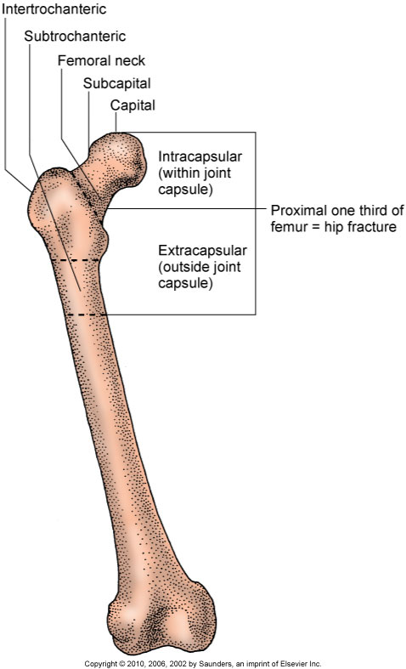
Types of Hip Fractures

Slide 35
Lower Extremity Fractures
Fractures include those of the:
Femur
Patella
Tibia and fibula
Ankle and foot

Slide 36
Fractures of the Pelvis
Associated internal damage the chief concern in fracture management of pelvic fractures
Non–weight-bearing fracture of the pelvis
Weight-bearing fracture of the pelvis

Slide 37
Compression Fractures of the Spine
Most are associated with osteoporosis rather than acute spinal injury.
Multiple hairline fractures result when bone mass diminishes.

Slide 38
Compression Fractures of the Spine (Cont’d)
Nonsurgical management includes bedrest, analgesics, and physical therapy.
Minimally invasive surgeries are vertebroplasty and kyphoplasty, in which bone cement is injected.

Slide 39
Amputations
Surgical amputation
Traumatic amputation
Levels of amputation
Complications of amputations—hemorrhage, infection, phantom limb pain, neuroma, flexion contracture

Slide 40
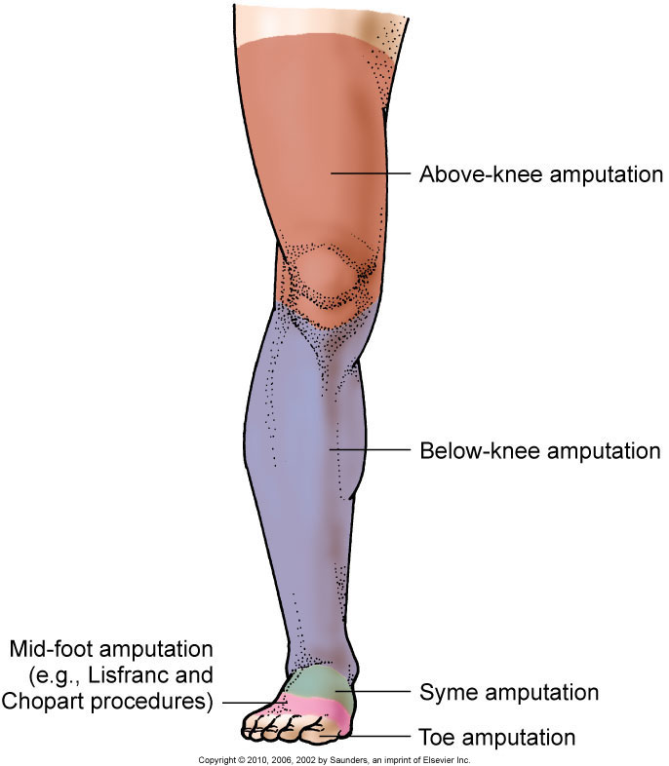
Common Levels of Amputation

Slide 41
Phantom Limb Pain
Phantom limb pain is a frequent complication of amputation.
Patient complains of pain at the site of the removed body part, most often shortly after surgery.
Pain is intense burning feeling, crushing sensation, or cramping.
Some patients feel that the removed body part is in a distorted position.

Slide 42
Management of Pain
Phantom limb pain must be distinguished from stump pain because they are managed differently.
Recognize that this pain is real and interferes with the amputee’s ADLs.

Slide 43
Management of Pain (Cont’d)
Opioids are not as effective for phantom limb pain as they are for residual limb pain.
Other drugs include beta blockers, antiepileptic drugs, antispasmodics, and IV infusion of calcitonin.

Slide 44
Exercise After Amputation
ROM to prevent flexion contractures, particularly of the hip and knee
Trapeze and overhead frame
Firm mattress
Prone position every 3 to 4 hours
Elevation of lower-leg residual limb controversial

Slide 45
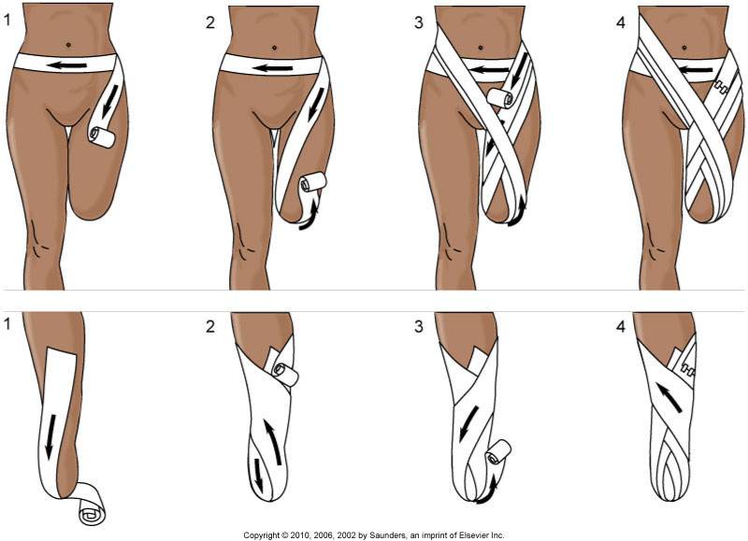
Stump Care

Slide 46
Prostheses
Devices to help shape and shrink the residual limb and help patient adapt
Wrapping of elastic bandages
Individual fitting of the prosthesis; special care

Slide 47
Complex Regional Pain Syndrome
A poorly understood complex disorder that includes debilitating pain, atrophy, autonomic dysfunction, and motor impairment
Collaborative management—pain relief, maintaining ROM, endoscopic thoracic sympathectomy, and psychotherapy

Slide 48
Knee Injuries, Meniscus
McMurray test
Meniscectomy
Postoperative care
Leg exercises begun immediately
Knee immobilizer
Elevation of the leg on one or two pillows; ice

Slide 49
Knee Injuries, Ligaments
When the anterior cruciate ligament is torn, a snap is felt, the knee gives way, swelling occurs, and stiffness and pain follow.
Treatment can be nonsurgical or surgical.
Complete healing of knee ligaments after surgery can take 6 to 9 months.

Slide 50
Tendon Ruptures
Rupture of the Achilles tendon is common in adults who participate in strenuous sports.
For severe damage, surgical repair is followed by leg immobilized in a cast for 6 to 8 weeks.
Tendon transplant may be needed.

Slide 51
Dislocations and Subluxations
Pain, immobility, alteration in contour of joint, deviation in length of the extremity, rotation of the extremity
Closed manipulation of the joint performed to force it back into its original position
Joint immobilized until healing occurs
Notes:
S&P

Slide 52
Strains
Excessive stretching of a muscle or tendon when it is weak or unstable
Classified according to severity—first-, second-, and third-degree strain
Management—cold and heat applications, exercise and activity limitations, anti-inflammatory drugs, muscle relaxants, and possible surgery

Slide 53
Sprains
Excessive stretching of a ligament
Treatment of sprains:
First-degree—rest, ice for 24 to 48 hr, compression bandage, and elevation (RICE)
Second-degree—immobilization, partial weight bearing as tear heals
Third-degree—immobilization for 4 to 6 weeks, possible surgery

Slide 54
Rotator Cuff Injuries
Shoulder pain; cannot initiate or maintain abduction of the arm at the shoulder
Drop arm test
Conservative treatment—NSAIDs, physical therapy, sling support, ice or heat applications during healing
Surgical repair for a complete tear

