Slide 1
Chapter 63
Care of Patients with Malnutrition and Obesity

Slide 2
Nutrition Standards for Health Promotion and Maintenance
Dietary Guidelines for Americans
Food Guide Pyramid
Vegetarian Food Guide Pyramid
Cultural awareness
Geriatric considerations

Slide 3
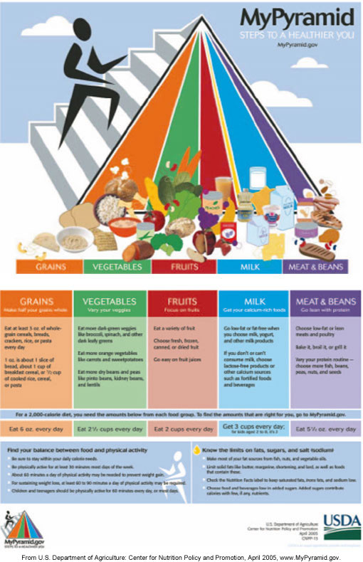
Food Guide Pyramid

Slide 4
Nutritional Assessment
Initial nutritional screening
Anthropometric measurements
Body mass index
Skin-fold measurements

Slide 5
Malnutrition
Protein-calorie malnutrition
Marasmus calorie malnutrition, in which body fat and protein are wasted, serum proteins are often preserved
Kwashiorkor
Marasmic-kwashiorkor

Slide 6
Eating Disorders
Anorexia nervosa
Bulimia nervosa

Slide 7
Patient-Centered Collaborative Care
Patient history
Clinical manifestations
Psychosocial assessment

Slide 8
Laboratory Assessment
Hemoglobin
Hematocrit
Serum albumin, thyroxine-binding prealbumin and transferrin
Cholesterol
Total lymphocyte count

Slide 9
Medical Nutritional Supplements
Boost
Ensure
Carnation Instant Breakfast

Slide 10
Drug Therapy
Drugs to stimulate appetite—Periactin, Megace

Slide 11
Total Enteral Nutrition (TEN)
Those patients who can eat but cannot maintain adequate nutrition by oral intake of food alone
Those patients who have permanent neuromuscular impairment and cannot swallow
Those patients who do not have permanent neuromuscular impairment but are critically ill and cannot eat because of their condition

Slide 12
Methods of Administering Total Enteral Nutrition
Nasoenteric tube (NET)
Nasogastric tube (NG)
Nasoduodenal tube (NDT)

Slide 13
Enterostomal Feeding Tubes
Gastrostomy
Percutaneous endoscopic gastrostomy (PEG)
Low-profile gastrostomy device (LPGD)
Jejunostomy

Slide 14
Administration of Tube Feedings
Bolus feeding
Continuous feeding
Cyclic feeding

Slide 15
Complications of Total Enteral Nutrition
Refeeding syndrome
Tube misplacement and dislodgement
Abdominal distention and nausea and vomiting
Fluid and electrolyte imbalances

Slide 16
Parenteral Nutrition
Partial parenteral nutrition
Total parenteral nutrition

Slide 17
Complications of Parenteral Nutrition
Fluid imbalances
Electrolyte imbalances

Slide 18
Community-Based Care
Home care management
Health teaching
Health care resources

Slide 19
Obesity
Overweight—increase in body weight for height compared with standard, or up to 10% greater than ideal body weight
Obesity—excess amount of body fat when compared with lean body mass, at least 20% above upper limit of normal range for ideal body weight
Morbid obesity—severe negative effect on health, usually more than 100% above ideal body weight

Slide 20
Common Complications of Obesity
Hypertension
Hyperlipidemia
CAD
Stroke
Peripheral arterial disease
Metabolic syndrome
Obstructive sleep apnea
Obesity hypoventilation syndrome

Slide 21
Common Complications of Obesity (Cont’d)
Depression and other mental health problems
Urinary incontinence
Cholelithiasis
Gout
Chronic back pain
Early osteoarthritis
Decreased wound healing

Slide 22
Etiology and Genetic Risk
Diet
Physical inactivity
Drug treatment
Familiar and genetic factors

Slide 23
Patient-Centered Collaborative Care
Patient history
Clinical manifestations
Psychosocial assessment

Slide 24
Nonsurgical Management
Diet programs
Nutrition therapy
Exercise program
Drug therapy—Meridia, Tenuate, Bontril, Xenical
Behavioral management
Complementary and alternative therapies—acupuncture, acupressure, ayurvedic therapy hypnosis

Slide 25
Surgical Management
Liposuction
Bariatrics—branch of medicine that manages obesity and its related diseases:
  Gastric restrictive
  Malabsorption
  Both
Preoperative care

Slide 26
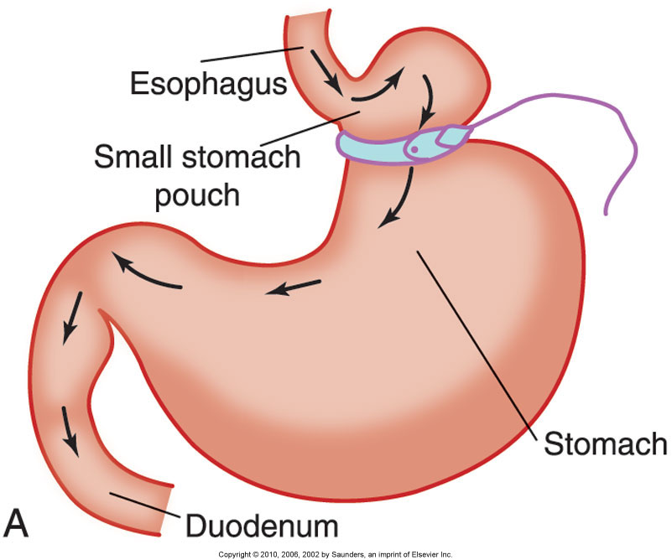
Operative Procedures
Gastric restriction

Slide 27
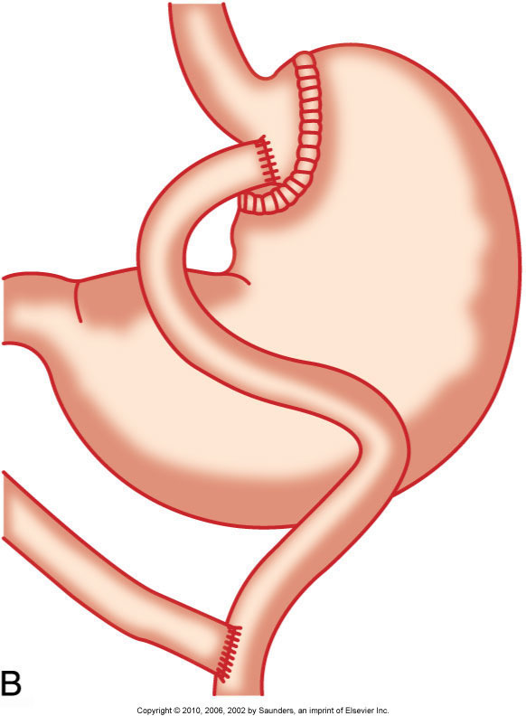
Operative Procedures (Cont’d)
Malabsorption surgery
Gastric bypass

Slide 28
Postoperative Care
Airway management
Pain management
Patient and staff safety
Care of NG tube
Assess for anastomotic leaks

Slide 29
Special Considerations After Bariatric Surgery
Abdominal binder
Position
Monitor SaO₂
Sequential compression hose and/or heparin
Assess skin
Absorbent padding
Remove urinary catheter within 24 hours

Slide 30
Special Considerations for Bariatric Surgery (Cont’d)
Assist patient out of bed
Ambulation as soon as possible
Monitor abdominal girth
6 small feedings and prevent dehydration
Observe for signs of dumping syndrome

