Slide 1
Chapter 67
Care of Patients with Diabetes Mellitus

Slide 2
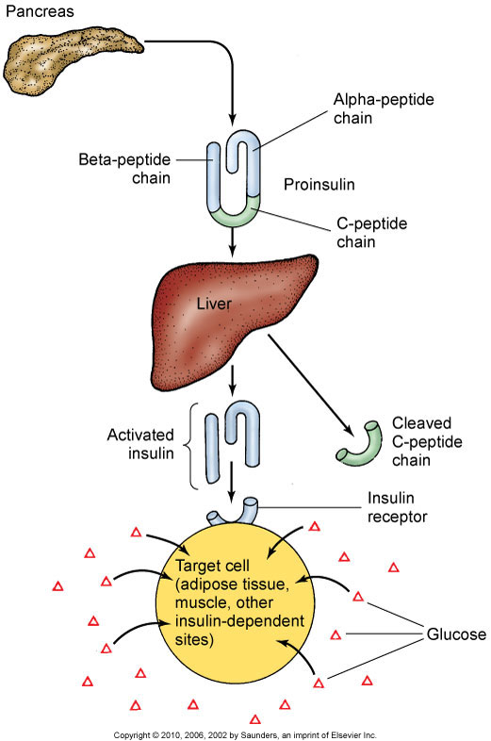
Insulin Physiology

Slide 3
Types of Diabetes
Type I
Type 2
Gestational Diabetes (GDM)
Other specific conditions resulting in hyperglycemia

Slide 4
Absence of Insulin
Hyperglycemia
Polyuria
Polydipsia
Polyphagia
Ketone bodies
Hemoconcentration, hypovolemia, hyperviscosity, hypoperfusion, and hypoxia
Acidosis, Kussmaul respiration
Hypokalemia, hyperkalemia, or normal serum potassium levels

Slide 5
Acute Complications of Diabetes
Diabetic ketoacidosis
Hyperglycemic-hyperosmolar state (HHS)
Hypoglycemia from too much insulin or too little glucose

Slide 6
Chronic Complications of Diabetes
Macrovascular and microvascular disease
Retinopathy (vision problems)
Nephropathy (kidney dysfunction)
Neuropathy (nerve dysfunction)

Slide 7
Macrovascular Complications
Cardiovascular disease
Cerebrovascular disease

Slide 8
Microvascular Complications
Eye and vision complications
Diabetic neuropathy
Diabetic nephropathy
Male erectile dysfunction

Slide 9
Type 2 Diabetes and Metabolic Syndrome
Metabolic syndrome, also called syndrome X, is classified as the simultaneous presence of metabolic factors known to increase risk for developing type 2 diabetes and cardiovascular disease.

Slide 10
Health Promotion and Maintenance
Control of diabetes and its complications is a major focus for health promotion activities.

Slide 11
Assessment
History
Blood tests:
Fasting plasma glucose (FPG)
Oral glucose tolerance test (OGTT)
Other blood tests for diabetes
Screening for diabetes
Ongoing assessment—glycosylated hemoglobin assays, gluycosylated serum proteins and albumin, urine tests, tests for renal function

Slide 12
Drug Therapy
Oral therapy:
Sulfonylurea agents
Meglitinide analogues
Biguanides
Alpha-glucosidase inhibitors
Thiazolidinediones
Combination agents

Slide 13
Insulin Therapy
Types of insulin
Insulin regimens
Factors influencing insulin absorption
Mixing insulins

Slide 14
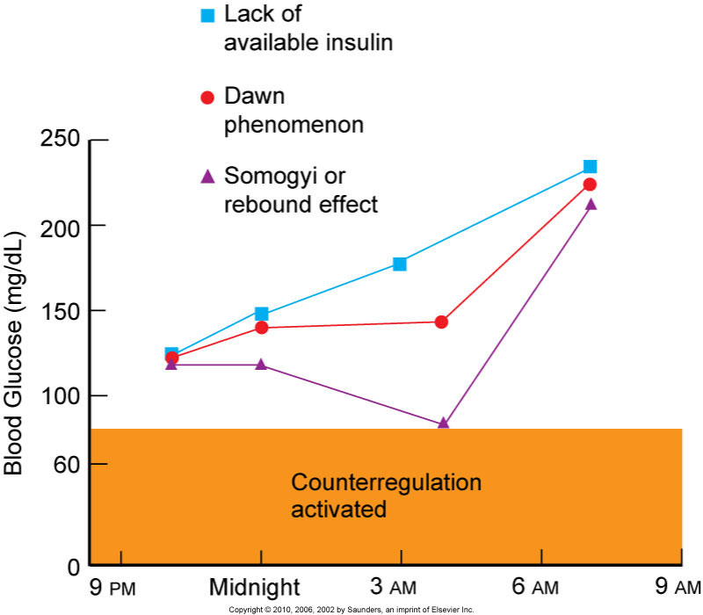
Complications of Insulin Therapy
Lipoatrophy
Lipohypertrophy
Dawn phenomenon
Somogyi’s phenomenon

Slide 15
Alternative Methods of Insulin Administration
Continuous subcutaneous infusion
Injection devices
New technology

Slide 16
Patient Education
Insulin storage
Dose preparation
Syringes
Blood glucose monitoring
Infection control measures
Diet therapy

Slide 17
Principles of Nutrition in Diabetes
Protein
Dietary fat and cholesterol
Fiber
Sweeteners
Alcohol

Slide 18
Meal Planning Strategies
Exchange systems
Carbohydrate counting

Slide 19
Hyperinsulinemia
Chronic high blood insulin levels that can occur with intensive treatment schedules and may result in weight gain.
These patients may need to treat hyperglycemia by restricting calories rather than by increasing insulin.
Weight gain can be minimized by following the prescribed meal plan, getting regular exercise, and avoiding overtreatment of hypoglycemia.

Slide 20
Exercise Therapy
Regular exercise is an essential part of a diabetic treatment plan
Benefits of exercise
Exercise in the presence of long-term complications of diabetes
Assessment before initiating an exercise program
Guidelines for exercise

Slide 21
Surgical Management
Transplantation of the pancreas
Whole-pancreas transplantation
Islet cell transplantation

Slide 22
Proper Foot Care
Foot injury is the most common complication of diabetes leading to hospitalization
Prevention of high-risk conditions
Peripheral sensation management
Footwear
Foot care

Slide 23
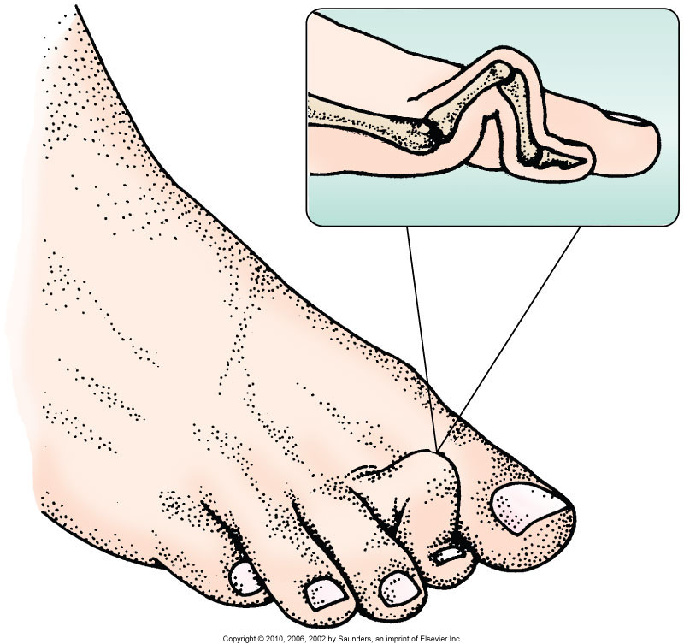
Hammertoe

Slide 24
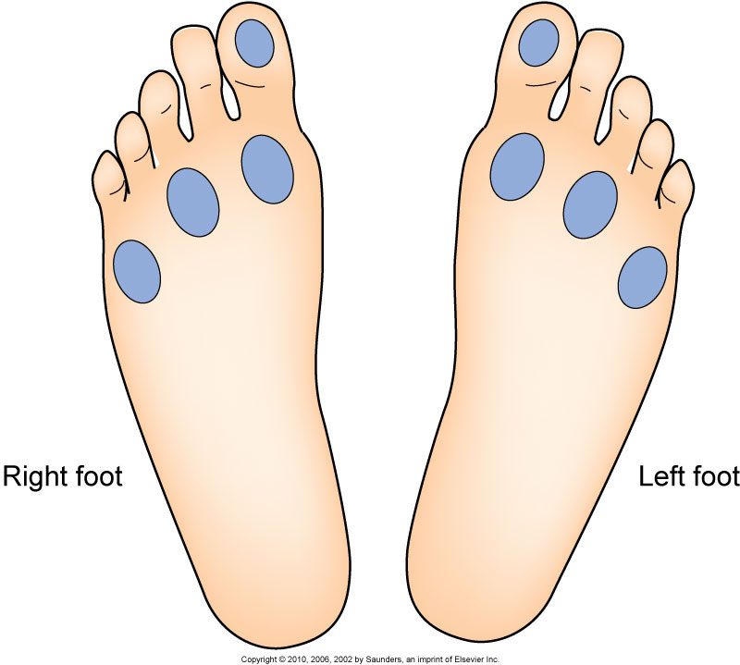
Testing Sensation

Slide 25
Wound Care
Wound environment
Débridement
Elimination of pressure
Growth factors

Slide 26
Chronic Pain
Neuropathic pain results from damage to the nervous system anywhere along the nerve
Pharmacologic agents
Nonpharmacologic interventions

Slide 27
Risk for Injury Related to Disturbed Sensory Perception: Visual
Interventions include:
Blood glucose control
Environmental management:
Incandescent lamp
Coding objects
Syringes with magnifiers
Use of adaptive devices

Slide 28
Ineffective Tissue Perfusion: Renal
Interventions include:
Control of blood glucose levels
Yearly evaluation of kidney function
Control of blood pressure levels
Prompt treatment of UTIs
Avoidance of nephrotoxic drugs
Diet therapy
Fluid and electrolyte management

Slide 29
Potential for Hypoglycemia
Blood glucose level <70 mg/dL
Diet therapy—carbohydrate replacement
Drug therapy—glucagon, 50% dextrose, diazoxide, octreotide
Prevention strategies for:
Insulin excess
Deficient food intake
Exercise
Alcohol

Slide 30
Potential for Diabetic Ketoacidosis
Interventions include:
Monitoring for manifestations
Assessment of airway, level of consciousness, hydration status, blood glucose level
Hyperglycemia management
Management of fluid and electrolytes

Slide 31
Potential for Diabetic Ketoacidosis (Cont’d)
Drug therapy goal—to lower serum glucose slowly
Management of acidosis
Patient education—prevention

Slide 32
Potential for Hyperglycemic-Hyperosmolar State (HHS)
Hyperosmolar state caused by hyperglycemia
Differences of DKA and HHS
Monitoring
Fluid therapy
Continuing therapy

Slide 33
Community-Based Care
Home care management
Health teaching
Health care resources

