Slide 1
Chapter 71
Care of Patients with Acute Renal Failure and Chronic Kidney Disease

Slide 2
Acute Renal Failure
Pathophysiology
Types of acute renal failure include:
Prerenal
Intrarenal
Postrenal

Slide 3
Types of Acute Renal Failure
Prerenal azotemia—renal failure caused by poor blood flow to the kidneys
Most commonly caused by hypovolemic shock and heart failure

Slide 4
Phases of Acute Renal Failure
Phases of rapid decrease in renal function lead to the collection of metabolic wastes in the body.
Phases include:
Onset phase
Oliguric phase
Diuretic phase
Recovery phase
Acute syndrome may be reversible with prompt intervention.

Slide 5
Health Promotion and Maintenance
Severe blood volume depletion can lead to renal failure even in people who have no known kidney problems
Continual assessment of I&O, blood volume depletion, laboratory values, use of nephrotoxic substances

Slide 6
Assessment
History
Physical assessment/clinical manifestations
Laboratory assessment
Imaging assessment
Other diagnostic tests

Slide 7
Drug Therapy
Cardioglycides
Vitamins and minerals
Synthetic erythropoietin
Phosphate binders
Notes:
Not parallel

Slide 8
Treatment
Nutrition therapy
Dialysis therapies:
Continuous renal replacement therapy
Continuous arteriovenous hemofiltration (CAVHD)
Continuous arteriovenous hemodialysis and filtration (CAVHD)
Hemodialysis
Peritoneal dialysis

Slide 9
Continuous Renal Replacement Therapy
Standard treatment
Dialysate solution
Vascular access
Continuous arteriovenous hemofiltration
Continuous venovenous hemofiltration

Slide 10
Posthospital Care
If renal failure is resolving, follow-up care may be required.
There may be permanent renal damage and the need for chronic dialysis or even transplantation.
Temporary dialysis is appropriate for some patients.

Slide 11
Chronic Kidney Disease
Progressive, irreversible kidney injury; kidney function does not recover
End-stage renal disease (ESRD)
Azotemia
Uremia
Uremic syndrome

Slide 12
Stages of Chronic Kidney Disease
Reduced renal reserve
Renal insufficiency
End-stage renal disease

Slide 13
Stages of Chronic Kidney Disease Changes
Kidney changes
Metabolic changes:
Urea and creatinine
Electrolytes changes:
Sodium
Potassium
Acid-base balance changes
Calcium and phosphorus changes

Slide 14
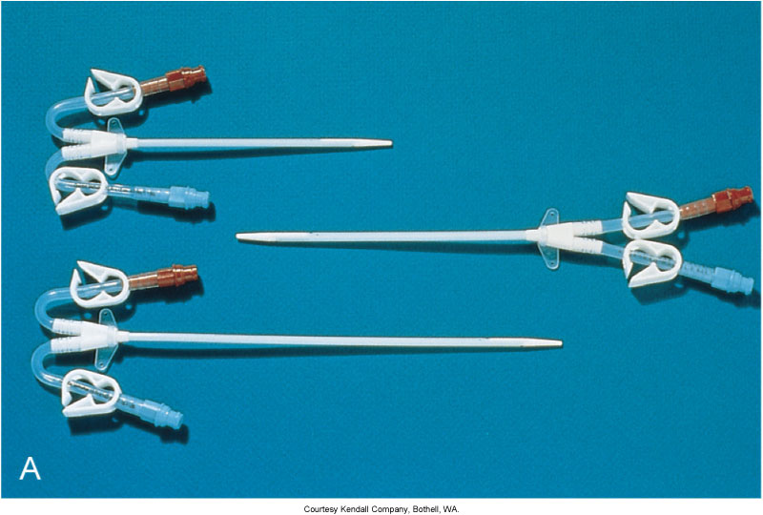
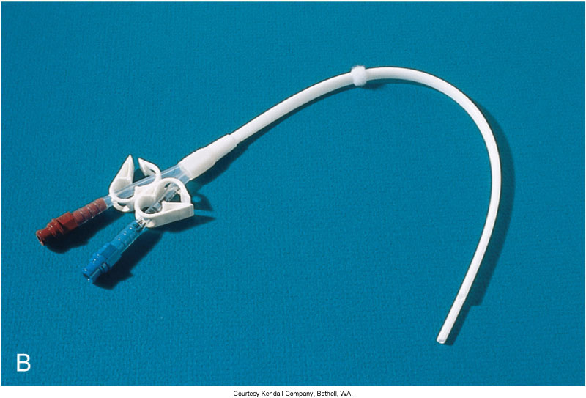
Calcium and Phosphate Balance

Slide 15
Stages of Chronic Kidney Disease Changes (Cont’d)
Cardiac changes:
Hypertension
Hyperlipidemia
Heart failure
Pericarditis
Hematologic changes
GI changes

Slide 16
Clinical Manifestations
Neurologic
Cardiovascular
Respiratory
Hematologic
Gastrointestinal
Skeletal
Urinary
Skin

Slide 17
Assessments
Psychosocial assessment
Laboratory assessment
Imaging assessment

Slide 18
Imbalanced Nutrition: Less Than Body Requirements
Interventions include:
Dietary evaluation for:
Protein
Fluid
Potassium
Sodium
Phosphorus
Vitamin supplementation

Slide 19
Excess Fluid Volume
Interventions:
Monitor intake and output.
Promote fluid balance.
Assess for manifestations of volume excess:
Crackles in the bases of the lungs
Edema
Distended neck veins
Drug therapy includes diuretics.

Slide 20
Decreased Cardiac Output
Interventions:
Control hypertension with calcium channel blockers, ACE inhibitors, alpha- and beta-adrenergic blockers, and vasodilators.
Instruct patient and family to monitor blood pressure, patient’s weight, diet, and drug therapy.

Slide 21
Risk for Infection
Interventions include:
Meticulous skin care
Preventive skin care
Inspection of vascular access site for dialysis
Monitoring of vital signs for manifestations of infection

Slide 22
Risk for Injury
Interventions include:
Drug therapy
Education to prevent fall or injury, pathologic fractures, bleeding, and toxic effects of prescribed drugs

Slide 23
Fatigue
Interventions:
Assess for vitamin deficiency, anemia, and buildup of urea.
Administer vitamin and mineral supplements.
Administer erythropoietin therapy for bone marrow production.
Give iron supplements as needed.

Slide 24
Anxiety
Interventions include:
Health care team involvement
Patient and family education
Continuity of care
Encouragement of patient to ask questions and discuss fears about the diagnosis of renal failure

Slide 25
Potential for Pulmonary Edema
Interventions:
Assess the patient for early signs of pulmonary edema.
Monitor serum electrolyte levels, vital signs, oxygen saturation levels, hypertension.

Slide 26
Hemodialysis
Patient selection
Dialysis settings
Procedure
Anticoagulation

Slide 27
Subclavian Dialysis Catheters

Slide 28
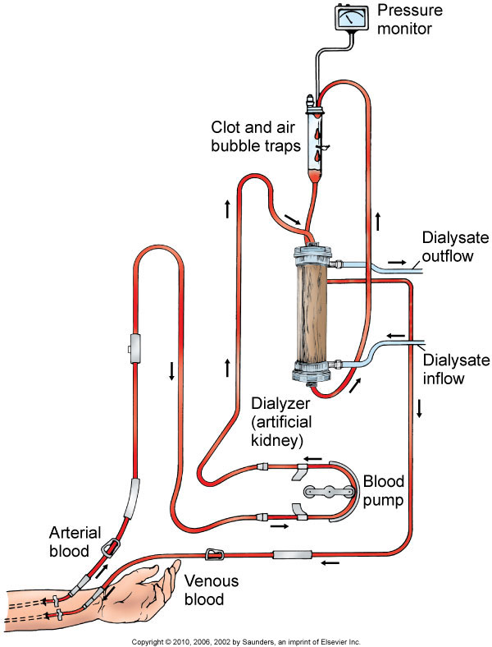
Hemodialysis Circuit

Slide 29
Vascular Access
Arteriovenous fistula or arteriovenous graft for long-term permanent access
Hemodialysis catheter, dual or triple lumen, or arteriovenous shunt for temporary access
Precautions
Complications

Slide 30
Complications
Thrombosis or stenosis
Infection
Aneurysm formation
Ischemia
Heart failure

Slide 31
Hemodialysis Nursing Care
Drugs
Post-dialysis assess for hypotension, headache, nausea, malaise, vomiting, dizziness, and muscle cramps or bleeding

Slide 32
Complications of Hemodialysis
Dialysis disequilibrium syndrome
Infectious disease
Hepatitis B and Hepatitis C
HIV

Slide 33
Peritoneal Dialysis
Procedure involves siliconized rubber catheter placed into the abdominal cavity for infusion of dialysate.
Types of peritoneal dialysis:
Continuous ambulatory peritoneal dialysis (CAPD)
Automated peritoneal dialysis
Intermittent peritoneal dialysis
Continuous-cycle peritoneal dialysis

Slide 34
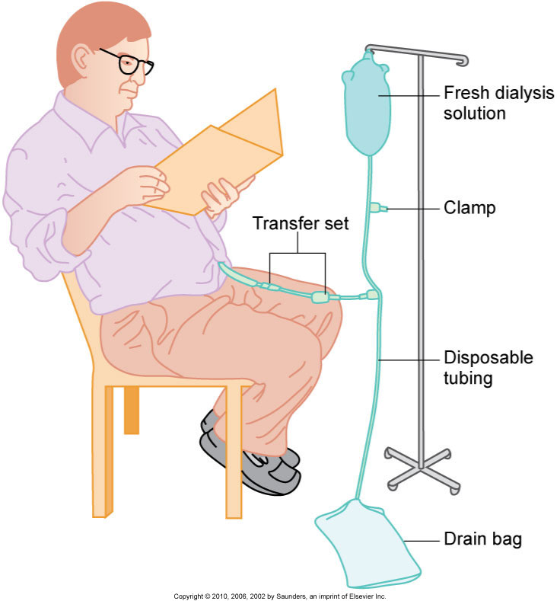
Peritoneal Dialysis Exchange

Slide 35
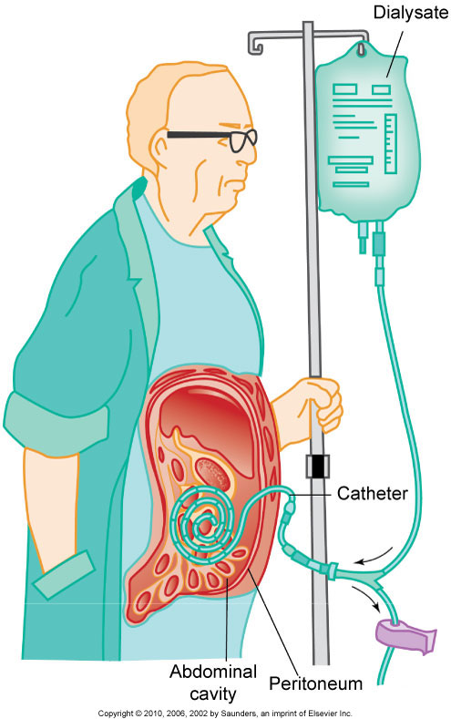
Continuous Ambulatory Peritoneal Dialysis (CAPD)

Slide 36
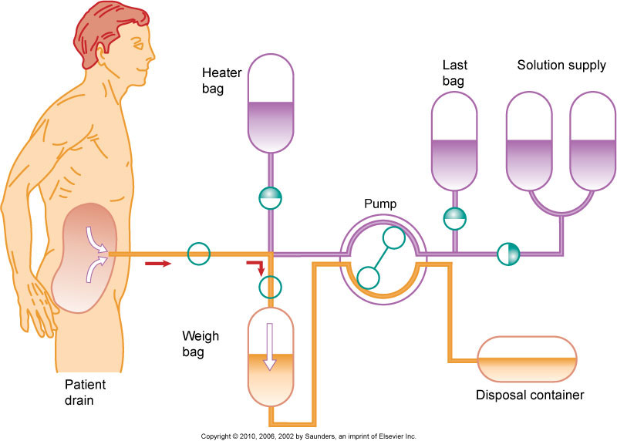
Automated Peritoneal Dialysis

Slide 37
Complications of Peritoneal Dialysis
Peritonitis
Pain
Exit site and tunnel infections
Poor dialysate flow
Dialysate leakage
Other complications

Slide 38
Nursing Care During Peritoneal Dialysis
Before treating, evaluate baseline vital signs, weight, and laboratory tests.
Continually monitor the patient for respiratory distress, pain, and discomfort.
Monitor prescribed dwell time, and initiate outflow.
Observe the outflow amount and pattern of fluid.

Slide 39
Renal Transplantation
Candidate selection criteria
Donors
Preoperative care
Immunologic studies
Surgical team
Operative procedure

Slide 40
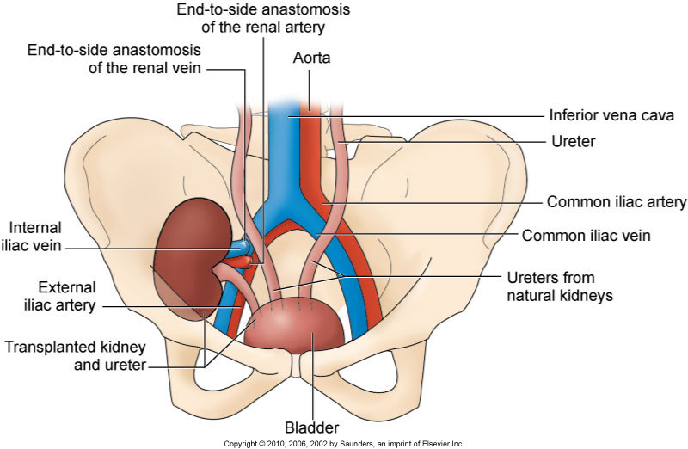
Transplanted Kidney

Slide 41
Postoperative Care
Urologic management
Assessment of urine output hourly for 48 hr
Complications include:
Rejection
Acute tubular necrosis

Slide 42
Postoperative Care (Cont’d)
Thrombosis
Renal artery stenosis
Other complications
Immunosuppressive drug therapy
Psychosocial preparation

Slide 43
Community-Based Care
Home care management
Health teaching
Psychosocial preparation
Health care resources

