Slide 1
Chapter 38
Care of Patients with Vascular Problems

Slide 2
Arteriosclerosis and Atherosclerosis
Arteriosclerosis—thickening or hardening of the arterial wall often associated with aging.
Atherosclerosis—type of arteriosclerosis involving the formation of plaque within the arterial wall.
Etiology and genetic predisposition:
Factors related to atherosclerosis include obesity, lack of exercise, smoking, and stress.

Slide 3
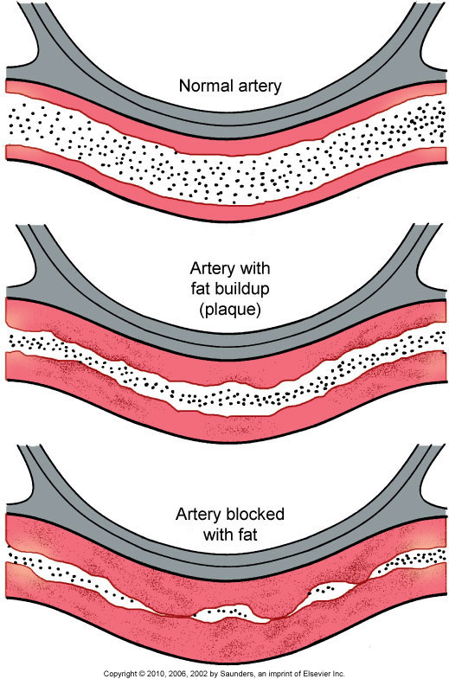
Atherosclerosis

Slide 4
Laboratory Assessment
Lipid level, including cholesterol and triglycerides, elevated
HDL and LDL
High serum levels of homocysteine can allow cell walls to become vulnerable to plaque buildup

Slide 5
Interventions
Evaluation of total serum cholesterol levels and lifestyle changes
Nutrition therapy
Smoking cessation
Exercise
National Cholesterol Education Program (NCEP)
Therapeutic Lifestyle Change (TLC) diet

Slide 6
Drug Therapy
HMG-CoA reductase inhibitors (statins)
Fibrinic acids
Zetia
Omacar

Slide 7
Hypertension
Hypertension—systolic blood pressure
≥ 145 mm Hg and/or diastolic blood pressure ≥ 90 mm Hg in people who do not have diabetes mellitus.
Patients with DM should have a BP below 130/90.
“Normal” adult systolic BP less than 120; diastolic less than 80.

Slide 8
Hypertension (Cont’d)
Prehypertensive systolic 120 to 139 and diastolic 80 to 89.
Isolated systolic hypertension.
Malignant hypertension is a severe type of elevated BP that rapidly progresses.

Slide 9
Essential Hypertension
Age greater than 60 years
Family history of hypertension
Excessive calorie consumption
Physical inactivity
Excessive alcohol intake
Hyperlipidemia
African-American ethnicity
High intake of salt or caffeine

Slide 10
Essential Hypertension (Cont’d)
Reduced intake of K, Ca, or Mg
Obesity
Smoking
Stress

Slide 11
Secondary Hypertension
Renal disease
Primary aldosteronism
Pheochromocytoma
Cushing’s syndrome
Medications

Slide 12
Assessment
Patient history
Physical assessment
Psychological assessment
Diagnostic assessment

Slide 13
Knowledge Deficit
Interventions include:
Sodium restriction
Weight reduction
Moderation of alcohol intake
Exercise
Relaxation techniques
Tobacco and caffeine avoidance

Slide 14
Drug Therapy
Diuretics
Calcium channel blockers
ACE inhibitors
Angiotensin II receptor antagonists
Aldosterone receptor antagonists
Beta-adrenergic blockers
Renin inhibitors
Central alpha agonists
Alpha-adrenergic agonists

Slide 15
Risk for Ineffective Therapeutic Regimen Management
Interventions include:
Teach medication compliance, usually for the rest of life.
Discuss goals of therapy, potential side effects, and how to identify potential problems.
Assist patient to understand therapeutic regimen.
Discuss consequence of noncompliance.

Slide 16
Peripheral Arterial Disease
Disorders that alter the natural flow of blood through the arteries and veins of the peripheral circulation

Slide 17
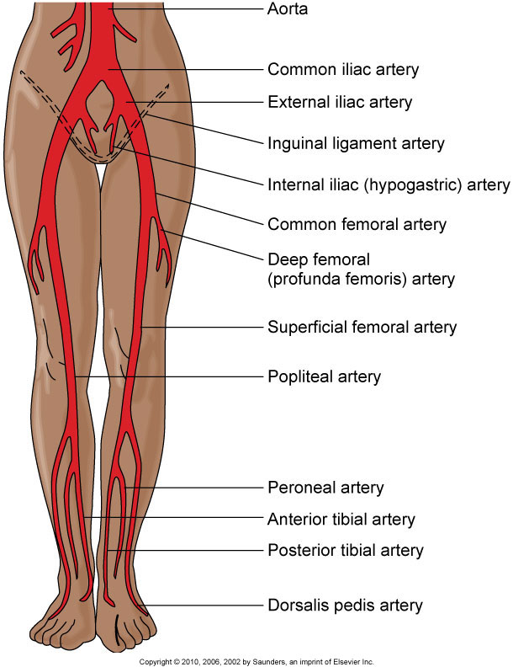
Lower Extremity Arterial Disease

Slide 18
Physical Assessment
Intermittent claudication
Pain that occurs even while at rest; numbness and burning
Inflow disease discomfort in the lower back, buttocks, or thighs
Outflow disease burning or cramping in the calves, ankles, feet, and toes

Slide 19
Physical Assessment (Cont’d)
Hair loss and dry, scaly, pale or mottled skin and thickened toenails
Severe arterial disease—extremity is cold and gray-blue or darkened; pallor may occur with extremity elevation; dependent rubor; and/or muscle atrophy

Slide 20
Diagnostic Assessments
Imaging assessment
Other diagnostic tests:
Ankle-brachial index (ABI)
Exercise tolerance testing
Plethysmography

Slide 21
Nonsurgical Management
Exercise
Positioning
Promoting vasodilation
Drug therapy
Percutaneous transluminal angioplasty
Laser-assisted angioplasty
Atherectomy

Slide 22
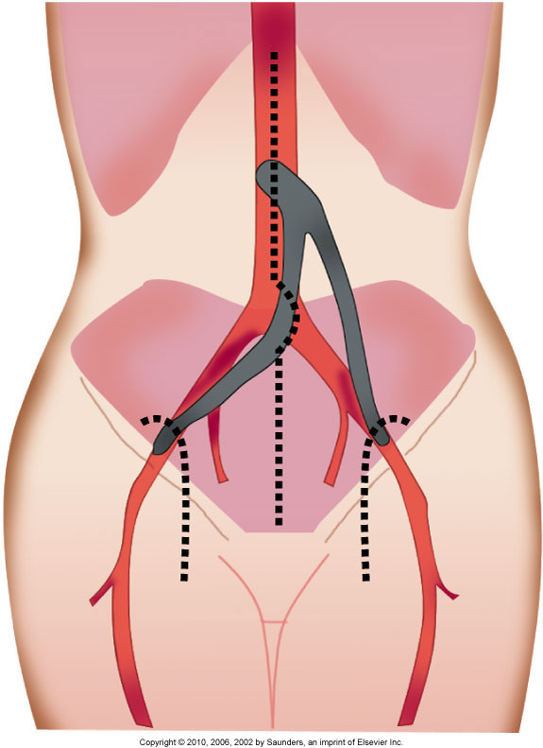
Surgical Management
Aortoiliac and aortofemoral bypass surgery

Slide 23
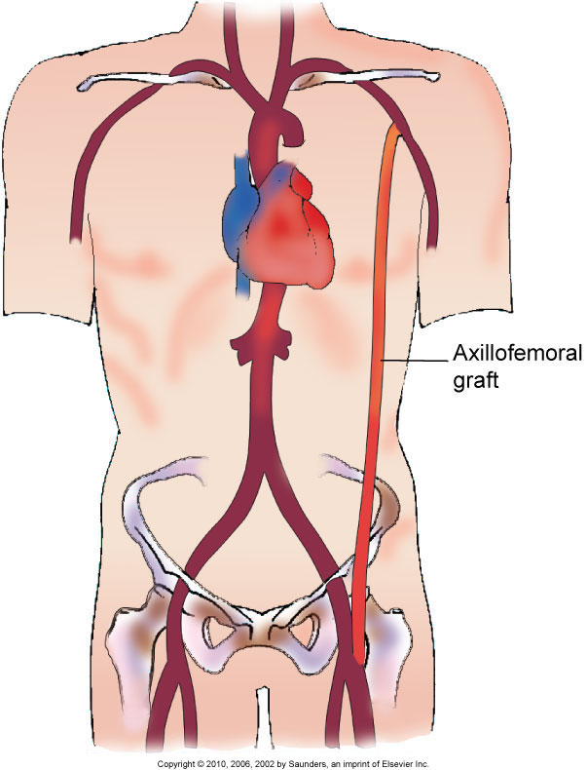
Axillofemoral Bypass Graft

Slide 24
Surgical Management
Preoperative
Intraoperative

Slide 25
Surgical Management (Cont’d)
Postoperative care:
Assessment for graft occlusion
Promotion of graft patency
Treatment of graft occlusion
Monitoring for compartment syndrome
Assessment for infection

Slide 26
Acute Peripheral Arterial Occlusion
Embolus—the most common cause of occlusions, although local thrombus may be the cause
Assessment—pain, pallor, pulselessness, paresthesia, paralysis, poikilothermia
Drug therapy
Surgical therapy
Nursing care

Slide 27
Aneurysms of Central Arteries
Aneurysm—a permanent localized dilation of an artery, enlarging the artery to twice its normal diameter
Fusiform aneurysm
Saccular aneurysm
Dissecting aneurysm (aortic dissection)
Abdominal aortic aneurysm
Thoracic aortic aneurysm

Slide 28
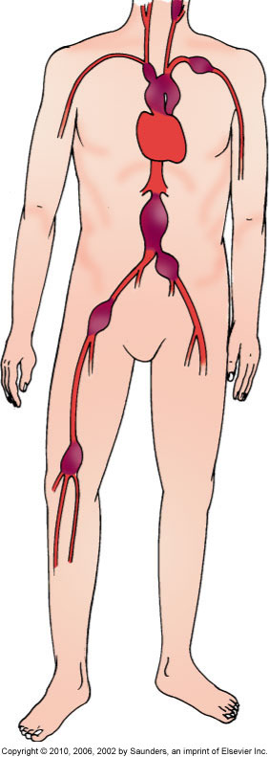
Arterial Aneurysms

Slide 29
Assessment of Abdominal Aortic Aneurysm (AAA)
Pain related to AAA is usually steady with a gnawing quality, is unaffected by movement, and may last for hours or days.
Pain is in the abdomen, flank, or back.
Abdominal mass is pulsatile.
Rupture is the most frequent complication and is life threatening.

Slide 30
Assessment of Thoracic Aortic Aneurysm
Assess for back pain and manifestation of compression of the aneurysm on adjacent structures.
Assess for shortness of breath, hoarseness, and difficulty swallowing.
Occasionally a mass may be visible above the suprasternal notch.
Sudden excruciating back or chest pain is symptomatic of thoracic rupture.

Slide 31
Diagnostic Assessment
X-ray “eggshell” appearance
CT
Aortic arteriography
Ultrasonography

Slide 32
Nonsurgical Management
Monitor the growth of the aneurysm.
Maintain BP at a normal level to decrease the risk of rupture.

Slide 33
Abdominal Aortic Aneurysm Resection
Preoperative care
Operative procedure
Postoperative care:
Monitor vital signs
Assess for complications
Assess for signs of graft occlusion or rupture

Slide 34
Thoracic Aortic Aneurysm Repair
Preoperative care
Operative procedure
Postoperative care assessments:
Vital signs
Complications
Sensation and motion in extremities
Respiratory distress
Cardiac dysrhythmias

Slide 35
Endovascular Repair of Abdominal Aortic Aneurysm
Patients selected for endovascular repair are generally at high risk for major abdominal surgery
Various designs
Benefits of endovascular repair
Complications of endovascular repair

Slide 36
Aneurysms of the Peripheral Arteries
Femoral and popliteal aneurysms
Symptoms—limb ischemia, diminished or absent pulses, cool to cold skin, and pain
Treatment—surgery
Postoperative care—monitor for pain

Slide 37
Aortic Dissection
May be caused by a sudden tear in the aortic intima, opening the way for blood to enter the aortic wall
Pain described as tearing, ripping, and stabbing

Slide 38
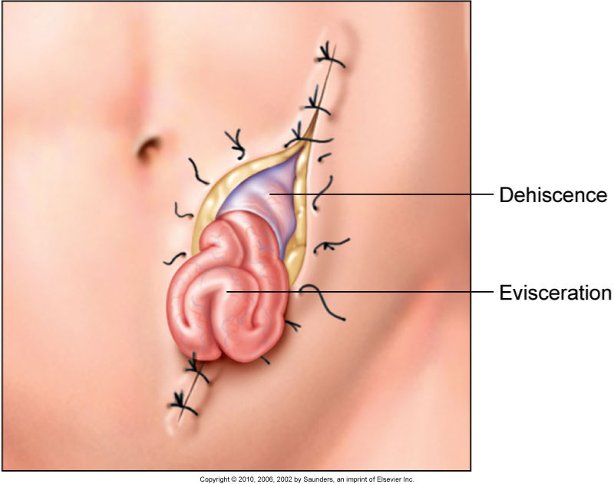
Aortic Dissection (Cont’d)

Slide 39
Aortic Dissection (Cont’d)
Emergency care goals include:
Elimination of pain
Reduction of blood pressure
Decrease in the velocity of left ventricular ejection
Nonsurgical treatment
Surgical treatment

Slide 40
Buerger’s Disease
Thromboangiitis obliterans—relatively uncommon occlusive disease limited to the medium and small arteries and veins
Often identified with tobacco smoking
Nursing interventions

Slide 41
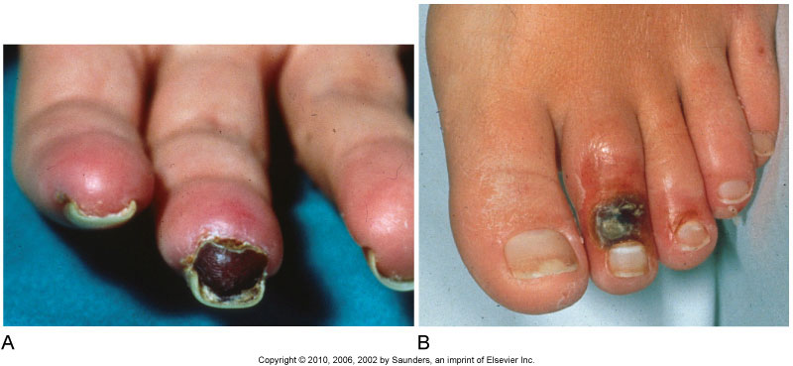
Buerger’s Disease (Cont’d)

Slide 42
Other Disorders
Subclavian steal occurring from artery occlusion or stenosis
Thoracic outlet syndrome resulting in arterial wall damage
Popliteal entrapment

Slide 43
Raynaud’s Phenomenon
Caused by vasospasm of the arterioles and arteries of the upper and lower extremities
Drug therapy—Procardia, Cyclospasmol, and Dibenzyline
Lumbar sympathectomy
Reinforcement of patient education; restriction of cold exposure

Slide 44
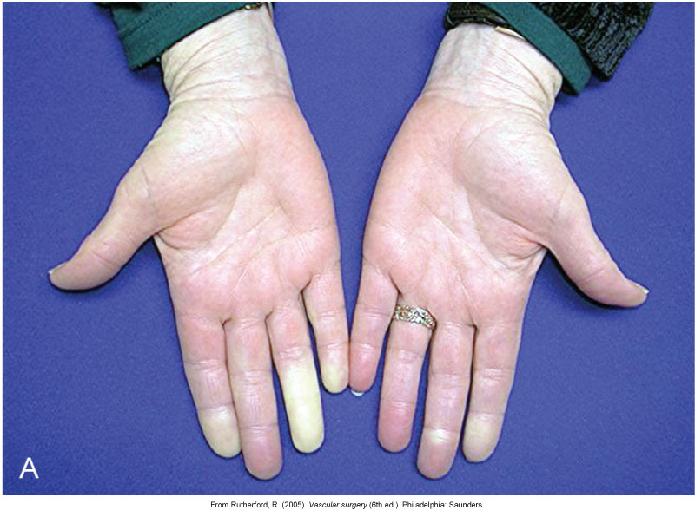
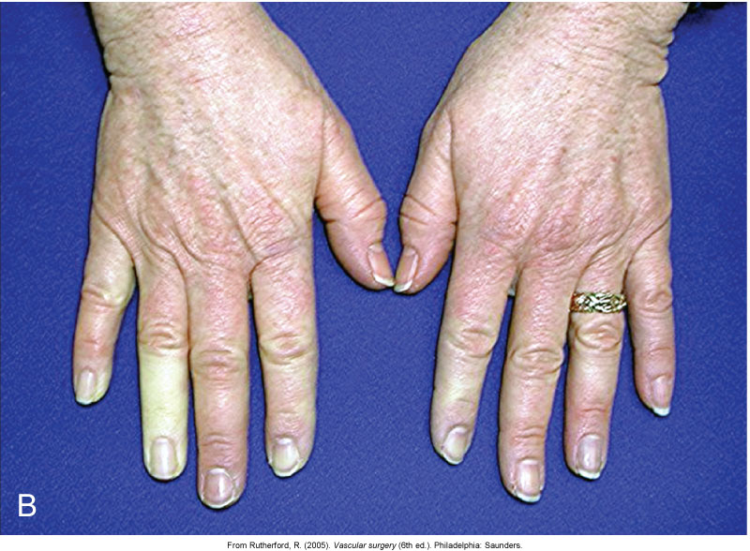
Raynaud’s Phenomenon (Cont’d)

Slide 45
Venous Thromboembolism
Thrombus—a blood clot
Thrombophlebitis
Deep vein thrombosis (DVT)
Pulmonary embolism
Virchow’s triad
Phlebitis

Slide 46
Assessment
Calf or groin tenderness or pain
Sudden onset of unilateral swelling of the leg
Checking Homans’ sign—not advised
Localized edema
Venous flow studies—venous duplex ultrasonography
MRI
D-dimer

Slide 47
Nonsurgical Management
Rest, drug therapy, preventive measures
Drug therapy includes:
Unfractionated heparin therapy
Low–molecular weight heparin
Warfarin therapy
Thrombolytic therapy

Slide 48
Surgical Management
Thrombectomy
Inferior vena caval interruption
Ligation or external clips

Slide 49
Venous Insufficiency
Result of prolonged venous hypertension, stretching veins and damaging valves
Stasis dermatitis, stasis ulcers
Management of edema
Management of venous stasis ulcers
Drug therapy
Surgical management

Slide 50
Varicose Veins
Distended, protruding veins that appear darkened and tortuous
Collaborative management includes:
Elastic stockings
Elevation of extremities
Sclerotherapy
Surgical removal of veins
Radio frequency energy to heat the veins

Slide 51
Phlebitis
Inflammation of the superficial veins
Management—warm, moist soaks and elastic stocking
Complications—tissue necrosis, infection, or pulmonary embolus

Slide 52
Vascular Trauma
Punctures
Lacerations
Transections
Assess for circulatory, sensory, or motor impairment

