Slide 1
Chapter 66
Care of Patients with Problems of the Thyroid and Parathyroid Glands

Slide 2
Hyperthyroidism
Thyrotoxicosis
Graves’ disease is the most frequent cause; usually has goiter, exophthalmos, pretibial myxedema
Assessment
History
Physical assessment
Clinical manifestations
Psychosocial assessment

Slide 3
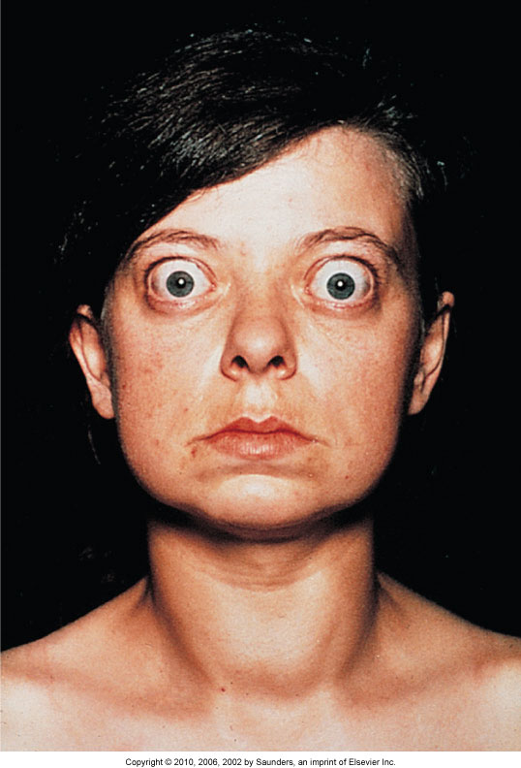
Exophthalmos

Slide 4
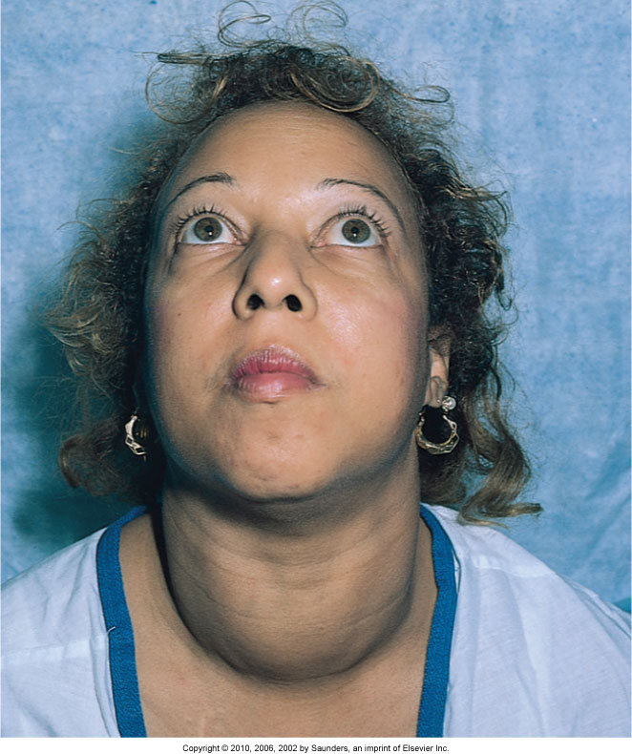
Goiter

Slide 5
Laboratory Tests
T₃, T₄, T₃RU, TSH, TSH-RAb
Thyroid scan
Ultrasonography
ECG

Slide 6
Nonsurgical Management
Monitoring
Reducing stimulation
Promoting comfort
Drug therapy—antithyroid drugs, iodine preparations, lithium, beta-adrenergic blocking drugs

Slide 7
Surgical Management
Total thyroidectomy, subtotal thyroidectomy
Postoperative complications:
Hemorrhage
Respiratory distress
Hypocalcemia and tetany
Laryngeal nerve damage
Thyroid storm or thyroid crisis
Eye and vision problems of Graves’ disease

Slide 8
Hypothyroidism
Decreased metabolism from low levels of thyroid hormones
Myxedema
Myxedema coma

Slide 9
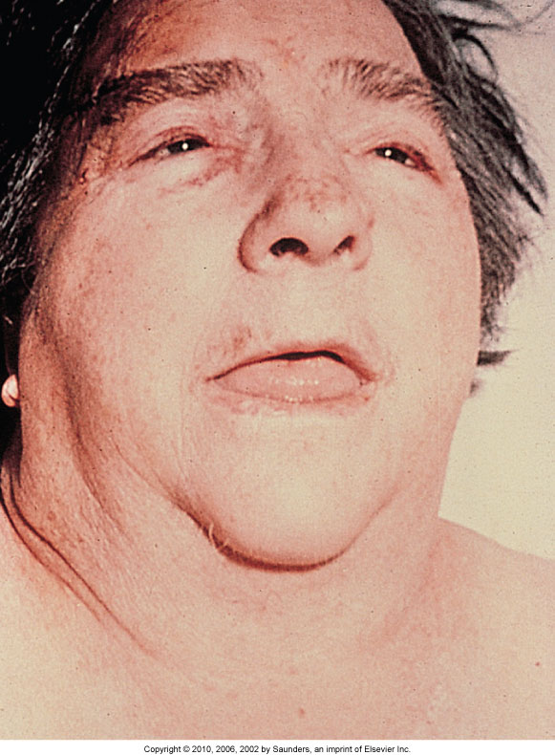
Myxedema

Slide 10
Hypothyroidism: Assessment
History
Physical assessment
Clinical manifestations
Psychosocial assessment
Laboratory assessment

Slide 11
Hypothyroidism: Community-Based Care
Home care management
Health teaching
Health care resources

Slide 12
Thyroiditis
Inflammation of the thyroid gland
Three types of thyroiditis—acute; subacute (granulomatous); and chronic (Hashimoto’s disease), the most common type
Nonsurgical management, drug therapy
Surgical management

Slide 13
Thyroid Cancer
Papillary, follicular, medullary, and anaplastic
Collaborative management
Surgery

Slide 14
Hyperparathyroidism
Parathyroid glands—calcium and phosphate balance
Hypercalcemia and hypophosphatemia

Slide 15
Hyperparathyroidism: Nonsurgical Management
Diuretic and hydration therapies
Monitoring
Preventing injury
Drug therapy

Slide 16
Hyperparathyroidism: Surgical Management
Parathyroidectomy

Slide 17
Hyperparathyroidism: Surgical Management (Cont’d)
Postoperative care includes:
Observe for respiratory distress.
Keep emergency equipment at bedside.
Hypocalcemic crisis can occur.
Recurrent laryngeal nerve damage can occur.

Slide 18
Hypoparathyroidism
Decreased function of the parathyroid gland
Iatrogenic hypoparathyroidism
Idiopathic hypoparathyroidism
Hypomagnesemia
Interventions—correcting hypocalcemia, vitamin D deficiency, and hypomagnesemia

