Slide 1
Creative Writing Blitz
English I

Slide 2
Directions
Open a blank Google document.
Title your document: Creative Writing Blitz.
Save you document in your writing (narrative) folder.
Choose Six of the following writing prompts and respond to them in your own creative way. Please number the prompts on your document.
Submit your document to Turnitin.com.

Slide 3
Point Value: 30 points
Each prompt you choose is worth five points.

Slide 4
Prompt #1
Create a dialogue between characters based on the following prompt:
Parents look on in horror as a magician’s trick goes horribly awry during a child’s birthday party.

Slide 5
Prompt #2
In 30 words or fewer, write an opening sentence—just one—to a story, incorporating the following words: lucky, charm, and sword.

Slide 6
Prompt #3
Write a concluding paragraph to the following prompt:
    You and he agreed on a meeting place in the event of a disaster. You are about to enter the place.

Slide 7
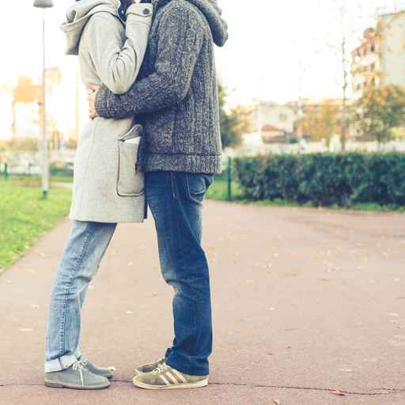
Prompt #4
Write the opening sentence (30 words or fewer) to a story based on the photo prompt below.

Slide 8
Prompt #5
Turn a story you have read or seen into a poem. Be sure to share with your teacher the inspiration for your poem (the book’s title or the movie’s title).

Slide 9
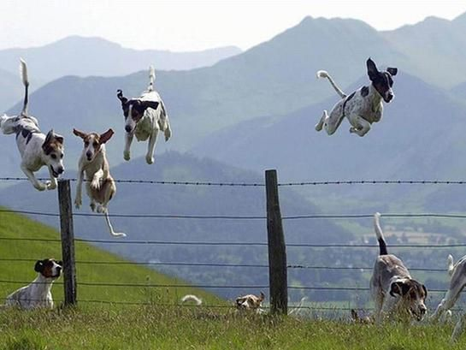
Prompt #6
Tell this story. One paragraph should do it.

Slide 10
Prompt #7
List seven good reasons for stopping a wedding. Be sure to use complete sentences.

Slide 11
Prompt #8
List seven good reasons why your story should not be told. Be sure to use complete sentences.

Slide 12
Prompt #9
List the seven worst things you could say to someone who just got dumped. Be sure to use complete sentences.

Slide 13
Prompt #10
List seven original things you can do with toilet paper. Be sure to use complete sentences.

Slide 14
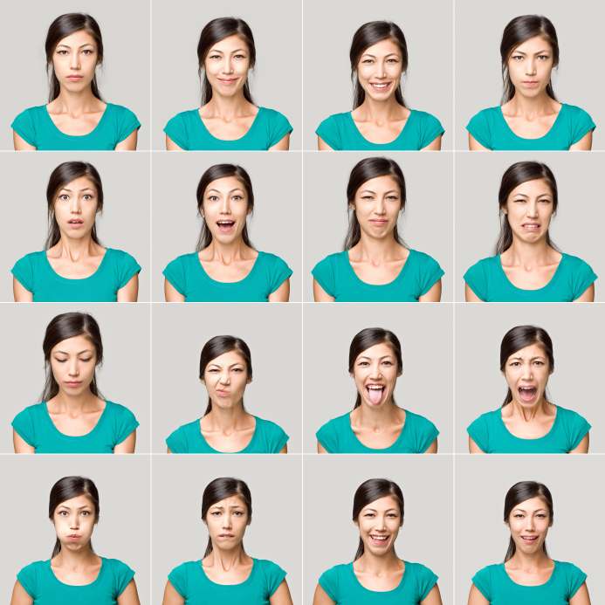
Prompt #11
From left to right,
and top to bottom,
describe the emotions
of the girl using tier-2
vocabulary (avoid
using bland descriptors).
Sixteen adjectives will
Be sufficient.

Slide 15
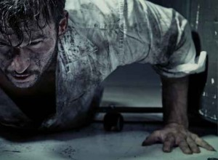
Prompt #12
In a paragraph, describe the man in the image below.

Slide 16
Prompt #13
In a paragraph, describe the human equivalent of war (how would he/she look, act, dress, speak, think).

Slide 17
Prompt #14
On your document, upload an image of a person wearing black and describe him or her in a paragraph.

Slide 18
Prompt #15
Find an image and write the opening sentence (30 words or fewer) to a story based on the photo that you have chosen. Be sure to include your image with your opening sentence.

Slide 19

Prompt #16
Write the opening paragraph (just one paragraph) to a story based on the photo below. You can be funny, poignant, witty, etc.

Slide 20
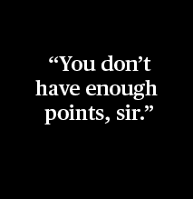
Write an introductory paragraph using the quote below as the opening to the story.
Prompt #17

