Slide 1
Etymology of a Mythical Word
English I

Slide 2
What should my presentation include?
Slide 1: Title Slide: Includes god’s/goddess’ name and the contemporary word (2 pts.)
Slide 2: English Word, Part of Speech, Definition (3 pts.)
Slide 3: Relevant image (photo, painting, chart, graph, etc.) for the English word (3 pts.)
Slide 4: Use the English word in a sentence including underlined/highlighted context clue(s) (3 pts.)
Slide 5: Introduce the Norse/Greek/Roman deity who is the root of your English word (include an image of the deity) (3 pts.)
Slide 6: 5 facts about the deity (Include another image) (3 pts.)
Slide 7: 2-3 minute video clip (optional)
Slide 8: MLA formatted works cited page including citations for websites referenced and images used (minimum 4 sources) (3 pts.)
Overall Presentation: Eye contact and delivery (5 pts.)

Slide 3
Point Value: 25 for each student
Students can elect to work with a partner or go solo.

Slide 4
What should I consider when presenting?
I should be knowledgeable about my Norse, Greek, or Roman deity so that I don’t have to read constantly from the slides. I am using my slides as a tool. My slides should not speak for me.
I should be engaging by showing interest in my topic.
I should share the presentation time and work equally with my partner (if applicable).
I should connect between the English word and its Norse/Greek/Roman history.

Slide 5
Words and their Roots: Choose a Word to Research
Atlas-Atlas
Hypnosis-Hypnos
Chaos-Khaos
Narcissism-Narcissus
Typhoon- Typhon
Cereal- Ceres
Echo- Echo
Hypnosis-Hypnos
April-Aphrodite
Music/museum- Muses
Panic- Pan
Titanic- Titans
Siren- Sirens
Iridescent- Iris
Psyche- Psykhe
Lunatic- Luna
Night-Nyx
Ocean-Okeanos
Zephyr-Zephyrus

Slide 6
Words and their Roots: Choose a Word to Research
Marshal- (Roman) Mars
Tantalize- Tantalus
Nike- Nike
Odyssey- Odysseus
Nemesis- Nemesis
Wednesday-Woden
Friday-Frigga
March-Mars
Nectarine-Nectar
Fury-The Furies (Erinyes)
Charity-Charis
Arachnid- Arachne
Pandora- Pandora
Fortune- Fortuna
Volcano- Vulcan
Thursday-Thor
Herculean-Hercules
Concord-Concordia
Harmony-Harmonia

Slide 7
Words and their Roots: Choose a Word to Research
Flowers-Flora
Peace-Pax
Nike- Nike
Terminal-Terminus
Neptune-Neptune
Saturn-Saturnus
Jupiter-Jupiter
Amazon-Amazonians
Aurora-Aurora Borealis
Spartan-Spartans (Sparta)
Or, you can pick your own from outside of this list

Slide 8
Here are a few helpful websites
Greek Gods & Goddesses
https://www.greekmythology.com/
https://www.greek-gods.org/
https://pantheon.org/mythology/greek/
https://www.history.com/topics/ancient-history/greek-mythology
Roman Gods & Goddesses
https://www.ancient.eu/Roman_Mythology/
https://www.unrv.com/culture/mythology.php
https://greekgodsandgoddesses.net/roman/
http://www.ancient-mythology.com/roman/

Slide 9
A Sample Slideshow

Slide 10
January
Mr. Boesch and Mrs. Armstrong

Slide 11
January
Part of Speech: Noun
Definition: The first month of the Gregorian calendar.

Slide 12
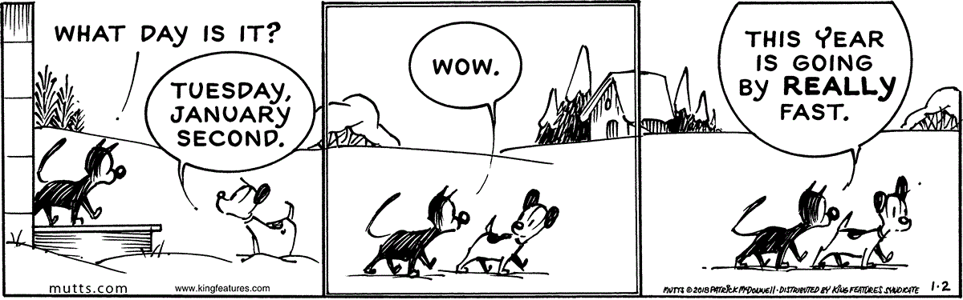
“January” in an Image

Slide 13
“January” in a Sentence
January is a time for New Year’s resolutions; it is a time to look at the past and take hold of the future.

Slide 14
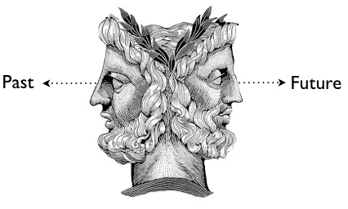
Janus, God of the Threshold

Slide 15
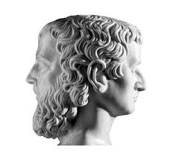
Facts about Janus
Two faced god in Roman mythology who guarded the gate of heaven.
Generally regarded as the god of opposites.
Presided over the beginning and end of conflict, war and peace. The doors to his temple were open in times of war and closed in times of peace.

Slide 16
Facts about Janus
Unlike most Roman gods, the Greeks did not have an equivalent deity.
He typically symbolized change or transitions.
He joined the Titans in their fight against the Olympians in the Titan War.

Slide 17
Any Questions?

Slide 18
Works Cited
Alchin, Linda. "Janus." Janus ***. Siteseen Ltd., 2017. Web. 16 Mar. 2017. <http://www.talesbeyondbelief.com/roman-gods/janus.html>.
Bardot, Michael. “Janus: Past and Future.” Myths of the World, Mythology.com), Web. 18 Mar. 2018, <https://www.greekmythology.com/Myths/Roman/Janus/janus.html.>
"January." Merriam-Webster. Merriam-Webster, n.d. Web. 16 Mar. 2017. <https://www.merriam-webster.com/dictionary/January>.
Lemkin, Jason. "10 SaaS New Year Resolutions For You. A Pick List." SaaStr. N.p., 10 Jan. 2017. Web. 16 Mar. 2017. <https://www.saastr.com/10-saas-new-year-resolutions-for-you/>.
Mostak, Todd. "The Janus Post: Looking Back on 2017 and Forward to 2018." MapD Blog. MapD Blog - Thoughts on GPU Databases, Data Visualization and Integrated Analytics, 24 Dec. 2016. Web. 16 Mar. 2018. <https://www.mapd.com/blog/2016/12/23/the-janus-post/>.

