Slide 1
Chemistry Chapter 5
Electrons in Atoms

Slide 2
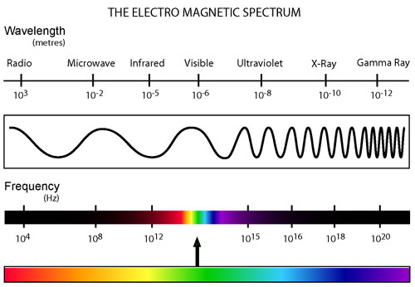
Light
Is a form of electromagnetic radiation.
In some ways it behaves as a wave.

Slide 3
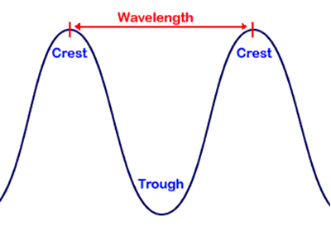
Wavelength
The distance from a point in one wave to the same point in the next wave.

Slide 4
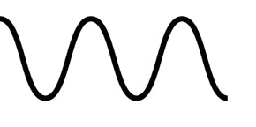
Frequency
The number of waves that pass a point in a second.
Measured in Hertz (Hz)

Slide 5
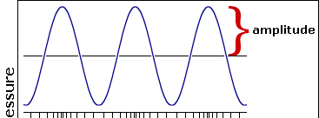
Amplitude
The height of a wave from the origin to the crest or the origin to the trough.

Slide 6
Electromagnetic Wave Relationship
c=λυ
C- speed
λ − wavelength
υ − frequency

Slide 7
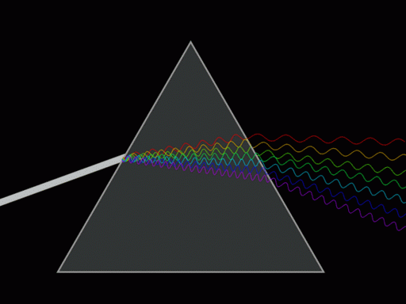

Slide 8
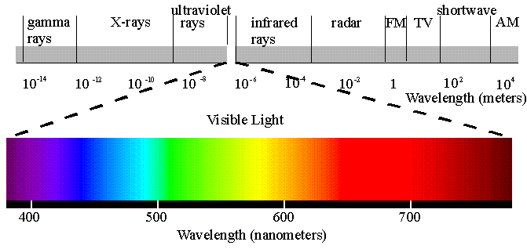
Electromagnetic Spectrum
All of the different types of electromagnetic radiation. The only difference is the wavelength and frequency.

Slide 9
Light as a dual nature
Light has wave properties, but in some ways it acts just like a particle.
Quantum – the minimum amount of energy an atom can lose.

Slide 10
Photoelectric effect

Slide 11
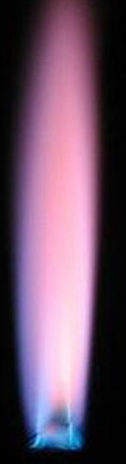
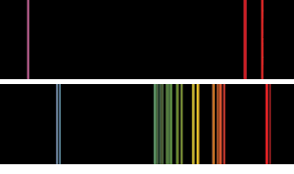
Atomic Emission Spectrum
The electromagnetic wavelengths or frequencies emitted by the atoms of an element.

Slide 12
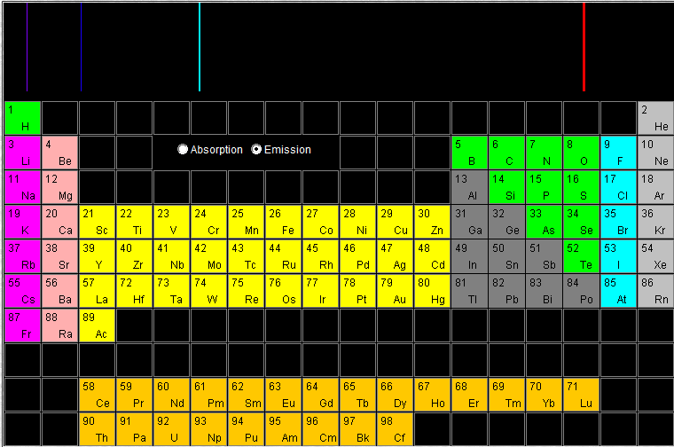

Slide 13
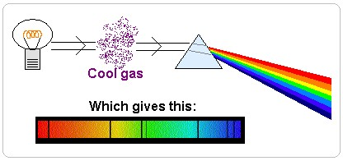
Atomic Absorption Spectrum
The electromagnetic wavelengths or frequencies absorbed by the atoms of an element.

Slide 14
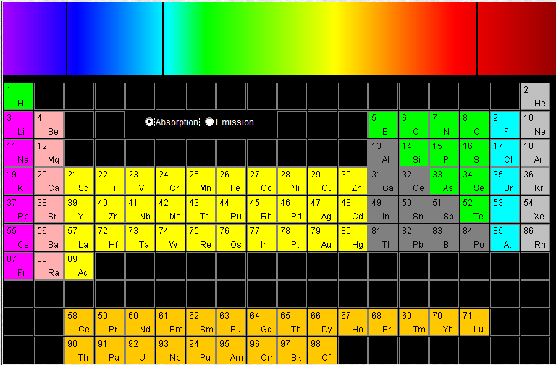

Slide 16
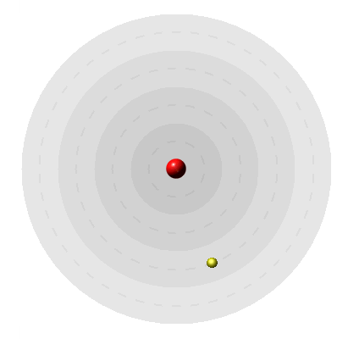
Quantum Theory and the Atom

Slide 17
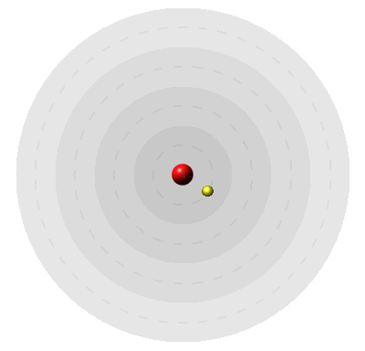
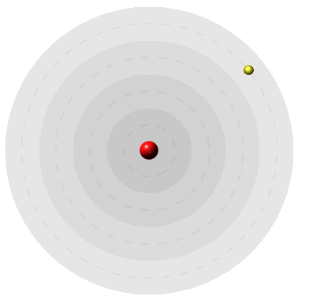
Bohr’s Model of the Atom
Niels Bohr explained the hydrogen emission spectrum.
Ground State is the lowest energy level possible for an atom

Slide 18
Electron’s Location
An atomic orbital describes the probable location of an electron in an atom.
Each orbital can hold 2 electrons spinning in the opposite direction.

Slide 19
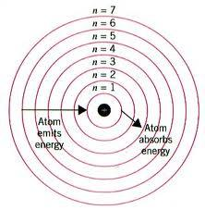
Principle Quantum Number = Principle Energy Level

Slide 20
Energy sublevels
Each energy level is made up of sublevels.
Sublevels are identified by the letters s, p, d and f.
Each increase in energy level adds 1 sublevel.

Slide 21
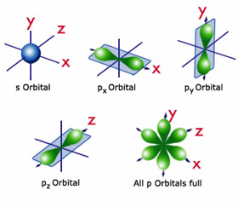
S sublevel (spherical)
Each energy level starts with an S sublevel.
The S sublevel only has one orbital and can hold 2 electrons.

Slide 22
P sublevel
P sublevels are made up of 3 dumbbell shaped orbitals.
P sublevels can hold 6 total electrons.

Slide 23
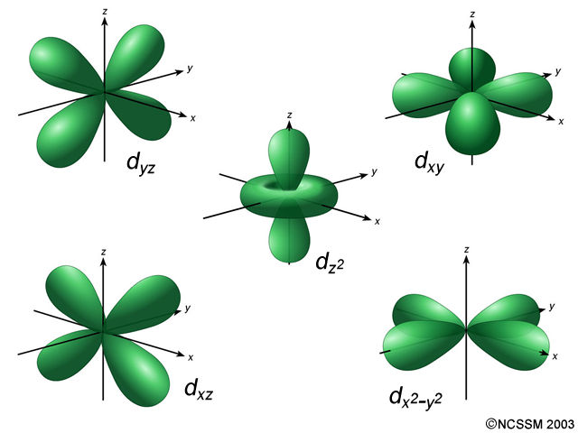
D sublevels
D sublevels contain 5 orbitals.
This allows them to hold 10 electrons

Slide 24
Energy Level | Sublevels | Number of orbitals in each sublevel | Number of orbitals in energy level | Number of Electrons
1 | s | 1 | 1 | 2
2 | s p | 1 3 | 4 | 8
3 | s p d | 1 3 5 | 9 | 18
4 | s p d f | 1 3 5 7 | 16 | 32

Slide 25
Electron Configuration
The arrangement of electrons in an atom
Aufbau principle
Pauli exclusion principle
Hund’s Rule

Slide 26
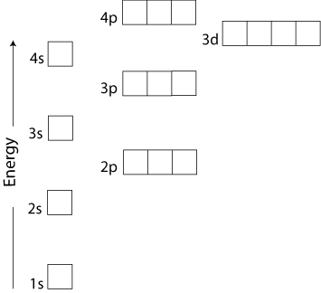
Aufbau principle
Electrons will occupy the lowest energy orbital available.
17
18
1s
2s 2p
3s 3p 3d
4s 4p 4d 4f
5s 5p 5d 5f
6s 6p 6d
7s 7p
16
11
12
13
14
15
10
7
8
9
6
3
4
5
2
1

Slide 27
Pauli Exclusion Principle
States that each orbital can hold 2 electrons, but only if the electrons have opposite spin.

Slide 28
Hund’s Rule
Each orbital in the same sublevel must have one electron with the same spin before any electrons will pair up in the same orbital.
2p

Slide 29
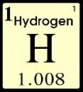
Orbital Diagrams
1s 2s 2p 3s 3p
Notation
1s¹

Slide 30

Orbital Diagrams
1s 2s 2p 3s 3p
Notation
1s²

Slide 31
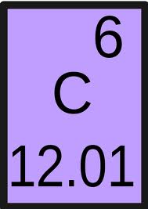
Orbital Diagrams
1s 2s 2p 3s 3p
Notation
1s²2s²2p²
Nobel Gas Notation
[He]2s²2p²

Slide 32
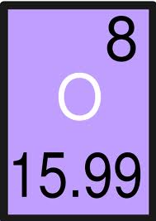
Orbital Diagrams
1s 2s 2p 3s 3p
Notation
1s²2s²2p⁴
Nobel Gas Notation
[He]2s²2p⁴

Slide 33

Orbital Diagrams
1s 2s 2p 3s 3p
Notation
1s²2s²2p⁶
Nobel Gas Notation
[He] 2s²2p⁶

Slide 34

Orbital Diagrams
1s 2s 2p 3s 3p
Notation
1s²2s²2p⁶3s²3p²
Nobel Gas Notation
[Ne]3s²3p²

Slide 35
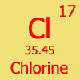
Orbital Diagrams
1s 2s 2p 3s 3p
Notation
1s²2s²2p⁶3s²3p⁵
Nobel Gas Notation
[Ne]3s²3p⁵

Slide 36
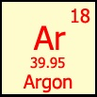
Orbital Diagrams
1s 2s 2p 3s 3p
Notation
1s²2s²2p⁶3s²3p⁶
Nobel Gas Notation
[Ne] 3s²3p⁶

Slide 37
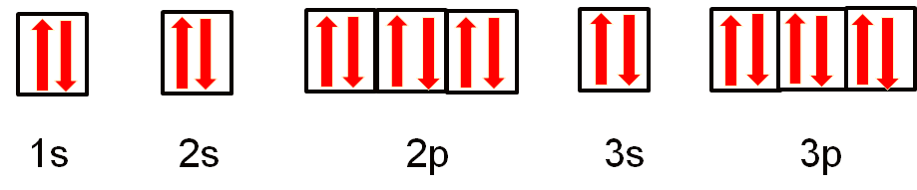
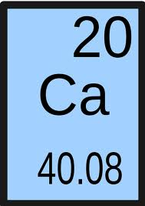
Orbital Diagrams
4s 3d 4p
Notation
1s²2s²2p⁶3s²3p⁶4s²
Nobel Gas Notation
[Ar]4s²

Slide 38

Orbital Diagrams
4s 3d 4p
Notation
1s²2s²2p⁶3s²3p⁶4s²3d⁶
Nobel Gas Notation
[Ar]4s²3d⁶

Slide 39
Exceptions
Sublevels are more stable when they are full or half full.
Some elements will move an electron up in energy to half fill or fill a d sublevel

Slide 40
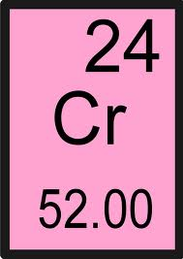
Predicted Orbital Diagrams
4s 3d 4p
Predicted Notation
1s²2s²2p⁶3s²3p⁶4s²3d⁴
Nobel Gas Notation
[Ar]4s²3d⁴

Slide 41
Predicted Orbital Diagrams
4s 3d 4p
Actual Notation
1s²2s²2p⁶3s²3p⁶4s¹3d⁵
Nobel Gas Notation
[Ar]4s¹3d⁵

Slide 42

Predicted Orbital Diagrams
4s 3d 4p
Predicted Notation
1s²2s²2p⁶3s²3p⁶4s²3d⁹
Nobel Gas Notation
[Ar]4s²3d⁹

Slide 43
Actual Orbital Diagrams
4s 3d 4p
Actual Notation
1s²2s²2p⁶3s²3p⁶4s¹3d¹⁰
Nobel Gas Notation
[Ar]4s¹3d¹⁰

Slide 44
Valence Electrons
Electrons that are located in the outermost energy level

Slide 45
Electron dot structures
(aka Lewis dot diagrams)

Slide 46
Lewis Dot Diagrams
Symbols that show an element and it’s valence electrons
Ca

Slide 47
N

Slide 48
F

Slide 49
C

Slide 50
Ne

Slide 51
Draw Lewis Dot Diagrams for the following
Cl
O
Al
Sr
Pb

