Slide 1
SOCI 1010 Week 7
July 23, 2018

Slide 2
Agenda
Review components of culture
Film clip: “The Gods Must Be Crazy”
Discuss how components of culture vary in “size” from culture to culture
Discuss the levels of societal development in context with the film and our own culture

Slide 3
Components of Culture
Material Culture
Normative Culture
Non Material Culture
Cognitive Culture
Notes:
There are three main components of culture. The material and the two aspects of the non-material culture: the cognitive and the normative. The circles are drawn as over-lapping because the components are so connected to one another. For every thing (ie, toaster) you have to have some cognitive information or knowledge (how to plug it in; where to insert the bread; how to push it down and set the control to achieve the appropriate shade) and some norms or rules (don’t immerse it in water; don’t stick a fork or other metal tool into). Further, if you’re mad at your brother, you should not bonk him on the head with the toaster.

Slide 4
The Gods Must Be Crazy

Slide 5

Societies and the Major Social Revolutions

Slide 6
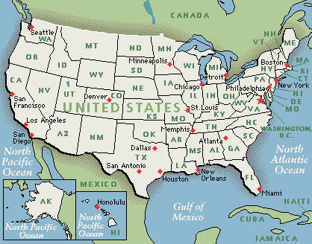
What is a Society?
A group of people who share a culture and a territory
Example - United States

Slide 7
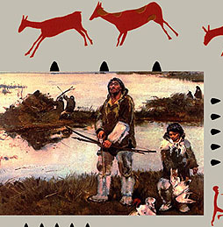
Hunting and Gathering Societies
Simplest type
People rely on vegetation and game
Small (25-40 people)
Nomadic
Most egalitarian of all societies

Slide 8
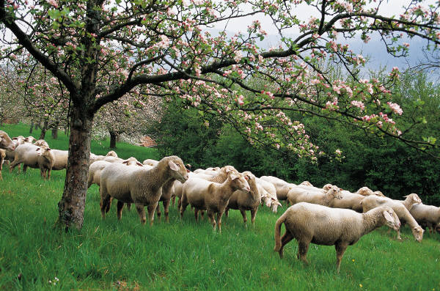

Societies Branched in One of Two Directions
Key to first branching is pasture - Pastoral Societies are based on pasturing of animals.
Key to second branching is horticulture - Horticulture Societies are based on the cultivation of plants by the use of hand tools.

Slide 9
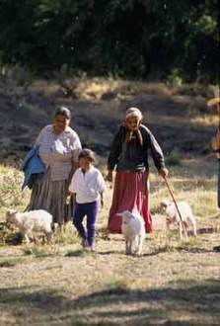
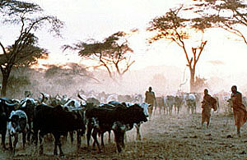
Pastoral Societies
Based on the pasturing of animals
Developed in arid areas
Remained nomadic

Slide 10
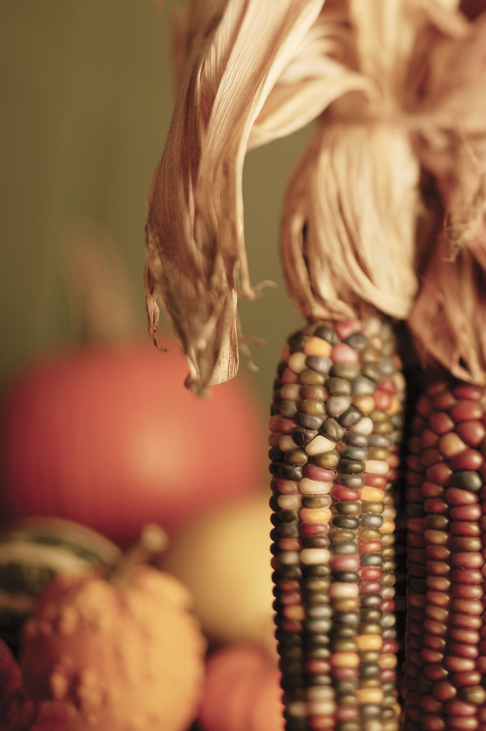
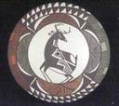
Horticultural Societies
Societies in which people plant gardens for subsistence.
No longer having to abandon an area as the food supply gave out, these groups developed permanent settlements.

Slide 11
The Agricultural Revolution
Occurred about five or six thousand years ago
Ushered in by invention of the plow, marking large-scale agricultural production possible, and leading to agrarian societies.

Slide 12
Agrarian Societies
Based on agriculture
More efficient - huge surplus
More complex division of labor
Considerable inequality
Cities develop
Rapid population growth

Slide 13
The Industrial Revolution
Began around 1764
Third major social revolution
Ushered in by invention of steam engine

Slide 14

Industrial Societies
Rely on machines powered by fuels
Increased efficiency of production
Greater surplus
Rapid population increase
Inequality increased at first; later wealth was more widely shared

Slide 15


The Information Revolution
Emerging new social
revolution ushered in by
chip

Slide 16

Postindustrial Societies
Dominated by information, services, and high technology more than the production of goods
United States was 1st country to have over half of its work force employed in service industries.
http://web.missouri.edu/~socbrent/timeline.htm

Slide 17
Examples of Societies
Hunting and gathering (!Kung, Plains Indians – Buffalo culture)
Herding (Bedouins, Laplanders, Navajo)
Horticultural (early farming communities)
Agricultural (pioneer Americans in Nebraska and Iowa) Industrial (Mexico and many European countries)
Post-Industrial (U.S., Japan, much of Europe)
Notes:
Once we have an understanding of the the three major components of culture (material, cognitive, and normative), we can compare one level of societal development with another. Throughout history and simultaneously at any point, societies reach various stages or levels of development.
If you watched “The Gods Must be Crazy” for Chapter 1 or if you have seen “Dances with Wolves,” you have observed the subsistence-level culture of hunter/gatherers.
Some cultures have settled in areas with fertile plant growth or with animals (goats, sheep, reindeer) that can be domesticated and herded.
Increased application of technology to farming (plow, irrigation, hybridization of seeds) allow for the development of a surplus and the move into an agricultural level of society. Rural America still functions at this level.
The surplus frees some individuals from the daily necessity to get food and enables them to trade their labors in arts, crafts, teaching, healing or religious work for food or money to purchase food.
This led the way to the development of industrial and post-industrial cultures. See Chapter 14 for more information on modernization, industrialization and urbanization.

