Slide 1
Welcome!
Determining Average
Eligibility for Special Needs Programs

Slide 2
Exceptional Needs
Learning disabilities
Dyslexia
Dyscalcula
Dysgraphia
Dysnomia
ADD/ADHD

Slide 3
Discrepancy Criterion
Aptitude and performance are more than 2 years different
aptitude testing
achievement testing
raw score (percent of total possible)
percentile (compared to reference pop.)

Slide 4
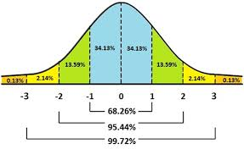
Normal Curve

Slide 5
Determining Average
Mean = arithmetic average sum of X N
Median = midpoint
(middle number with an odd number of subjects; average of the two middle numbers with an even number of subjects)
Mode = most frequent observation in an array of scores

Slide 6
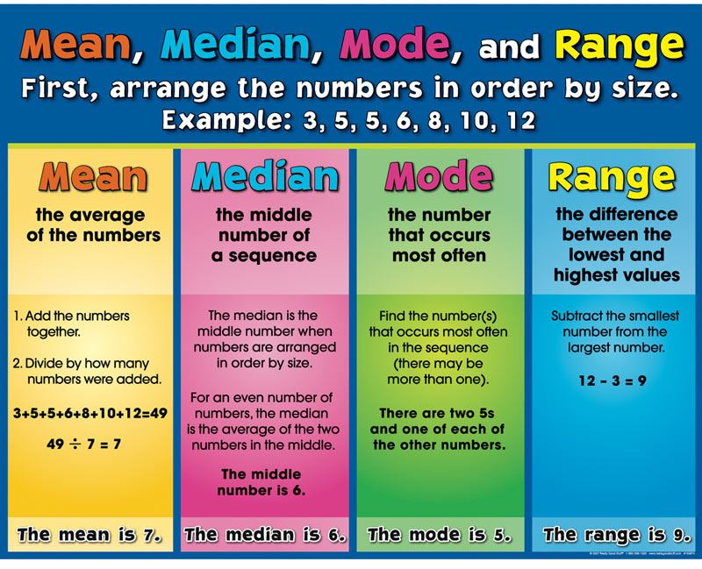

Slide 7
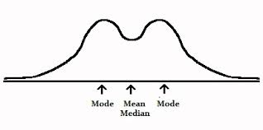
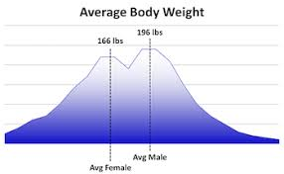
Bimodal Distributions

Slide 8
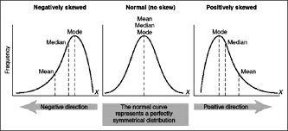
Skewed Distributions

Slide 9
Final thoughts regarding Learning Disabilities and Normal Human Behavior

Slide 10

Beyond FAT City Workshop Richard Lavoie
When Elephants Fight
Make Them Beautiful Again?

