Slide 1
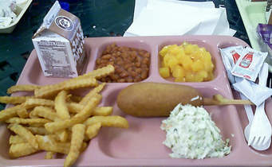
PSYC 1120 July 23, 2018

Slide 2
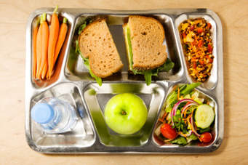
Agenda
Beyond FAT City
What People Eat and How Much they Spend
Nutritional Issues
Fast Food
Menu planning activity

Slide 3
Beyond FAT City
Application of the principles to any situation
Some learning differences are not “curable” but strategies to cope can be developed
Early intervention is important
Individual differences are important – we can’t have “one size fits all” educational programs

Slide 4
What’s wrong with this picture?

Slide 5
What’s right with this picture?

Slide 6
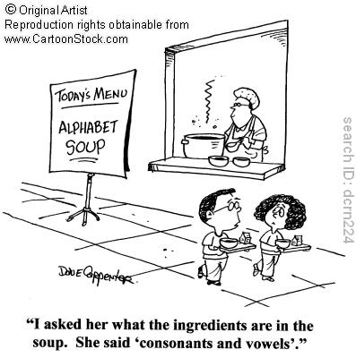

Slide 7

What People Eat and What They Spend for it.

Slide 8
What is your food budget for one week?
What do you actually spend?
How is it distributed according to FDA food pyramid suggestions?

Slide 9
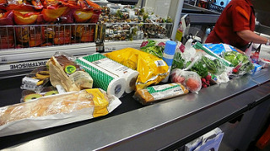
According to the U.S. Department of Agriculture, Americans spend, on average, around 6% of their budget on food. However, the study also shows that they also spend 5% of their disposable income on dining out. That makes your food budget 11% of your overall income.

Slide 10

If you use this method, budget 6% for groceries each month and 5% for dining out. If your take-home income is $3,000 a month, you will budget around $180 for groceries and $150 for dining out. Of course, if $180 won’t cover your needs, you should cut back on dining out and use any additional money towards your grocery needs.

Slide 11

Another way to choose a grocery budget amount is to look at the plans created by the USDA. The most recent plans can be found on their website. They provide the weekly cost for a thrifty, low-cost, moderate-cost and liberal plan on a weekly and monthly basis. The amounts are broken down by gender and age. You will need to total the amounts listed for the people in your family.

Slide 12
For example, let’s say you are a family of four. Your kids are a 12-year-old boy and an 8-year-old girl. You decide to try to live on a low-cost plan. According to the report, the total monthly amount for your son will be $236.30 and for your daughter $190.10. Dad’s monthly amount is $238.30 and mom’s is $206.30. That makes the grand total grocery budget $871.00 per month or $217.75 per week.
https://www.usatoday.com/story/money/personalfinance/2017/08/02/how-much-should-you-budget-groceries/529006001/

Slide 13
What Can You do to Reduce your Food Costs?

Slide 14
What Can You do to Reduce your Food Costs?
Reduce your dining out budget. Eat at home more often
• Use coupons. Coupons are the simplest way to save money on the items you need. Even if the coupons aren’t available for the foods you need to eat, you can find them for household products you use.
Menu plan. Figure out your meals every single week before you shop.
• Use a cash back credit card. There are a lot of great rewards cards that help you earn cash back and other perks while you shop. This can help lessen the stress of grocery costs. Remember, a lot of these cards require a decent credit score. Before applying, see where your credit stands.

Slide 15
Take the time to create a grocery budget that is feasible. Don’t try to make it so low that it is unrealistic, or your budget will fail month after month. Personalize it to your family’s needs and find a way to make it work.

Slide 16
In the following slides, notice the types and quantities of foods
Think about cost as proportion to probable income
Notice, too, composition of family and apparent standard of living based on housing and personal property

Slide 17
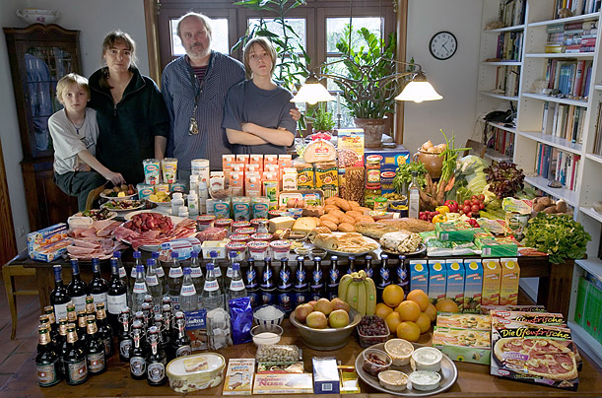
Germany The Melander family of Bargteheide Food expenditure for one week : 375.39 Euros or $500.07

Slide 18
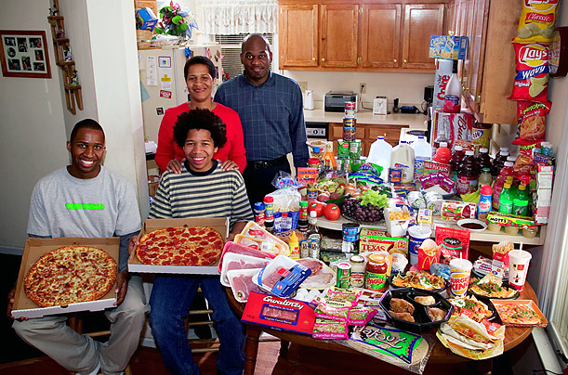
United States The Revis family of North Carolina: one week $341.98

Slide 19
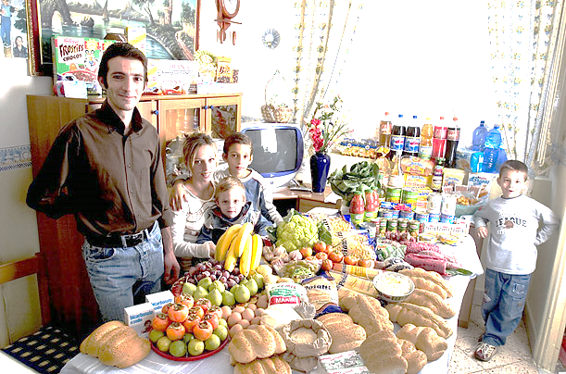
Italy The Manzo family of Sicily: for one week : 214.36 Euros or $260.11

Slide 20
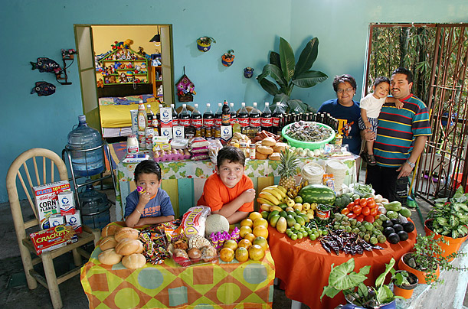
Mexico: The Casales family of Cuernavaca One week : 1,862.78 Mexican Pesos or $189.09

Slide 21
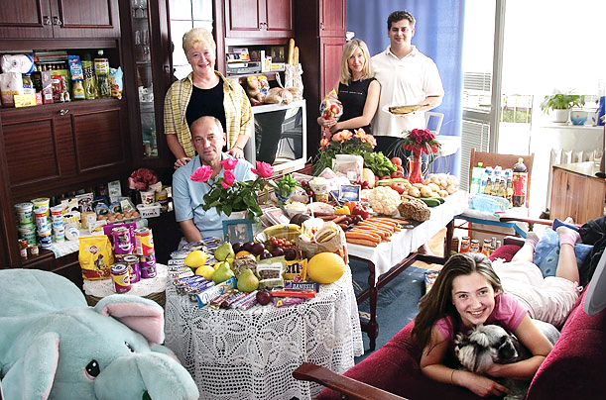
Poland The Sobczynscy family of Konstancin-Jeziorna 1week : 582.48 Zlotys or $151.27

Slide 22
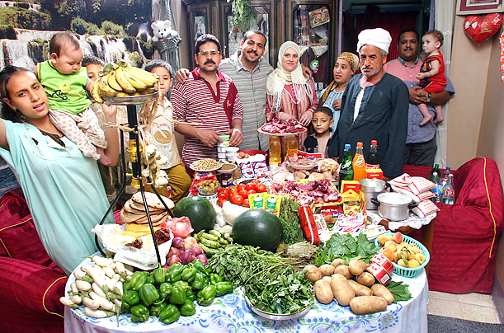
Egypt The Ahmed family of Cairo One week : 387.85 Egyptian Pounds or $68.53

Slide 23
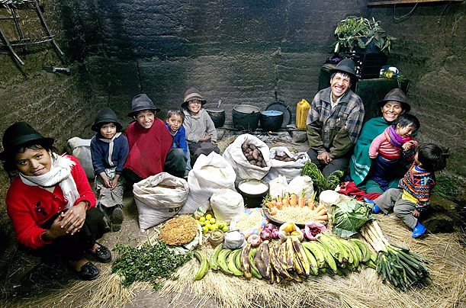
Ecuador The Ayme family of Tingo; Food expenditure for one week : $31.55

Slide 24
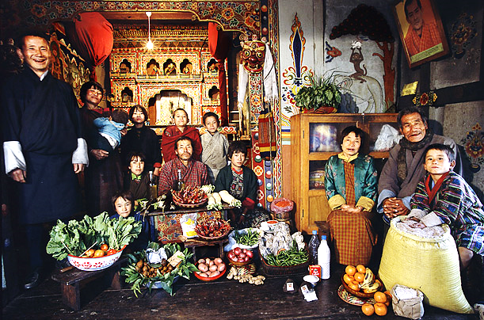
Bhutan The Namgay family of Shingkhey Village One week : 224.93 ngultrum or $5.03

Slide 25
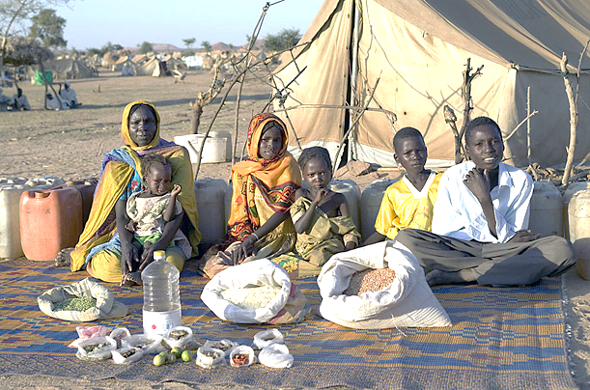
Chad The Aboubakar family of Breidjing Camp -- Expenditure for one week : 685 CFA Francs or $1.23

Slide 26
What observations would you make?

Slide 27

Nutritional Issues

Slide 28
Nutritional Issues: Daily Nutrition Guidelines
 | 4 – 8 years | 9 – 13 years
Calories | 1200 - 2000 | 1400 - 2600
Protien | 4 oz. | 5 oz.
Fruits | 1 – 2 cups | 1.5 – 2 cups
Vegetables | 1.5 – 2.5 cups | 2 – 3.5 cups
Grains | 4 – 6 oz. | 5 – 9 oz.
Dairy | 2.5 – 3 cups | 2.5 – 3 cups

Slide 29
Visualizing Portion Sizes
Deck of cards = 3 oz meat
Four dice = 1 oz cheese
Ping pong ball = 2 T peanut butter
Tennis ball = 1 cup grains, fruit, vegetables or 1 medium piece of fruit
https://health.gov/dietaryguidelines/2015/guidelines/chapter-1/a-closer-look-inside-healthy-eating-patterns/#callout-meat-poultry

Slide 30
Adult Nutritional Guidelines
Food Group | 2,000-Calorie-Level Pattern
Vegetables | 2½ c-eq/day
Fruits | 2 c-eq/day
Grains | 6 oz-eq/day
Dairy | 3 c-eq/day
Protein Foods | 5½ oz-eq/day
Oils | 27 g/day (About 5 teaspoons)
Limit on Calories for Other Uses (% of calories)^{c} | 270 kcal/day (14%)

Slide 31
Vegetables | 2½ c-eq/day
Dark green | 1½ c-eq/wk
Red and orange | 5½ c-eq/wk
Legumes (beans and peas) | 1½ c-eq/wk
Starchy | 5 c-eq/wk
Other | 4 c-eq/wk
Grains | 6 oz-eq/day
Whole grains | ≥ 3 oz-eq/day
Refined grains | ≤ 3 oz-eq/day

Slide 32
https://health.gov/dietaryguidelines/2015/guidelines/chapter-1/a-closer-look-inside-healthy-eating-patterns/#callout-meat-poultry
Protein Foods | 5½ oz-eq/day
Seafood | 8 oz-eq/wk
Meats, poultry, eggs | 26 oz-eq/wk
Nuts, seeds, soy products | 5 oz-eq/wk

Slide 33







Dining out
https://m.nutritionix.com/red-lobster/menu/premium/
Fast Food
Mid-priced restaurants

Slide 34
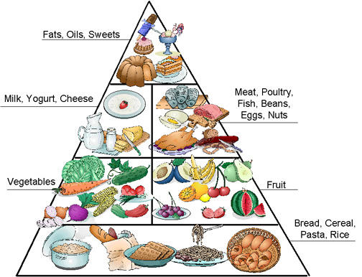
Old Food Pyramid

Slide 35
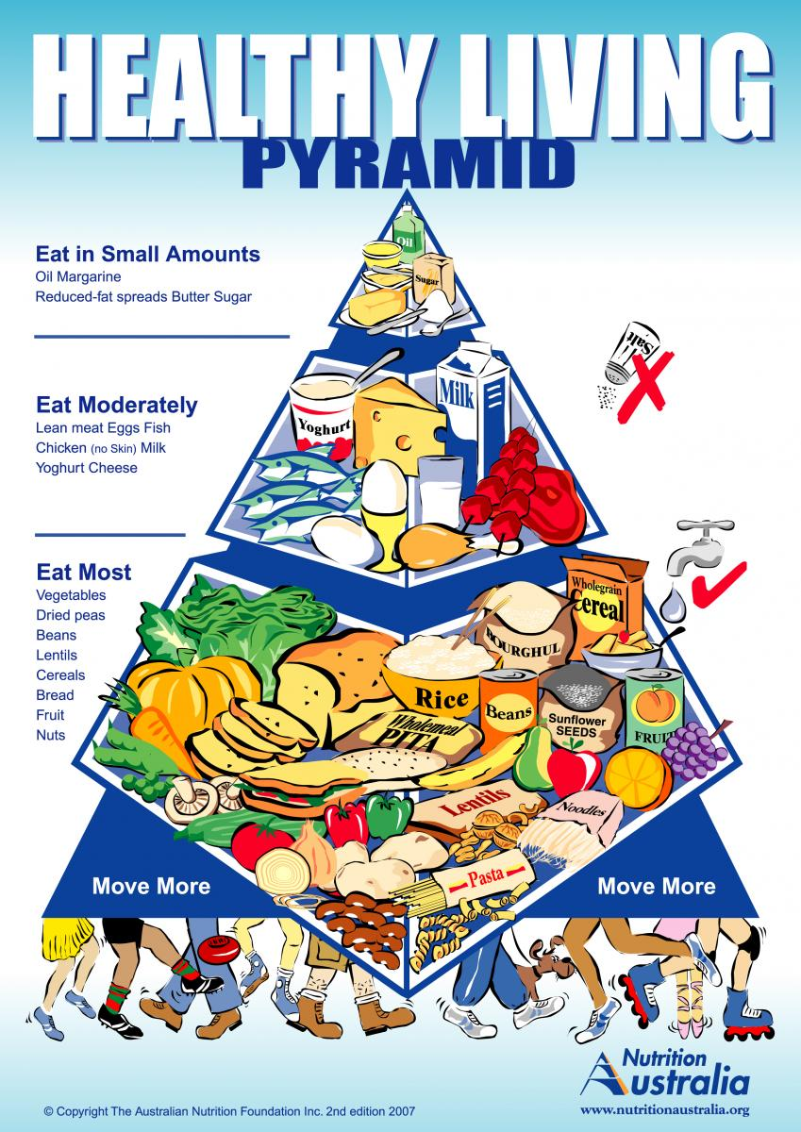

Slide 36

Planning Meals for Children, Teens and Adults
www.myplate.gov

Slide 37

Menu Planning Activity

Slide 38
What can be done to help obese grade school children?
1.
2.
3.
4.

Slide 40
Conversions
1 cup = 8 oz. = ½ pound = 227 grams
1 oz. = 28 grams = 2 Tablespoons (T) = 6 teaspoons
1 Tablespoon = 3 teaspoons (t) = ½ ounce
1 gram = 1000 milligrams
1 pint = 2 cups (liquid)
2 pints = 1 quart = 4 cups (liquid)
8 T butter = 1 stick = ½ cup = ¼ pound
1 pat of butter = 1 teaspoon
1 pound = 454 grams
1 Kilogram = 2.2 pounds

Slide 41

Plan a school day menu
Plan a healthy home breakfast
Grade school
Adolescent/middle and high school
Does your menu fit “my plate” suggested guidelines?
Plan a healthy school lunch or school sack take-along lunch
Grade school
Adolescent/middle and high school
Adult (home breakfast or take-along breakfast)
Consider your lunch menu and a menu from the senior citizen meal sites. How do they match the “my plate” indicators?

Slide 42
Calculations: https://www.supertracker.usda.gov/foodapedia.aspx
Look up the following values for the items you chose:
Calories
Carbohydrates, grams
Fat, grams
Fiber, if known (The RDA for fiber is 25 g.) Sodium, milligrams (1200 – 1500 milligrams per day)
Protein, grams

Slide 43
Obesity in Grade School Children
Most children who are obese will become obese adults
Caused by both genetic and environmental factors
Social problems
Television viewing
Lack of exercise becomes vicious cycle

