Slide 1
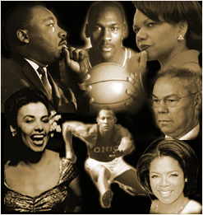
Inequality
Who are
We?

Slide 2
Agenda
Review Game https://www.quia.com/cb/267137.html
--ism’s
Defining the terms
Estimating population change
Social Distance
Prejudice and Discrimination
Confronting Prejudice and Discrimination
Stereotypes
Confronting Prejudice and Discrimination

Slide 3
Name some –ism’s
What is the basis for these terms?
Relating to “political correctness”

Slide 4
Race Vs. Ethnicity
Racial categories – based on physical characteristics
Socially defined in many ways
Ethnicity – the result of nationality and/or cultural background and characteristics
Often overlapping; not mutually exclusive
Notes:
The characteristics that minority categories share are either physical or cultural or both. When we make the distinction based on physical characteristics (skin color or other obvious physical features), we are making a racial distinction. When we base our assessment on cultural or national background, we call the distinctions ethnic. Race and ethnicity may be separate but often tend to overlap. For example, a person from Kenya may be set apart based on his race as well as the fact that his native language is different and thus he speaks English with a pronounced accent. White ethnics are often categorized as those individuals who are racially the same as the “dominant” culture but are different because of language, religion, food patterns, etc.

Slide 5
Sex vs. Gender
Sex is the physical reality of being either male or female
Genetically determined
Gender is the social definition of what it means to be masculine or feminine; how males or females should behave
Psychologically determined
Socially defined

Slide 6

Sexual Orientation
Wikipedia; Free Dictionary
Sexual orientation is an enduring pattern of romantic or sexual attraction (or a combination of these) to persons of the opposite sex or gender, the same sex or gender, or to both sexes or more than one gender.
These attractions are generally subsumed under heterosexuality, homosexuality, and bisexuality, while asexuality (the lack of sexual attraction to others) is sometimes identified as the fourth category
According to the American Psychological Association, sexual orientation "also refers to a person's sense of identity based on those attractions, related behaviors, and membership in a community of others who share those attractions".
LGBTQIA -- Lesbian, Gay, Bisexual, Transgender, Questioning, Intersex and Allies
Alternatives: SGL ("same gender loving"); MOGAI (Marginalized Orientations, Gender Alignments and Intersex); etc.

Slide 7
Ability vs. Disability
Ability
power or capacity to do or act physically, mentally, legally, morally, financially, etc.
competence in an activity or occupation because of one's skill, training, or other qualification
Disability
lack of adequate power, strength, or physical or mental ability; incapacity.
a physical or mental handicap, especially one that prevents a person from living a full, normal life orfrom holding a gainful job.
anything that disables or puts one at a disadvantage
according to Dictionary.com

Slide 8
In 2012, what percent of the population of the United States is represented by each of the following:
White
Black
Asian
American Indian and Native Alaskan
Persons with 2 or more races in their background
Hispanic
What will be the percentages of each in 2060?
White
Black
Asian
American Indian and Native Alaskan
Persons with 2 or more races in their background
Hispanic

Slide 9
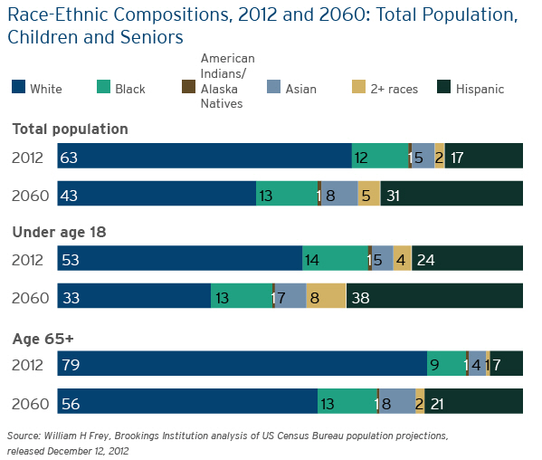
Dimensions of minority – majority relations

Slide 11
Social Distance
Feelings of separation between individuals and groups
Based on perceived, often only superficial, differences
Determines the extent that differences will be tolerated
Notes:
The more we are tuned in to “see” the differences among people, the more we may lack the ability to identify with them. Because of ethnocentrism (our tendency to use our own way of life as a standard against which to evaluate different patterns or individual), we feel varying degrees of “distance” from people who are more or less like us. Often these differences are inconsequential -- i.e., differences in speech patterns or accent. The more distance we feel, the more likely it is that we will treat groups and individuals unequally.

Slide 12
Social Distance, continued
Perceptions are rooted in ethnocentrism
In-group (we) Vs. Out-group (they)
Distances seem greater when magnitude of difference seems larger
i.e.. skin color, religious practice, other cultural patterns
Notes:
Ethnocentrism may lead us to feel competitive with other groups or individuals. Those groups with whom we identify (feel no or minimal distance from) become the in-group and anyone who has any observable difference is evaluated as an out-group. The bigger the perceived difference, the greater the social distance that is felt.

Slide 13
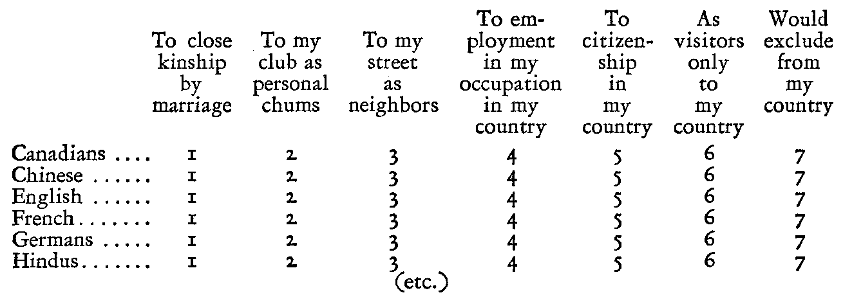

Slide 14
Prejudice
Categorical
Irrational
Like or dislike
Applied to all members of a group
Based on irrelevant information such as racial or cultural characteristics
Notes:
Ethnocentrism serves a function because it allows us to feel national pride, patriotism, and to develop a sense of self-identity. A major dysfunction of ethnocentrism is that it allows us to make judgments and feel distances. It helps us develop prejudices against or in favor of certain individuals or categories. Prejudice motivates us to categorize individuals by looks, accent, family name, or other behavior. Generally these categories are superficial, arbitrary, and illogical.
We can be prejudiced in favor of something but generally we view the negative side of prejudice -- we feel prejudice against someone or something.
If we feel prejudice against individuals who have the target (hated) characteristic, we tend to believe that everyone who shares that characteristic deserves our negative assessment. Thus we say we hate or dislike all members of that group. For example, at a faculty dinner another teacher’s date asked if I minded if he smoked. I said I did and he said “too bad, it’s a free country.” His actions may lead me to perceive ALL smokers as rude and become intolerant of ALL SMOKERS.

Slide 15
Discrimination
Acting out prejudice
Systematically grants advantages or disadvantages based on competition for a society’s resources and rewards
Notes:
When we turn the prejudicial beliefs we hold into some sort of action, we are guilty of discrimination.
Very often our negative assessment of another category of individuals springs from one bad experience or even just the fear that a bad experience might take place. We feel anxiety that turns into animosity. We feel that we must compete with others for jobs, water, food, money, even space on the bus, etc. So we behave in such a way that we try to limit the access of the feared minority group members to jobs, natural resources, money, etc. For example, we may say that “they” must sit in the back 3 rows of the bus as was true for African Americans in the South prior to the Civil Rights Movement.

Slide 16
Confronting Prejudice and Discrimination
The eye of the storm: https://www.searchencrypt.com/videos?eq=CN9X%2FsZAxhKNH1STk4Ilcg%3D%3D
The Angry Eye: https://www.searchencrypt.com/videos?eq=CN9X%2FsZAxhKNH1STk4Ilcg%3D%3D
Excerpt from Blue-Eyed: https://www.youtube.com/watch?v=H-nQF4RYC7w
Jane responding to the NFL players protest: https://www.youtube.com/watch?v=NGoOVpA-pQM
Robber’s Cave https://www.youtube.com/watch?v=8PRuxMprSDQ

Slide 17
Prejudice = Attitude or Belief
Discrimination = Behavior or Action
Stereotype = a simplified and standardized conception or image
http://www.youtube.com/watch?v=fgUNixkTV8c
http://www.youtube.com/watch?v=rltvFGiIY8E&feature=related
http://www.youtube.com/watch?v=rI21cNzuofY&feature=related
(caution: this is an older film made by an individual whose reputation has been modified by exposed biases/behaviors of his own. Try to look beyond that and focus on the bitterness of the message)
Notes:
So, the difference between prejudice and discrimination is that prejudice goes on in your mind and discrimination shows up in your activities. It might be possible to have one without the other but generally the two go hand in hand.
Go to the Course Communication area:
In the long run, it is easier to control one than the other. Which do you think is easiest to control? Why? Cite some real life examples to support your answer.

Slide 18
Patterns of Acceptance of Racial and Cultural Minorities
Assimilation
Cultural Pluralism
Amalgamation
Notes:
There are three basic patterns of interaction with minority groups that have led to the acceptance of those groups into a culture.
Groups become assimilated when they are absorbed into the mainstream culture. This may be voluntary, permissible or forced.
Groups may be pluralistic or multicultural. This means that all groups live in “peaceful coexistence” sharing aspects of the mainstream culture and yet maintaining characteristics and patterns that are unique to their first culture.
One of the original views related to the U.S. was as a “nation of immigrants” who would all blend together in the huge melting pot of American culture. In other words, through contact, intermarriage, etc. the differences would disappear and a new “American” would appear who was a “Heinz 57” combination of all that had contributed to his or her past. This may have happened within a given racial category, but multi-racial amalgamation has not occurred to date and probably will not happen on any large scale.

Slide 19
Patterns of Rejection
Extermination
Population Transfer
Subjugation (social and economic deprivation)
Notes:
Prejudice and discrimination have led to negative patterns of interaction. These are three ways that minority groups have been rejected.
Genocide or extermination means killing them off in random or systematic ways. Examples given in your test include the Holocaust in WWII Germany, the Hutu/Tutsi conflicts in Africa and the U.S. treatment of Native Americans in the late 19th century.
Population Transfer means to “put them off someplace”. This movement can be voluntary (indirect) because living conditions are intolerable or it can be forced (direct) when groups are made to move to a particular location (reserve) or are deported from the country altogether.
Subjecting members to differential treatment is the third form of rejection. Segregation is probably the most common form of subjugation but any form of economic exploitation may qualify.

