Slide 1
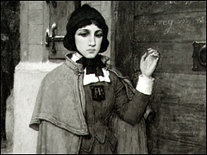
The Scarlet Letter
by
Nathaniel Hawthorne
Mrs. Bohs – RKYHS English Grade 11- American Literature

Slide 2
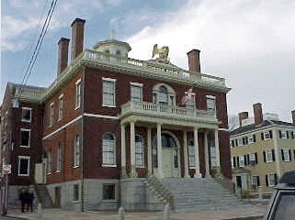
Surveyor of The Custom House
Having contributed to the Democratic Review, and once the Democrats were in power in the mid 1840s, Hawthorne was appointed surveyor of the customhouse of Salem, an experience which aided him in writing the Introduction to The Scarlet Letter
Hawthorne found a piece of cloth with an A on it and used it as the major symbol of his novel about the Puritan lifestyle
Custom House in Derby Street, Salem, Massachusetts

Slide 3
The Romantic Hawthorne
Hawthorne is considered a writer of the Literary Movement known as Romanticism
Romantics concern themselves with the soul, stress emotions over reason, show an appreciation for nature, and focus on the exceptional figure and his passions and inner struggles
All Hawthorne’s work is one form or another of “handling sin”
He was intensely interested in Puritanism as a historic phenomenon
Hawthorne is haunted by what is obscure, dangerous, and the confines of good and evil, by what is abnormal, and social relations
It is what is mysterious in the soul that attracts him
All of his stories are about people’s crimes—or misunderstood virtue or misfortune—which, created by themselves, leaves them in a worse companionship than solitude
The soul becomes the individual’s “best friend” because the person is shunned by everyone else

Slide 4
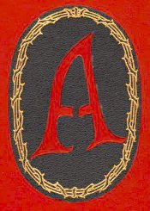
The 411 on The Scarlet Letter
Set in 17th Century Boston
Puritan code of life
Main characters
  Hester Prynne
  Pearl Prynne
  Arthur Dimmesdale
  Roger Chillingworth
Novel spans a total of seven years
The Scarlet Letter as a SATIRE

Slide 5
Themes in The Scarlet Letter
Alienation—the character is in a state of isolation because of self-cause, or societal cause, or a combination of both
Initiation—involves the attempts of an alienated character to get rid of his isolated condition
Problem of Guilt —a character’s sense of guilt forced by the Puritan lifestyle/heritage or by society; guilt vs. innocence
Pride—Hawthorne treats pride as evil; spiritual pride, intellectual, and physical
Allegory—each character is a labeled equivalent of “something bigger”
Other themes—individual vs. society, self-fulfillment vs. accommodation or frustration; hypocrisy vs. integrity, love vs. hate, exploitation vs. hurting, and fate vs. free will

Slide 6

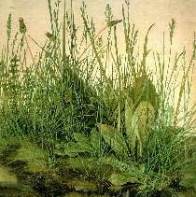
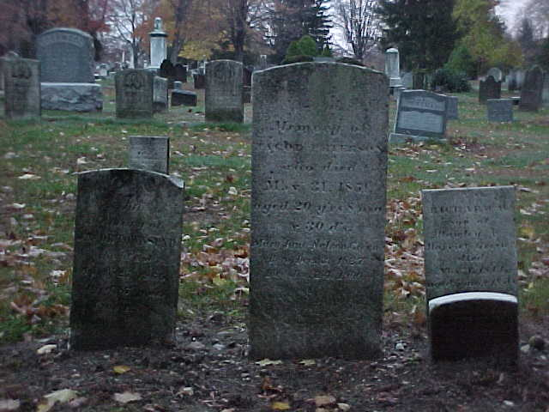
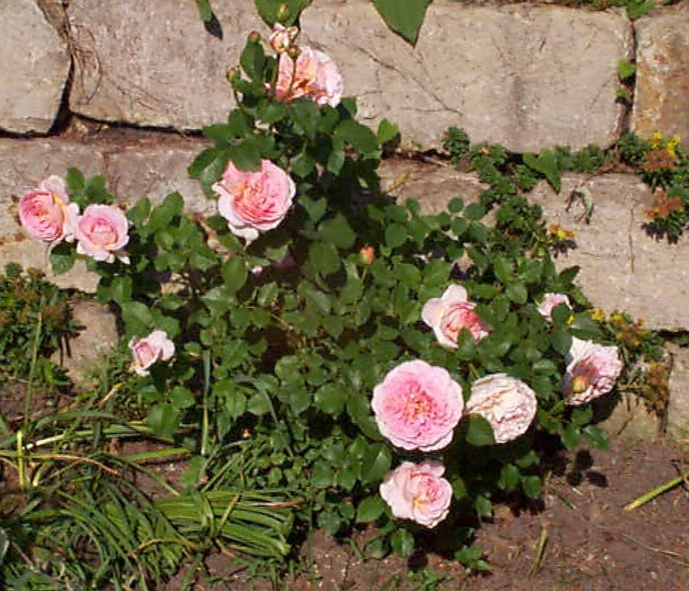
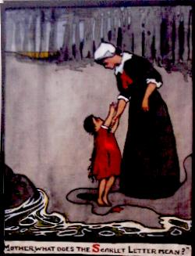
Symbols
Weeds
Rose-bush
Flowers
Prison
Cemetery
Scaffold
Town beadle
Letter A
Pearl
Sunshine
Brook

Slide 7
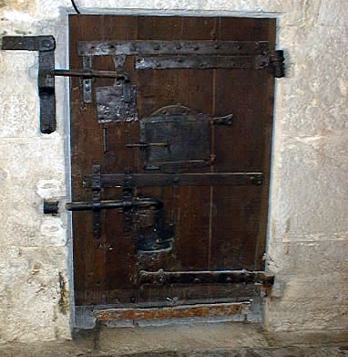
Chapter 1: The Prison Door
Exposition and setting of novel
First two edifices built—foreshadowing or strict Puritan code?
Rosebush, weed, and other flowers grow “by chance”
First few symbols
  Cemetery
  Prison
  Weeds
  Rosebush
  flowers
The Prison Door

Slide 8
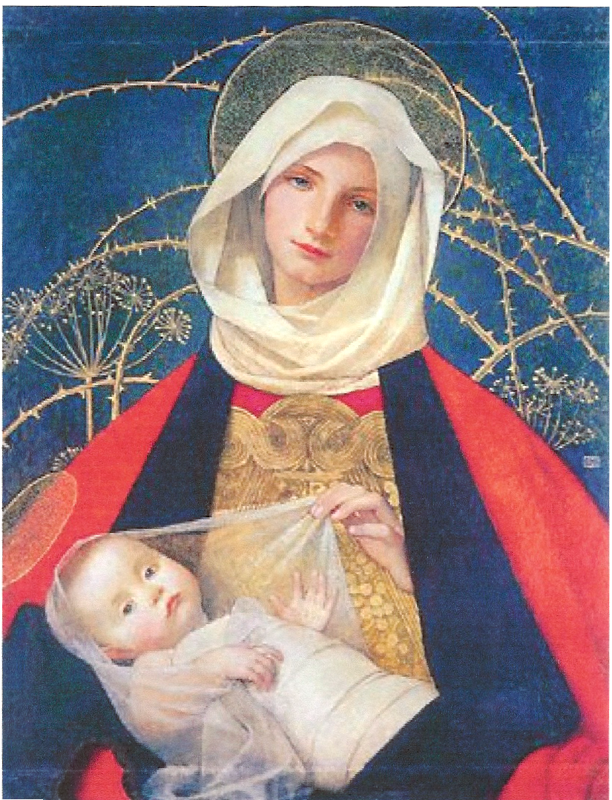
Chapter 2: The Market Place
1st of 3 scaffold scenes
The scorns of the women
Introduction of Hester Prynne holding her daughter, Pearl—image created by Hawthorne is like the Madonna and child (IRONY & SATIRE)
Hester’s beauty
Introduction of the scarlet letter
Reveries of long ago
A familiar stranger

Slide 9
One “might have seen in this beautiful woman…an object to remind him of the image of Divine Maternity…” (53).

Slide 10
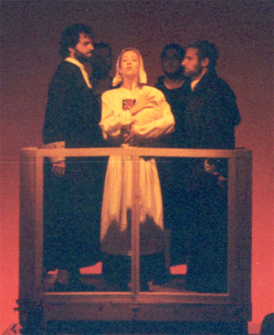
Chapter 3: The Recognition
Hester recognizes her husband
Where has he been these two years?
The riddle begins to consume Chillingworth already
Introduction of the magistrates and their plea for Hester to announce her partner in crime
  what would they have done to him?

Slide 11
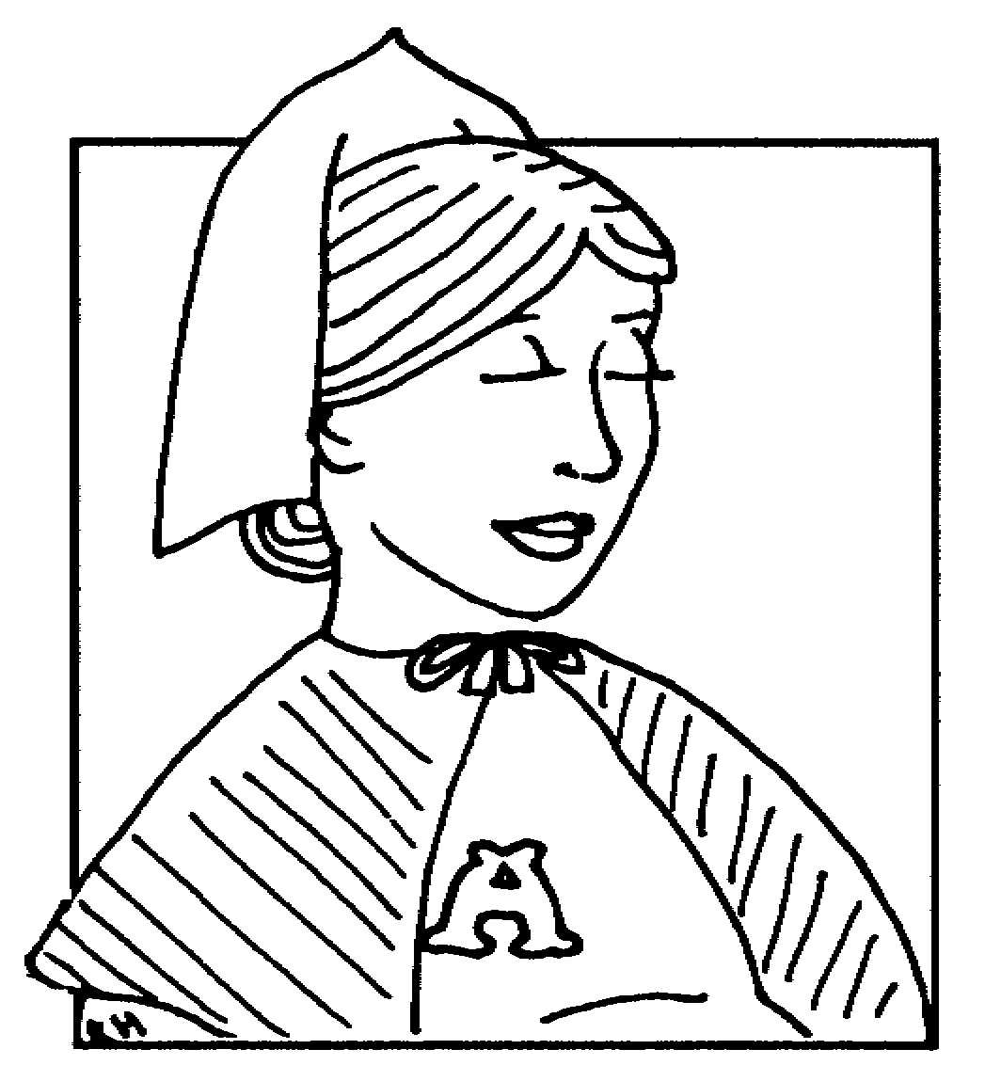
Chapter 4: The Interview
Why doesn’t Chillingworth want to kill Hester and her child?
Chillingworth as the leech = pun
Chillingworth admits it was both of their faults
Hester holds two secrets
Hester asks if Chillingworth is the Black Man

Slide 12
Chapter 5: Hester at Her Needle
Hester is released from prison but decides to stay in Boston for three reasons:
  She feels drawn to the place that marked a great change or growth in her life
  The gentleman who fathered her baby still resides in Boston
  She feels she must repent of her sins by staying and doing what she can for forgiveness
Hester must support herself and Pearl, so she sews
Even the wealthy people who once scolded her pay her for her expertise with the needle
Hester is allowed to sew everything—but a wedding dress
In her spare time, Hester gives her time to charities

Slide 13
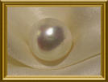
Chapter 6: Pearl
Hester named her baby Pearl, “as being of great price,--purchased with all she had…” (82).
Pearl was called a sprite, an imp, an elf—all alluding to her expected terror-like behavior being the product of sin
Hester admitted that the only times she felt as peace was when Pearl was asleep
Hester knows that Pearl was given to her to remind her of her sin; Pearl saw to it that her mother “paid the price”
Is she a devil-child or just an innocent product of love?

Slide 14
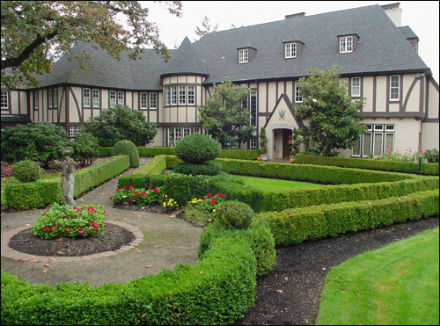
Chapter 7: The Governor’s Hall
Hester is afraid that they will take Pearl away from her
Hester understands that Pearl is her punishment and gift from God—to remind her of her sin and her love
Irony & satire: the governor’s hall is exquisite when the Puritan code strictly forbids “earthly treasures”

Slide 15
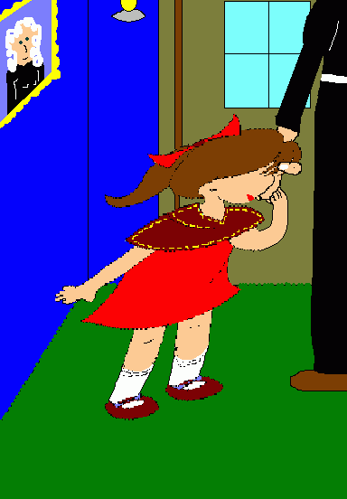
Chapter 8: The Elf-Child & the Minister
Governor Bellingham affirms that they will take Pearl from Hester
Hester turns to Reverend Dimmesdale for help
Dimmesdale points out that the child was sent by God as a reminder of her sin
If Hester can “turn the child around,” then Pearl may just help Hester enter Heaven as well

Slide 16
Chapter 9: The Leech
Chillingworth is revered for his skills as a physician; Dimmesdale is revered for his sermons that grow stronger each Sunday, even though his health deteriorates each day
The townspeople beg Dimmesdale to take Chillingworth as his physician, and the reverend finally accepts
Chillingworth grows suspicious of Dimmesdale’s unexpected deteriorating health
The two begin to live in the same house
The townspeople notice a big change in Chillingworth’s appearance and begin to gossip that either Satan or Satan’s emissary has now resided along with their godly Reverend Dimmesdale and fear for their pastor

Slide 17

Chapter 10: The Leech& His Patient
Chillingworth and Dimmesdale discuss guilt
Chillingworth urges Dimmesdale to share his guilt, but the latter refuses
Dimmesdale admits that Hester is better off than her secret lover, for he believes it is “better for the sufferer to be free to show his pain, as [Hester], than to cover it all up in his heart” (124).
Chillingworth “unravels” the truth

Slide 18
Chapter 11: The Interior of a Heart
Dimmesdale “achieved a brilliant popularity in his sacred office”
All of his sermons hinted at his own sins but he never confessed outwardly
Townspeople thought he was too godly and were humbled by him
They deemed Dimmesdale to be “a miracle of holiness”
Dimmesdale tried to confess but never could
The townspeople, upon hearing him speak boldly about his own wrongdoings, did nothing more but revere him all the more
We find out that he whips himself with a scourge, keeps vigils each night, and fasts—all of which have led to his deteriorating health
He finally realized he could do something about his guilt

Slide 19
Chapter 12: The Minister’s Vigil
Sleepwalking, Dimmesdale leads himself to the scaffold—2nd major scaffold scene
He utters a cry—for repentance or to try to call out to others so they could see him up there?
We know that seven years have passed since Hester first stood up on the scaffold
Only two people heard Dimmesdale’s cry
Governor Winthrop had just passed away
Hester, Pearl, and Dimmesdale form “an electric chain”—of what?
Chillingworth sees the three and smiles devilishly—and Dimmesdale declares his hate for the physician (isn’t it a sin to hate?)
Pearl asks one of the most important questions to Dimmesdale—does she know who he is?
The “A” in the sky made of crimson light—could that have been the result of their “electric chain”?
The townspeople ignorantly translate it to be “A” for Angel—for Governor Winthrop’s soul rising up to Heaven
The glove could NOT have been Dimmesdale’s! Only Satan could have put it there to mock the Puritan’s leader!

Slide 20

Chapter 13: Another View of Hester
Hester has lost her beauty, for “there seemed to be no longer anything in Hester’s face for Love to dwell upon
Hester’s “A” now means “Able”—for she gave so kindly to the poor and became such a good listener that all went to her with their troubles
Hester makes it her ultimate duty
to save Dimmesdale from
Chillingworth—she thinks she
owes it to him

Slide 21
Chapter 14: Hester and the Physician
“But the former aspect of an intellectual and studious man, calm and quiet, which was what she best remembered in him, had altogether vanished…”
“Ever and anon, too, there came a glare of red light out of his eyes; as if the old man’s soul were on fire, and kept on smoldering duskily within his breast…”
“In a word, old Roger Chilliingworth was a striking evidence of man’s faculty of transforming himself into a devil…”
“Your clutch is on his life, and you cause him to die daily a living death; and still he knows you not.”
“But for my aid, his life would have burned away in torments, within the first two years after the perpetration of his crime and thine….”
“Better he had died at once!”
“…A mortal man, with once a human heart, has become a fiend for his especial torment!”
“Hast thou not tortured him enough?”
“No—no! He ha but increased the debt!”
“There is no good for him,—no good for me,—no good for thee! There is no good for little Pearl! There is no path to guide us out of this dismal maze!”
“There might be good for thee, and thee alone, since thou hast been deeply wronged, and hast it at thy will to pardon.”
“By thy first step awry thou didst plant the germ of evil; but since that moment, it has all been a dark necessity….It is our fate. Let the black flower blossom as it may!”

Slide 22
Chapter 15: Hester and Pearl
Hester admits that she, too, hates Chillingworth and realizes that it was he “[had] done [her] worse wrong” for having forced her to marry him even when she had not loved him
Pearl is described to be very happy in nature, as if she is one with it. Could it be that she is a product of nature rather than sin?
Pearl creates her own letter “A” out of eel-grass and asks her mother what it means
Hester realizes that Pearl, now seven, may actually be able to learn from her mistake if Hester teaches her what the “A” symbolizes
Pearl makes the connection between Hester’s “A” and Dimmesdale’s hand over his heart—but does she really know that the two are connected?

Slide 23
Chapter 16: A Forest Walk
Pearl points out to Hester that the sunshine runs away from her mother but not from her; Pearl says it is because of the “A” on Hester’s bosom
Characterization of Pearl—she is devilishly happy and does what she wants; she does not seem to be afraid of anything
Pearl asks Hester if Hester has ever met the Black Man, and Hester answers that she did once—and the scarlet letter is his mark
Pearl is compared to the brook
Pearl also questions whether Dimmesdale has met the Black Man, and if that is the reason why he always covers his heart with hand. Does she know?

Slide 24
Chapter 17: The Pastor & His Parishioner
This is the first time that Hester and Dimmesdale have been alone in seven or more years!
It is said that they “questioned one another’s actual and bodily existence”—a romantic quality that Hawthorne inserts for emotional effect. Were they really standing apart a few feet from one another? Was it a dream?
Dimmesdale’s cold hand touching Hester’s cold hand somehow led them “back to earth”
Dimmesdale asks Hester if she has found peace? Why is this the first question he asks her after they have become familiar with each other again?
When Hester finally musters the courage to tell Dimmesdale who Chillingworth really is, he blames her! WHAT IRONY!
Hester is the man in this relationship; Dimmesdale even admits that she is stronger than him—sort of like Romeo and Juliet
Hester gives Dimmesdale hope

Slide 25
Chapter 18: A Flood of Sunshine
The cowardly and weakly Dimmesdale is afraid to start anew ALONE!
Hester, still pathetically in love with the cowardly minister—a leader in his community, a “godly” and highly revered man—decides she and Pearl will go with him
Hester unclasps the scarlet letter from her bosom and threw it into the distance
The “burden of shame” was lifted from her spirit— “exquisite relief”
Her beauty came back through the “magic” (romanticism) of the past hour
Does she regret what she did? Has she ever demonstrated remorse in any way? Why does she love Dimmesdale so much?
Dimmesdale confesses to being afraid of children, even Pearl
In the last scene of the chapter, Pearl is described to be in one with nature. Why is this important?

Slide 26
Chapter 19: The Child at the Brookside
Compare the forest, as described by Hawthorne, to the town
Why do Hester and Dimmesdale find comfort in the forest? Why does Pearl relate so well with nature? Is there a connection?

Slide 27
Chapter 20: The Minister in a Maze
Hester and Dimmesdale decide to leave in four days’ time—after the Election Sermon
Dimmesdale is happy that he can “leave” his office after the Election Sermon
Hester has booked passage to Bristol for herself and two others; the captain has allowed her to board for her good works with the Sisters of Charity
Dimmesdale feels a heavy burden lifted from his soul—and he begins to think of many sinful thoughts. Why is this important?
Name the three things he has thought about doing that are considered out of character for him.
Mistress Hibbins offers Dimmesdale a personal introduction to her master.
Dimmesdale gains confidence to tell Chillingworth that the physician is no longer needed in the minister’s home

Slide 28
Chapter 21: New England Holiday
At the start of the Election Sermon and celebration, Hester and Pearl wait for Dimmesdale
The town is in a festive mood for the inauguration of the new governor
Pearl notices how strange Dimmesdale’s physical features look
At the end of the chapter, Hester receives disturbing news that an additional passenger has also secured passage onto the ship bound for Bristol—and this person claims to be “of [Hester’s] party”
Will Chillingworth ever unleash his clutch on Dimmesdale?

Slide 29
Chapter 22: The Procession
Hester and Pearl watch as Dimmesdale and the magistrates walk past, and Hester feels a “dreary influence come over her”—foreshadowing
Dimmesdale does not look at them—as if he doesn’t know them
Hester starts to feel the weight of the scarlet letter on her bosom, again—even at “its final hour”—when she was to fling it off forever and live a new life with her family
Hawthorne creates a great contrast between the minister and the wearer of the scarlet letter—even though they really are as one

Slide 30
Chapter 23: The Revelation
Dimmesdale looks like he is near death; he knows it as well
Passing through the scaffold—where Hester and Pearl have planted themselves as they watched the magistrates pass to the festival, Dimmesdale stops at their side
Alas, doing what he should have done seven years ago, Dimmesdale decides to take his rightful place on the scaffold
Chillingworth reacts quicky, grabs the minister’s arm, and questions whether it is really something the latter wants to do
The scaffold is the only place where Dimmesdale could have escaped from Chillingworth—is it a place of punishment or redemption?
Dimmesdale confesses and tears open his ministerial band to show his own “A”—carved in his flesh!
Pearl’s tears broke the spell that she was born with; she would grow up to love and be loved—like a normal being
Dimmesdale gives Hester no lie about their after-life
Did he really love her? Or were they destined to go their separate ways at the moment of their adultery?

Slide 31
Chapter 24: Conclusion
Lots of satire in this chapter
There are many “interpretations” as to the death of the revered minister
  Some believe that what was told to the reader actually happened
  Others believed that the scarlet letter had been a form of poison given to Dimmesdale by Chillingworth
  Yet others believed that the “A” grew “out” of Dimmesdale’s heart and guilt
  The ignorant ones claimed to never have seen the “A” at all, nor did they actually hear a confession; they agreed that the minister had claimed all those things to make a parable of his life!
The leech had nothing left to leech on to, so he died within a year
Ironically, Chillingworth bequeathed all of his treasures in both Worlds to little Pearl
Hester is claimed to be the interest and love of an unknown inhabitant from another land
Pearl is married and happy
Why do you think Hester chose to go back to the little cottage and keep her “A” stitched to her clothing even after the death of Dimmesdale?
In the end, a new grave was made next to an old sunken one—yet there was a space between the two, as if the two had no right to intermingle…

