Slide 1
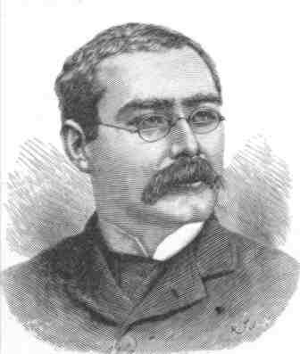
Sestina of the Tramp-Royal
Rudyard Kipling

Slide 2

Poem Text
Speakin’ in general, I ’ave tried ’em all—
The ’appy roads that take you o’er the world.
Speakin’ in general, I ’ave found them good
For such as cannot use one bed too long,
But must get ’ence, the same as I ’ave done,
An’ go observin’ matters till they die.
What do it matter where or ’ow we die,
So long as we’ve our ’ealth to watch it all—
The different ways that different things are done,
An’ men an’ women lovin’ in this world;
Takin’ our chances as they come along,
An’ when they ain’t, pretendin’ they are good?
In cash or credit—no, it aren’t no good;
You ’ave to ’ave the ’abit or you’d die,
Unless you lived your life but one day long,
Nor didn’t prophesy nor fret at all,
But drew your tucker some’ow from the world,
An’ never bothered what you might ha’ done.
But, Gawd, what things are they I ’aven’t done?
I’ve turned my ’and to most, an’ turned it good,
In various situations round the world—
For ’im that doth not work must surely die;
But that's no reason man should labour all
’Is life on one same shift—life’s none so long.
Therefore, from job to job I’ve moved along.
Pay couldn’t ’old me when my time was done,
For something in my ’ead upset it all,
Till I ’ad dropped whatever ’twas for good,
An’, out at sea, be’eld the dock-lights die,
An’ met my mate—the wind that tramps the world!
It’s like a book, I think, this bloomin’ world,
Which you can read and care for just so long,
But presently you feel that you will die
Unless you get the page you’re readin’ done,
An’ turn another—likely not so good;
But what you’re after is to turn ’em all.
Gawd bless this world! Whatever she ’ath done—
Excep’ when awful long I’ve found it good.
So write, before I die, ‘’E liked it all!’
(1896)

Slide 3
“Sestina”
The Poem’s Style
1
2
3
4
5
6
Speakin’ in general, I ’ave tried ’em all—
The ’appy roads that take you o’er the world.
Speakin’ in general, I ’ave found them good
For such as cannot use one bed too long,
But must get ’ence, the same as I ’ave done,
An’ go observin’ matters till they die.
What do it matter where or ’ow we die,
So long as we’ve our ’ealth to watch it all—
The different ways that different things are done,
An’ men an’ women lovin’ in this world;
Takin’ our chances as they come along,
An’ when they ain’t, pretendin’ they are good?
In cash or credit—no, it aren’t no good;
You ’ave to ’ave the ’abit or you’d die,
Unless you lived your life but one day long,
Nor didn’t prophesy nor fret at all,
But drew your tucker some’ow from the world,
An’ never bothered what you might ha’ done.
But, Gawd, what things are they I ’aven’t done?
I’ve turned my ’and to most, an’ turned it good,
In various situations round the world—
For ’im that doth not work must surely die;
But that's no reason man should labour all
’Is life on one same shift—life’s none so long.
Therefore, from job to job I’ve moved along.
Pay couldn’t ’old me when my time was done,
For something in my ’ead upset it all,
Till I ’ad dropped whatever ’twas for good,
An’, out at sea, be’eld the dock-lights die,
An’ met my mate—the wind that tramps the world!
It’s like a book, I think, this bloomin’ world,
Which you can read and care for just so long,
But presently you feel that you will die
Unless you get the page you’re readin’ done,
An’ turn another—likely not so good;
But what you’re after is to turn ’em all.
Gawd bless this world! Whatever she ’ath done—
Excep’ when awful long I’ve found it good.
So write, before I die, ‘’E liked it all!’
(1896)
451362
615243
246531
364125
246531
532614

Slide 4
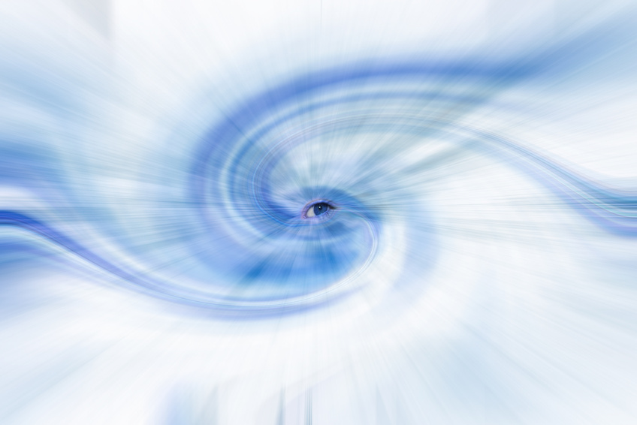
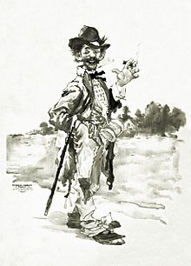
Title Analysis
* Recall Title: “Sestina of the Tramp-Royal”
A tramp is a wanderer or a bum, an idea which sharply contrasts with the concept of “royal”
  Question: What is royalty? How is the tramp royal?
  Possible Answer: The tramp is rich in life, in experiences and in understanding
  Possible Sarcasm: Character believes that he is wealthy, when in fact he is impoverished, like a tramp
Tramp in the poem: stanza 5: Wind triumphs over world, as does he
Sestina is a circular poem, developing ideas but not a plot:
  This poem discusses the narrator’s journey in circles throughout life
  The poem also mentions the theme of life, which is circular as well
  Developing ideas: concept of being “done” with obligations; recognition of lack of finality in life until death; what makes up the world

Slide 5

Paraphrase
Stanza 1: Narrator discusses his wide variety of experiences; expresses belief in change, to see new things
Stanza 4: Discusses narrator’s personal experiences in all aspects of life; role of work in life as a positive factor, claims one should not always do the same work
Stanza 2: Means of death not important in life, but the importance of having observed the world and taken chances as they came while seeing everything optimistically
Stanza 5: Explains his migrations; unexplainable motivation to move on; found kinship with the wind
Stanza 6: Metaphor of world as book—need to turn the pages with the goal of getting to the end
Stanza 3: Life is about experiences, not about money or about living a hermetic life
Stanza 7: The world (i.e. life) is sweet in its brevity

Slide 6
Connotation
Diction: abbreviation and slang of lower classes
Extended metaphor: Life=book
Irony: literacy of narrator?
His point: Is reading a pleasure or a necessity? What about life?
Symbolism of nature in poem: Stanza 5: “the wind that tramps the world!”
Only mention of nature
Wind=both powerful and ephemeral
Second definition of tramps: destroys; overcomes; STRENGTH
Repetition
“Speaking in general”—significantly leaves out details of occupations
“Gawd”—lofty idea; exclamation; recognition of end of life
Reference to death: die (6); life (3); live (1)
Seems close to death (“What are things that I haven’t done;” past tense; “before I die”)—knowledge that end is coming, but with optimism of narrator; almost foolish bliss

Slide 7
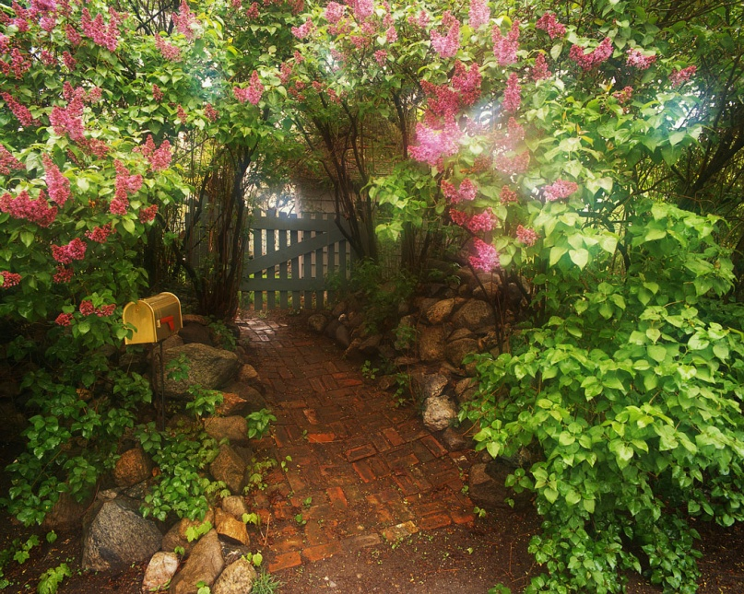
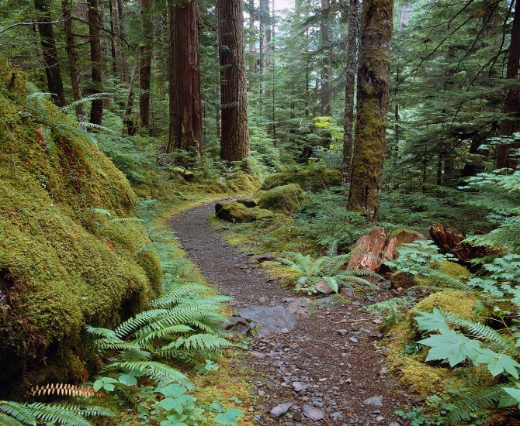
Attitude
Of narrator:
*Blissful
*Judgmental
*Tranquil
*Lofty
*Accepting
*Didactic
Enjoy your temporary visit!
Move on.

Slide 8


Attitude
Of author:
*Blissful
*Judgmental
*Tranquil
*Lofty
*Accepting
*Didactic
It’s true, the world is beautiful.
Take off those glasses already!

Slide 9
Shift
Stanza 3
Discussion before shift:
Positive aspects of having had many experiences
why others should do as he did
How he should be emulated
Discussion after shift:
What more he has to do
Hints that maybe he should be spending less time working
Justifies himself
Feeling that he has finished the book: no what?
To continue in the same place or to die?

Slide 10

Title (2)
After completion of sestina, role of form is better understood
Notice double meaning of word tramp: both a wanderer and one with consummate power—here, narrator is possibly both
Tramp-royal is noticed as being an inverse phrase, leading to the second definition of tramp as being a better interpretation than otherwise

Slide 11
Themes
Life and its shortness
Travelling and occupations
Recreation and work
Life as a journey

Slide 12
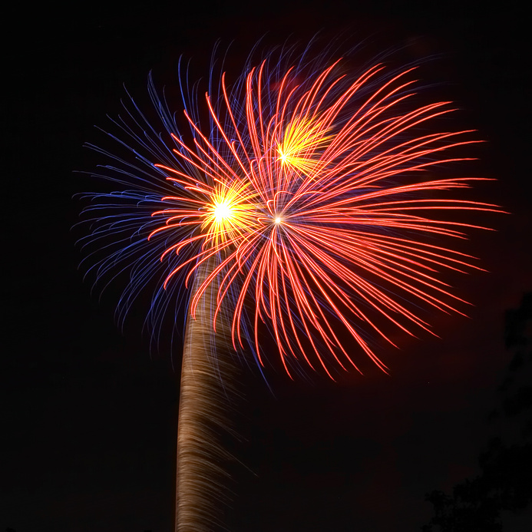
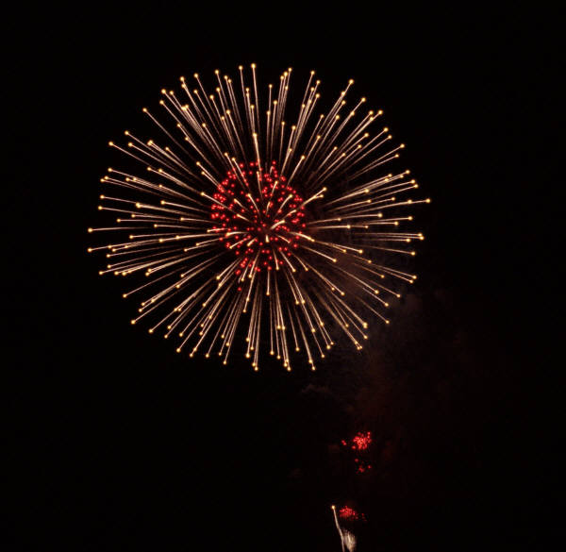

RUDYARD
KIPLING
EDYT
DICKSTEIN

